Slide 1
AI-Powered Form Automation Using OCR
Caelan Mason

Slide 2
Project Overview
Develop an web app with a form that extracts user details from an uploaded ID document or image and auto-fills based on an AI tool.

Slide 3
Technology Stack
Frontend: Angular (Reactive Forms, Standalone Components)
Backend: Firebase Firestore (Data Storage)
AI: Azure Computer Vision API (OCR for text extraction)
API Calls: Axios for HTTP requests

Slide 4
How It Works
User selects the type of ID they are uploading
User uploads an image or any ID document (Driver’s License, Passport, etc.).
Azure Computer Vision extracts text using Optical Character Recognition (OCR).
Extracted data is mapped to form fields (e.g., Name, DOB, Address).
The user reviews and submits the form.
Data is stored in Firebase.

Slide 5
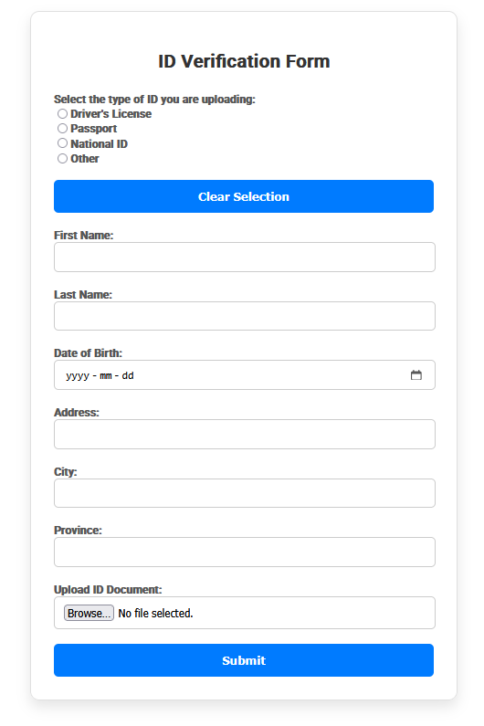
1. Form Handling
The component initializes a Reactive Form (FormGroup) using FormBuilder.
The form includes fields for:
  First Name, Last Name, Date of Birth, Address, City, Province
  A radio button group for selecting the ID type.
Validation: Required fields are enforced using Validators.required.

Slide 6
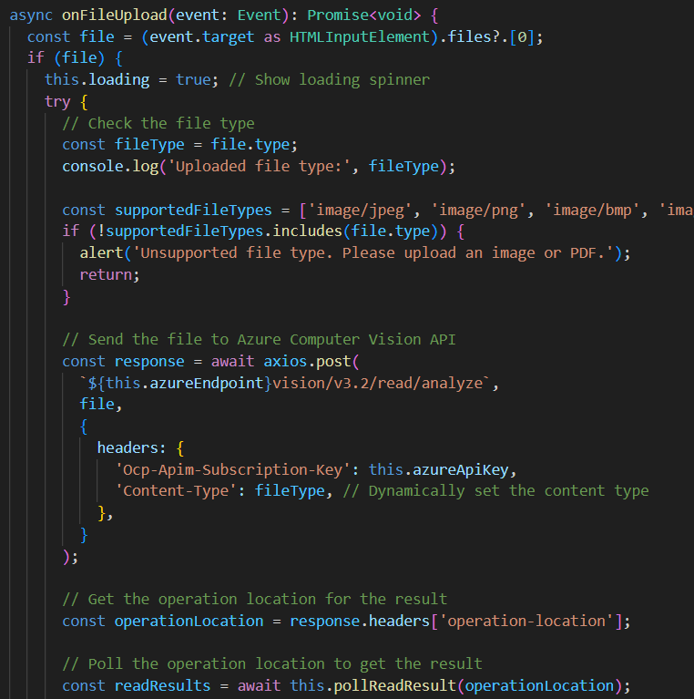
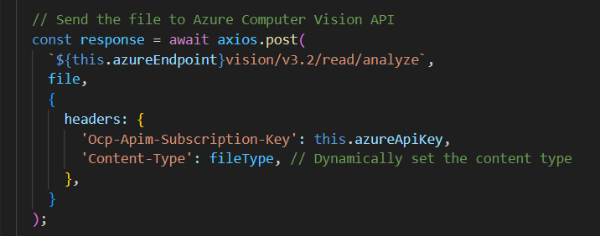
2. Image upload & Computer Vision OCR API CALL
When a user uploads an image (JPEG, PNG, BMP, TIFF, or PDF), the onFileUpload() function:
Extracts the file from the event.
Checks the file type to ensure it's supported.
Sends the image to Azure Computer Vision API (vision/v3.2/read/analyze) via axios.post(), including:
  Subscription Key (Ocp-Apim-Subscription-Key)
  Content-Type: Based on the uploaded file type.
Receives a response containing an operation-location URL for retrieving the OCR results.

Slide 7
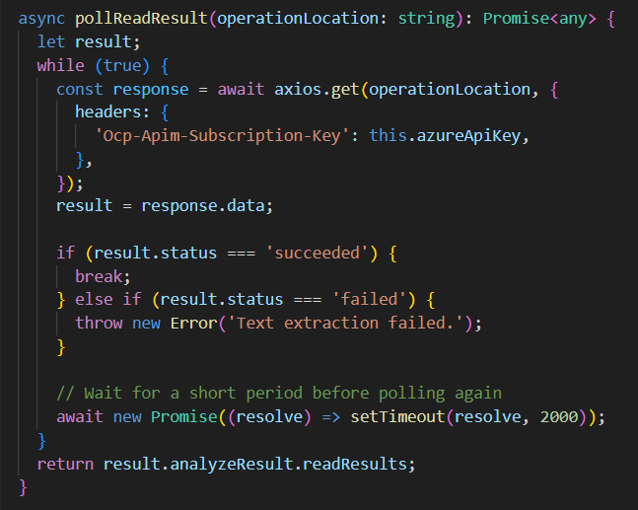
3. Polling for OCR Results Asynchronously
Since OCR is not instantaneous, pollReadResult() continuously requests the operation-location until:
The status is "succeeded" → meaning text has been extracted.
The status is "failed" → meaning OCR failed.
It waits 2 seconds between API requests to reduce excessive calls.
Notes:
When you upload an image of an ID document, the Azure Computer Vision API first needs to analyze the image, detect text regions, and recognize individual characters.
This step involves deep learning models that take time to process.

Slide 8
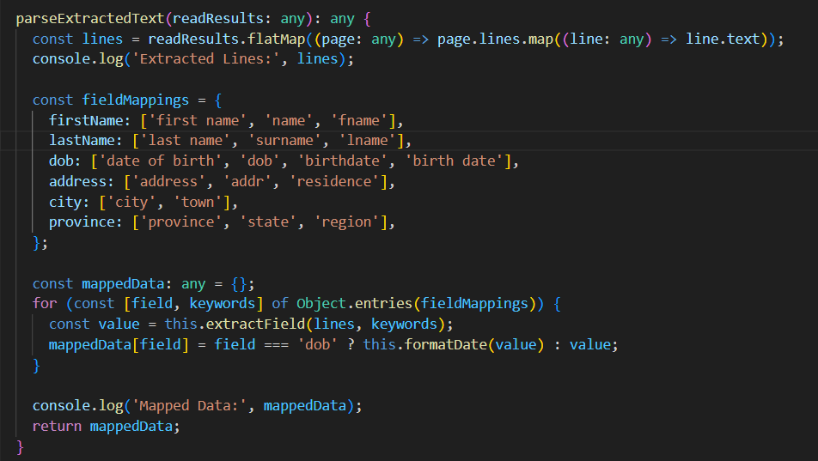
4. Extracting Text & Auto-Filling the Form
Once OCR succeeds, parseExtractedText():
Flattens the detected text lines into an array.
Matches keywords (e.g., "first name", "DOB", "address") to form fields using a keyword-matching algorithm.
Uses this.form.patchValue() to auto-fill the form fields.
Date Formatting: Ensures DOB is converted to YYYY-MM-DD.
Notes:
When you upload an image of an ID document, the Azure Computer Vision API first needs to analyze the image, detect text regions, and recognize individual characters.
This step involves deep learning models that take time to process.

Slide 9
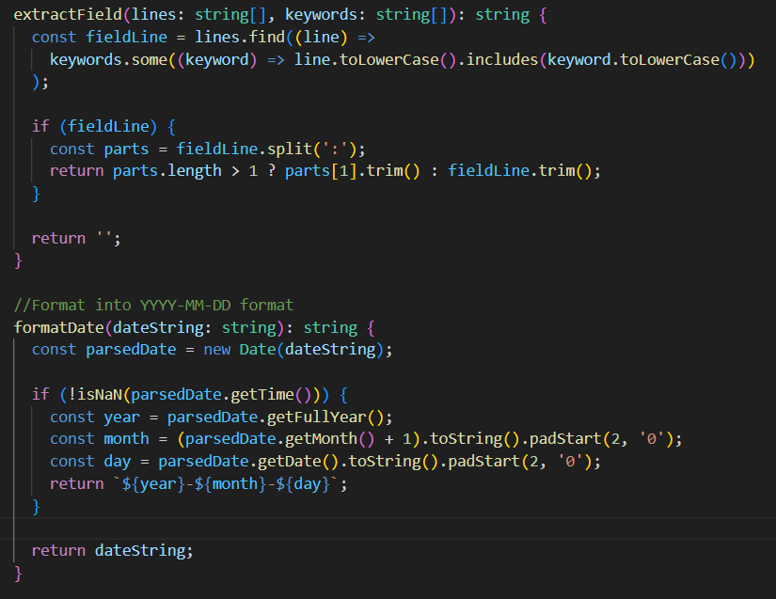
4. Extracting Text & Auto-Filling the Form
extractField() method:
Scans OCR results for specific keywords.
Finds a matching line and splits it at a colon (:) to extract the value.
Returns the value or an empty string if no match is found.
formatDate() method:
Converts date string into YYYY-MM-DD format.
Uses JavaScript Date object to parse and format the date.
Returns the formatted date or the original string if invalid.
Notes:
When you upload an image of an ID document, the Azure Computer Vision API first needs to analyze the image, detect text regions, and recognize individual characters.
This step involves deep learning models that take time to process.

Slide 10
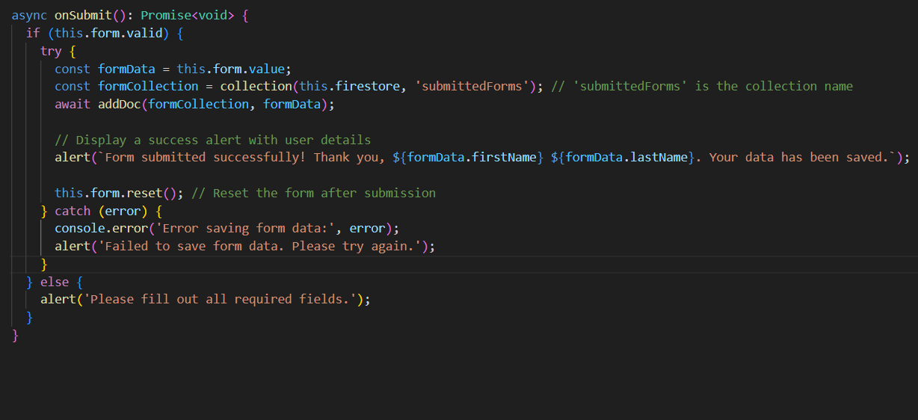
5. Submitting Data to Firebase Firestore
When the user submits the form, onSubmit():
Validates the form (if (this.form.valid) { ... }).
Saves the data to Firebase Firestore:
  Creates a submittedForms collection.
  Uses addDoc(formCollection, formData) to insert data.
Displays a confirmation alert with the extracted user name.
Resets the form after submission.
Notes:
When you upload an image of an ID document, the Azure Computer Vision API first needs to analyze the image, detect text regions, and recognize individual characters.
This step involves deep learning models that take time to process.

Slide 11
Challenges & Solutions
Challenge: OCR accuracy for different ID formats specifically for date format
  Solution: Using keyword-based extraction and formatting

Slide 12
Future Improvements
Enhance OCR accuracy with AI model training
Support additional ID formats globally
Improve UI for better user experience
Integrate multi-language support
Allow user to view id document in UI

Slide 13
Thank you

