Slide 1
Sirius IROM Flowchart Rev-10 10/14/2024

Slide 2
Sirius IROM Flow chart & System operation - 1
Reset
Access MTP
Read Configuration Data records:
CONFIG0
DPCD_VSF
LVDS_CONFIG
Perform CRC check and setup validity flags.
If CRC is valid, override the Configuration Data Instance that might be set with valid data from MTP earlier. Will be used to configure the HW settings later. EEPROM has higher priority over MTP.
Read Product records:
Tracking & Production
DUSR
Calibration
Perform CRC checking and setup validity flags.
Read Configuration Data records:
CONFIG0
DPCD_VSF
LVDS_CONFIG
Perform CRC checking and setup validity flags.
If CRC is valid, update the Configuration Data Instance (zero-initialized). Will be used to configure the HW settings later.
startup_IROM
main
If not all the Configuration Data from MTP or EEPROM are valid, Sirius will run in SAFE Application Mode with default Configuration Data (for default 1080p panel timing) stored in IROM.
In Full / SAFE Application Mode:
DP2LVDS operation is allowed.
Host Interface is available to check the validity of MTP / EEPROM Product and/or Configuration Data records.
I2C interface is available to program Configuration Data records to MTP.
Host Interface is available to program the Configuration Data records to EEPROM.
NOTES:
Host Interface register INTERRUPT_STATUS (0x05), MTP_REC_ERR_STATUS bit (BIT 0) will be set if there is CRC Error on any MTP Record.
Host Interface register MTP_EEP_RECORD_STATUS (0x16) also indicates the CRC check status of each MTP/EEPROM record.
Host Interface IRQ will be generated (if IRQN pin is selected) after system initialization is done.
Application Init
1
Application Task
2
Read Code Patch, perform Signature checking, and setup validity flag.
Break Point initialization if Code Patch is valid.
Set RC OSC Trim and Buck Regulator Calibration data if MTP is valid after Cold / Warm Start.
NOTE: If no valid Trim/Calibration data from MTP, default values will be applied to ensure Sirius can still work properly.
Access EEPROM (use default AUX_SDA/SCL, A8h/A9h)
NOTE: Using EEPROM for Configuration Data is optional.
OK
Yes
No
1 - Continue

Slide 3
Sirius IROM Flow chart & System operation - 2
Application Init
1 - Continue
Initial Power On Configuration:
In SAFE Application Mode
Select RC_OSC as default for TCLK
Select PDN as default Host Interface IRQN Out Pin Select
Default EEPROM Device Address = 0xA8 (0x54)
Default Slave I2C Device Address = 0xE0 (0x70)
In Full Application Mode
Select RC_OSC for TCLK
Configuration settings are based on Configuration Data Instance created (from MTP or EEPROM) to specify:
Host Interface IRQN Out Pin Select
If no pin is selected, Host will need to poll the INTERRUPT_STATUS (0x05) register periodically to detect HI interrupt events.
EEPROM Device Address
DBG timing for Free-Run Mode (in case Panel EDID is not detected by Host)
Slave I2C Address: Specified in CONFIG0→MTP_I2C_ADD_SEL
0: Use Default Slave I2C Device Address = 0xE0 (0x70)
1: Use the address specified in MTP_I2C_SLAVE_ADDR.
System initialization:
Clock Init: RCLK, OCM CLK, RCLK, LT_CLK, AVDDS
UART, timers, interrupts
Watch Dog Timer Init (Expiration Time is ~5s)
Host Interface (HI) Init
Update validity flags to HI Status register.
DPRX / DPCD Init
In Full / SAFE Application Mode
HDCP Init
DPRX / DPCD override
LVDS Initialization
Panel Power Seq Init
PWM Init
Black Video TG Init
L/R Screen Split & Pixel Overlap Init
RX HPD Low (HPD will be controlled by Panel Power Sequence)
Application Task
2

Slide 4
Sirius IROM Flow chart & System operation - 3
while loop
UART / I2C Slave Handler
Application Task
2
GProbe Thru DPCD Handler (Debug option over AUX)
Full / SAFE Application Mode with Valid / Default Configuration Data.
Host Interface Handler
Host Interface ISR
Display Handler
AUX DPCD Write ISR
LVDS Handler
NOTES:
After RX HPD is asserted, Host can start the Host Interface to read status registers to check the validity of MTP/EEPROM Configuration Data.
In SAFE Application Mode, Host can issue a sequence of Host Interface register writes to update Configuration Data for Sirius to write to EEPROM with CRC calculated. This is the mechanism to (1) Recover from possible MTP write failure at facility, or (2) Customize the system configuration for Sirius to operate.
In addition, this Host Interface write sequence allows Host to customize the Configuration Data in Application Mode for different panel and store to EEPROM (has higher priority than the Configuration Data in MTP). Host will need to reset Sirius to read back updated Configuration Data and re-initialize Sirius accordingly.
Host Interface sequence to update EEPROM and MTP update via I2C mechanism will be described in the following sections.
Black Video TG Handler
Panel Power Sequence Handler
Left / Right Screen Split & Pixel Overlap Handler
HDCP Handler
PWM Handler
Power Management Handler

Slide 5
Configuration Update to EEPROM via Host Interface

Slide 6
EEPROM Configuration Data Update sequence
Host | Direction | Sirius
When override/recover/customize CONFIG0 record is needed, issues HI register CONFIG0_PAYLOAD_OFFSET_DATA (0x06) writes with Offset/Data Byte specified to Sirius. | → | Stores data in CONFI0 buffer
After all the data are updated, issues HI register CONFIG0_UPDATE (0x07) write with CONFIG0_UPDATE_DONE bit set to Sirius. | → | Calculate CRC value and program the CONFIG0 record to EEPROM.
Upon detecting HI IRQ, read HI register CONFIG0_UPDATE (0x07) and check if CONFIG0_UPDATE_EEPROM_DONE bit is set | ← | Set HI register CONFIG0_UPDATE (0x07) with CONFIG0_UPDATE_EEPROM_DONE bit and generate HI IRQ
When override/recover/customize DPCD_VSF record is needed, issues HI register DPCD_VSF_PAYLOAD_OFFSET_DATA (0x08) writes with Offset/Data Byte specified to Sirius. | → | Stores data in DPCD_VSF buffer
After all the data are updated, issues HI register DPCD_VSF_UPDATE (0x09) write with DPCD_VSF_UPDATE_DONE bit set to Sirius. | → | Calculate CRC value and program the DPCD_VSF record to EEPROM.
Upon detecting HI IRQ, read HI register DPCD_VSF_UPDATE (0x09) and check if DPCD_VSF_UPDATE_EEPROM_DONE bit is set | ← | Set HI register DPCD_VSF_UPDATE (0x09) with DPCD_VSF_UPDATE_EEPROM_DONE bit and generate HI IRQ
When override/recover/customize LVDS_CONFIG record is needed, issues HI register LVDS_CONFIG _PAYLOAD_OFFSET_DATA (0x0A) writes with Offset/Data Byte specified to Sirius. | → | Stores data in LVDS_CONFIG buffer
After all the data are updated, issues HI register LVDS_CONFIG _UPDATE (0x0B) write with LVDS_CONFIG _UPDATE_DONE bit set to Sirius. | → | Calculate CRC value and program the LVDS_CONFIG record to EEPROM.
Upon detecting HI IRQ, read HI register LVDS_CONFIG _UPDATE (0x0B) and check if LVDS_CONFIG _UPDATE_EEPROM_DONE bit is set | ← | Set HI register LVDS_CONFIG _UPDATE (0x0B) with LVDS_CONFIG _UPDATE_EEPROM_DONE bit and generate HI IRQ
After all the Configuration Data record(s) update to EEPROM is done. Host can reset Sirius for Sirius to restart and use the latest Configuration Data from EEPROM to re-initialize the Sirius. | → | After reset, Sirius IROM will read back the Configuration Data from EEPROM to re-initialize the system.

Slide 7
MTP Programming via I2C

Slide 8
MTP product/Configuration Data / code patch Update
IND87451 I2C Slave Interface can be used for ISP (In System Programming). This is a mean to update the Product / Configuration Data and / or Code Patch stored inside the MTP.
To perform the ISP, the I2C Master controller must follow the recommended ISP protocol described in this document.
I2C Master
controller
IND87451
I2C Bus
MTP
I2C Slave
ISP

Slide 9
Gprobe commands and ddc2bi protocol
The GProbe commands used for ISP has the DDC2Bi3 wrapper. This makes the ISP messages compliant with the DDC2Bi protocol.
The DDC2Bi3 wrapper for ISP through the I2C Interface has the same message structure as the standard DDC2Bi3 used over the HDMI DDC interface.
Consists of following message fields: DDC Destination, DDC Source, Length, VCP Prefix, Message and Checksum
The VCP prefix consists of two parts:
VCP command code 0xC2: This particular code is undefined in the official DDC2Bi standard and is available for custom commands. Indie’s DDC2Bi3 wrapper uses the VCP command code 0xC2 and further expands it into the command page with the sub-commands specified in the remainder of the message.
The command page: This is made up of two bytes following the VCP command code 0xC2. Indie reserves the command page 0x0000 for its own commands. Indie can assign individual command pages to its customers upon request, if customers wish to implement their own command sets for specific applications.

Slide 10
DDC2Bi3 wrapper for ISP through the I2C Interface
Name | Length | Value | Comment
DDC Destination | 1 | 0x6E
DDC Source | 1 | 0x51 | Please note that length of VCP Prefix + Message can’t exceed 127
Length | 1 | 0x80 | Length of VCP prefix + Message
VCP Prefix | 3 | 0xC2 0x00 0x00
Message | variable
Checksum | 1 | XOR of all previous bytes | Byte chksum = 0 For(i=0;i<buffersz;i++) chksum ^= buf[i];

Slide 11
Gprobe command loads 1KB DATA into Sirius SRAM memory for MTP
GProbe Command
0x10 = MTPWrite
DDC2BI Header
S
0x37
Dst
0x51
Src
0x85
Length
0xC2 0x00 0x00
VCP Prefix
0x03 0x10
Message
0x6B
Chksum
Address (0x13000~0x133FF for Product/Configuration or 0x300000~0x307FFF for Code Patch)
Count (Maximum: 0x400=1KB per message)
GProbe
MTPWrite
Command
0x00 0x01 0x30 0x00
Address = 0x13000
0x00 0x00 0x04 0x00
Count = 0x400
Message
Payload, Size is 1024B
CRC16
0x00 0x00 0x17 0xC2
CRC16 = 0x17C2
P

Slide 12
Python script to generate files for I2C update sequence
Convert Product/Configuration Data or Code Patch binary to files for ISP
Install Python (v3.12.6)
Execute Python script :
Python modify_binary_file.py [Type] [InputBIN] [OutputBIN] [OutputXML]
Type:
codepatch: Input binary contains Code Patch
mtpfull: Input binary contains all Product related records (Tracking & Production / DUSR / Calibration Data in Sections 1-3) and Configuration Data related records (CONFIG0 / DPCD_VSF / LVDS_CONFIG in Section 4)
mtpproduct: Input binary contains only Product related records
mtpconfig: Input binary contains only Configuration Data related records
InputBIN: Original Product / Configuration Data or Code Patch binary array file
OutputBIN: Converted binary array file for I2C update sequence. It can be used in script(s) or batch(es) for customer’s I2C master device
OutputXML: To run in Total Phase Control Center Batch Mode with Aardvark I2C/SPI Host Adapter
NOTE: Will not support the individual Configuration Data record update to MTP. All the 3 Configuration Data records (CONFIG0 / DPCD_VSF / LVDS_CONFIG) shall be combined in one binary and programmed together to avoid number of MTP programming times and risks to accidently corrupt the Product related records.

Slide 13
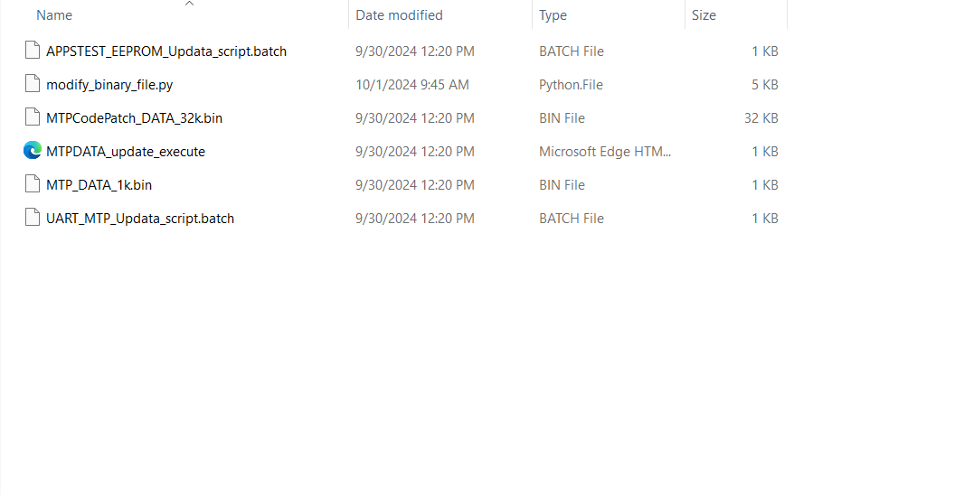
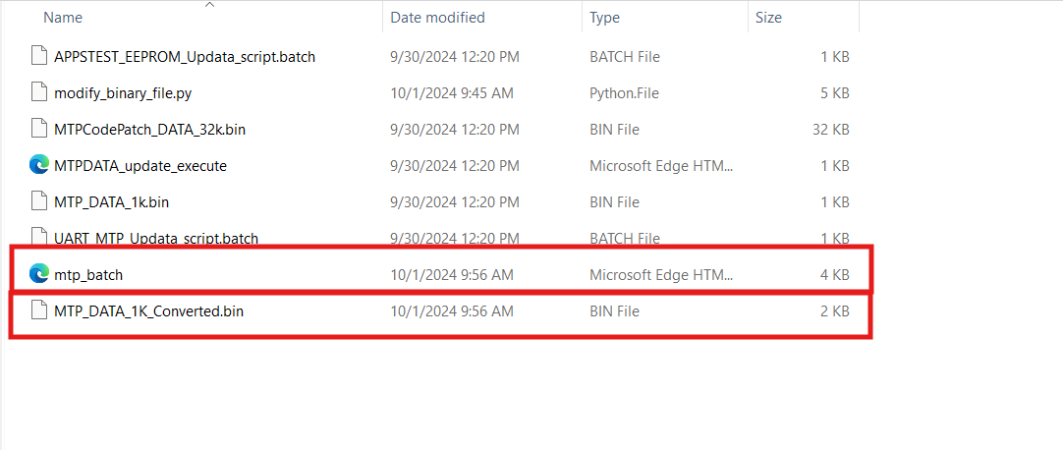
Example of sequence to update 1kb DATA to MTP – 1 (case: Product + Configuration DATA)
Run Python script from Windows Command Prompt to generated converted files:
> Python modify_binary_file.py mtpfull MTP_DATA_1K.bin MTP_DATA_1K_Converted.bin mtp_batch.xml
After executing python

Slide 14
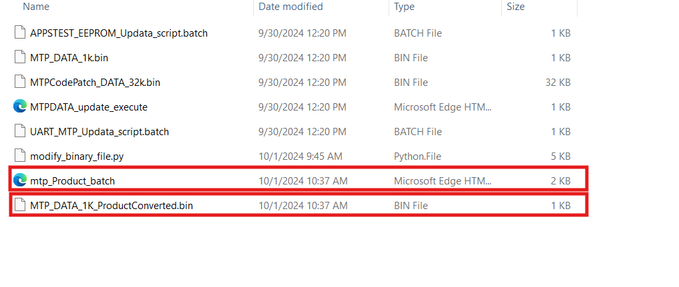
Example of sequence to update 1kb DATA to MTP – 1 (case: product DATA only)
Run Python script from Windows Command Prompt to generated converted files separately:
> Python modify_binary_file.py mtpproduct MTP_DATA_1K.bin MTP_DATA_1K_ProductConverted.bin mtp_Product_batch.xml
After executing python

Slide 15
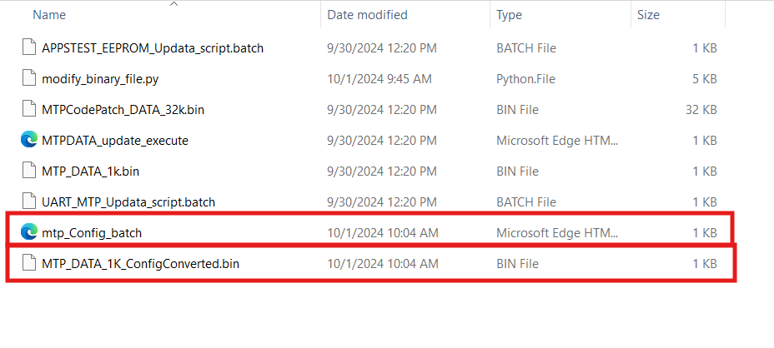
Example of sequence to update 1kb DATA to MTP – 1 (case: Configuration DATA only)
Run Python script from Windows Command Prompt to generated converted files separately:
> Python modify_binary_file.py mtpconfig MTP_DATA_1K.bin MTP_DATA_1K_ConfigConverted.bin mtp_Config_batch.xml
After executing python

Slide 16
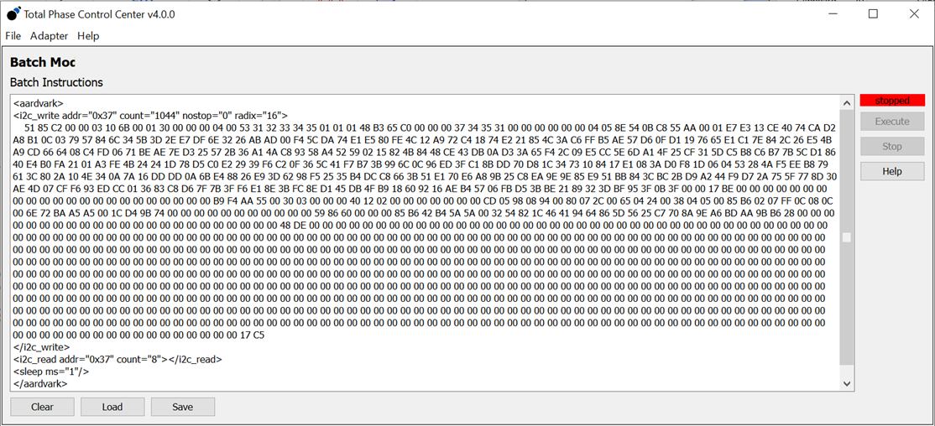
Example of sequence to update 1kb DATA to MTP – 2
If use Aardvark to update, load the mtp_batch.xml file from Total Phase Control Center → Adapter → Batch Mode. Then hit “Execute” button after loaded.
NOTE: This step only writes the binary into Sirius’s SRAM memory for MTP. Yet updating to MTP.

Slide 17
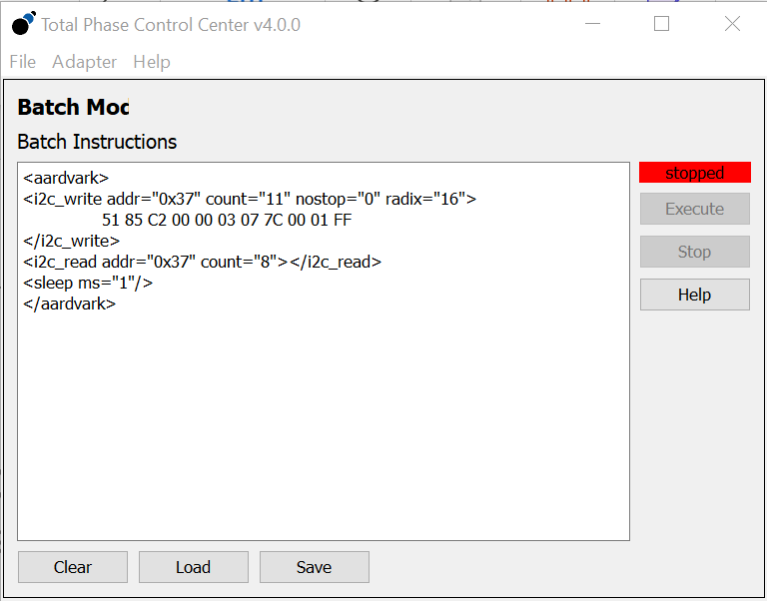
Example of sequence to update 1kb DATA to MTP – 3
After writing to Sirius internal memory is done, load the MTPDATA_update_execute.xml file from Total Phase Control Center → Adapter → Batch Mode. Then hit “Execute” button to start updating to MTP (from SRAM).

