Slide 1
Cloud Adoption Framework and Azure Migration
Niels Ophey, Cloud Solution Architect OCP

Slide 2
Agenda
1.
2.
3.
4.
Introducing the MS Cloud Adoption Framework for Azure Getting to know the Strategy-Plan-Ready Workshop Format First look at Azure Migrate as a possible tool for assessment and migration HandsOn - Assessments and Migration of a First Application

Slide 3
Introducing the MS Cloud Adoption Framework for Azure
Slides

Slide 4
Agenda
1.
2.
3.
4.
Introducing the MS Cloud Adoption Framework for Azure Getting to know the Strategy-Plan-Ready Workshop Format First look at Azure Migrate as a possible tool for assessment and migration HandsOn - Assessments and Migration of a First Application

Slide 5
Strategy-Plan-Ready Workshop Format
Slides

Slide 6
Agenda
1.
2.
3.
4.
Introducing the MS Cloud Adoption Framework for Azure Getting to know the Strategy-Plan-Ready Workshop Format First look at Azure Migrate as a possible tool for assessment and migration HandsOn - Assessments and Migration of a First Application

Slide 7
Azure Migrate

Slide 8
Why Migrate to Azure?
Unparalleled Innovation
Azure SQL Database
Azure IaaS
Azure Migrate
Unmatched Security
Azure Security Center
Azure Sentinel
Confidential Computing
Unbeatable Offers
Azure Migration Program (Azure.com/AMP)
Azure Hybrid Benefit
Free Extended Security Updates
Hybrid by design
SQL code parity | Windows Admin Center

Slide 9
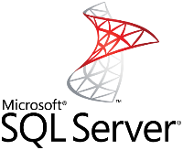

Windows Server and SQL Server EOS
Opportunity to modernize infrastructure & data estate
2008 | R2
Ended July 9, 2019
Ends January 14, 2020
Reuse existing investments with Azure Hybrid Benefit
Extended security updates (free only on Azure)

Slide 10


Pay less with Azure
Windows Server savings illustration
AWS is 5x more expensive than Azure
Azure Hybrid Benefit Savings
ESU Savings
Azure
AWS
Windows VM
Extended security updates
SQL Server savings illustration (PaaS)
Azure Hybrid Benefit Savings
Azure
AWS
Azure SQL Database
AWS RDS for SQL EE
Learn more: aka.ms/why5xmore

Slide 11
What’s driving migrations to Azure?
Software and hardware refresh
Security threats
Urgent capacity needs
Compliance
Quickly integrate acquisitions
Application innovation
Migration and innovation triggers
Software end of support
Datacenter contracts expiry

Slide 12
Transformation path 1: Operational efficiency focus
Datacenter contracts expiry
Rehost
Lift-optimize-shift
Reliable Azure platform
Benefit from Hybrid Benefit / EOS offers
Right-size workloads
Stay secure and compliant
Refactor | Rearchitect | Rebuild
Driven by app prioritization
Use Containers, PaaS, Serverless technologies in Azure
Urgent capacity needs
Quickly integrate acquisitions
Software and hardware refresh
Security threats
Compliance
Software end of support
Application innovation
Infrastructure-oriented drivers
App-oriented modernization drivers

Slide 13
Transformation path 2: Innovation and efficiency focus
Datacenter contracts expiry
Rehost
Lift-optimize-shift
Reliable Azure platform
Benefit from Hybrid Benefit / EOS offers
Right-size workloads
Stay secure and compliant
Urgent capacity needs
Infrastructure-oriented
Quickly integrate acquisitions
Software and hardware refresh
Software end of support
Refactor | Rearchitect | Rebuild
Driven by app prioritization
Use Containers, PaaS, Serverless technologies in Azure
Security threats
App-oriented
Compliance
Application innovation

Slide 14


The Allscripts prescription for agility: lift and shift to the cloud
Allscripts is a leading healthcare software manufacturer, serving physician practices, hospitals, health plans, and Big Pharma. To transform its applications frequently and host them securely and reliably, Allscripts has started to use Microsoft Azure. In just three weeks, the company lifted and shifted dozens of acquired applications running on 1,000 virtual machines to Azure. Allscripts also develops software in Azure and realizes dramatic time-to-market gains and savings by using the Azure platform as a service offering.
Products and services
Organization size
Industry
Country
Microsoft Azure
Azure Cosmos DB
Azure Site Recovery
Azure SQL Database
Azure Virtual Machines
10,000 employees
Partner professional services
United States
Notes:
https://customers.microsoft.com/en-us/story/allscripts-partner-professional-services-azure

Slide 15


Top online retailer bets on Azure to provide a stellar experience for 15.4 million customers worldwide
ASOS, a leading online fashion retailer, transformed its platform from a monolithic, on-premises e-commerce system to a microservices platform running on Microsoft Azure. In 2016, the new platform handled more than double the volume of Black Friday orders from the previous year. The rapidly growing company with 15.4 million customers has also accelerated development of innovative mobile apps and features to quickly target new markets and stay on top of consumer and technology trends.
Products and services
Organization size
Industry
Country
Business need
Azure PaaS services
Azure Cosmos DB
Employees: 4,000
Retail & Consumer Goods
United Kingdom
Business agility
Notes:
https://customers.microsoft.com/en-us/story/asos
https://aka.ms/tjbuo8

Slide 16




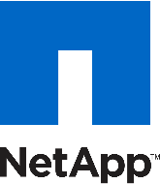
Migration scenarios that we are seeing
Windows Server
File servers, containers, AD/DNS/DHCP
SQL Server
Application databases, Analytics (BI, DW)
ASP.NET / PHP / Java
Customer facing & internal LoB apps
Linux / Open source databases
(e.g., RedHat/SUSE, Hadoop, MySQL,
PostgreSQL, NoSQL)
SAP
Specialized workloads
e.g., HPC, NetApp, VMware

Slide 17

Azure Migration Journey and Tools

Slide 18
Migration journey
Assess
Migrate
Optimize
Secure & Manage
Migration tools | Azure migration center | Scenario guidance | FastTrack for Azure | Azure Expert MSPs
Azure Fundamentals
Target architecture | Governance | Connectivity | Security | Skilling & Readiness

Slide 19
Azure Migrate – Hub for all migration tools
Discover, assess, and migrate applications, infrastructure, and data with Azure Migrate
Assess
Migrate
Optimize
Secure & Manage
Server Assessments for large-scale VMware and ^{NEW} Hyper-V migrations
Database Assessments across various database targets including Azure SQL Database and Managed Instance
Server Migrations for VMware, Hyper-V, or any virtual or physical server
^{NEW} Additional agentless option for VMware
^{NEW} Integrated experience for discovery, assessment, and migration
^{NEW} End-to-end progress tracking for servers and databases
^{NEW} Extensible approach with ISV tools such as Carbonite, Cloudamize, Corent Tech, Device42, Turbonomic, and UnifyCloud

Slide 20

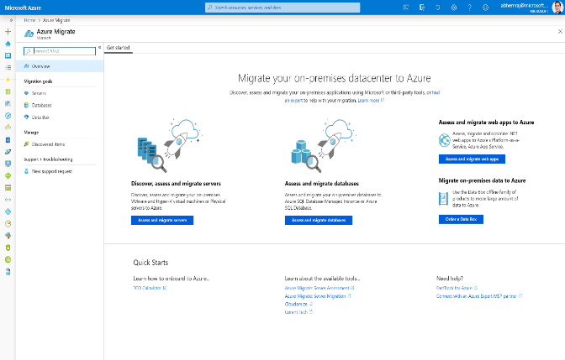
The evolution of Azure Migrate is now GA
^{NEW} Guided migration scenarios with end-to-end progress tracking
^{NEW} Feature-based choice between Microsoft and ISV partner tools
^{ENHANCED} Large-scale VMware and Hyper-V assessments with Server Assessment
^{NEW} Agentless migrations for VMware and Hyper-V with Server Migration
^{INTEGRATED} SQL Server assessments with Database Assessment
^{INTEGRATED} Integrated ISVs include Carbonite, Corent, Cloudamize, Device42, Turbonomic, UnifyCloud

Slide 21
Agenda
1.
2.
3.
4.
Introducing the MS Cloud Adoption Framework for Azure Getting to know the Strategy-Plan-Ready Workshop Format First look at Azure Migrate as a possible tool for assessment and migration HandsOn - Assessments and Migration of a First Application

Slide 22
Hands on…
Challenge 1

Slide 23
Hands on…
Challenge 2

Slide 24
Cloud Adoption Framework and Azure Migration
Day 2
Niels Ophey, Cloud Solution Architect OCP

Slide 25
Review Day 1

Slide 26








Application migration – Azure IaaS
LOB App
LOB App
Web and app
Azure IaaS
Azure Migrate – Server Assessment
Azure Migrate – Server Migration
Data layer
Azure IaaS

Slide 27



Azure Migrate – Assess and migrate servers
1. Deploy the Azure Migrate appliance
2. Appliance starts discovery and analyzing performance of the on-premises Windows or Linux servers
3. Group servers and perform assessments to determine Azure suitability, right-sizing information, dependency mapping, and cost planning
4. Start migrating servers to Azure with the combined appliance. Test migration and perform zero data loss cutover to Azure

Slide 28
Agenda
1.
2.
3.
4.
Introduction to Governance and Management Set up an initial Governance and LandingZone in Azure before a migration (HandsOn) Azure Migrate and the 5R-Strategy aspect (rehost, refactor, rearchitecture, rebuild, replace) HandsOn - Azure Migrate and Data Migration

Slide 29
Governance and Management
Slides Govern

Slide 30
Agenda
1.
2.
3.
4.
Introduction to Governance and Management Set up an initial Governance and LandingZone in Azure before a migration (HandsOn) Azure Migrate and the 5R-Strategy aspect (rehost, refactor, rearchitecture, rebuild, replace) HandsOn - Azure Migrate and Data Migration

Slide 31
LandingZone
Challenge 3

Slide 32
Outview – Northstar

Slide 33
Hands on…
Migrate the Applikation Server

Slide 34
Feedback

