Slide 1
CAF-Expert Hackathon Migrate
März 2021

Slide 2
Why become a CAF Expert?
Customer Journey
Best practices
Archi-tectures
Metho-dologies
Enterprise scale - Landing Zone
The Microsoft Cloud Adoption (CAF) Framework is an iterative approach to support the digital transformation journey of an organization. It gives a collection of best practices, architectures and methodologies to ensure the integration of cloud into this journey .
Having CAF Experts in your organization enables you as a partner to become a trusted advisor for your customers on their journey to cloud. Continuously generate more business with your customers along the iterative journey of the digital transformation!

Slide 3
Cloud Adoption Framework - Experts
Learning Path*
Introduction Call
Module 1 CAF BASIC
Module 2 CAF Migration
Module 3 CAF Advanced
ESLZ IaC Hackathon (optional “Add-on” Module )
Microsoft Cloud Adoption Framework (CAF) Intro
Microsoft Cloud Adoption Framework (CAF) Migrate
Microsoft Cloud Adoption Framework (CAF) Landing Zone & Govern
Enterprise Scale – Infrastructure as Code College
1h Online self paced Training
Basic understanding of CAF
1h Online self paced Training
Applications and infrastructure migration and modernization
2 Module Online Training
Modul 1 Governance Methodology
Modul 2 Enterprise Scale
Min. 3 Days Hackathon + additional Modules
CAF Hackathon Basic
2x 0,5 Days Hackathon (virtual or in person)
CAF Hackathon Migration
1,5 Days Hackathon (virtual or in person)
CAF Hackathon Advanced
1,5 Days Hackathon (virtual or in person)
1 Day Training – Construction Sets
CAF Expert Level
* Go the whole path or exit the path wherever you want…

Slide 4
Target roles:
CAF Migrate
Hackathon
Consultants
Architects
Hackathon Description
In this workshop, you will learn how to design a migration strategy for on-premises environments to Azure, including the migration of virtual and physical services as well as databases.
At the end of this workshop, you will be better able to rationalize the migration of various workloads to Microsoft Azure as well as understanding how to determine the cost of hosting migrated workloads in Azure.
Part 1 – Whiteboard Design Session (WDS)
In this whiteboard design session, you will look at how to design an Azure migration for a heterogenous customer environment. The existing infrastructure comprises both Windows and Linux servers running on both VMware and physical machines and includes some legacy servers. Throughout the whiteboard design session, you will look at the various options and services available to migrate heterogenous environments to Azure.
At the end of this workshop, you will be better able to design and implement the discovery and assessment of environments to evaluate their readiness for migrating to Azure using services including Azure Migrate and Azure Database Migration Service.
Hackathon Agenda
Day 1 (6h)
CAF Migrate Methodology, Tools
Whiteboard Design Session
HOL
Azure Services and related products
Azure Migrate
Azure Site Recovery
Azure Database Migration Service
Microsoft Data Migration Assistant
Part 2 – Hands-on Lab (HOL)
In this hands-on lab, you will learn how to assess and migrate a multi-tier application from Hyper-V to Azure. You will learn how to use Azure Migrate as the hub for executing a migration, together with accompanying tools.
After this hands-on lab, you will know the role of Azure Migrate and related migration tools and how to use them to successfully migrate an on-premises multi-tier application to Azure.
Day 2 (6h)
HOL
Discovery and Assessment
Migrate Application Database Migrate Application
Prerequisites
Azure Knowledge (compared to AZ-104)
Azure Subscription with owner rights
CAF Basic

Slide 5
Microsoft Cloud Adoption Framework for Azure
Modular approach, meeting the customer in their journey
Adopt
Define Strategy
Understand motivations
Business outcomes
Business justification
Prioritize project
Plan
Digital estate
Initial organization alignment
Skills readiness plan
Cloud adoption plan
Ready
Azure setup guide
First landing zone
Expand the blueprint
Best practice Validation
Migrate
• First workload migration
• Expanded scenarios
• Best practice validation
• Process improvements
Innovate
• Innovation guide
• Expanded scenarios
• Best practice validation
• Process improvements
Govern
Methodology • Benchmark
initial best practice • Governance maturity
Manage
Business commitments
operations baseline • Ops maturity
Aka.ms/adopt
Aka.ms/adopt/overview

Slide 6
Agenda
TAG 1
09:30 – 10:30 | Intro CAF Migrate
10:45 – 12:15 | Challenge 1
13:00 – 14:30 | Challenge 2
14:45 – 16:00 | CAF Govern
TAG 2
09:30 – 11:00 | Challenge 3
11:15 – 12:15 | CAF Landing Zone
13:00 – 15:15 | Challenge 4
 | Closing / Outview

Slide 7
Cloud Adoption Framework and Azure Migration
Niels Ophey, Cloud Solution Architect OCP

Slide 8
Agenda
1.
2.
3.
4.
Introducing the MS Cloud Adoption Framework for Azure Getting to know the Strategy-Plan-Ready Workshop Format First look at Azure Migrate as a possible tool for assessment and migration HandsOn - Assessments and Migration of a First Application

Slide 9
Introducing the MS Cloud Adoption Framework for Azure
Notes:
Jump to the slides if needed

Slide 10
Agenda
1.
2.
3.
4.
Introducing the MS Cloud Adoption Framework for Azure Getting to know the Strategy-Plan-Ready Workshop Format First look at Azure Migrate as a possible tool for assessment and migration HandsOn - Assessments and Migration of a First Application

Slide 11
Strategy-Plan-Ready Workshop Format
Notes:
Jump to the slides if needed

Slide 12
Agenda
1.
2.
3.
4.
Introducing the MS Cloud Adoption Framework for Azure Getting to know the Strategy-Plan-Ready Workshop Format First look at Azure Migrate as a possible tool for assessment and migration HandsOn - Assessments and Migration of a First Application

Slide 13
Azure Migrate
Notes:
Jump to the slides

Slide 14
Agenda
1.
2.
3.
4.
Introducing the MS Cloud Adoption Framework for Azure Getting to know the Strategy-Plan-Ready Workshop Format First look at Azure Migrate as a possible tool for assessment and migration HandsOn - Assessments and Migration of a First Application

Slide 15
Hands on…
Challenge 1

Slide 16
Hands on…
Challenge 2

Slide 17
Governance and Management

Slide 18
CAF-Expert Hackathon Migrate
September 2021
Day 2

Slide 19
Review Day 1

Slide 20








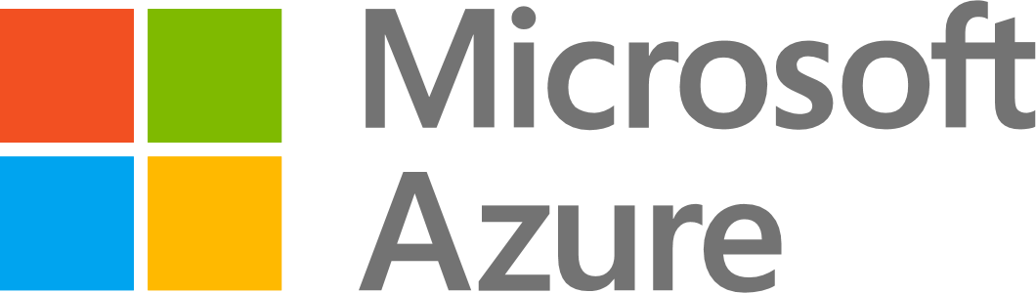
Application migration – Azure IaaS
LOB App
LOB App
Web and app
Azure IaaS
Azure Migrate – Server Assessment
Azure Migrate – Server Migration
Data layer
Azure IaaS

Slide 21



Azure Migrate – Assess and migrate servers
1. Deploy the Azure Migrate appliance
2. Appliance starts discovery and analyzing performance of the on-premises Windows or Linux servers
3. Group servers and perform assessments to determine Azure suitability, right-sizing information, dependency mapping, and cost planning
4. Start migrating servers to Azure with the combined appliance. Test migration and perform zero data loss cutover to Azure

Slide 22
Agenda
TAG 1
09:30 – 10:30 | Intro CAF Migrate
10:45 – 12:15 | Challenge 1
13:00 – 14:30 | Challenge 2
14:45 – 16:00 | CAF Govern
TAG 2
09:30 – 11:00 | Challenge 3
11:15 – 12:15 | CAF Landing Zone
13:00 – 15:15 | Challenge 4
 | Closing / Outview

Slide 23
Surprise Challenge SQL Database
Challenge 2a
Notes:
Optional challenge to be used – when progressing fine!
https://github.com/caf-expert/CAF-Hackathon-Migration/blob/main/challenges/challenge2a.md

Slide 24
LandingZone
Challenge 3

Slide 25
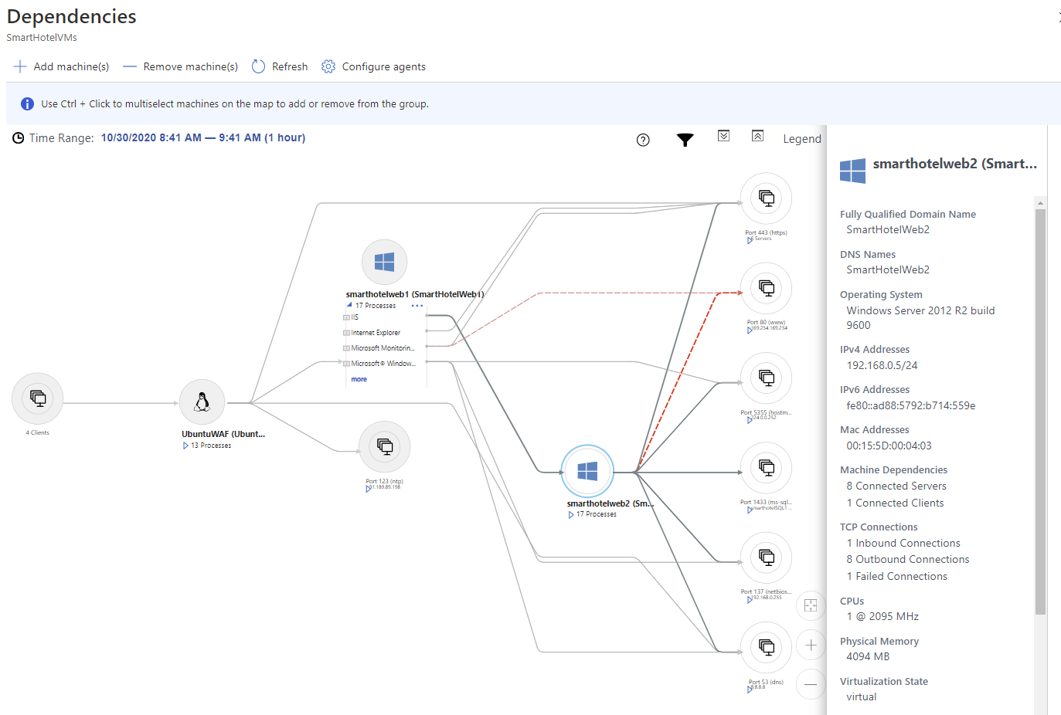

Slide 26
Outview – Landing Zones…
Notes:
[optional] depending on the timing of the hackathon

Slide 27
Hands on…
Migrate the database and the applikation server

Slide 28
Feedback

