Slide 1
CSE-4084
Multimedia Systems
Face Recognition Techniques with Python
Instructor : Prof. Cigdem Eroglu Erdem
Presenter : Cafer S. Yükseloğlu

Slide 2
Objective
The full purpose of this project is to reveal the exact purpose of the techniques we learn in lessons using python libraries and how they can be used, and to show how the techniques affect the time-performance relationship.
“Computer Vision is a field of deep learning that enables machines to see, identify and process images like humans.”

Slide 3
Libraries
CV2 : OpenCV (Open Source Computer Vision Library) is an open source computer vision and machine learning software library. C++ Multiple Platforms
face_recognition : Recognize and manipulate faces from Python or from the command line with the world's simplest face recognition library.
numpy : NumPy is an open source project aiming to enable numerical computing with Python.
-opencv.org/about/ -github.com/ageitgey/face_recognition - numpy.org/about/

Slide 4
Features of OpenCV
Reading, Writing and Displaying Images Changing Color Spaces
Resizing Images Image Rotation
Image Translation Simple Image Thresholding
Adaptive Thresholding Bitwise Operations
Edge Detection Image Filtering
Image Contours Feature Matching
Face Detection

Slide 5
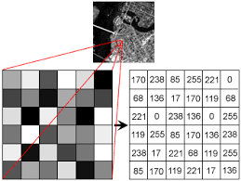
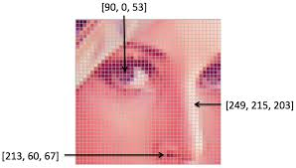
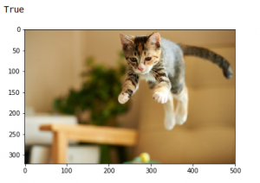
Reading, Writing and Displaying Images
import cv2
image = cv2.imread('index.png')
image = cv2.cvtColor(image,cv2.COLOR_BGR2RGB)
cv2.imshow('my_test', image)
cv2.imwrite('test_write.jpg',image)

Slide 6
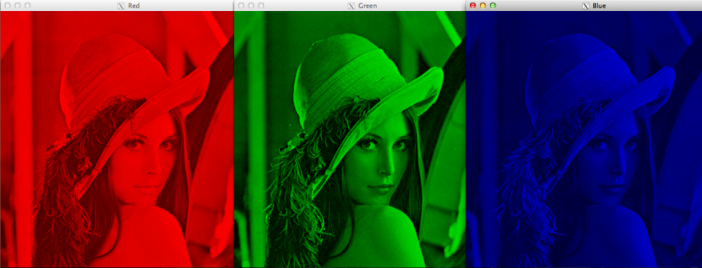
Changing Color Spaces
import cv2
gray_image = cv2.cvtColor(image,cv2.COLOR_BGR2GRAY)
hsv_image = cv2.cvtColor(image,cv2.COLOR_BGR2HSV)

Slide 7
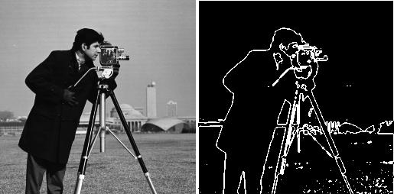
Edge Detection
import cv2
edges = cv2.Canny(image,100,200)

Slide 8
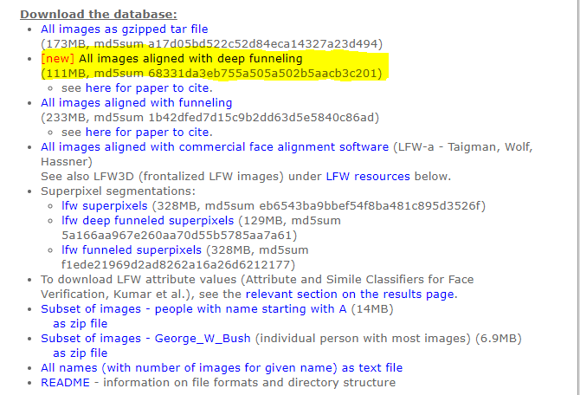

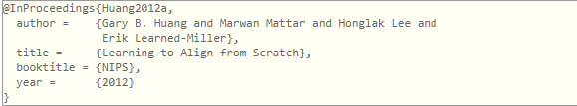
Data Gathering
Labeled Faces in the Wild : Labeled Faces in the Wild, a database of face photographs designed for studying the problem of unconstrained face recognition.

Slide 9
Speed
Python not compiled program, thus slower than compiled based programs. However, thanks to its compatibility it can be used in multiplatform and well working.
There are many things that affect the speed of face recognition systems. But we can say basically we could say Hardware and Software.

Slide 10
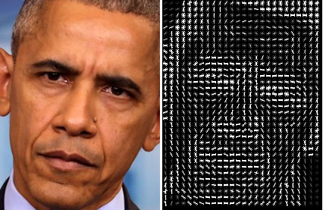
HOG
HOG is a feature descriptor used to extract the features pixel by pixel with the help of gradients. HOG works on grey scale images. Every image has a particular gradient orientation which helps the HOG extract the unique features from an image.

Slide 11
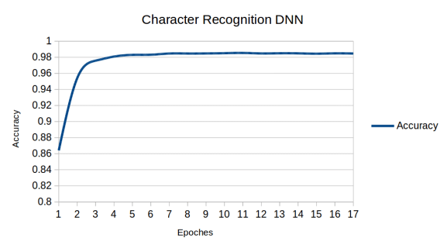
CNN
A convolutional neural network consists of an input layer, hidden layers and an output layer. In any feed-forward neural network, any middle layers are called hidden because their inputs and outputs are masked by the activation function and final convolution.

Slide 12

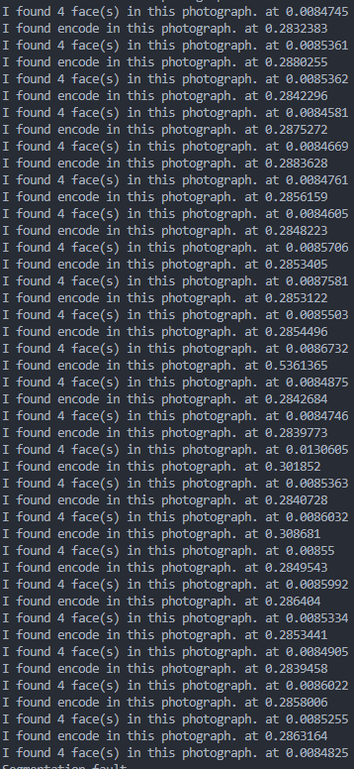
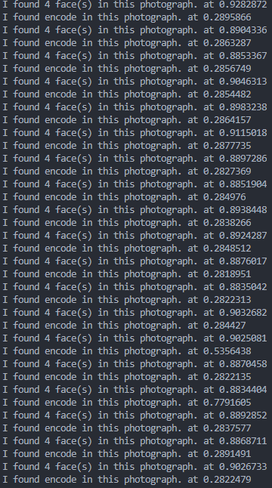
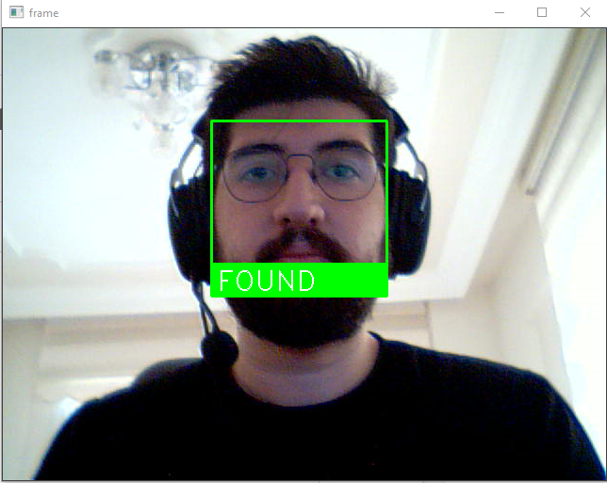
CPU VS GPU
Notes:
# My tests show that 12gb ram for face locating took 1 second for hog but 30,5 second for cnn | CNN Better ML HOG Faster

Slide 13
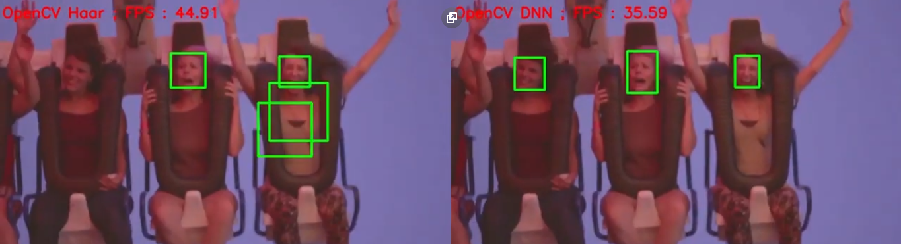
FEATURE

Slide 14
FINAL
Thanks to listening and contributing to this project.

