Slide 1

GIT 1.5
Software Testing

Slide 2



Thanks to
Our Sponsors

Slide 3
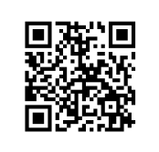
Check out our website
galway-it-meetup.github.io

Slide 4
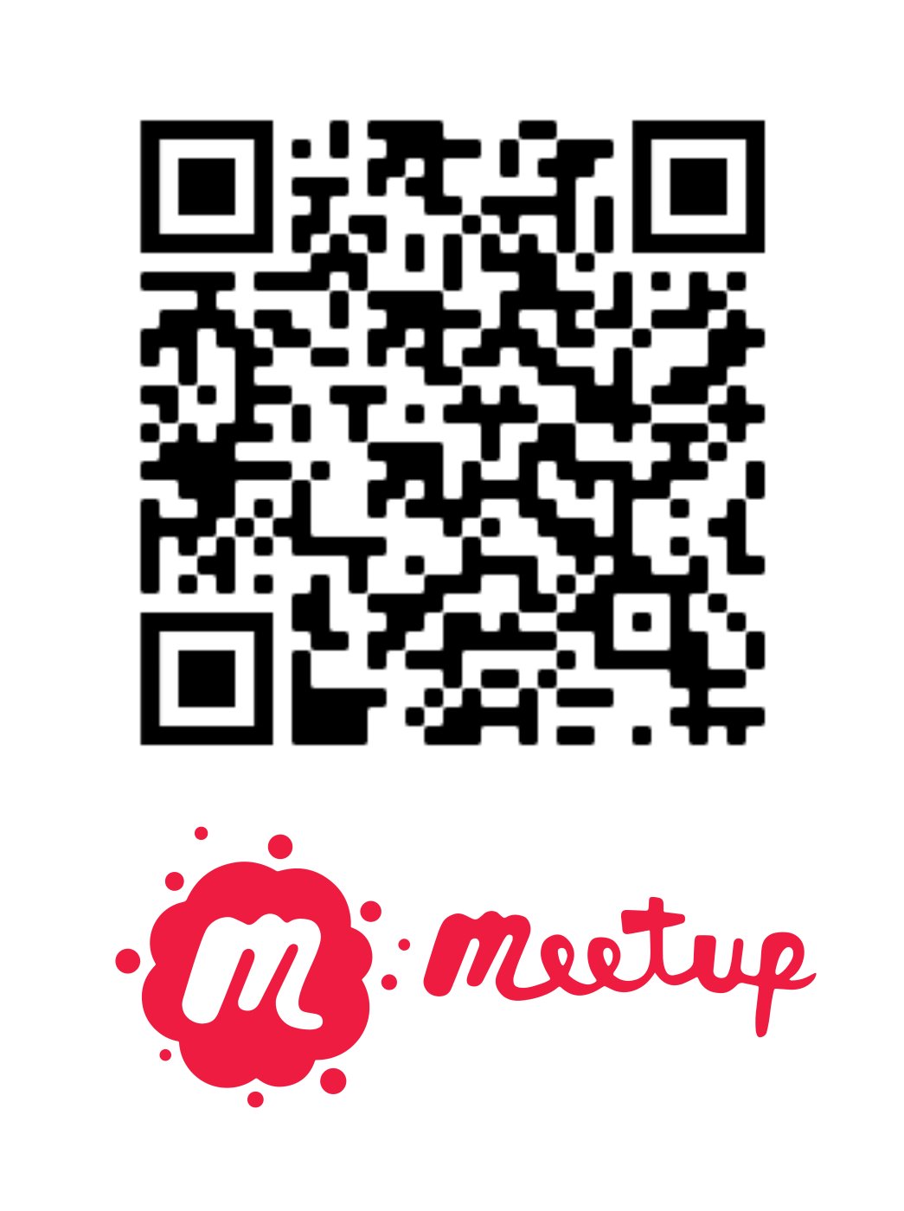
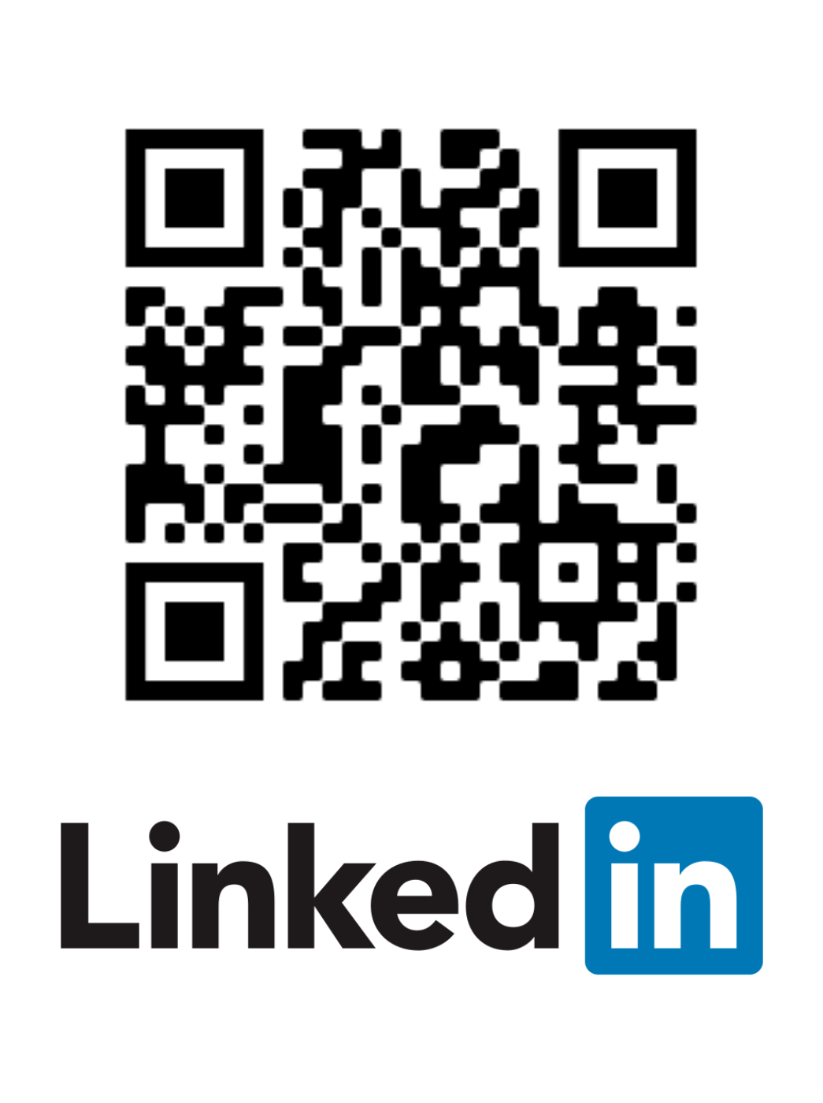
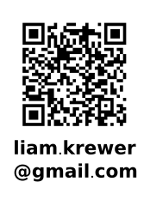
Looking
For speakers

Slide 5
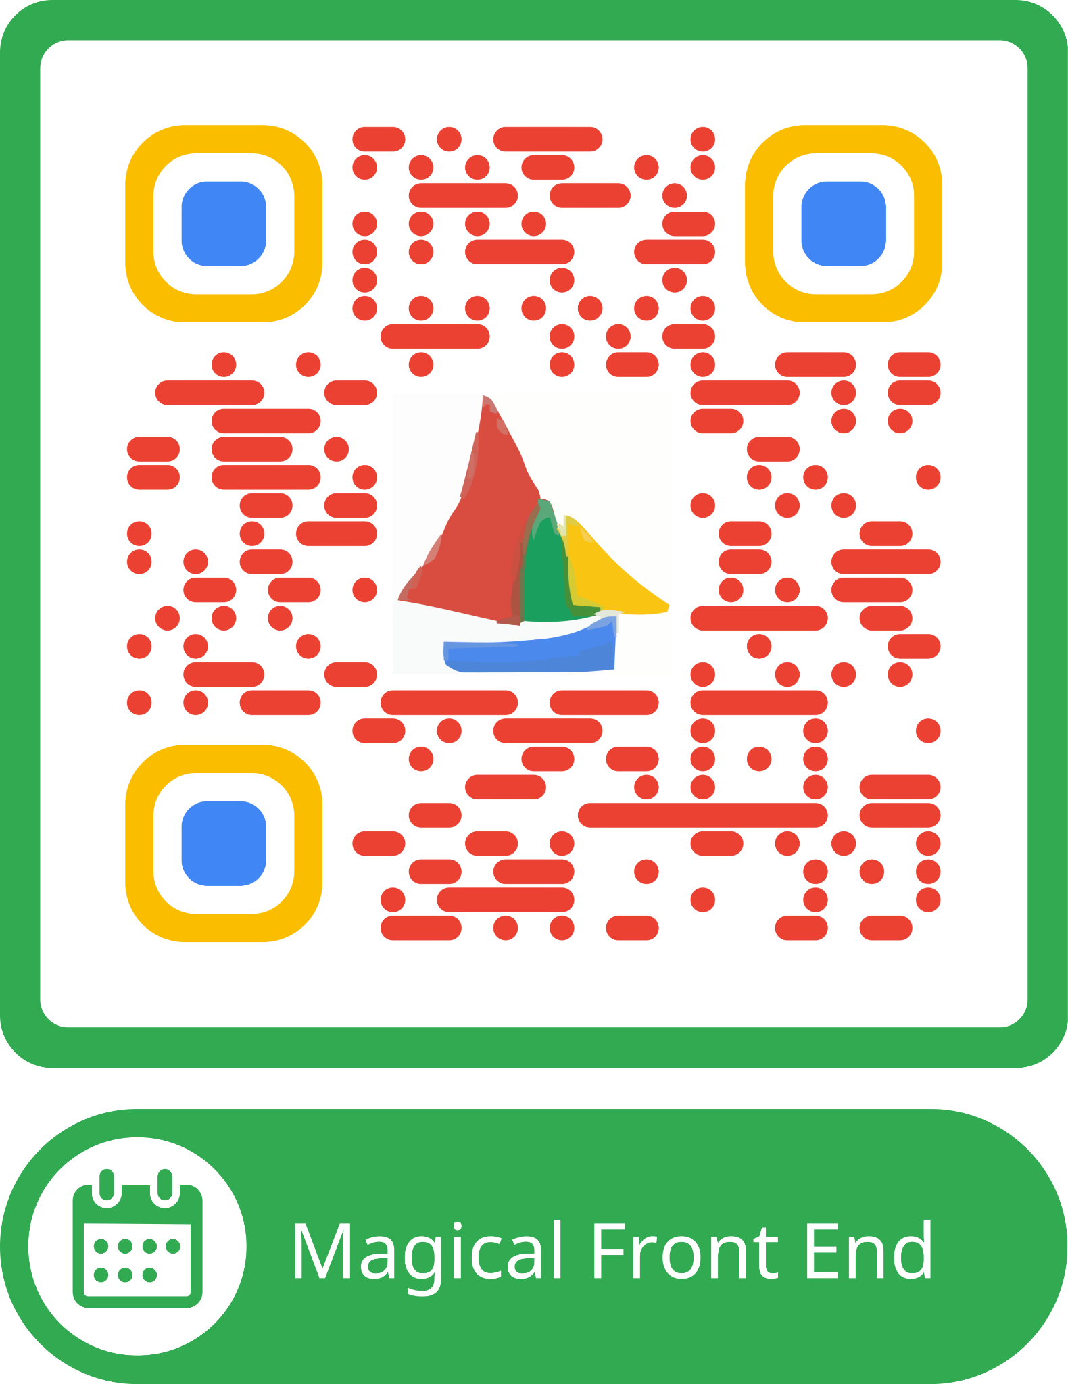
Friends of GIT
Google Developer Group
Magical Frontend
Tomorrow 6:30 pm
PorterShed

