Slide 1
Making Testable Apps

Slide 2
What is Software Testing?
“Software testing is the process of evaluating and verifying that a software product or application does what it’s supposed to do”
ibm.com/topics/software-testing
Notes:
So what do I mean when I talk about software testing. I could be talking about manual testing, about using an application and therefore verifying that it works.
But when a developer talks about testing, they usually mean automated tests, written in code. But that doesn’t mean other forms of testing aren’t valid too.
The first result on Google to this question is this quote from IBM.
No mention of automation, frameworks, continuous automation or any of that good stuff I’d like to spend hours talking about.
But there’s another very big omission in this statement. Has anyone spotted it?

Slide 3
What is Software Testing?
“Software testing is the process of evaluating and verifying that a software product or application does what it’s supposed to do”
ibm.com/topics/software-testing
Notes:
What is your software supposed to do?
Before we can get on with writing a well defined, robust test, we need to define what exactly it is we are testing.
What does your software do? How does it do it? What are all possible states, side effects and exceptions?

Slide 4
App Specification
Given I want to try out your awesome application
When I go to your signup page
And I enter my username and password correctly
And I click the login button
Then I receive a confirmation email
And can access your application
Notes:
So let’s define some specification for our application.
Here’s a pretty universal scenario.
There’s still some glaring assumptions in this specification, but those can be refined with some more specific specifications and tests later.
And if I did go into the minutiae of this feature specification, we would have to talk about email Regular expressions, and no one wants that

Slide 5
RFC 5322 Email Specification Regular Expression
(?:[a-z0-9!#$%&'*+/=?^_`{|}~-]+(?:\.[a-z0-9!#$%&'*+/=?^_`{|}~-]+)*|"(?:[\x01-\x08\x0b\x0c\x0e-\x1f\x21\x23-\x5b\x5d-\x7f]|\\[\x01-\x09\x0b\x0c\x0e-\x7f])*")@(?:(?:[a-z0-9](?:[a-z0-9-]*[a-z0-9])?\.)+[a-z0-9](?:[a-z0-9-]*[a-z0-9])?|\[(?:(?:25[0-5]|2[0-4][0-9]|[01]?[0-9][0-9]?)\.){3}(?:25[0-5]|2[0-4][0-9]|[01]?[0-9][0-9]?|[a-z0-9-]*[a-z0-9]:(?:[\x01-\x08\x0b\x0c\x0e-\x1f\x21-\x5a\x53-\x7f]|\\[\x01-\x09\x0b\x0c\x0e-\x7f])+)\])

Slide 6
Code
Culture
Process
Notes:
Enough with that. Let’s move onto the meat of what I want to discuss about Making a testable application.
Similar to writing any good software you need these three items:
You need to write the tests themselves,
build a culture which values and maintains these tests,
and wrap it all up in processes which makes sure the tests cannot be ignored or forgotten
Let’s start with code. I’ll jump through a couple of languages, frameworks and testing systems to show that the fundamentals apply across the board.

Slide 7
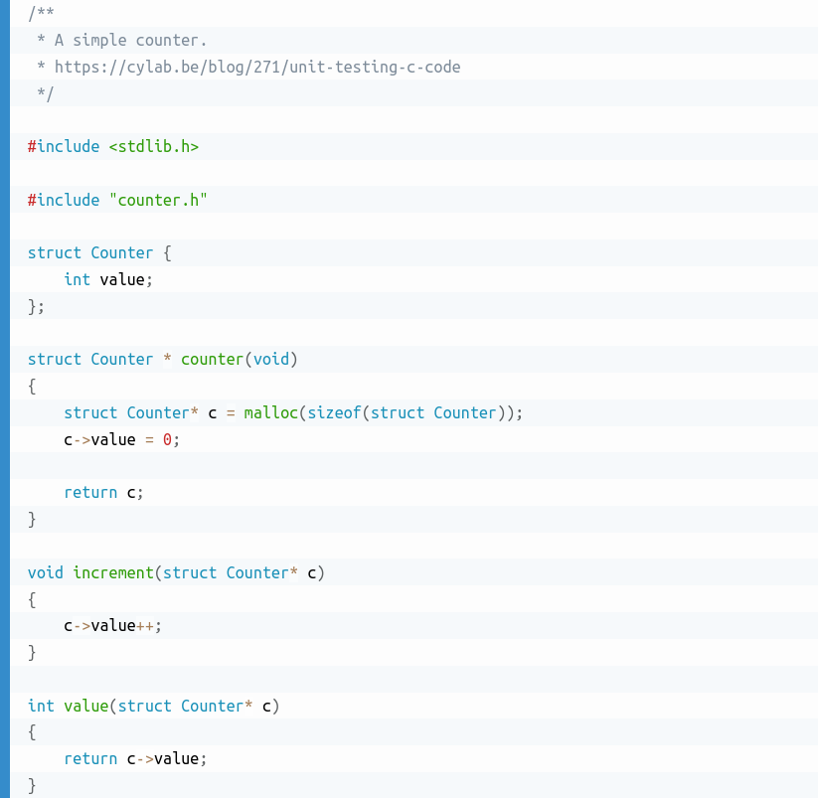
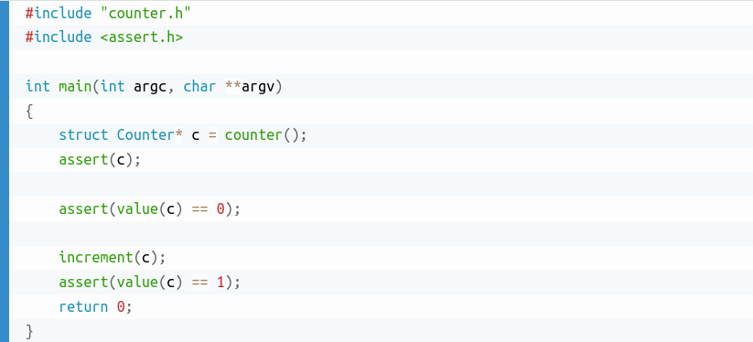
Unit Test
Source: https://cylab.be/blog/271/unit-testing-c-code
Notes:
So what is a test?
Here’s a counter in C, and a test.
There’s no need for fancy libraries and frameworks

Slide 8
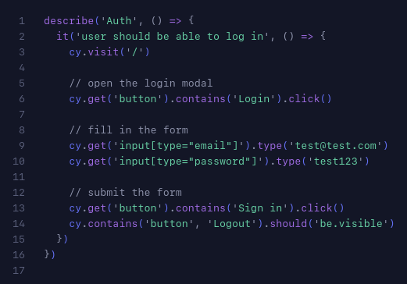
UI Testing with Cypress
Source: cypress.io/
Notes:
Earlier we described a very visual interaction - an authentication form, so it should be tested with a UI tool. Here is some cypress code showing how to test a log in form, taken straight from their homepage.
This test will automate a web browser to interact with your web app. There’s some domain specific stuff like visiting a url, and finding html elements by xml style selectors.
If it were a mobile app, we would be referring to activities, views and native UI components instead.
Let’s see what this code does:

Slide 9

Notes:
Here is a video of this test running on cypress.io
A form is opened, filled out, button is clicked, we see a new page.
Success.
It’s not very easy to follow as it happens quickly. After all it’s supposed to be a quick automated test, not a nice animation.
Though a lot of UI testing tools can indeed output screenshots or screen recordings of errors to make fixing tests faster.

Slide 10
Source: cypress.io/
Notes:
So what does this code test?
It tests the UI which a user uses to sign in.
That means it also tests your web server which handles the request
The code which loads the user from database and checks their password
The redirect to your app and whatever is required to render that home screen view.
Also consider that while this is domain specific to a web site or app, it doesn’t care if that web app is written in React, Angular or plain HTML.
There’s no extreme coupling such as looking up elements by their id or other none visual property.
But there is some brittleness to this test.
A successful login is defined by the presence of a Logout button on following page.
What if that button gets renamed or moved to a submenu? That would mean our login test now fails, though the app is still perfectly functional.
Does anyone have a suggestion for an alternative way to test for a successful login?

Slide 11
Testable UI
Interact with the page like a user would
No references to functions / ids / view names
Test only what’s visible
Use accessibility standards to annotate your views
⚙ = “gear icon”
Make third party tools optional
Eg. APM, user analytics, helpdesk
Notes:
When it comes to testing a GUI, there are some common guidelines:

Slide 12
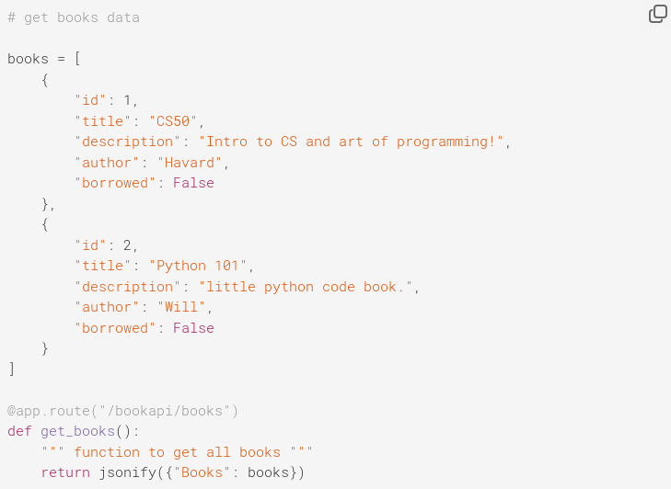
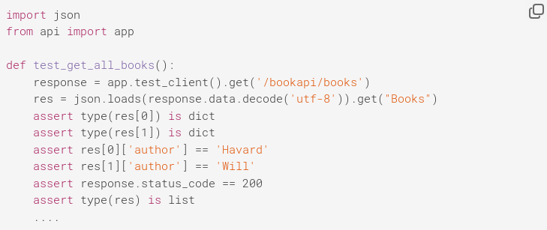
API Testing with Python Flask and Pytest
Source: circleci.com/blog/testing-flask-framework-with-pytest/
Notes:
Now for a backend test.
On the left we have a HTTP Endpoint defined with python flask.
It returns a JSON array of books. It’s pretty trivial, but here we have a new test syntax: assertions.
The rest of the test function is regular python, we make a HTTP request to a url and parse the JSON response.
Then assertions can evaluate some conditionals with which we verify that the output matches our expected format and contents.
It’s pretty inefficient at first glance, as we needed an 8 line test for a single line function.

Slide 13
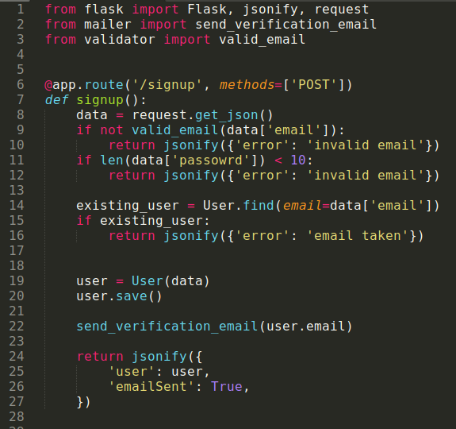
Notes:
Let’s test a more complicated example: back to our signup feature, but as an API endpoint.
Is there anything tricky in this when it comes to testing?

Slide 14
Side effects & Dependencies
Pure Functions = Easy to Test
Minimize Side Effects
Minimize Dependencies
Single responsibility
Notes:
That’s right, there’s a side effect. Signing up means an email gets sent so you can verify you are the owner of said email address.
Avoiding side effects will make your code easier to test.
Pure functions would be best.
There’s an input, and an output.
The same input get’s the same output
No other side effects or changes
But that’s not always possible as some features just require side effects.

Slide 15
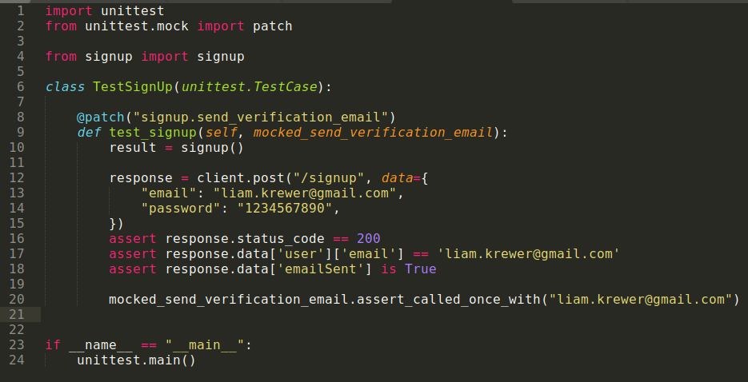
Patching / Dependency Injection
Notes:
Here we have a more realistic api function for signup.
Unlike pure functional testing, we have some dependencies and side effects.
We access a database to check for existing users with this address, and create a user if none exist.
Then we send a verification email to the user.
Neither of these operation’s success can be validated by looking at the function out (the http response)
Nor do we want to actually make calls to a database or send emails when running this test.

Slide 16
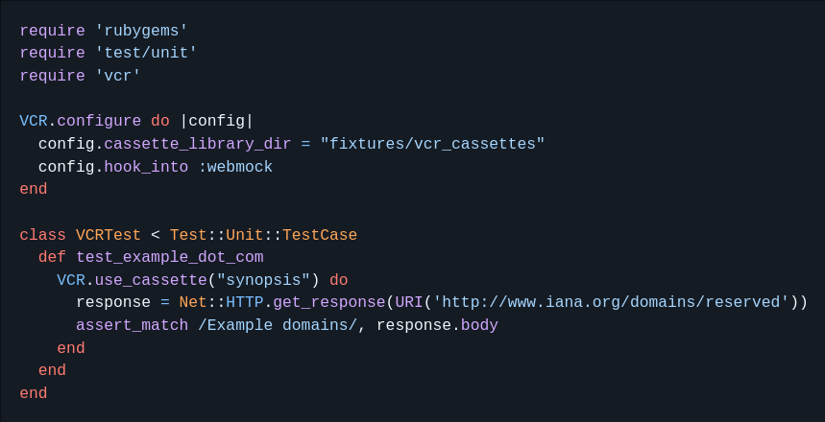
Request Recording
Notes:
Patching and mocking side effects is like single responsibility functions.
They work well when you don’t have something complicated to test.
Take an example of importing data from another API to your database. You could be making 100s of API requests, looping over data, fetching related data, then combining everything into your database schema. Mocking all of those requests and setting up existing data is a monumental task.
VCR to the rescue: This is originally a ruby library, but has equivalents in many other languages. This will make the live API requests to external services, record those requests in yaml files, and replay them for subsequent tests.
This is an excellent tool for test driven development, as it provides you with sample data to write your code against.

Slide 17
Testable Code Summary
Anything is testable
But just because you can, doesn’t mean you should.
And it won’t be easy
Follow best practices for your language / framework of choice
Example: pylint: small functions, arguments etc.
Avoid side effects and excess dependencies
Well defined interfaces
Remove unused code
Stay up to date on documentation
GUI tests
Testing visuals, not ids
Use Open Source tools to help

Slide 18
Culture

Slide 19
Stakeholder Buy-In
What value do tests add?
Don’t we already manually test everything?
Can’t we just do that later?
Notes:
The people who decide what your software does, need to make the call on how much time and energy you should spend on testing
There will be a lot of tough questions for you to answer if you want to convince them testing is valuable
Has anyone had to field similar questions, or got their own questions on why testing is important?

Slide 20
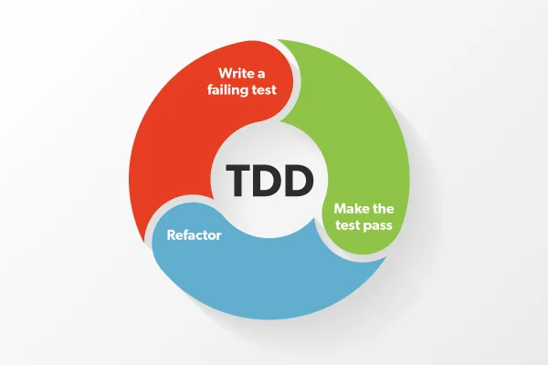
Test Driven Development
Source: https://marsner.com/blog/why-test-driven-development-tdd/
Notes:
TDD is an ideal, and probably not the easiest to get stakeholder buyin on.
Before writing any code, you have to write a test for that functionality which should fail.
Then write the code which makes the test pass.
Only because your tests pass, doesn’t mean your code is perfect, efficient and infallible, which is why the refactor step is next.
TDD means you need to know exactly what you want your app to do, and how it should do it.
The first step to making rigorous testing a part of your culture, is to ensure planning and feature definitions

Slide 21
Good Planning and Specification
Agile
Six Sigma
Waterfall
Scrum
Kanban
Notes:
Here are some project management frameworks you’ve probably all come across.
Luckily they all have something in common:
They all insist on solidly defined features, and have a space for testing (though possibly called analysis or validation)
6sigma: DMAIC (Define, Measure, Analyze, Improve, Control)

Slide 22
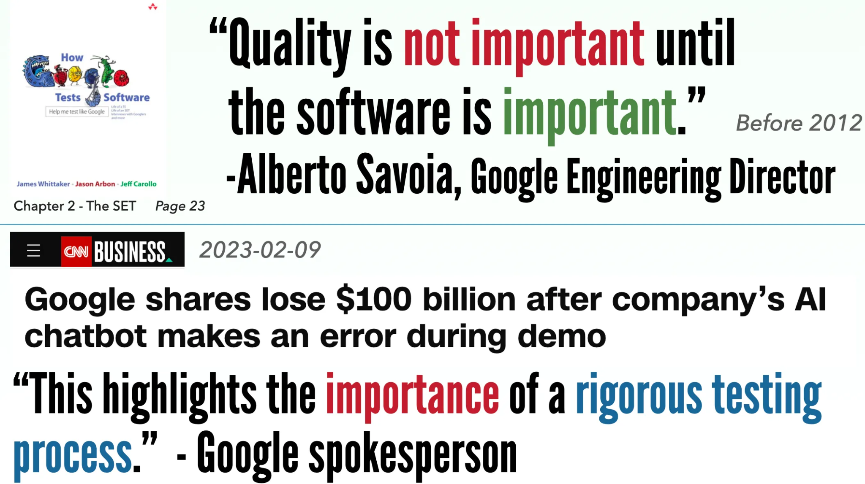
Source: https://zhiminzhan.medium.com/a-good-software-testing-culture-can-be-easily-broken-4c0ef90f5fbc
Notes:
Here is a slide from a medium post showing the two different attitudes to software testing from the same company.
That first quote is a fallacy anyway. Of course this software is important, otherwise why am I paid to write it?
But with testing we can be certain it does work.

Slide 23
Automating Tests

Slide 24
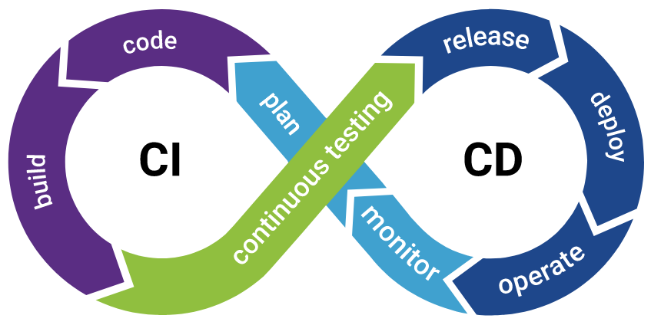
Continuous Integration & Deployment
Source: synopsys.com/glossary/what-is-cicd.html
Notes:
Once you have even just one test, you should run it on every commit and release.
Once you have many tests, you can switch to continuous integration and deployment.
That means make small changes often, and deploy them often. You can do all of this automatically and with confidence because of that big green arrow in the middle: continuous testing.
If your tests pass, you can be confident the app works as well as what is already deployed.

Slide 25
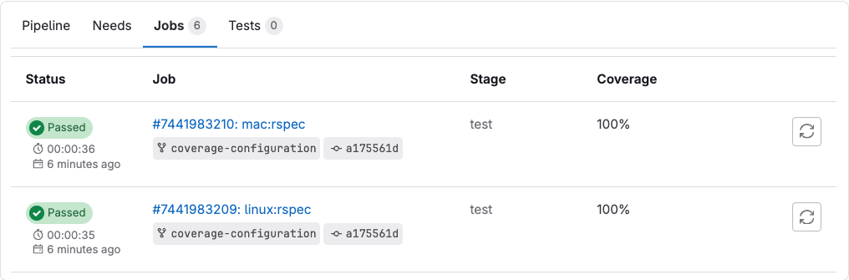
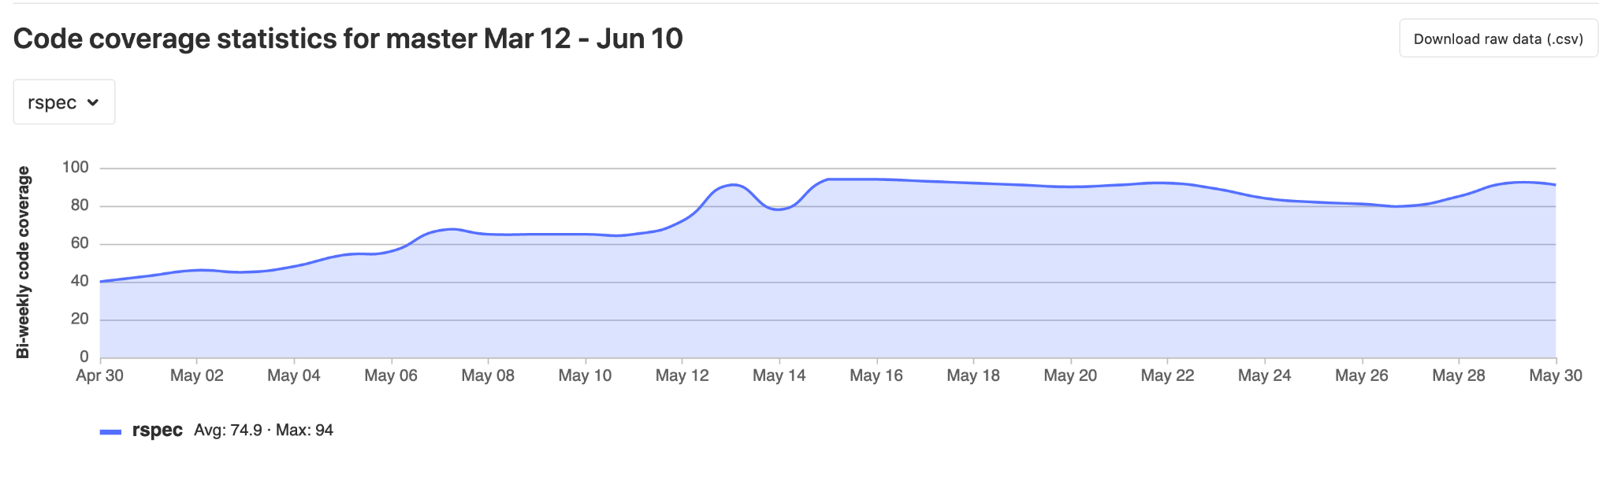
Test Coverage
Source: docs.gitlab.com/ee/ci/testing/code_coverage.html
Notes:
With CI/CD you can automate your testing.
But once something is automated, you lose visibility.
Sure your tests are passing, but have you been keeping up with adding new tests for every new feature?
Code coverage is an inbuilt tool from many testing frameworks, which tells you what percentage of your code base has been executed by running your tests.
This helps you spot if files, functions or conditional branches have been missed by tests.
Here you can see coverage reports generated by CI in gitlab which are available inside a merge request.

Slide 26
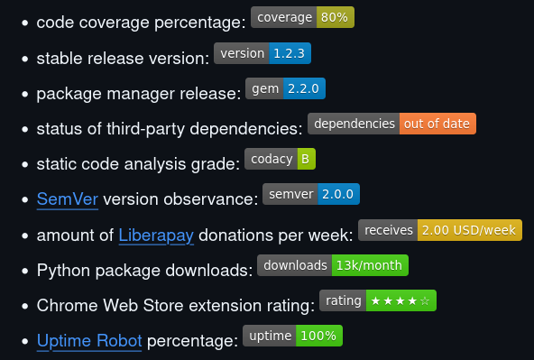
Badges & Visibility
Source: https://github.com/badges/shields
Notes:
Coverage reports are great, but you only have to see them on merge requests or maybe an alert email is sent because it drops too low. That might be too late to easily fix it.
If you are running code coverage analysis in your CI/CD, you can also use the output to generate badges for your repository, where ever it is hosted.
Make sure colors change like a traffic light: 80%+ is green, 60+ is yellow, under is red. They aren’t just a pretty decoration, but an important indicator to show the health of your code base at a glance.

Slide 27
Automating Culture
Notes:
Now we’ve seen some processes for automating tests and reports on them.
But the other important part of building a testable app is culture.
There are some frameworks you can implement, and when strictly followed, they ensure you keep a high standard of testing.

Slide 28
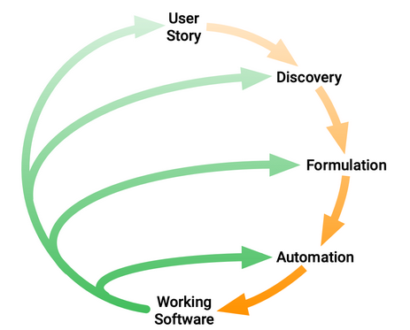
Behaviour Driven Development
Source : https://cucumber.io/docs/bdd/
Notes:
Behaviour Driven Development is a system like agile.
The whole team needs to buy in and continuously work on making the process their own.
First you need to decide what your app does in Discovery.
Technical and non technical staff come together to formulate how the app does this. This needs to be detailed and definitive.
You cannot just say “fill out a form”. What fields are there? What is optional / required? Any error states? What happens after?
Then everything is wrapped up in user stories which can be automated as tests run against your application. The tests can come first, or you can define the user stories for an existing app.
But these user stories are definitive documentation. The single source of truth saying what an application does. All changes and new features need to come as new user stories.
Let’s take a look at an example:

Slide 29
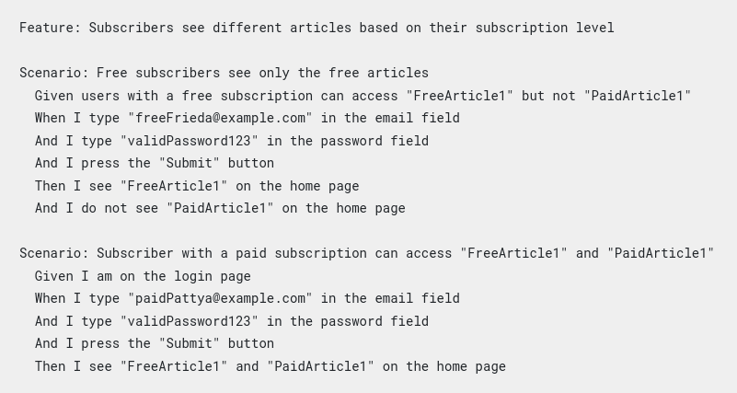
Gherkin Feature Test
Source: https://cucumber.io/docs/bdd/better-gherkin/#consider-a-more-declarative-style
Notes:
Gherkin is the language in which user stories or features are defined.
Each scenario consists of Given, WHen and Then clauses.
Given sets up the existing data/state
When is how you define the user interactions
Then defines the expectations of what should happen.

Slide 30
References
Cucumber BDD
Pytest
Gitlab badges
Github Badges
Code Coverage
coverage.py
Rapid software testing
Stackoverflow
IBM
RFC5322
Cypress
circleCI
Perfecto
Marsner
Stakeholder buy-in
Unittest
Vcr
Unit test Android

