Slide 1
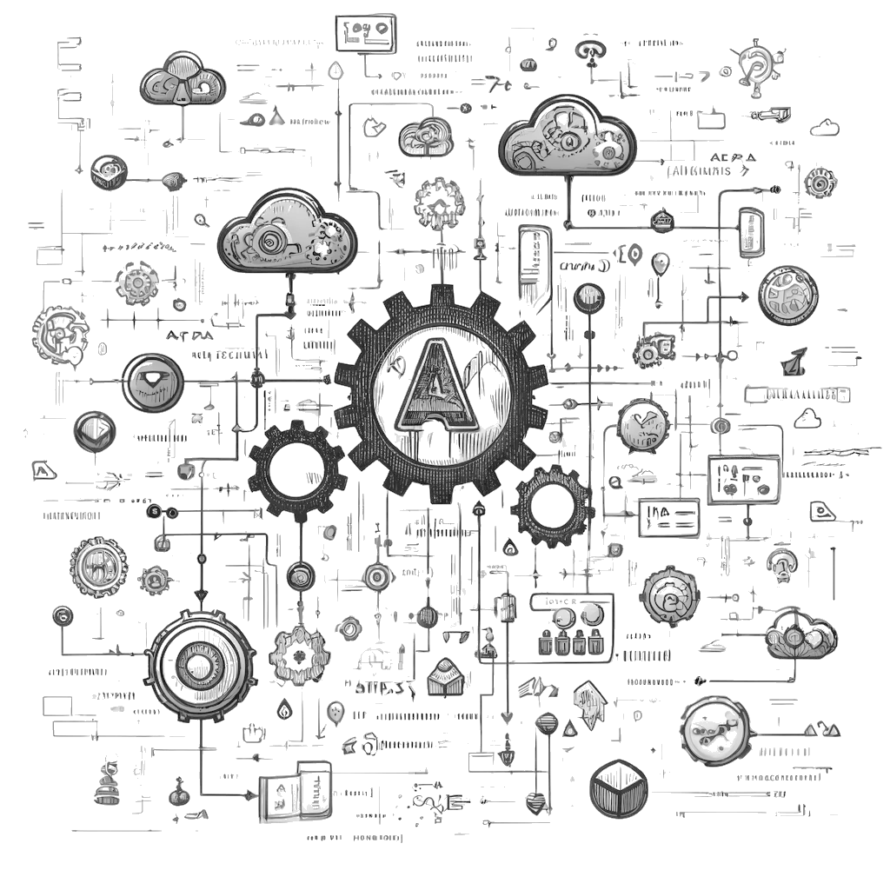
Code Generation
Automatic Programming
Nino Musanovic
Senior Software Engineer @ Signify Health

Slide 2
Code Generation? Automatic Programming?
Automatic programming Any process of generating code from higher-level specifications or models.
examples: compilers (steps), Github Copilot, UML to code, Intellisense...
Code Generation Specific technique within the broader field of automatic programming.
Involves automatically producing code based on predefined rules, templates, or specifications.
examples: API Code Generation, Terraform, EF migrations…
Notes:
‹#›

Slide 3
API Code generation
API Code Generation
Generating client libraries, server stubs, documentation and other code
from API specifications like OpenAPI specification.
The OpenAPI Specification (previously Swagger Specification)
Specification for a machine-readable interface definition language for describing, producing, consuming and visualizing web services.
A REST API is a web service interface that allows clients to interact with resources on a servers.
Notes:
‹#›

Slide 4
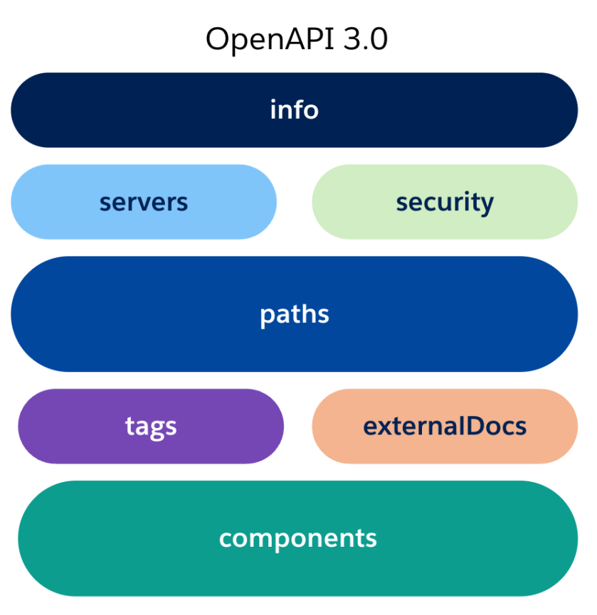
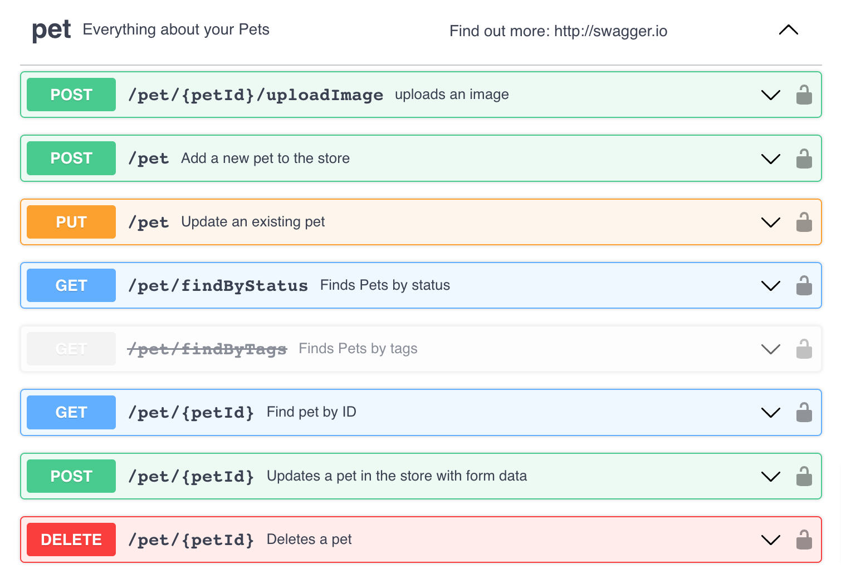
Open API Specification visual examples
image source: https://developer.salesforce.com/blogs/2023/06/design-a-swagger-api-with-code-to-bring-data-into-salesforce
Notes:
‹#›

Slide 5
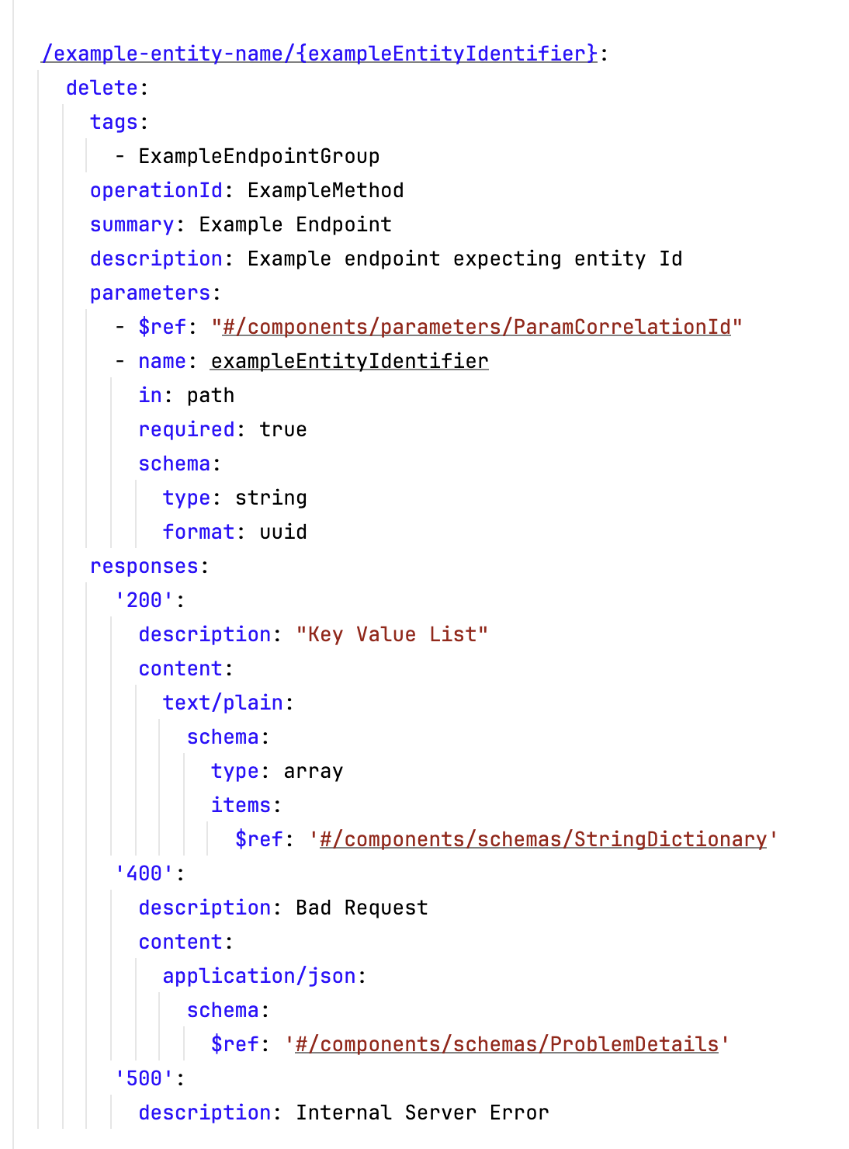
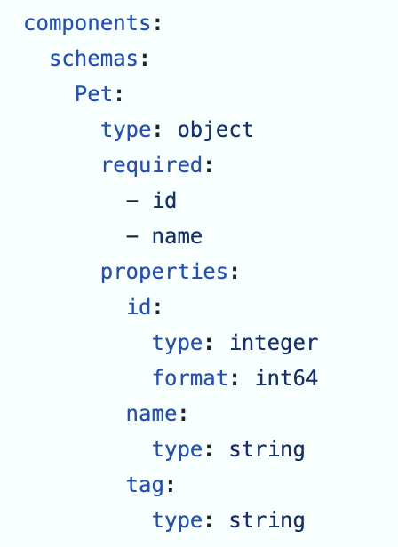
Open Api Specification code example
OAS Path
(Api Endpoint)
OAS Schema
(model)
Notes:
‹#›

Slide 6
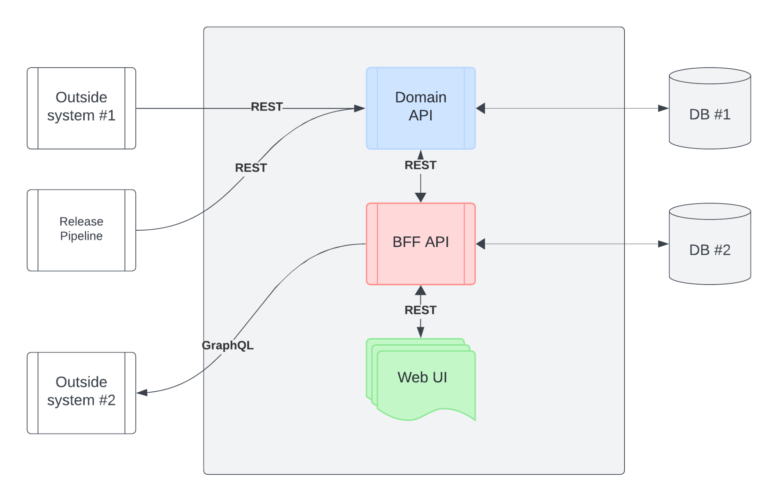
Sample System diagram showing usage of generated code
C# server stub
Python Client
Models generated at design time
C# Client
C# server stub
C# GraphGL Client
Angular Client
Models generated at design time
STUB is a program that acts as a temporary replacement for a remote service or object.
Notes:
‹#›

Slide 7
Code Generator
openapi-generator.tech is a host application that supports executing different generators.
Install or use via brew, npm or docker
Community project, support via slack workspace and twitter
Server stub generators:
ada-server, aspnetcore, cpp-pistache-server, cpp-qt-qhttpengine-server, cpp-restbed-server, cpp-restbed-server-deprecated, csharp-functions, erlang-server, fsharp-functions (beta), fsharp-giraffe-server (beta), go-echo-server (beta), go-gin-server, go-server, graphql-nodejs-express-server, haskell, haskell-yesod (beta), java-camel, java-helidon-server (beta), java-inflector, java-micronaut-server (beta), java-microprofile, java-msf4j, java-pkmst, java-play-framework, java-undertow-server, java-vertx (deprecated), java-vertx-web (beta), java-wiremock (beta), jaxrs-cxf, jaxrs-cxf-cdi, jaxrs-cxf-extended, jaxrs-jersey, jaxrs-resteasy, jaxrs-resteasy-eap, jaxrs-spec, julia-server (beta), kotlin-server, kotlin-spring, kotlin-vertx (beta), kotlin-wiremock (beta), nodejs-express-server (beta), php-flight (experimental), php-laravel, php-lumen, php-mezzio-ph, php-slim4, php-symfony, python-aiohttp, python-blueplanet, python-fastapi (beta), python-flask, ruby-on-rails, ruby-sinatra, rust-axum (beta), rust-server, scala-akka-http-server (beta), scala-cask, scala-finch, scala-http4s-server, scala-lagom-server, scala-play-server, scalatra, spring
Client code generators:
ada, android, apex, bash, c, clojure, cpp-qt-client, cpp-restsdk, cpp-tiny (beta), cpp-tizen, cpp-ue4 (beta), crystal (beta), csharp, dart, dart-dio, eiffel, elixir, elm, erlang-client, erlang-proper, go, groovy, haskell-http-client, java, java-helidon-client (beta), java-micronaut-client (beta), javascript, javascript-apollo-deprecated (deprecated), javascript-closure-angular, javascript-flowtyped, jaxrs-cxf-client, jetbrains-http-client (experimental), jmeter, julia-client (beta), k6 (beta), kotlin, lua (beta), n4js (beta), nim (beta), objc, ocaml, perl, php, php-dt (beta), php-nextgen (beta), powershell (beta), python, python-pydantic-v1, r, ruby, rust, scala-akka, scala-gatling, scala-pekko, scala-sttp, scala-sttp4 (beta), scalaz, swift-combine, swift5, typescript (experimental), typescript-angular, typescript-aurelia, typescript-axios, typescript-fetch, typescript-inversify, typescript-jquery, typescript-nestjs (experimental), typescript-node, typescript-redux-query, typescript-rxjs, xojo-client, zapier (beta),
source: https://openapi-generator.tech/docs/generators
Notes:
‹#›

Slide 8
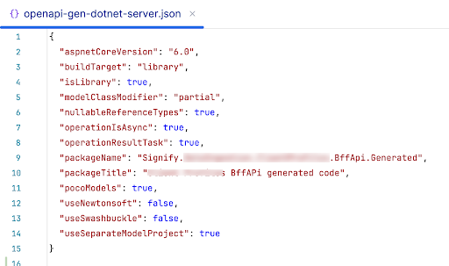
How to generate code using code generator?
Example which generates dotnet server stub: openapi-generator-cli generate -i openapi/specification.yaml -g aspnetcore --config docs/openapi-gen-dotnet-server.json
OpenAPI document
Select generator
Separate config file
Config file example
STUB is a program that acts as a temporary replacement for a remote service or object.
Notes:
‹#›

Slide 9
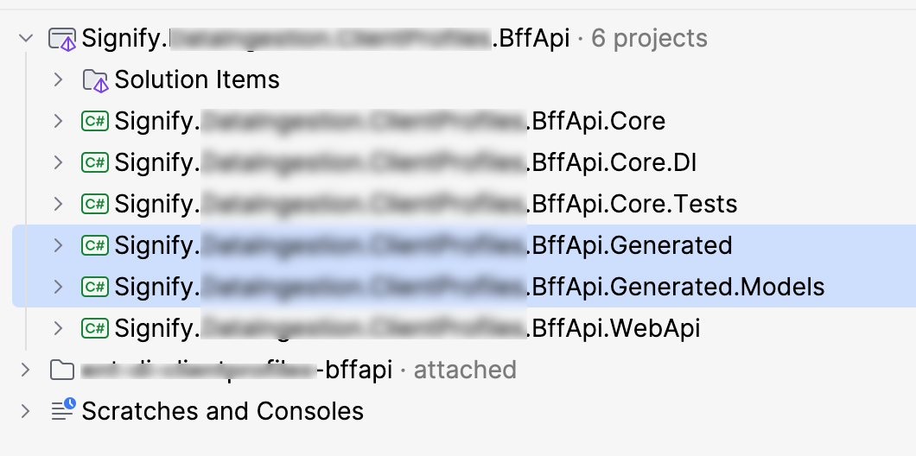
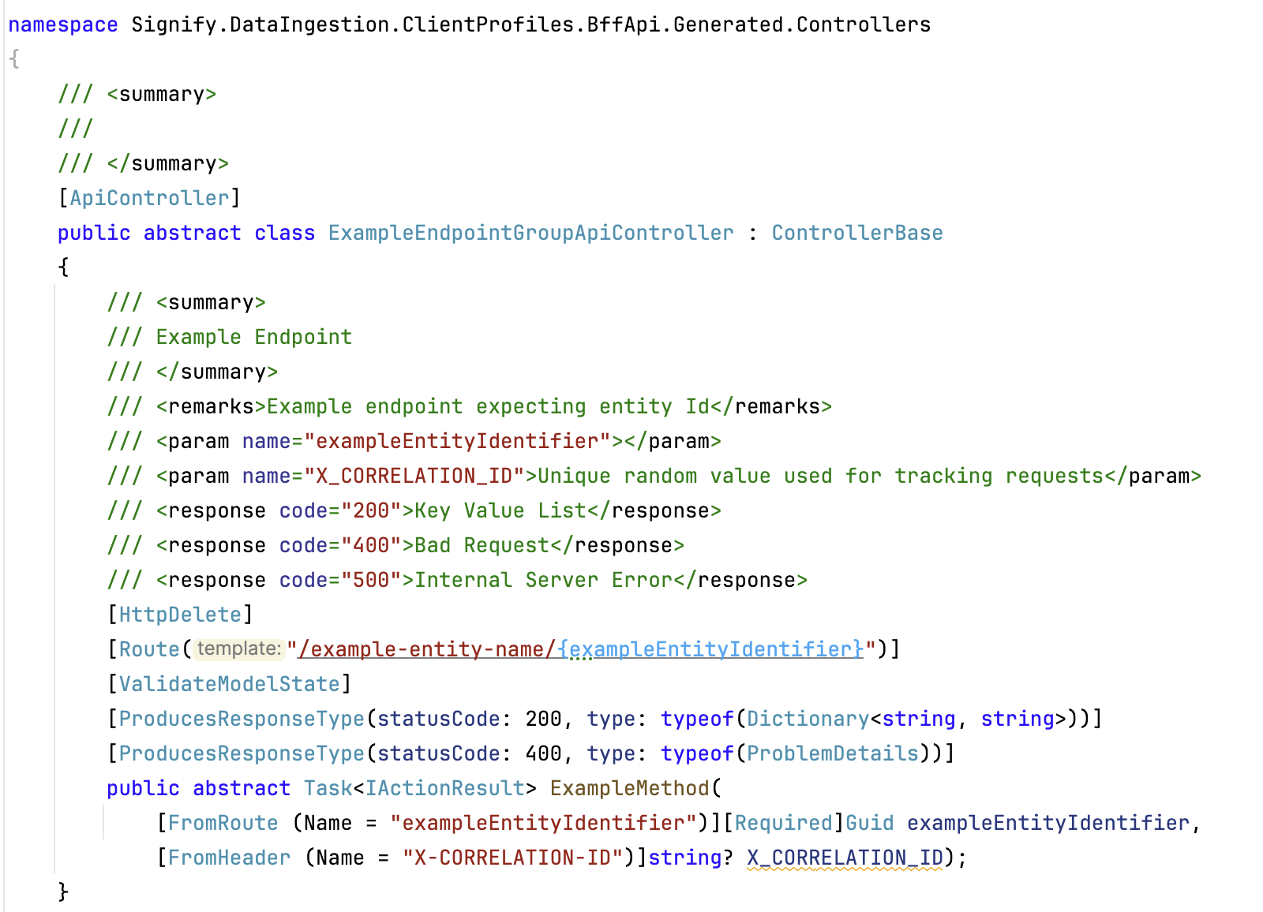
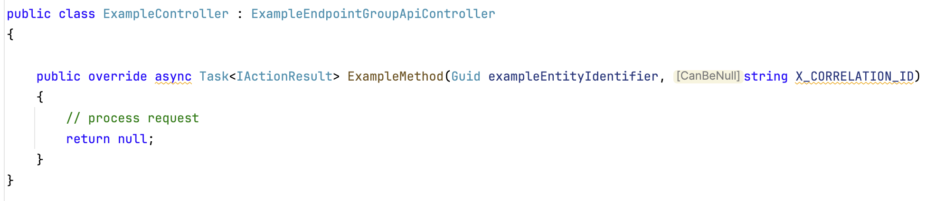
Generating and using server stubs (C#)
Generated abstract C# class and method with defined VERB, routing, request and response types
Generated projects within the existing sln structure
Generate
Create Api Controller and which inherits from generated abstract class
Use
Endpoint described in OpenAPI document
Notes:
‹#›

Slide 10
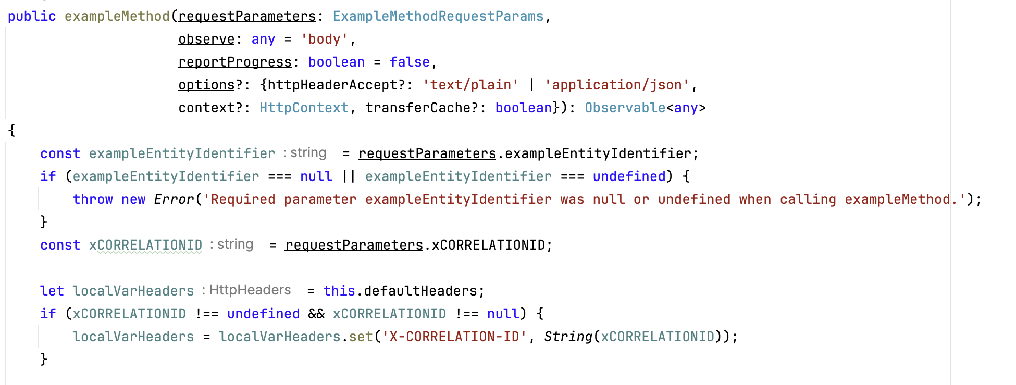
Generated Client Library example (angular)
Endpoint described in OpenAPI document
Generated typescript code
Generate
Notes:
‹#›

Slide 11
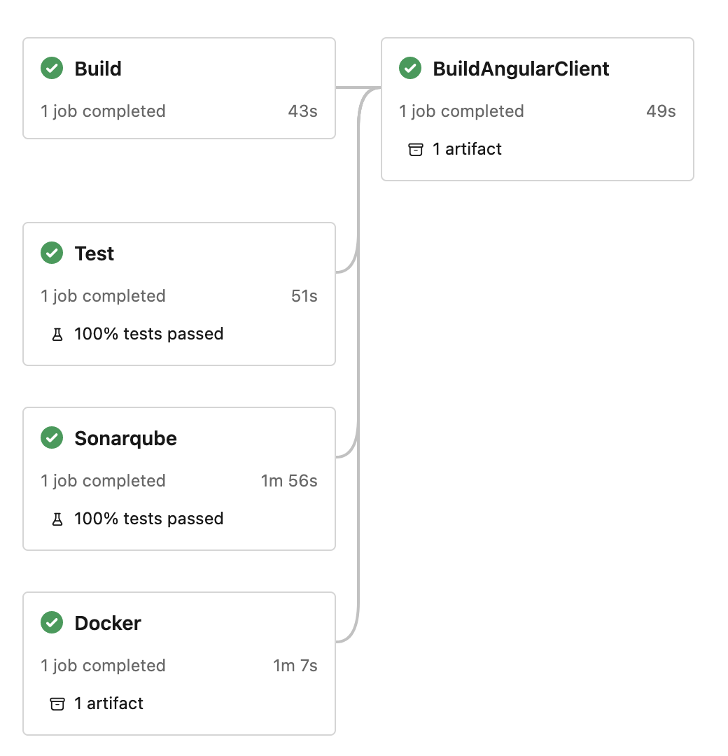
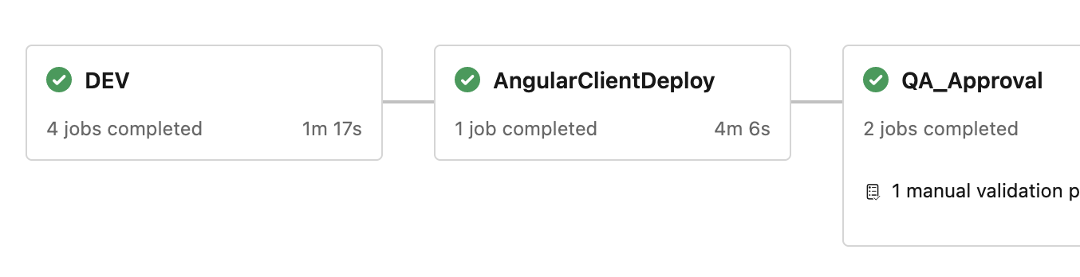
Deploying Client Library (angular)
Build pipeline builds both Server and Client
Deploy pipeline pushes Client packages to Azure Feeds, Maven, Nuget etc…
Deploy
Release branch name is used to set version for Server and Client
Notes:
‹#›

Slide 12
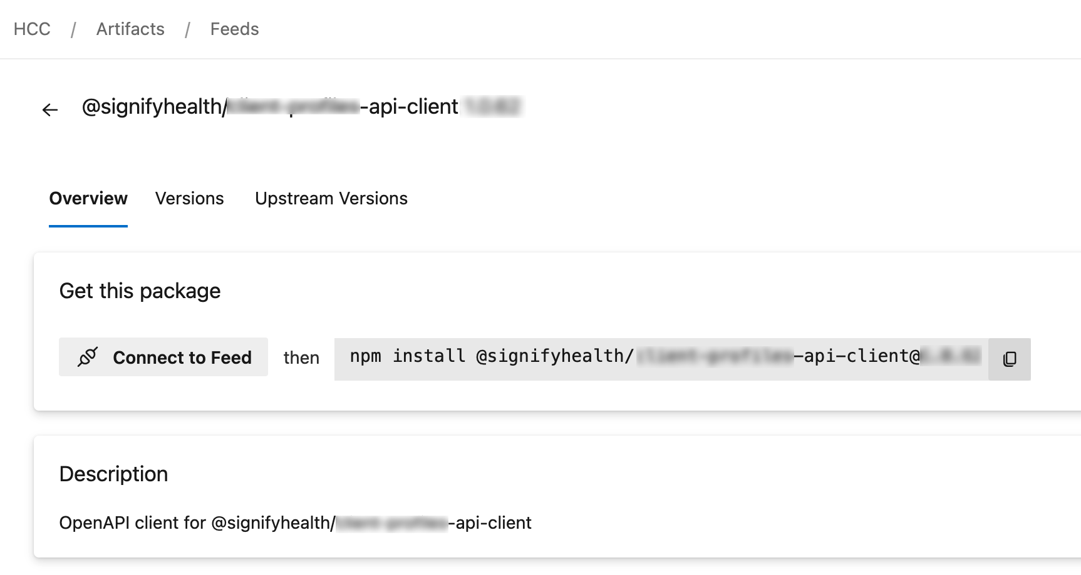
Using Client Library (angular)
Deployed client library
Using library to send requests to API
import { GeneratedApiClientService } from '@signifyhealth/generated-api-client';
…
this.generatedApiClientService
.apiMethod({ GeneratedApiRequestModel: { test: true } })
.subscribe({
next: (data: GeneratedApiResponseModel) => {
console.log(data);
}
},
error: (error) => {... }
);
Notes:
‹#›

Slide 13
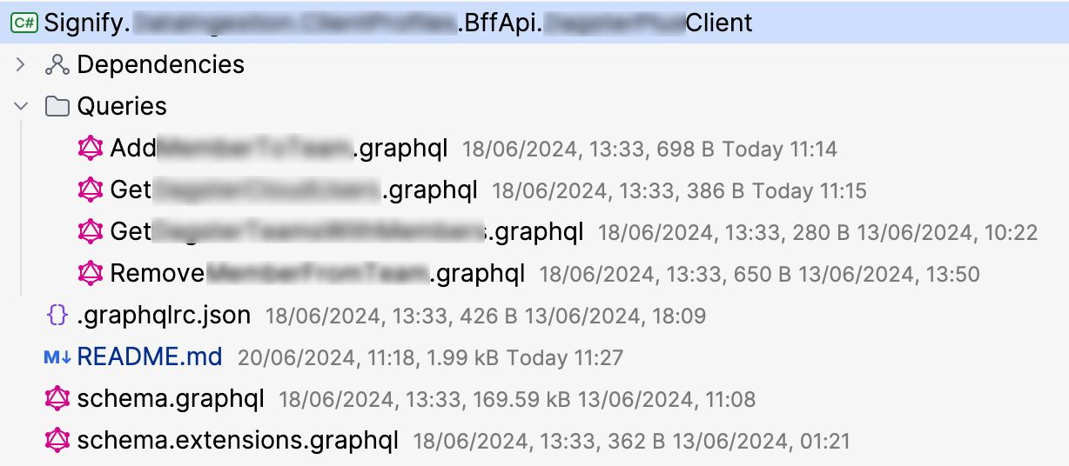
Generate GraphQL client using StrawberyShake
GraphQL project example
Install StrawberryShake code generator as dotnet tool
Create separate new project to existing solution and add StrawberryShake.Server nuget package
Add “named” GraphQL queries to project
Client is generated on every build based on added queries
Add generated client to IServiceCollection
Inject client where needed
Notes:
‹#›

Slide 14
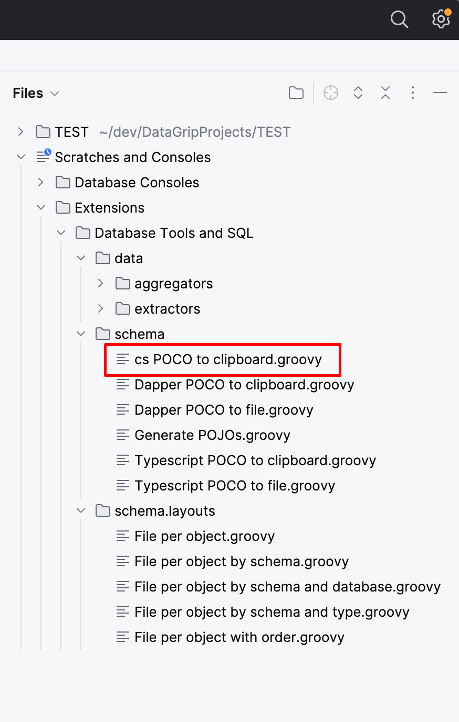
Create DB models using IDE provided scripts (i.e. Datagrip)
Example database table
Script creates models from selected table
Example of C# model class
create table dbo.table_name
(
id uniqueidentifier
PRIMARY KEY,
…
)
[Table(“table_name”, Schema=”dbo”)]
public class TableName
{
[Key]
public Guid Id {get;set}
…
}
Class is ready to be used as Entity Framework DbSet
public virtual DbSet<TableName>
TableName { get; set; }
Notes:
‹#›

Slide 15
Mapping different models using Automapper
DB Models
CreateMap<DatabaseModel, OpenApiSpecModel>()
.ReverseMap();
CreateMap<SomeOtherApiModel, OpenApiSpecModel>()
.ReverseMap();
CreateMap<GeneratedGraphQLModel, OpenApiSpecModel>()
.ReverseMap();
mapper.Map<OpenApiSpecModel>(
await dbcontext.DatabaseModel.FirstOrDefault()
)
Models from other APIs
GraphQL models
Usage example
Notes:
‹#›

Slide 16
Advantages of generating code from OpenAPI Specification
Consistency and Standardization: Uniformity of API implementation and Compliance to standards
Efficiency and Speed: Automatically generating boilerplate code and Rapid Prototyping
Reduced Errors: Minimized Human Error and producing validated code
Enhanced Documentation: Self-Documentation and Interactive Docs
Interoperability: Multi-Language Support and Cross-Platform Compatibility
Maintainability: Easier Updates and Version Control of specification document
Improved Collaboration: Clear contract between backend and frontend and easy Client-Server Integration
Enhanced Security: Security Best Practices and Consistent Enforcement
Scalability: Facilitates the scaling of API projects by providing a solid foundation, clear guidelines and Reusable Components
Cost Savings: Reduced Development Costs and Resource Optimization by automating repetitive tasks.
Notes:
‹#›

Slide 17
Thank you
Questions, comments?
Notes:
‹#›

Slide 18
Links
Automatic Programming https://en.wikipedia.org/wiki/Automatic_programming
Open API specification https://en.wikipedia.org/wiki/OpenAPI_Specification
Open API official specification https://spec.openapis.org/oas/v3.1.0
Open API documentation and guide (swagger.com) https://swagger.io/docs/specification/about/
Open API generator https://openapi-generator.tech/
Open API generator slack workspace https://openapi-generator.slack.com
StrawberryShake code generator https://chillicream.com/docs/strawberryshake/v13/get-started/console
Notes:
‹#›

