Slide 1


GIT 1.4
Cloud Computing

Slide 2


Thanks to
Our Sponsors

Slide 3
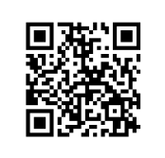
We have
a website
galway-it-meetup.github.io

Slide 4
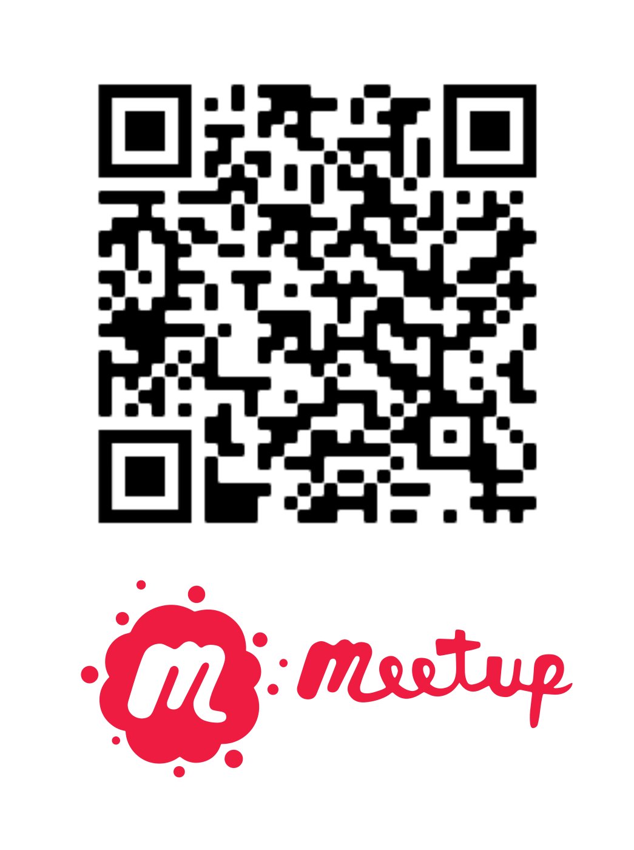

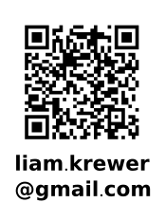
Looking
For speakers

