Slide 1
FINAL PHASE 2 MODEL
EXP030
A quality-first VarNet submission
4 cascades · 12 channels · 8 sensitivity channels · 20 epochs
0.915251
0.9178
0.9108
FINAL TOTAL SCORE
SSIM FULL
SSIM BBOX
30 / 30
official runs completed
2026 SNU FastMRI Challenge · EXP030
01

Slide 2
MODEL DESIGN
VarNet reconstruction path
Only undersampled k-space and its acquisition mask enter inference.
01
02
03
04
05
K-space + mask
Sensitivity U-Net
VarNet cascades ×4
Data consistency
Magnitude image
Complex input
8 channels
12 channels each
Measured samples
Slice output
Inference integrity
✓
No image field input
✓
No bbox annotations
✓
No provided GRAPPA
✓
Batch = 1 timing
2026 SNU FastMRI Challenge · EXP030
02

Slide 3
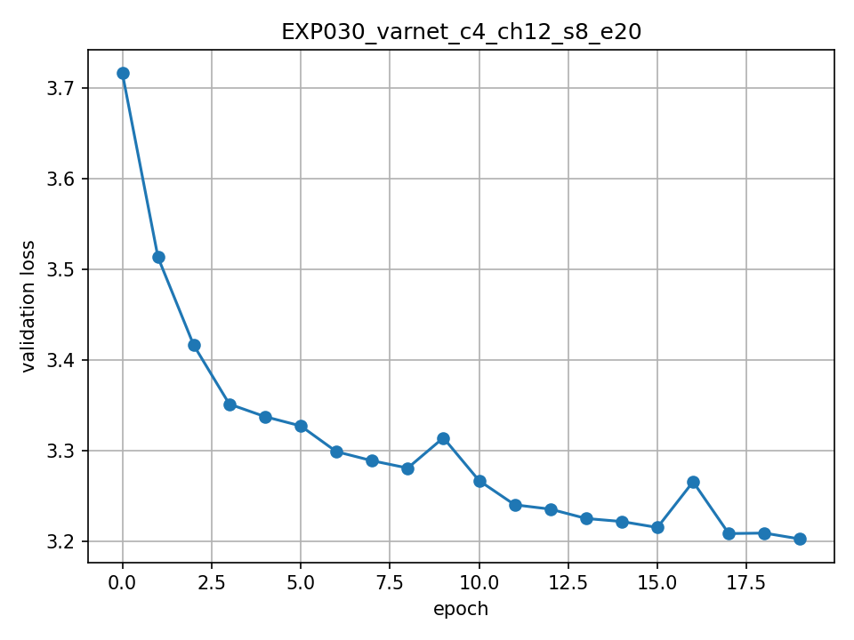
TRAINING EVIDENCE
EXP030 converged to the best validation candidate
19
3.20296
BEST EPOCH
BEST VAL LOSS
0.90337
0.92599
VAL SSIM FULL
VAL SSIM BBOX
+0.005595
validation quality vs EXP012
Validation loss · 20 epochs
Longer training + stronger sensitivity estimation improved both full-image and lesion-box metrics.
2026 SNU FastMRI Challenge · EXP030
03

Slide 4
CANDIDATE SELECTION
EXP030 wins on both official quality metrics
+0.0063
quality-score gain
+0.006286
one-shot total-score gain
Decision rule
Quality gap > 0.001 → prefer EXP030; timing cannot reverse the result.
2026 SNU FastMRI Challenge · EXP030
04

Slide 5
OFFICIAL TIMING
Thirty repeats confirm stable quality and runtime
173.4
BEST MS / SLICE · RUN 01
0.9143
QUALITY · ALL 30 RUNS
0.915251
Run number
FINAL TOTAL SCORE
2026 SNU FastMRI Challenge · EXP030
05

Slide 6
SUBMISSION HANDOFF
One command, fixed harness, auditable artifacts
1
Place weight
2
Mount data read-only
3
Run official entrypoint
../result/test_Varnet/checkpoints/best_model.pt
/root/Data/leaderboard
bash recon_eval.sh
Integrity record
Required deliverables
Checkpoint SHA-256
ef74bec4243e7aa39d5aa8dae031e1bb83e771c26be00c4e5330e17b60a66085
GitHub repository
Loss graph
Evaluator SHA-256
a93cf978b4938a060d4f5a204d3f7118fb8c17bf12408cbe44e6e7954ba5a135
Model weight
Description deck
EXP030 is ready for final submission.
Selected for its durable quality advantage—not a fragile timing win.
2026 SNU FastMRI Challenge · EXP030
06

