Slide 1

Organization Name : Ministry of Housing and Urban Affairs
PS Code : 1515
Problem Statement Title: Smart and Effective realtime Management of street parking
Team Name : return 0;
Team Leader Name : Aastha Shah
Institute Code (AISHE):
Institute Name : Pune Institute of Computer Technology
Theme Name :Smart Automation

Slide 2
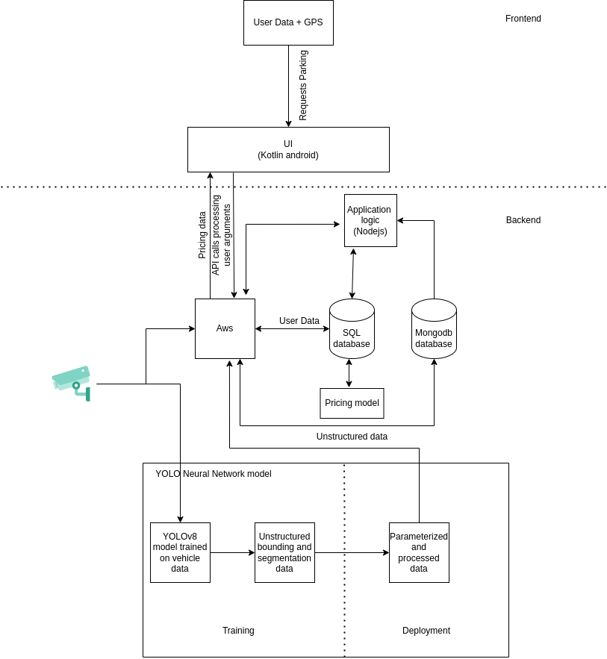
Approach
Details
Add process flow chart or simulated image of prototype or any relevant image related to your idea

Slide 3
Idea/Approach Details
Describe your idea/Solution/Prototype here:
Describe your Technology stack here:

Slide 4
Idea/Approach Details
Describe your Use Cases here
Describe your Dependencies / Show stopper here

Slide 5
Team Member Details
Team Leader Name: Aastha Shah
Branch (Btech/Mtech/PhD etc): Btech Stream (ECE, CSE etc): CSE Year (I,II,III,IV): II
Team Member 1 Name: Aarya Bhave
Branch (Btech/Mtech/PhD etc): Btech Stream (ECE, CSE etc): CSE Year (I,II,III,IV): II
Team Member 2 Name: Digambar Jail
Branch (Btech/Mtech/PhD etc): Btech Stream (ECE, CSE etc): IT Year (I,II,III,IV): II
Team Member 3 Name: Sohan Chepe
Branch (Btech/Mtech/PhD etc): Btech Stream (ECE, CSE etc): E&TE Year (I,II,III,IV): II
Team Member 4 Name: Shreenath Bandivadekar
Branch (Btech/Mtech/PhD etc):Btech Stream (ECE, CSE etc): CSE Year (I,II,III,IV): II
Team Member 5 Name: Sachi Patankar
Branch (Btech/Mtech/PhD etc): Btech Stream (ECE, CSE etc): CSE Year (I,II,III,IV): II
Team Mentor 1 Name: Type Your Name Here
Category (Academic/Industry): Expertise (AI/ML/Blockchain etc): Domain Experience (in years):
Team Mentor 2 Name: Type Your Name Here
Category (Academic/Industry): Expertise (AI/ML/Blockchain etc): Domain Experience (in years):

Slide 6
Important Pointers
Please ensure below pointers are met while
Kindly keep the maximum slides limit to 4 pages
All the topics should be utilized for description of your idea
Try to avoid paragraphs and post your idea in points
Keep your explanation precisely and easy to understand
Idea should be unique and novel. If it has a business potential more weightage will be given.
Apart from this PPT abstract of your idea will be asked separately while submitting
You need to save the file in PDF and upload the same on portal. No PPT, Word Doc or any other format will be supported
You can delete this slide (Important Pointers) when you upload the details of your idea on SIH portal.

