Slide 1
Basics of Mobile Robotics. Final Project
Elisa Ferrara
Cédric Fournier
Simon Gmür
Edgar Aellen
19/12/2023

Slide 2
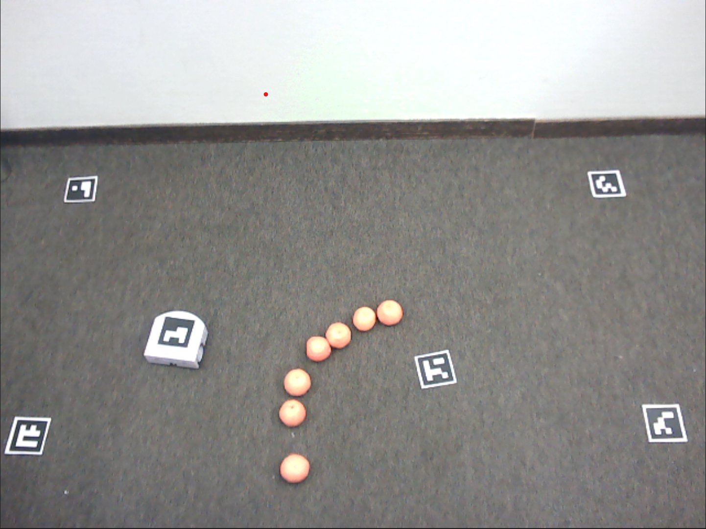

Computer vision
ArUco Library
Detect Marker Candidates
Analyse Marker Codification
Color detection
Define the color of the obstacles
Selection the pixels of the same color in the image

Slide 3
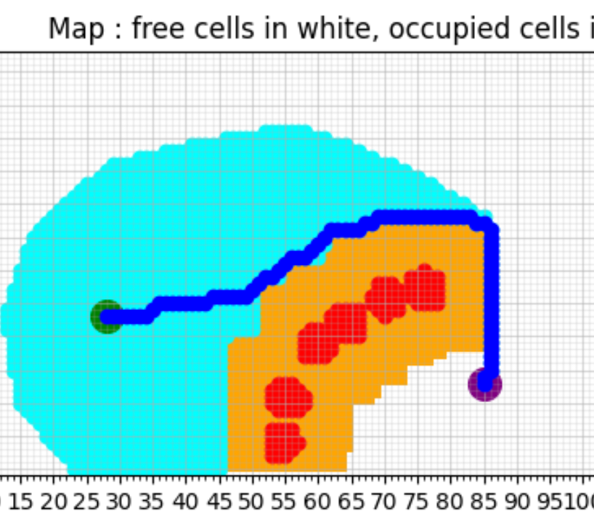
Global Path Planning
Alogrithm A*
Problem :
Too much point
Robot going slow
Risk of missing a point
Solution :
Keypoints
Reduce the number of point
Strategic point -> angle
Increase the robot speed
Keep the precision
Recurring problem :
Computation time

Slide 4
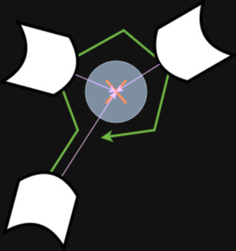

Local Obstacles Avoidance
Potential field
Problem : obstacle on keypoint
Solution : ignoring keypoint if angle between robot direction and keypoint higher than an angle threshold

Slide 5
Kalman Filtering
MODEL
State: (x,y, θ)
Inputs: right_speed, left_speed → Extended Kalman Filter for non linear systems
PROCESS NOISE
Gaussian White Noise of covariance Q due to slippering and errors in motor speed sensors
MEASUREMENT NOISE
Gaussian White Noise of covariance R due to errors in the camera measurements and Computer Vision algorithm
Estimating position including information from camera and odomtry

Slide 6
Control: Path Following
Basic P controller
If angle between robot direction and orientation goal too high :
Robot stop and turn
Else : P controller classic
Local avoidance :
Sum of the global speed and local speed to avoid the obstacle
P controller

