Slide 1
Basics of Mobile Robotics. Final Project
Elisa Ferrara
Cédric Fournier
Simon Gmür
Edgar Aellen
19/12/2023

Slide 2
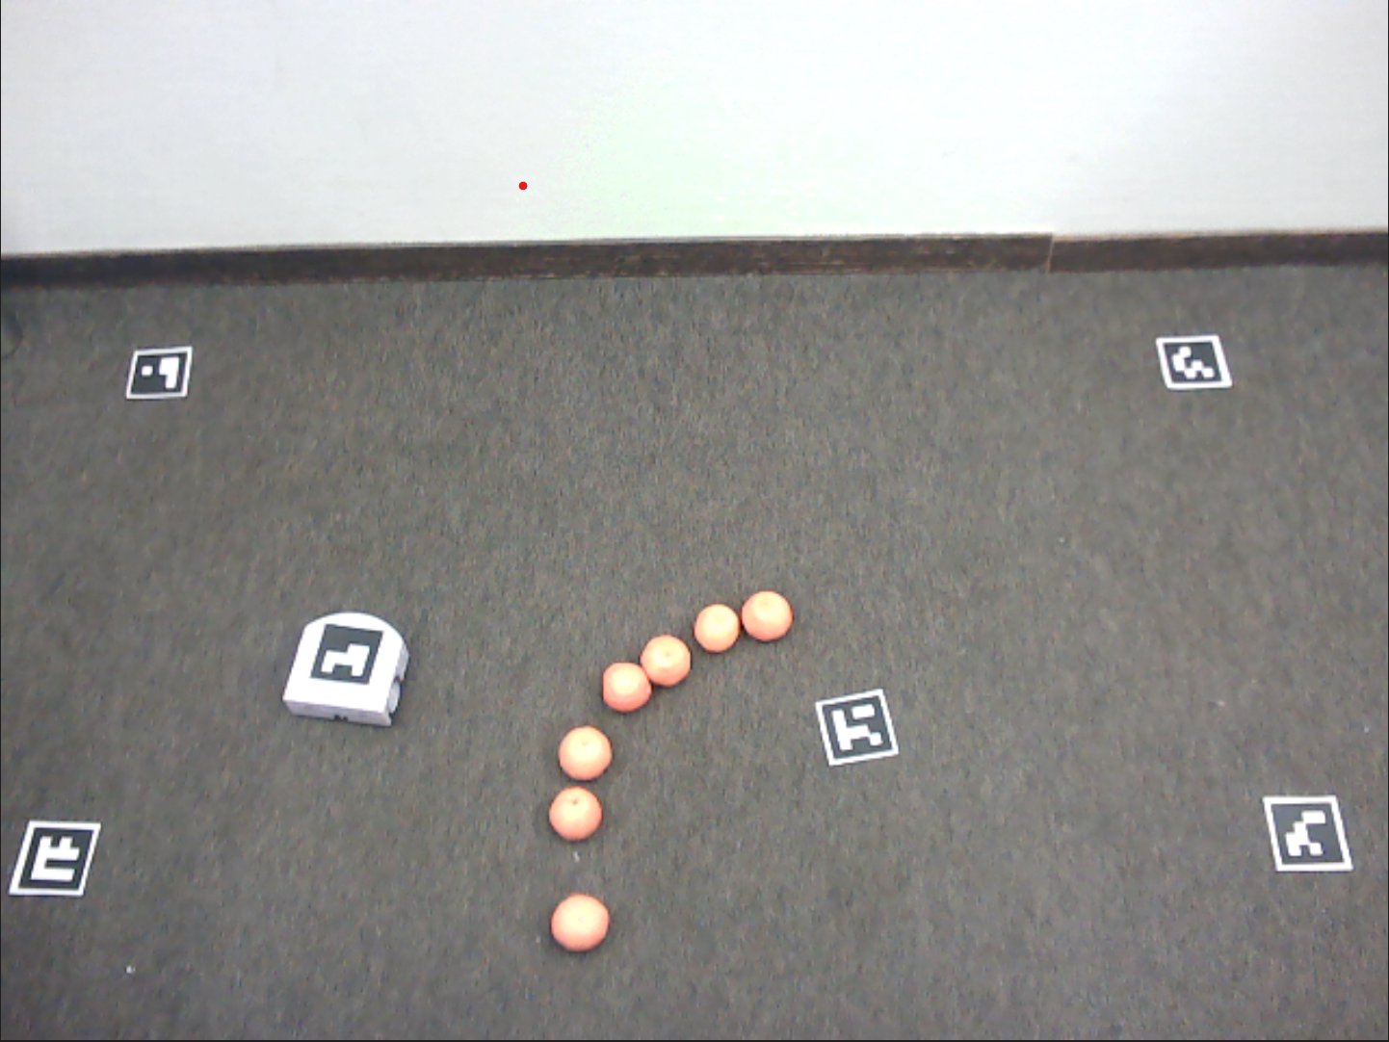

Computer vision
ArUco Library
Detect Marker Candidates
Analyse Marker Codification
Color detection
Define the color of the obstacles
Selection the pixels of the same color in the image

Slide 3
Global Path Planning

Slide 4
Local Obstacles Avoidance

Slide 5
Kalman Filtering
MODEL
State: (x,y, θ)
Inputs: right_speed, left_speed → Extended Kalman Filter for non linear systems
PROCESS NOISE
Gaussian White Noise of covariance Q due to slippering and errors in motor speed sensors
MEASUREMENT NOISE
Gaussian White Noise of covariance R due to errors in the camera measurements and Computer Vision algorithm
Estimating position including information from camera and odomtry

Slide 6
Control: Path Following

