Slide 1
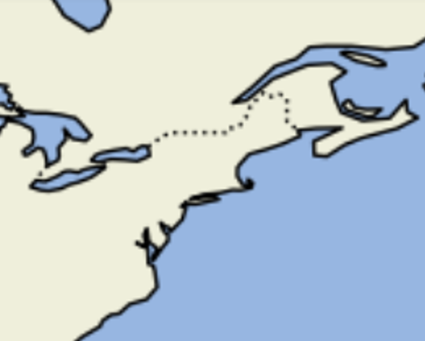



















$$Graph Nodes$$
A
B
C
D
Hop 5- $(5,5)$
${(lon}_{1}$, ${lat}_{1},t_{1,2,3}$)
${(lon}_{1}$, ${lat}_{1},t_{1,}$)
${(lon}_{1}$, ${lat}_{1}$)
${(lon}_{1}$, ${lat}_{1}$)
1
1
Hop 2- $(2,2)$
2
$$(1,1)$$
$$\left(−1,1\right)\left(0,1\right)$$
S
F
S
3
S
F
$$\left(−1,0\right) \left(0,0\right) (1,0)$$
S
F
F
$$\left(−1,−1\right) \left(0,−1\right) (1,−1)$$
${(lon}_{2}$, ${lat}_{2}$)
${(lon}_{2}$, ${lat}_{2}$)
1
1
${(lon}_{4}$, ${lat}_{4}$)
2
2
${(lon}_{3}$, ${lat}_{3}$)
3
${(lon}_{2}$, ${lat}_{2},t_{1,2}$)
${(lon}_{2}$, ${lat}_{2},t_{1,2,3}$)
${cell}_{x,y}$ has 4 passable neighbors
(1-passible; 0-impassible)
$$Matrix Grid$$

