Slide 1

Restaurant Carryout System
Cameron Garratt, Colin Wahl, Nicolas Burgess, Vivek Patel, Emma Fick

Slide 2

We Make It, You Take It!
A carryout and inventory management system all in one!
The restaurant carryout system we have designed allows for a restaurant manager to create multiple restaurants, menu items, and recipes. The web app also allows for you to manage the restaurant's current inventory.
Once a restaurant has been created a user can order any menu item from any of the restaurants you have created.

Slide 3
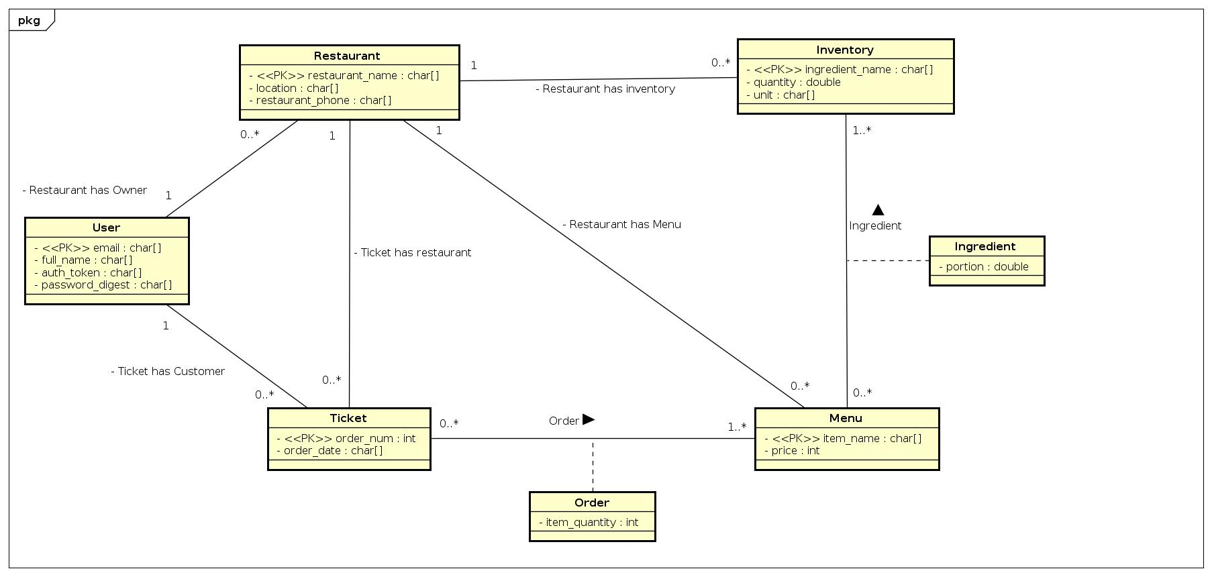
UML

Slide 4
UML -> RM (underline PK, italics FK)
7 Tables
9 FKs
User(email, full_name, auth_token, password_digest)
Restaurant(restaurant_name, location, restaurant_phone, email)
Ticket(order_num, restaurant_name, order_date, email)
Order(restaurant_name, order_num, item_name, item_quantity)
Menu(item_name, restaurant_name, price)
Ingredient(restaurant_name, item_name, ingredient_name, portion)
Inventory(ingredient_name, restaurant_name, quantity, unit)

Slide 5
BCNF Decomposition
Attributes: email, full_name, auth_token, password_digest, restaurant_name, location, reataurant_phone, item_name, price, portion, ingredient_name, quantity, unit, order_num, order_date, item_quantity
A - email
B - full_name
C - auth_token
D - password_digest
E - restaurant_name
F - location
G - restaurant_phone
H - item_name
I - price
J - portion
K - ingredient_name
L - quantity
M - unit
N - order_num
O - order_date
P - item_quantity

Slide 6
Functional Dependencies
A -> BCD email -> full_name, auth_token, password_digest
E -> FG restaurant_name -> location, restaurant_phone
H -> I item_name -> price
K - LM ingredient_name -> quantity, unit
N -> O order_number -> order_date
EHK -> J restaurant_name, item_name, ingredient_name -> portion
EHN -> P restaraunt_name, item_name, order_number -> quantity

Slide 7
BCNF Step 1
ABCDEFGHIJKLMNOP is not in BCNF
A is a superkey of ABCD but not of ABCDEFGHIJKLMNOP therefore
A -> BCD violates BCNF
ABCDEFGHIJKLMNOP
ABCD
AEFGHIJKLMNOP

Slide 8
BCNF Step 2
AEFGHIJKLMNOP is not in BCNF
E is a superkey of EFG but not of AEFGHIJKLMNOP therefore
E -> FG violates BCNF
AEFGHIJKLMNOP
EFG
AEHIJKLMNOP

Slide 9
BCNF Step 3
AEHIJKLMNOP is not in BCNF
H is a superkey of HI but not of AEHIJKLMNOP therefore
H -> I violates BCNF
AEHIJKLMNOP
HI
AEHJKLMNOP

Slide 10
BCNF Step 4
AEHJKLMNOP is not in BCNF
K is a superkey of KLM but not of AEHJKLMNOP therefore
K -> LM violates BCNF
AEHJKLMNOP
KLM
AEHJKNOP

Slide 11
BCNF Step 5
AEHJKNOP is not in BCNF
N is a superkey of NO but not of AEHJKNOP therefore
N -> O violates BCNF
AEHJKNOP
NO
AEHJKNP

Slide 12
BCNF Step 6
AEHJKNP is not in BCNF
EHK is a superkey of EHKJ but not of AEHJKNP therefore
EHK -> J violates BCNF
AEHJKNP
EHKJ
AEHKNP

Slide 13
BCNF Step 7
AEHKNP is not in BCNF
EHN is a superkey of EHNP but not of AEHKNP therefore
EHN -> P violates BCNF
AEHKNP
EHNP
AEHKN

Slide 14
BCNF Final Step
AEHKN is in BCNF
AEHKN is a superkey of AEHKN
AEHKN

Slide 15
Complete BCNF Decomposition
ABCDEFGHIJKLMNOP
ABCD
AEFGHIJKLMNOP
EFG
AEHIJKLMNOP
HI
AEHJKLMNOP
KLM
AEHJKNOP
NO
AEHJKNP
EHKJ
AEHKNP
EHNP
AEHKN

Slide 16
3NF Synthesis
Step 1) make all rhs singletons
Fm = {
A -> B
A-> C
A -> D
E -> F
E -> G
H -> I
K -> L
K -> M
N -> O
EHK -> J
EHN -> P
}
Find Minimal Cover
F = {
A -> BCD
E -> FG
H -> I
K - LM
N -> O
EHK -> J
EHN -> P
}
Step 2) Remove Extraneous Attributes
- None
Step 3) Remove redundant FD’s
- None

Slide 17
3NF Synthesis
Step 2) Form Tables From the FDs
R1 = ABCD
R2 = EFG
R3 = HI
R4 = KLM
R5 = NO
R6 = EHKJ
R7 = EHNP
Step 3) Remove Fully Contained Subschemas - None
Step 4) Make sure it’s lossless
-No table contains global key
-add table AEHKN
AEHKN+ = ABCDEFGHIJKLMNOP
A(BCD)E(FG)H(I)K(LM)N(O)
EHK ->J EHN ->P
Step 1) Merge FD’s with same LHS
Fm = {
A -> B
A-> C
A -> D
E -> F
E -> G
H -> I
K -> L
K -> M
N -> O
EHK -> J
EHN -> P
}
F = {
A -> BCD
E -> FG
H -> I
K -> LM
N -> O
EHK -> J
EHN -> P
}

Slide 18
Comparison of RM, BCNF, and 3NF
Both BCNF and 3NF gave us the same tables. They are very similar to our RM schema, but they have the extra superkey table. In practice, we do not need this table, so we chose to the the RM that we generated from our UML.

Slide 19
System Architecture
Play 2
Ebeans
Postgresql
React
We have a Play 2 server as the backend which uses ebeans to talk to our postgresql database. We wrote the frontend in react which fetches data from the backend using our API.

