Slide 1
BERT Fake News Classifier
Carlos Garcia
CSPB 4830-001-750

Slide 2

Problem Overview
Analyze how effective LLMs like Google's BERT can be at detecting and classifying false information. As more and more people have access to the internet and use it as their main source of news, there are more opportunities for large audiences to be exposed to false information via platforms like social media sites.

Slide 3

Motivation & Goals
By using Google's Bert to detect the validity of news, I hope to find out how effective LLMs are detecting the differences between real and fake news.

Slide 4

Dataset Description
Used the fake-and-real-news-dataset which can be found on Kaggle
Contains 23502 fake news articles and 21417 true news articles
Columns: Article Title, Article Text, Article subject, and Publish Date
For preprocessing used bert-base-uncased tokenizer and cleaned the true news data set
True News data contained many references to the location and news source at beginning of the source unlike fake news
Pattern could be picked up by LLM and associated with true news

Slide 5
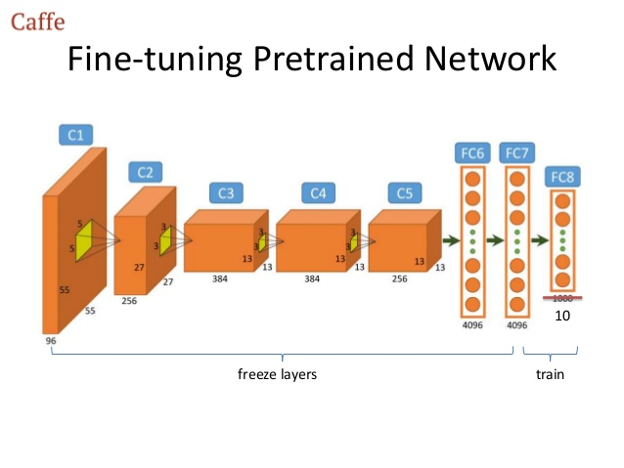
Approach Overview
Used a frozen (layers frozen) pre-trained BERT model as the encoder
Added custom classification layers on top for fine-tuning on our fake news dataset
Simplified from early plan to generate explanations (deemed too complex) to classification
Leveraged BERT's native tokenization and embedding capabilities instead of implementing word2vec separately

Slide 6
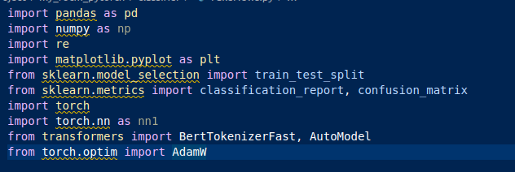
Tools & Techniques
Models
bert-base-uncased
Tools
Pandas
Numpy
Re
Matplotlib
Sklearn
Torch
Tranformers

Slide 7
Experiments & Analysis
I tried increasing the sequence length to around 1000 tokens to handle more article lengths but my GPU couldn't handle the workload and would terminate training
Also tried to increase the epoch size from 5 - 10 and achieved greater near perfect results for precision, recall, and F1 – Scores
Same thing could be said for increasing batch size and sequence size
Turns out the location and source of the news being included at the beginning of the article was a pattern picked up by the LLM.
Solution was to create a function to remove that specific data from the data set

Slide 8
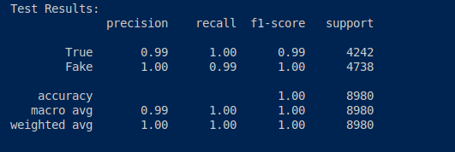
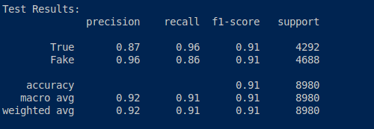
Results
Batch Size of 15, Length of sequence 20, Epoch size 10, and no clean text function (Location and New Source located on TrueNews.csv text)
Batch Size 15, Length of sequence 20, Epoch size 10, and clean text function (Location and New Source removed from article text data)

Slide 9
Challenges & Lessons Learned
The importance of understanding the data you're training off
There is more than just how the data is structured that needs to be understood
Lookout for unconventional patterns
Understanding the packages and libraries well enough to utilize was a challenge
Will dedicate more time in the future to understanding them better before implementing
Utilizing my GPU on my local machine
Had to download specialized AMD software and utilize custom Pytorch docker image dedicating a lot of time in the process
Sped up training time significantly as a result

Slide 10
Conclusion & Future Work
This project was a learning experience that I enjoyed.
It seems from the paper's I've read and the classifier I built that LLMs could be a useful tool for identifying fake news. There should be some skepticism however as no LLM is perfect at classifying fake news.
Would be interested in utilizing a model to provide unstructured/generative output explaining why news is or is not valid. Others have tried as seen in the paper Generative Large Language Models in Automated Fact-Checking: A Survey (Vykopal et al., 2024)
Have more compute power (relatively speaking) than ever at my disposal now to try and attempt

