Slide 1
Psyche
A dependency-free memory-and-activation substrate, and a software-testing-methodology case study
Cagan Caliskan
An engineering prototype. Not a mind, a consciousness, an AGI, or a validated cognitive model.
Notes:
One honest sentence: Psyche is a small, dependency-free Python prototype of a graph memory and spreading-activation substrate, and equally a case study in how adversarial, property-based testing caught a sequence of real structural bugs. The talk is methodology-first. Everything cognitive on top of the substrate is exploratory and is labeled as such. Nothing here claims a mind, consciousness, AGI, or a validated cognitive model.

Slide 2
What this is, and what it is not
• IS: a small Python prototype of a graph memory and spreading-activation substrate, built test-first
• IS: a case study in adversarial, property-based testing and loop-closure
• IS NOT: a mind, a consciousness, or an AGI
• IS NOT: a validated cognitive model; cognitive meaningfulness above the substrate is not claimed
• Neuroscience here is conceptual inspiration only, never implemented or reproduced
Binding non-claims for the rest of the talk.
Notes:
These non-claims bind everything that follows. The proven part is mechanism: the substrate does exactly and only what it says, reproducibly. The exploratory part runs and is deterministic, but whether its output is cognitively meaningful is an open question, not a result. The neuroscience vocabulary (complementary learning systems, synaptic tagging, global workspace, LIDA) is framing inspiration; no biological result is implemented, reproduced, or validated.

Slide 3
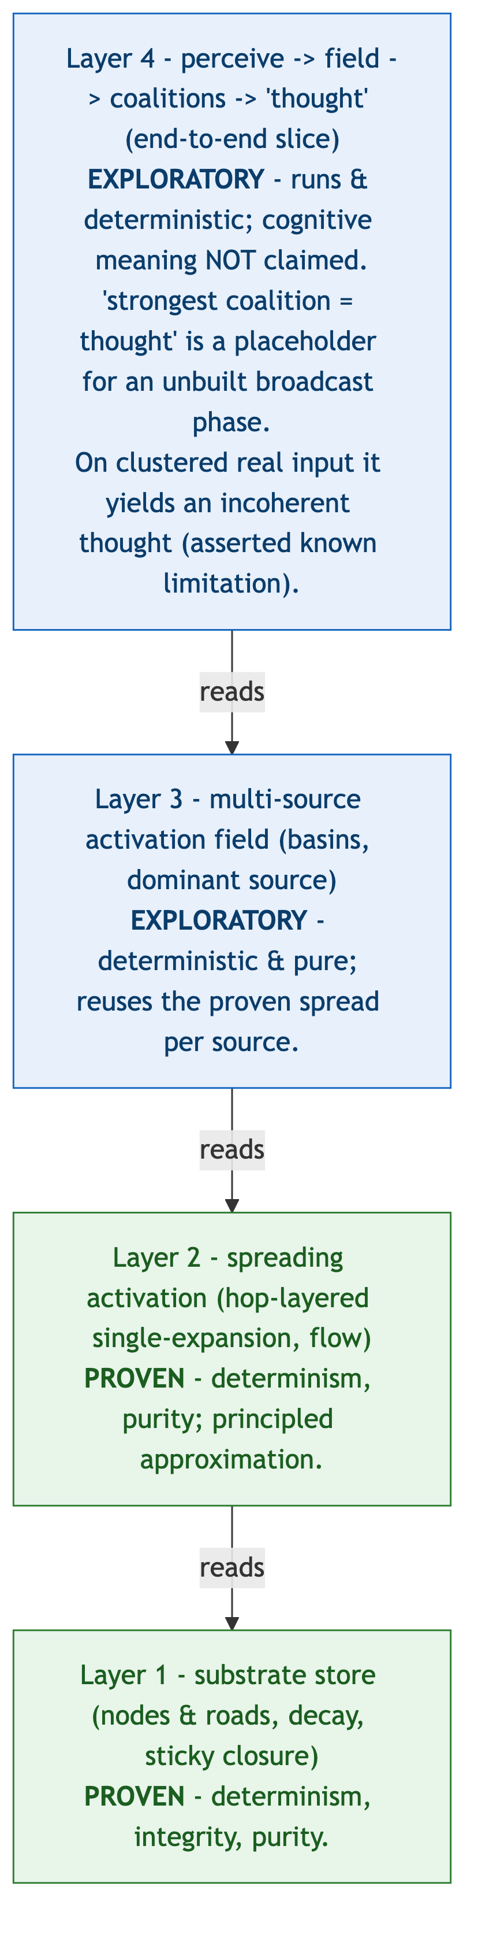
Four layers: two proven, two exploratory
Two rigorously tested substrate layers, with two exploratory cognitive layers built on top.
Figure: architecture_stack.png
Notes:
Bottom up: (1) Substrate store, a graph of concept nodes and weighted roads with consolidation-inspired dynamics, lazy decay, and sticky closure. (2) Spreading activation, a deterministic engine recording per-edge flow, treating closed roads as leaky rather than inert. Layers 1 and 2 are PROVEN for determinism, integrity, and purity. (3) Multi-source field, assigning each node to its dominant source. (4) The perceive-then-think slice. Layers 3 and 4 are EXPLORATORY: they run and are deterministic, but their cognitive meaningfulness is not claimed.

Slide 4
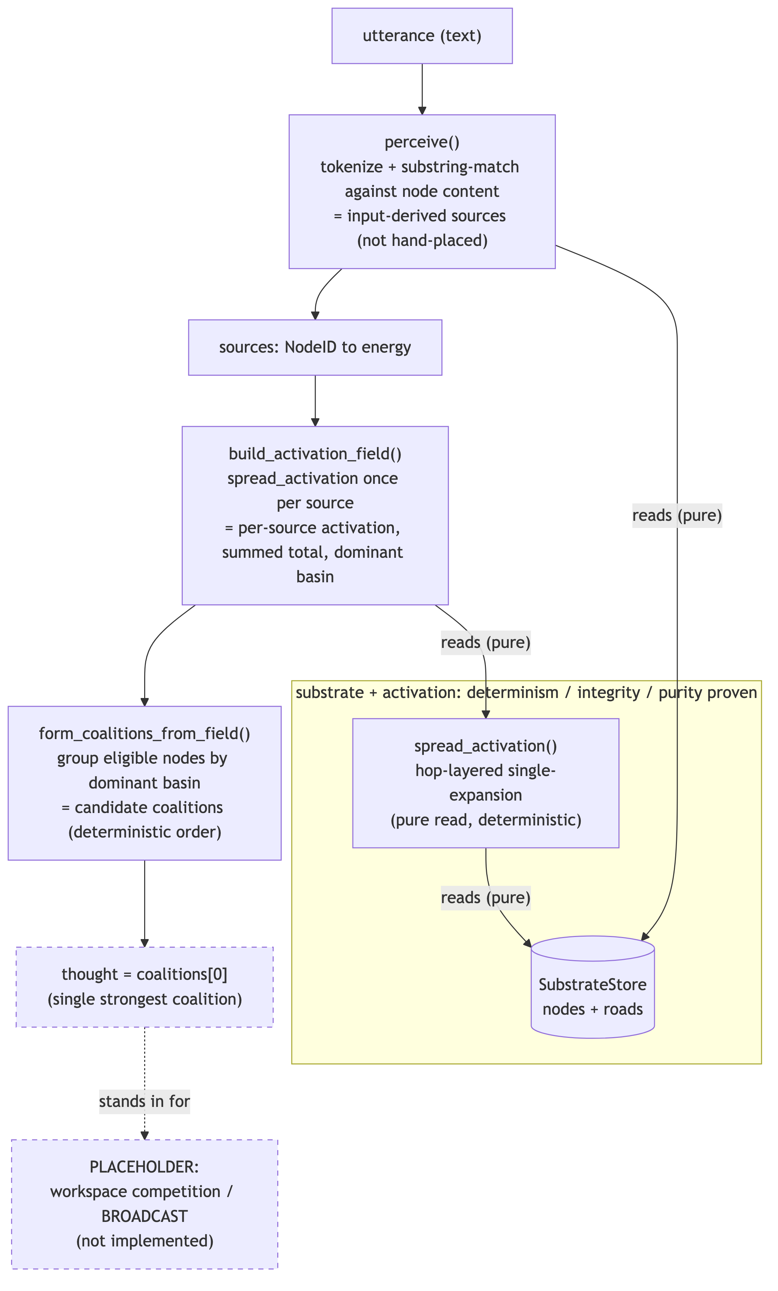
The end-to-end slice
perceive -> activate -> field -> coalitions -> one selected 'thought' (last step is a placeholder).
Figure: pipeline.png
Notes:
Input text is matched to nodes (exact/substring tokens, no embeddings), producing activation sources. The field runs the proven single-source spread once per source and assembles basins. Coalitions group co-activated nodes. The final step picks the single strongest coalition and calls it the 'thought'. That selection is an explicit PLACEHOLDER for a workspace-competition (broadcast) phase that does not yet exist. The pipeline is deterministic end-to-end; that is a mechanism property, not evidence of meaning.

Slide 5
The thesis: adversarial and property-based testing, plus loop-closure
• Build each layer test-first; write adversarial tests designed to break the claim, not confirm it
• Property-based checks: determinism across process hash seeds, read-purity, full-graph integrity
• Close the loop: feed each layer system-generated inputs instead of hand-chosen ones
• A 'structural bug' lives in the design's logic, not in a typo: it passes the happy path and fails adversarially
What 'structural bug' means.
Notes:
Happy-path tests confirm what you already believe. Adversarial tests are written to falsify the claim: re-run the same construction in fresh interpreters under different PYTHONHASHSEED values and demand byte-identical output; assert that reads never mutate state; scan the whole graph for index/adjacency drift after every mutation. Loop-closure means stop hand-feeding friendly inputs and let an earlier stage generate them. A structural bug is one in the logic of the design: it survives friendly inputs and only shows up under these pressures.

Slide 6
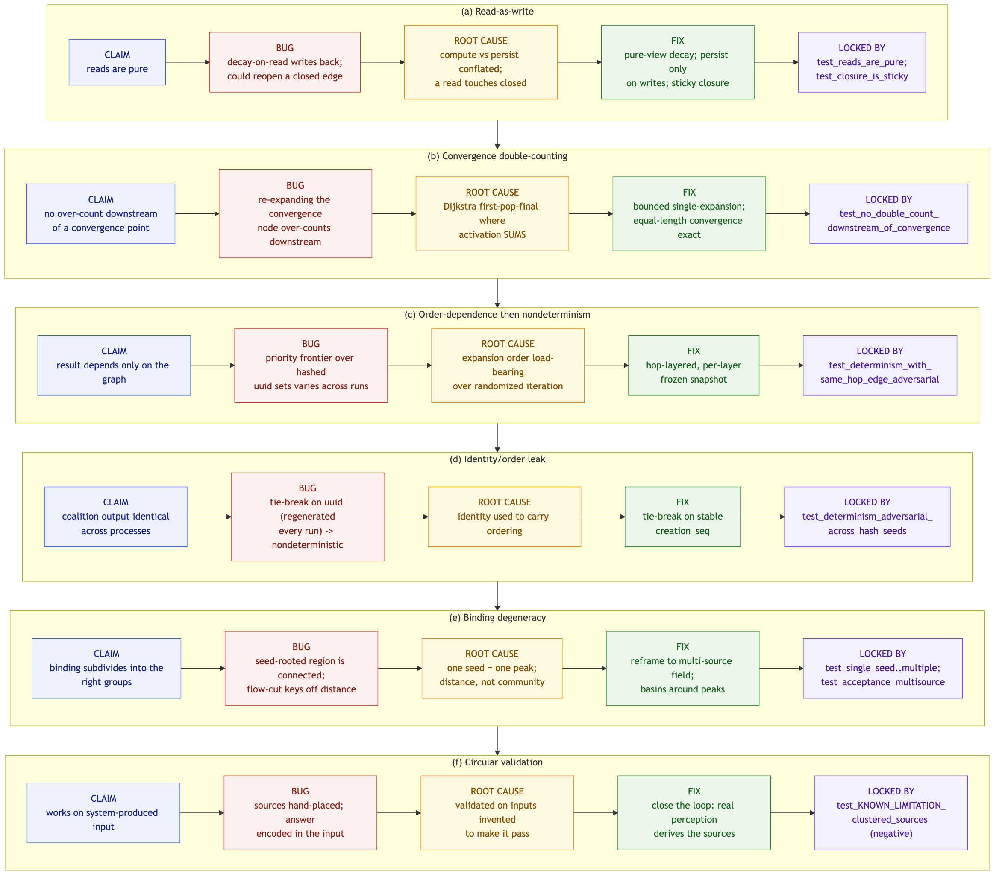
Six structural findings
One failure mode recurred: 'passes on a friendly input.' Each bug was caught adversarially or by loop-closure.
Figure: six_findings.png
Notes:
(a) Read-as-write: a lazy decay path that mutated on read. (b) Convergence double-counting: Dijkstra's 'first pop is final' imported into an engine that SUMS flow. (c) Order-dependence and nondeterminism: a priority frontier over hash-randomized sets. (d) Identity/order leak: uuid4 tie-breaks regenerated per process. (e) Binding degeneracy: connected-components always yields exactly one coalition. (f) Circular validation: sources hand-placed one per community, so the test could not fail. The common thread is the 'friendly input' failure mode.

Slide 7
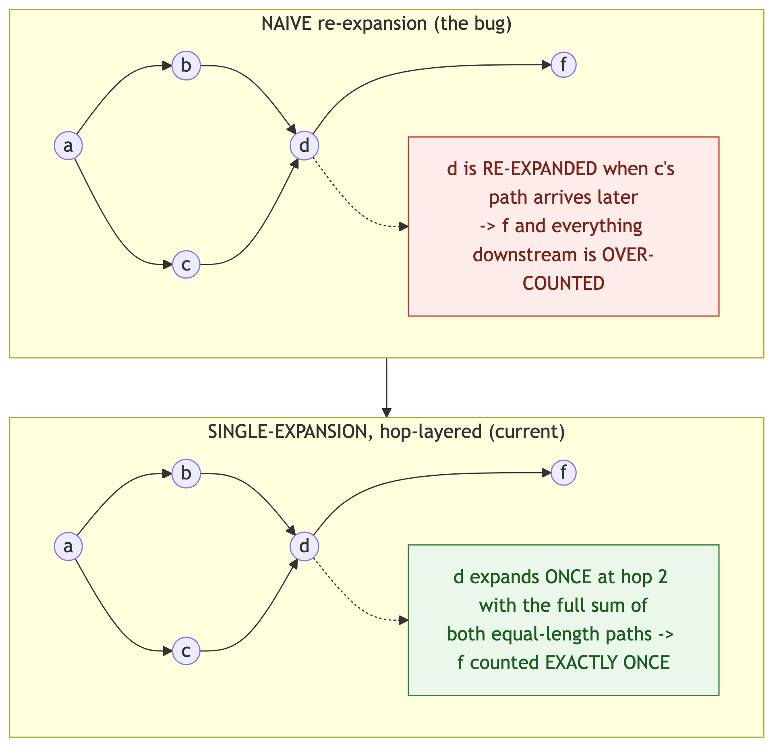
Deep example: convergence double-counting
Dijkstra's 'first pop is final' is wrong for an engine that SUMS flow at convergence points.
Figure: convergence_before_after.png
Notes:
Shortest-path intuition says the first time you pop a node you are done. But spreading activation adds contributions from every incoming path, so reusing that intuition counts converging flow more than once. The fix is a bounded, hop-layered single-expansion with per-layer frozen values, which is both correct and deterministic. This is a mechanism correction, asserted by a no-double-count test.

Slide 8
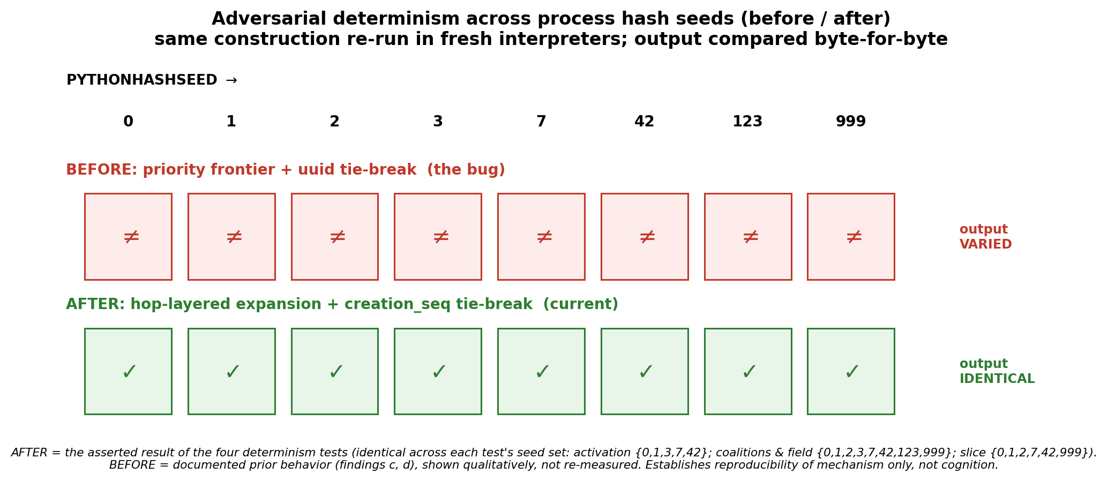
Deep example: determinism across process hash seeds
Same construction, fresh interpreters, several hash seeds: byte-identical output. Mechanism, not cognition.
Figure: determinism_seeds.png
Notes:
Natural implementations leak set-iteration order over uuid4 keys into results, so output varies across process runs. Four determinism tests re-run the same construction in fresh interpreters under several PYTHONHASHSEED values and assert byte-identical output (activation {0,1,3,7,42}; coalitions and field {0,1,2,3,7,42,123,999}; slice {0,1,2,7,42,999}). The 'before' row is the documented prior behavior shown qualitatively, not re-measured. This establishes reproducibility of MECHANISM only. It says nothing about cognition.

Slide 9
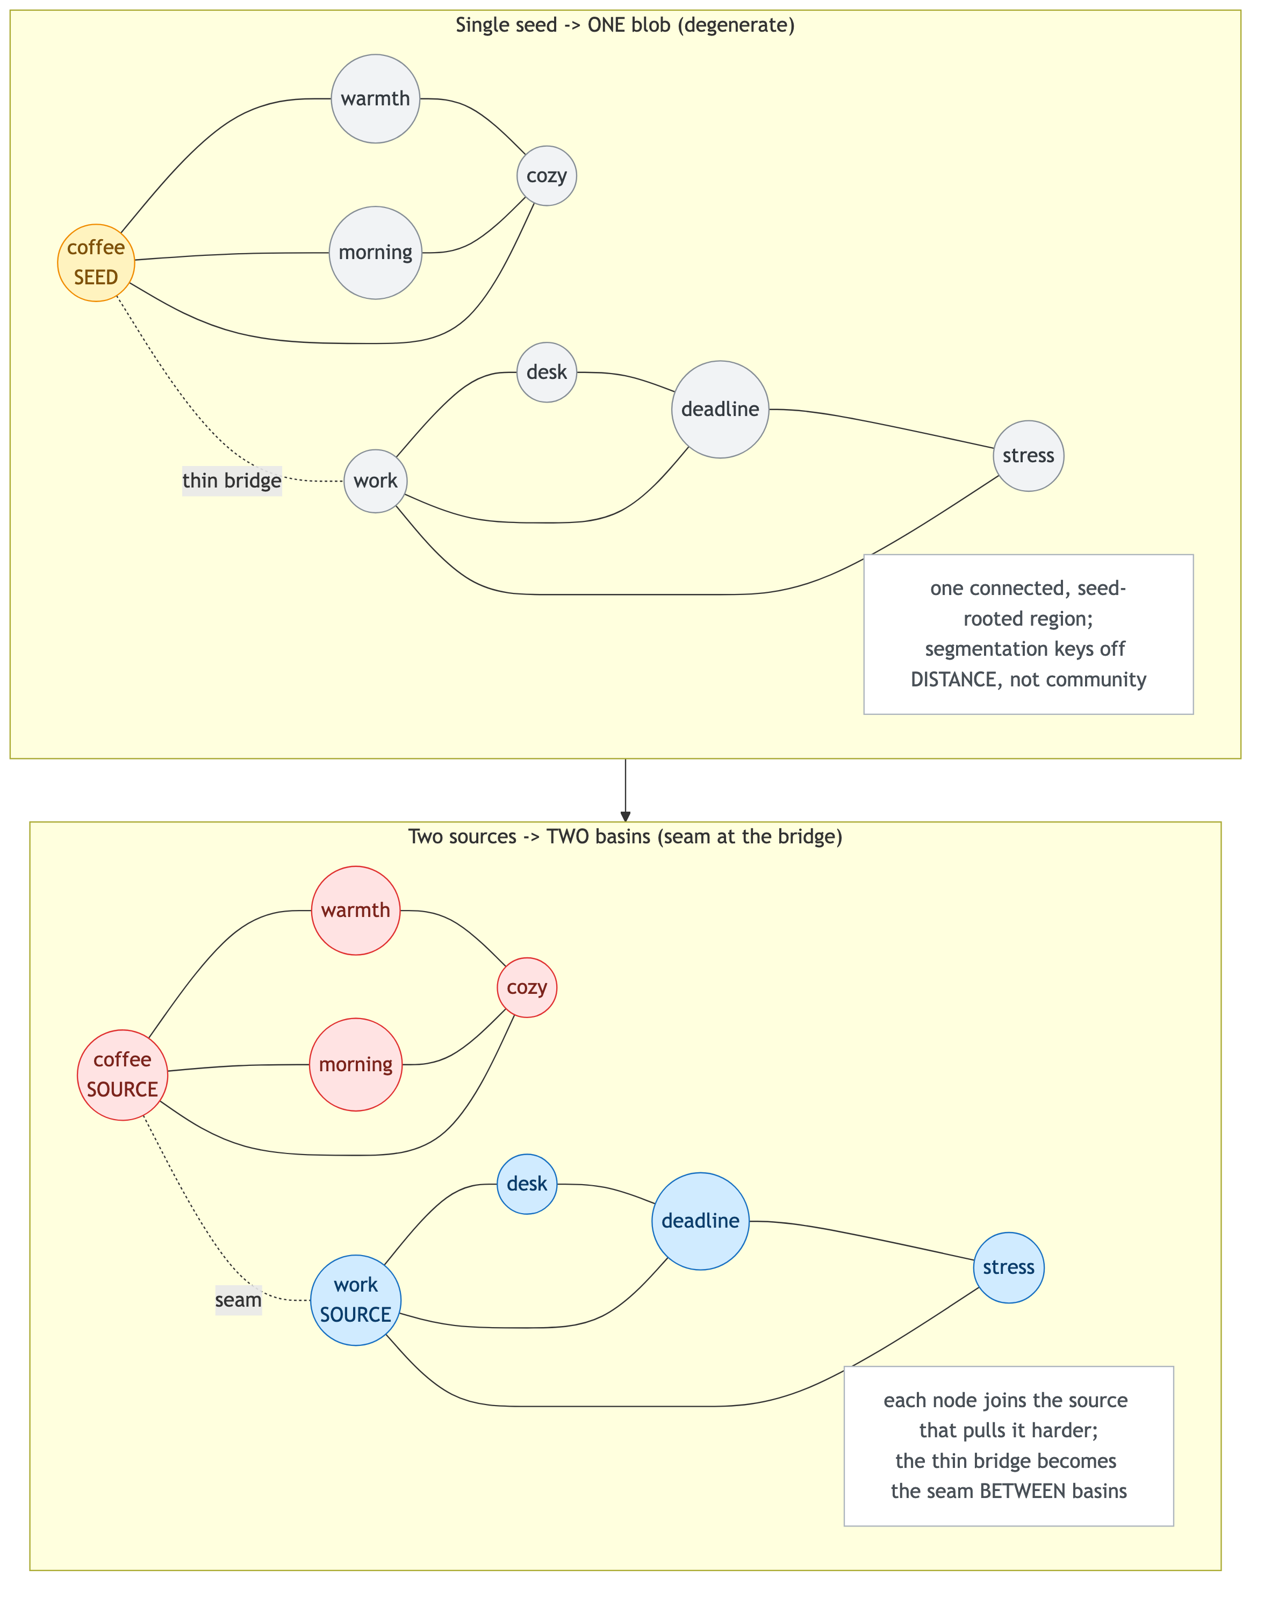
The reframe: single-seed degeneracy to multi-source
One seed always collapses to one blob; multiple sources give structure. Caveat: here the sources were hand-placed (finding f).
Figure: single_seed_vs_multisource.png
Notes:
A single seed over connectivity (or flow-cut) is degenerate: it tends to return one undifferentiated group, anti-correlated with real community structure. Running activation from several sources and assigning each node to its dominant source recovers structure and is deterministic. Spoken caveat: in this figure the sources are still hand-placed, one per community. That is exactly finding (f), the circular-validation trap, and it is what motivated closing the loop with real perception on the next slide.

Slide 10
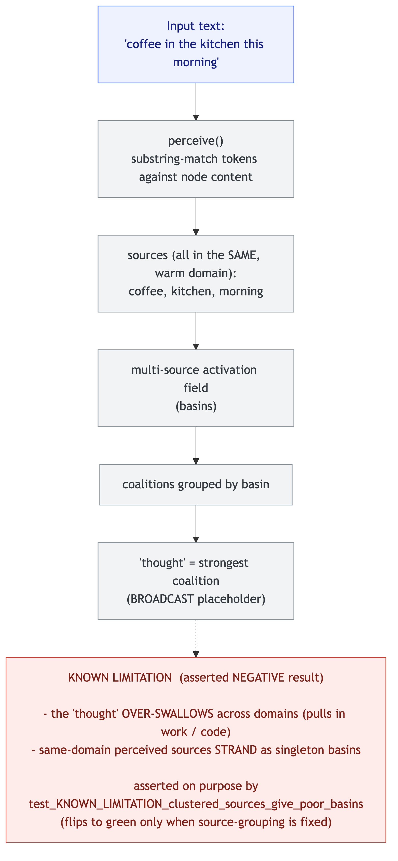
The honest negative result
Close the loop with real same-domain perception and the 'thought' is incoherent. Asserted as a known-limitation test.
Figure: closed_loop_known_limitation.png
Notes:
When real perception lights up several nodes in the SAME domain, the field's basins collapse: one source over-swallows across domains while same-domain siblings strand as singletons, so the selected 'thought' is incoherent. This is not hidden. It is asserted as test_KNOWN_LIMITATION_clustered_sources_give_poor_basins, which is currently red-by-design and flips to green only if the underlying problem is solved. A negative result, documented as one.

Slide 11
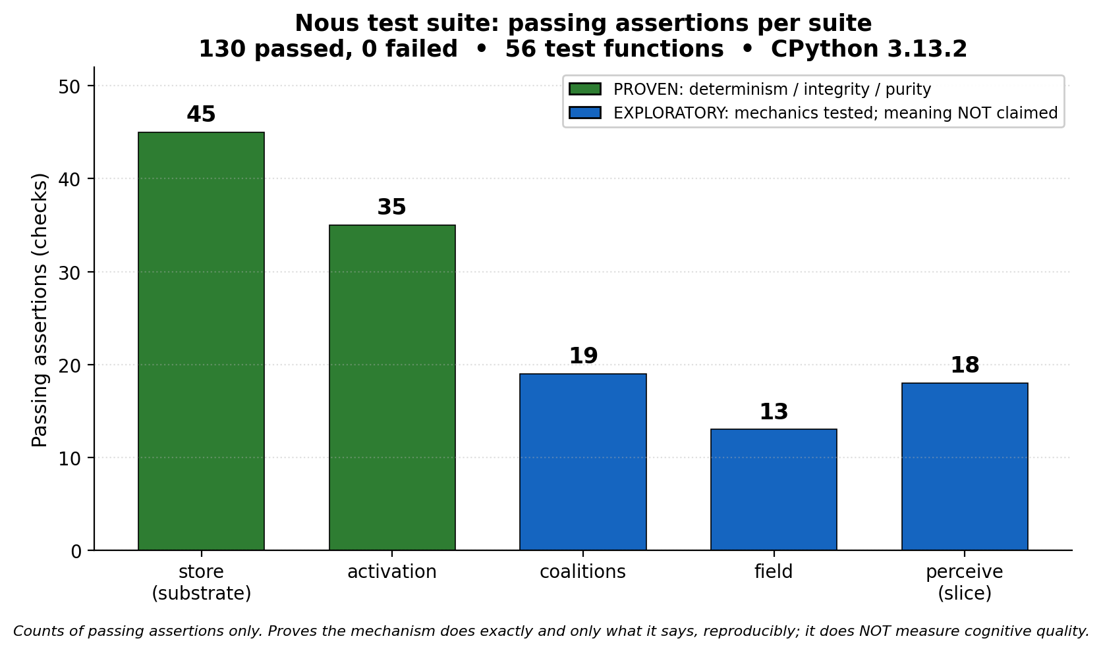
Proven vs. not: the test suite
130 assertions across 56 functions, all passing (45, 35, 19, 13, 18). Green = proven mechanism.
Figure: test_suite_bars.png - numbers verbatim from docs/TEST_OUTPUT.txt
Notes:
Per suite: substrate store 45, spreading activation 35, coalition formation 19, multi-source field 13, perception + slice 18. Total 130 passed, 0 failed, across 56 test functions, including the adversarial cross-process determinism checks and the one asserted known-limitation. 'Passing' means the mechanism is correct and deterministic, not that the cognitive layer is meaningful. Green marks the proven substrate; the rest is exploratory mechanics that merely runs reproducibly.

Slide 12
Future work, and the ethos
• Validate against a measurable effect with a known direction: semantic priming [10, 11]
• Fix source-grouping so same-domain perception does not collapse basins
• Build the broadcast/competition phase that 'strongest coalition = thought' currently stands in for
“This part is proven; that part is not, and here is the failing test that says so.”
Conclusion.
Notes:
The honest next step is to stop validating the cognitive layer against hand-built inputs and instead test it against a measurable cognitive effect whose direction is known independently of Psyche, for example semantic priming [10, 11]: does pre-activating a related concept measurably raise a target's activation? Then fix the source-grouping that collapses same-domain basins, and build the broadcast phase that the 'thought' selection currently stands in for. The ethos is the whole point: claim only what a test proves, and keep the failing test visible.

