Slide 1

(Unsupervised) Anomaly Detection
Uzay Çetin

Slide 2
Anomaly
Automated Surveillance
Unusual, infrequent and suspicious data points that are significantly different from others.
Healthcare
Smart Home Safety
Fraud Detection
And many other domains..

Slide 3
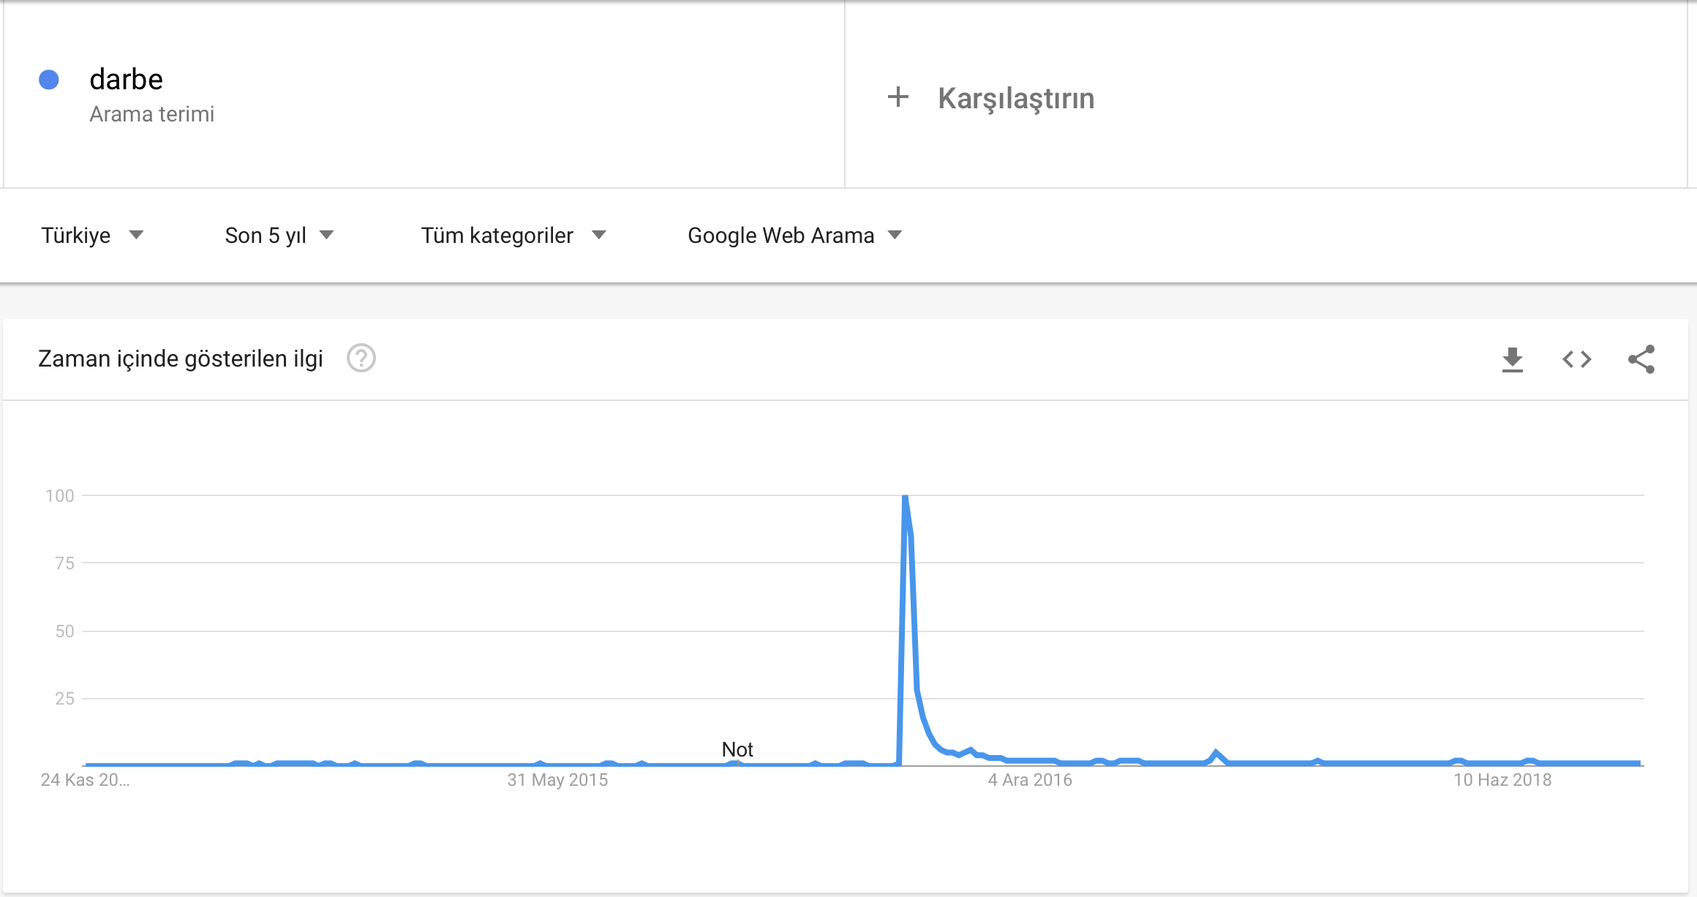
July 15 coup attempt
Google Trends: link

Slide 4
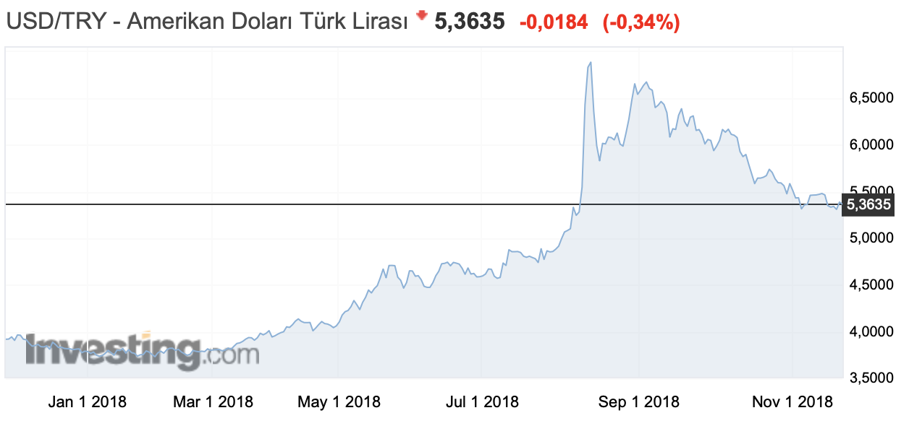
USD/TRY
Investing link

Slide 5
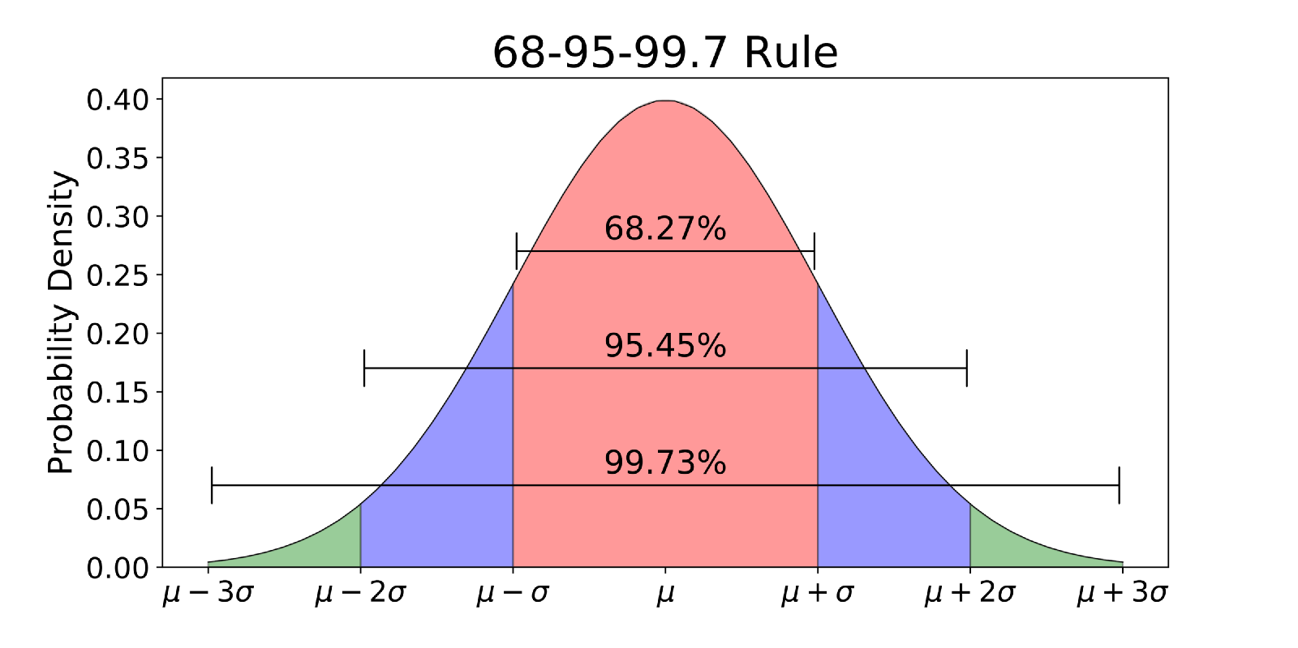
Method 1
Statistical Anomaly Detection

Slide 6
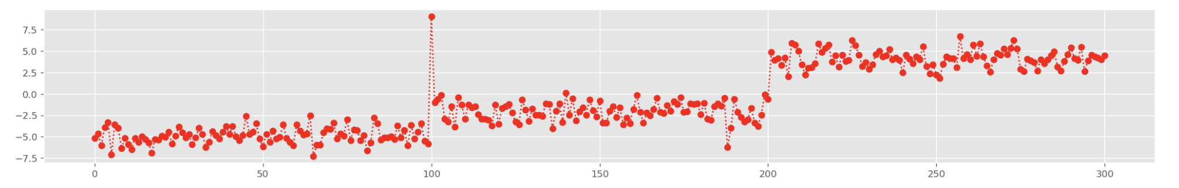
Toy Data
Contextual Anomaly

Slide 7
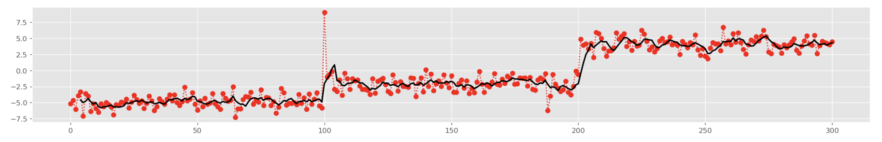
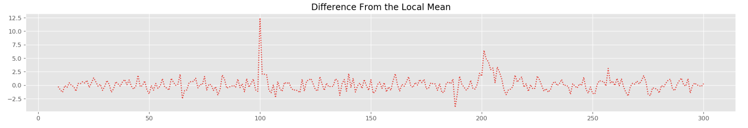
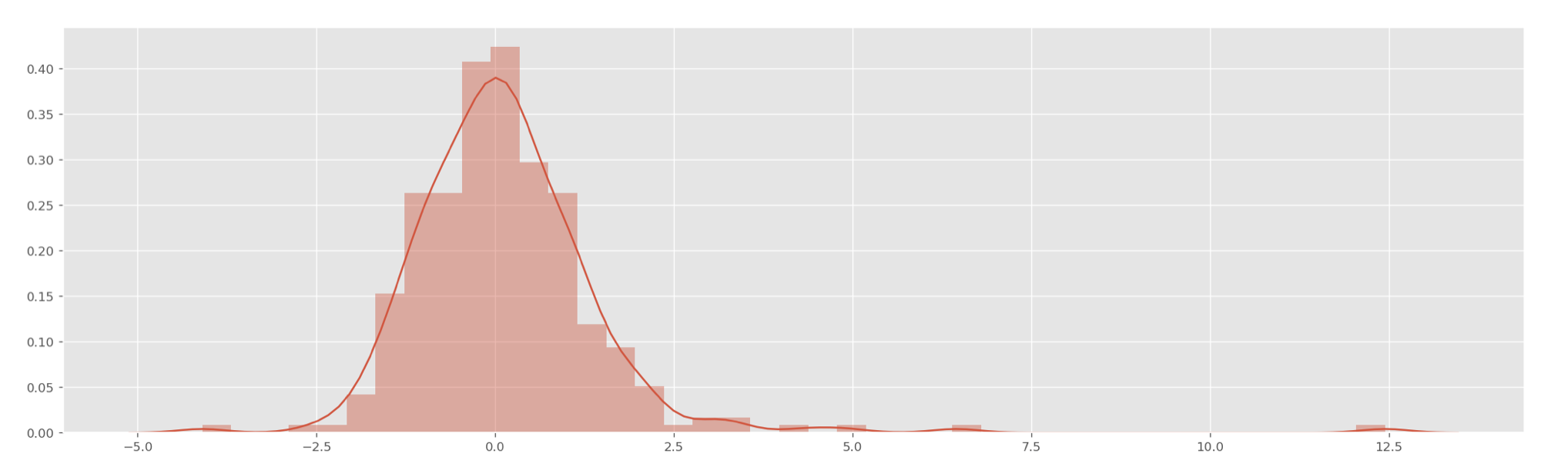
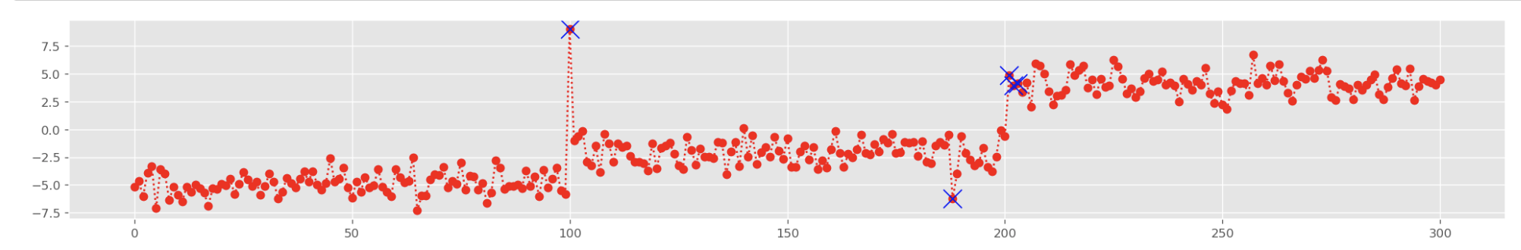
1 - Moving average
2- Difference from the moving average
3 - Distribution of de-mean
Result: Captured Contextual Anomaly

Slide 8
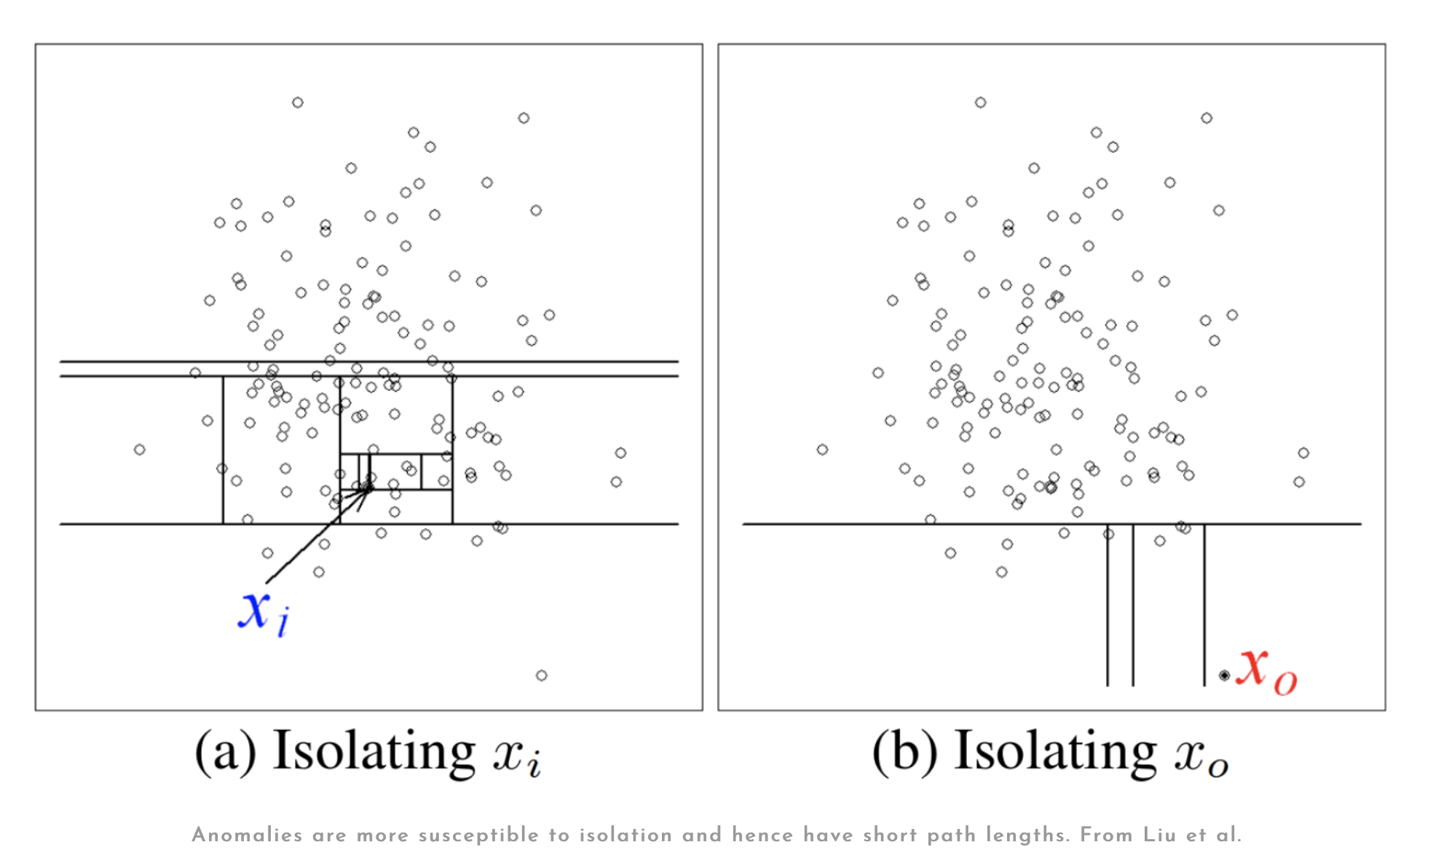
Method 2
Isolation Forest Algorithm

Slide 9
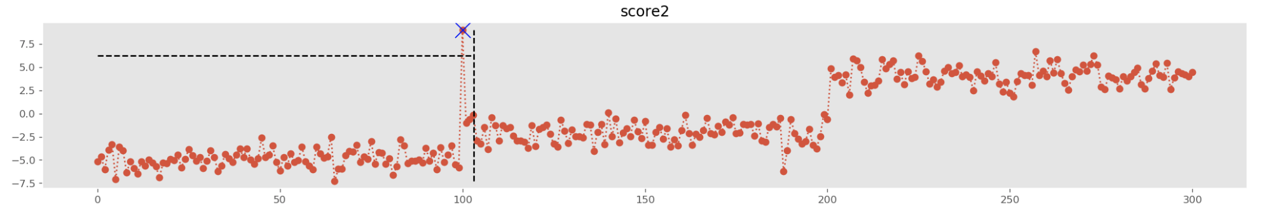
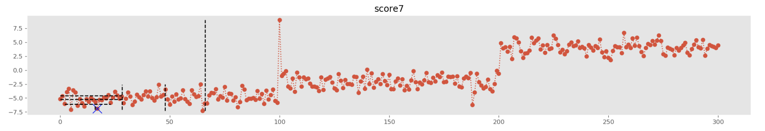
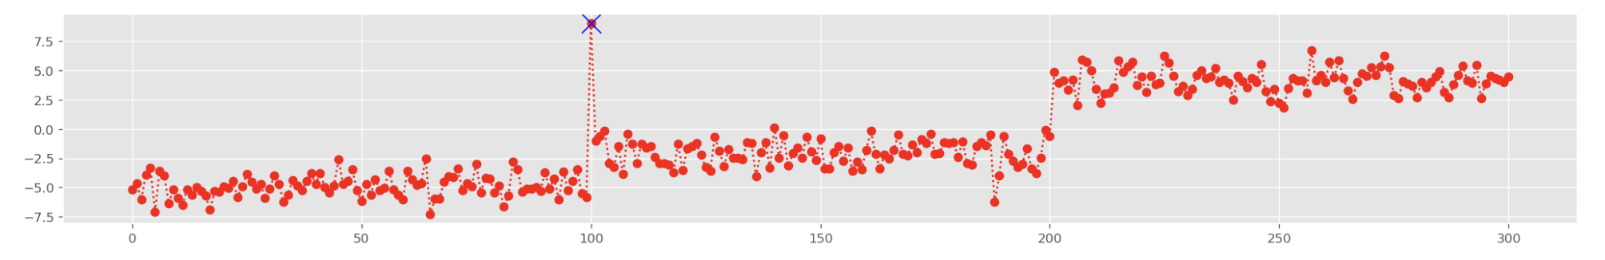
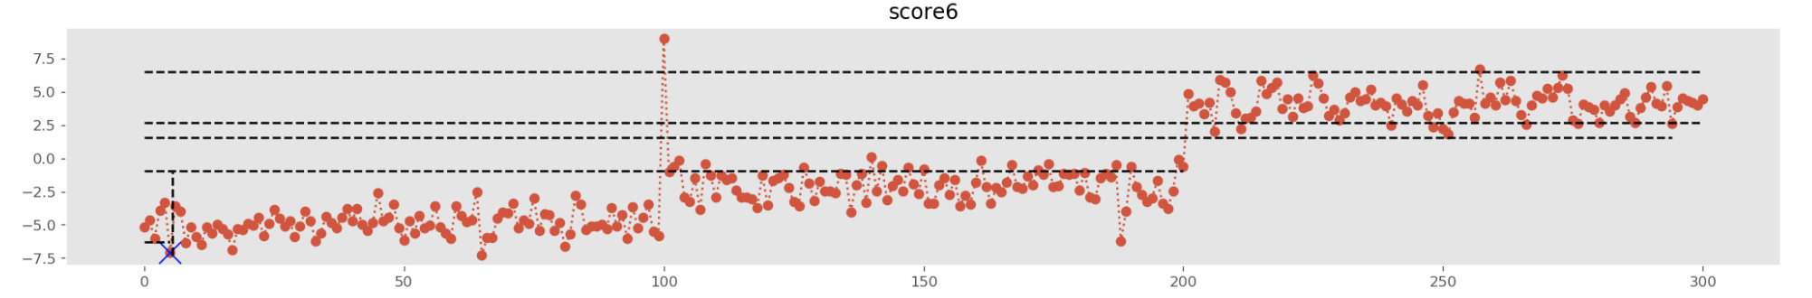
2 random splits
Since anomalies are significantly different from others, short number of splits is enough to isolate them.
7 random splits
6 random splits

Slide 10
Thank you
uzay00@gmail.com

