Slide 1
Social Media Analysis of Turkish Politicians
Fikret Efe Doğanay - Istanbul Bilgi University, Computer Engineering
Ali Çağan Keskin - Istanbul Bilgi University, Computer Engineering
Supervised by Uzay Çetin Ph.D.

Slide 2
Project Aim
Analysing Turkish politicians, based on their tweets.
Building a website to extend our analyses for other Twitter users.

Slide 3
Related Works - Our Difference
Twitter API and Tweepy Library.
Social Network Analysis with Similarity Graph

Slide 4



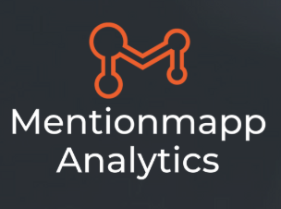
Related Works
Insight for one profile only.
Only sentiment analysis for one profile.
Only sentiment analysis for one profile.
Not using NLP techniques.

Slide 5

Methods – Data Handling
Data Retrieval
Twitter API
Data Cleaning
Filtering
Tokenization
Stemming
Stop-word Removal

Slide 6
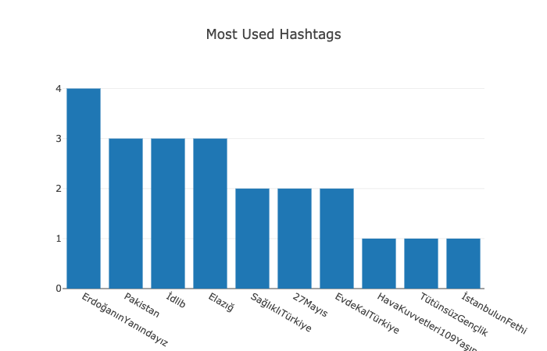
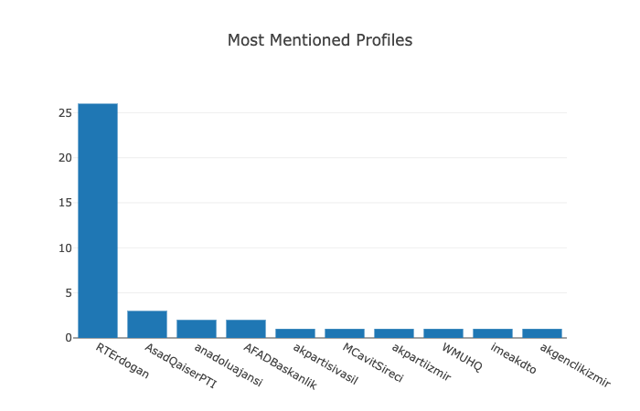
Methods – Statistical Insights
Most used hashtags and most mentioned profiles in Binali Yildirim’s Tweets :

Slide 7
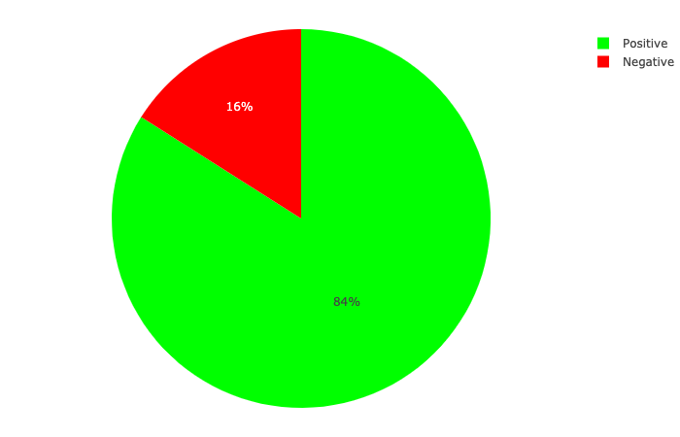
Methods – Sentiment Analysis
Machine Learning Techniques.
Sentiment analysis of Ekrem Imamoglu’s tweets :

Slide 8
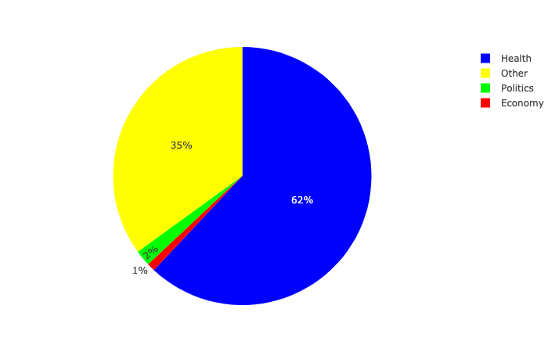
Methods – Tweet Categorization
Machine Learning Techniques.
Categorization of Dr. Fahrettin Koca’s tweets :

Slide 9
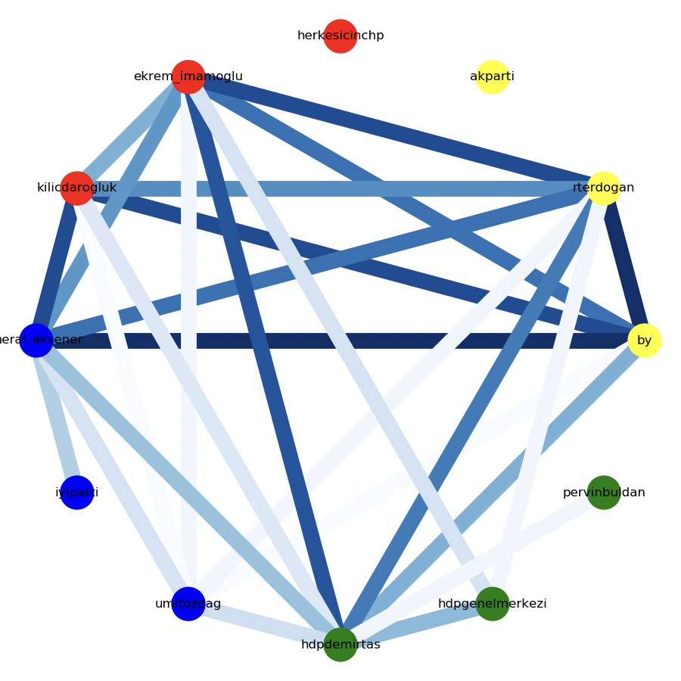
Methods – Similarity Network
Cosine Similarities
Darker and Lighter

Slide 10
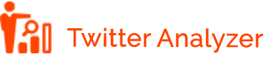
Website
We built a website to include analyses.
Frontend: HTML, CSS, Bootstrap, jQuery, JavaScript
Backend: Flask, Dash, Tweepy
ML & NLP: Python, Sklearn, NumPy, Pandas, etc.,
Networking: NetworkX, Matplotlib, Plotly

Slide 11
Demo…

Slide 12
Thanks For Listening…
Any Questions?

