Slide 1

32392-Çağatay Eroğlu
"The Impact of Academic Intensity and Campus Mobility on Physical Activity "

Slide 2

Data

Slide 3
EXPECTED RESULTS - HYPOTHESIS
Academic Terms: Step counts will be higher due to campus mobility. Summer and Midterm Breaks: Step counts will decrease compared to academic terms. Internship Periods(Outlier): Step counts may increase during internships, differing from holiday trends. Weekdays vs Weekends: Step counts will be higher on weekdays than weekends during academic terms.

Slide 4
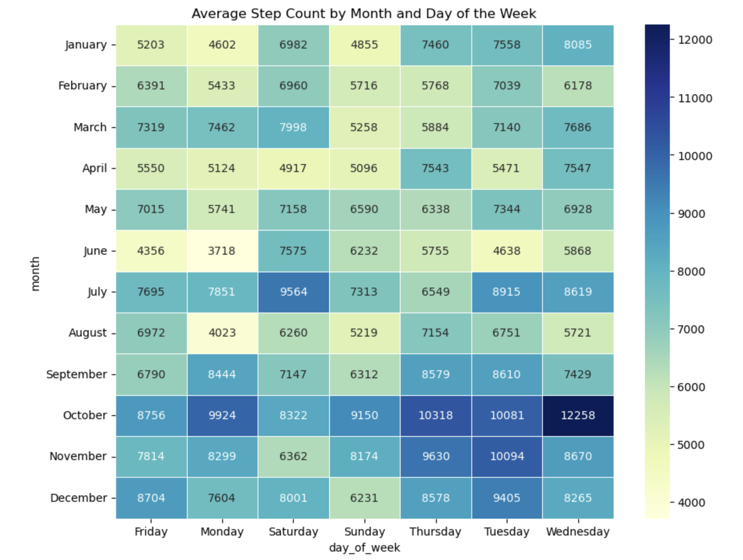
At first, I used heat map to show the total average step count month by month and day by day, which showed most of the steps comes during academic term. But there was an increase in the number of steps during the summer holidays, which is strange. But the source of this situation comes from the internship period, which we can call outlier.

Slide 5
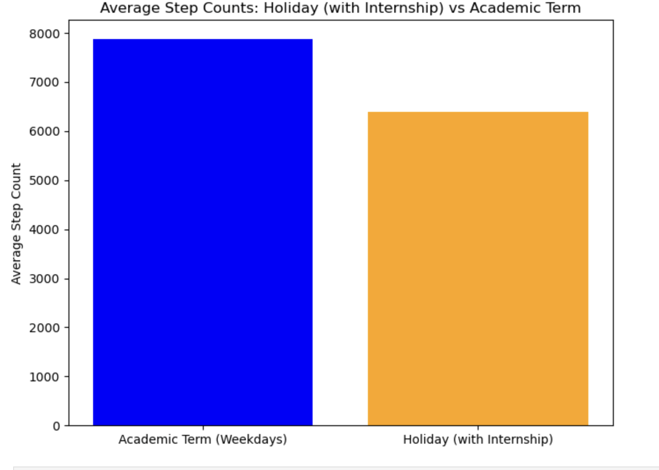
Then I checked the average step count during academic term (without weekend data) with the holiday data. My hypothesis was becoming true according to these bar charts.

Slide 6
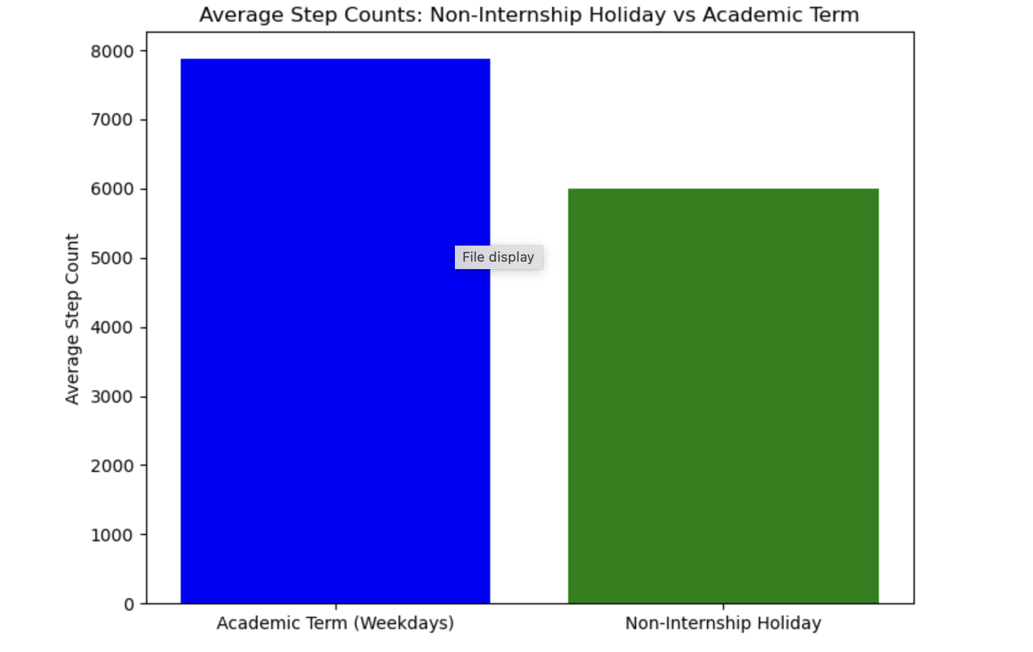
After that I continued with my other bar chart. This one excluded the internship data which was an outlier to my hypothesis. This chart proved the hypothesis even more due to decrease in step count during holiday.

Slide 7
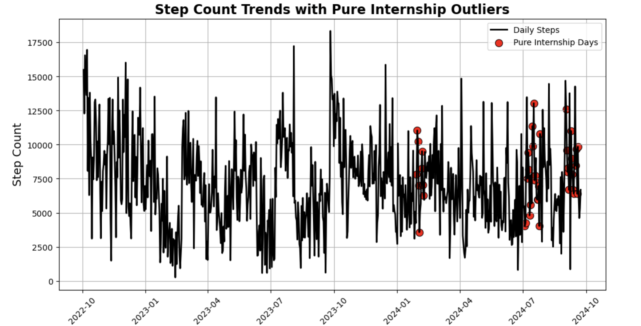
Also, the reason behind that the internships became an outlier can be observed very well.

Slide 8
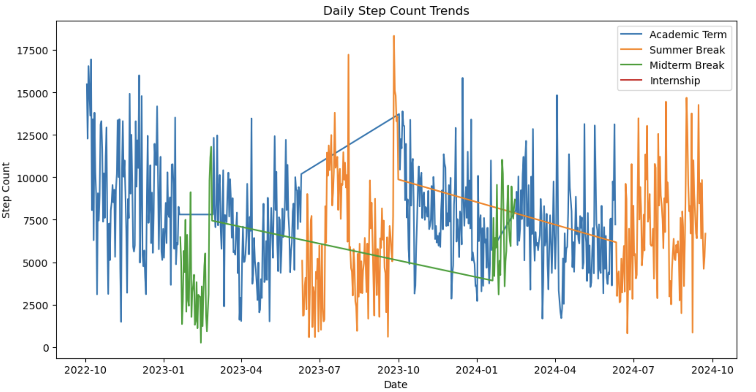
Here the trends can be seen..

Slide 9
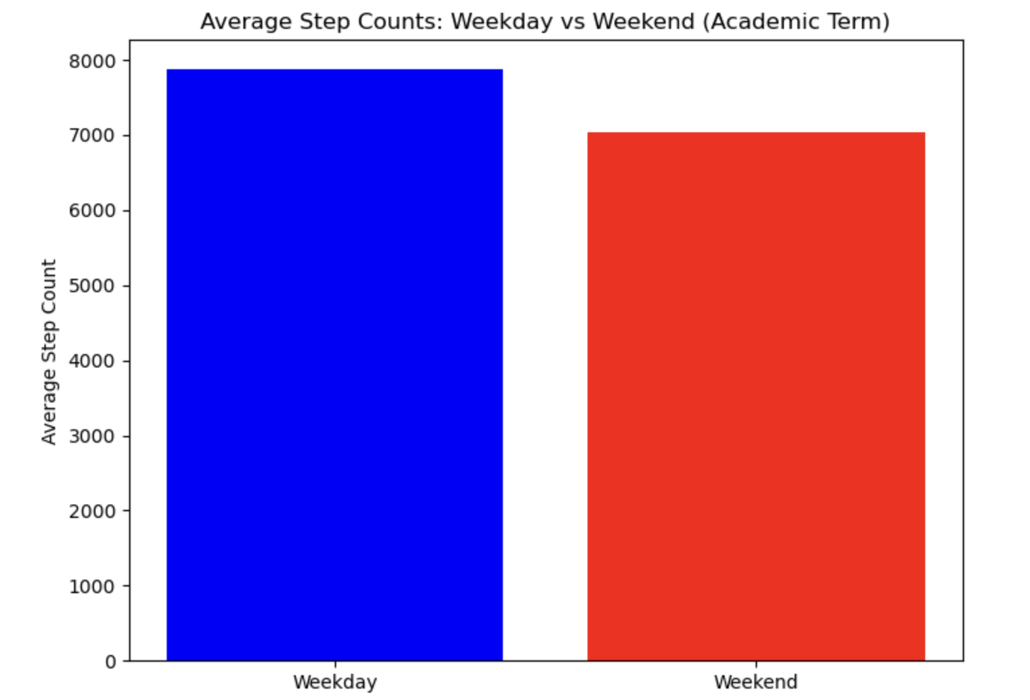
Then for last, I showed the reason that I excluded the weekend data sometimes. It can affect the academic term data due to decrease in step count because of lack of lessons during weekends.

Slide 10
And here is the results:
Steps count will increase during academic term due to campus mobility.
During summer and midterm breaks, step count will be lower compared the academic terms.
While doing internships, step count will increase due to increase in mobility and it this will become an outlier for step count during holidays.
Extra: Step counts were higher during weekdays compared to weekends during academic term (Can be seen in heat map).

Slide 11
Improvements
In the future, with more students and with more data, The results may become more accurate.
Sleep data could be added to the project to see the effects of campus on sleep time.

Slide 12

Thanks for coming this far and checking my analysis.

