Slide 1
Introduction to PsychoPy
Part 0: Introduction
Short URL to GitHub repo:
https://tinyurl.com/ycxj4vdt

Slide 2
Today’s agenda
Conda & PsychoPy installation
Clean installation, even if you have a running instance of Python & PsychoPy
Introduction to Python
Fundamental concepts (data types, containers, loops, conditionals etc.)
Visualisation, data tables, statistics?
With Google Colab examples
Introduction to PsychoPy
Overview, stimuli presentation and data collection
Creating a PsychoPy experiment
Examples with Builder and Scripting
Stroop and Image Tasks
Experiment packing
i.e. reproducibility and how do I carry my experiment around

Slide 3
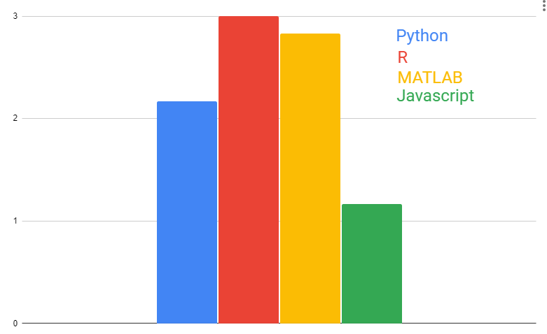
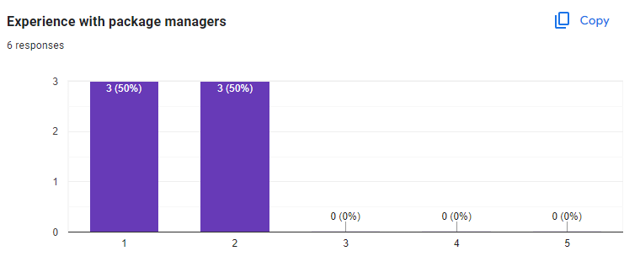
Results from the quick survey
Overall Coding/Scripting Experience
Experience with package managers

Slide 4
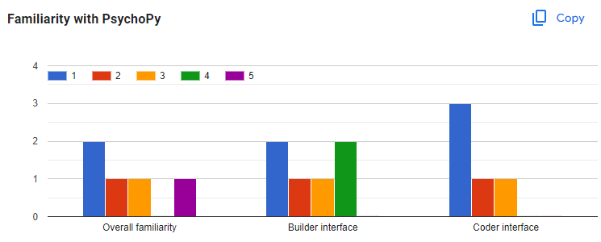
Results from the quick survey
Familiarity with PsychoPy

Slide 5
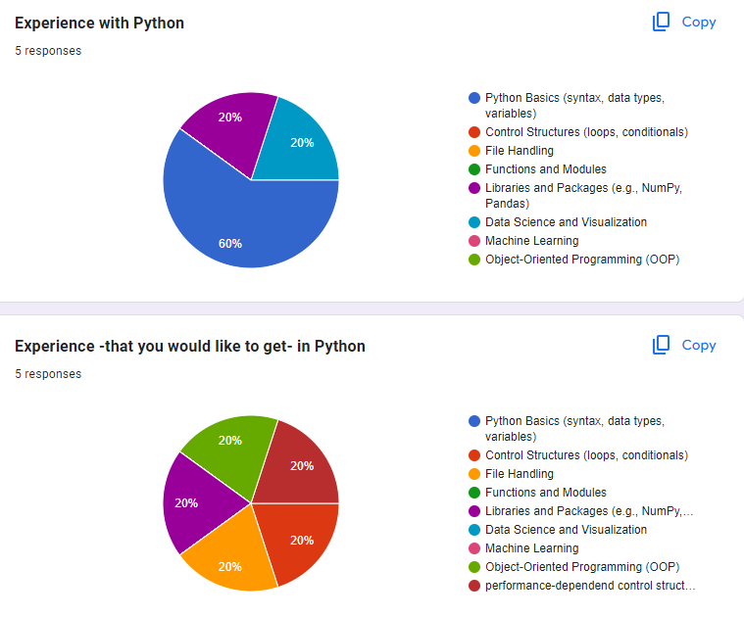
Results from the quick survey
Experience with Python
You have / would like to have

Slide 6
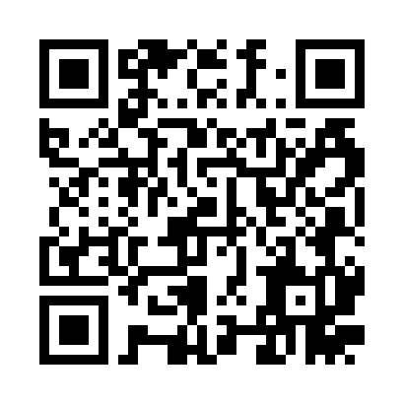
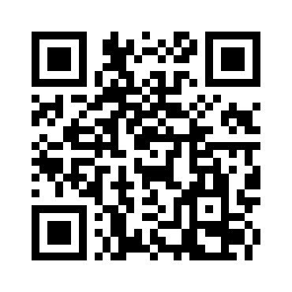
How to reach me / the GitHub repo
GitHub repo:
https://github.com/caggursoy/PsychoPy-Intro-Course
Me:
Email:
cagatay.guersoy@zi-mannheim.de
GitHub:
@caggursoy

