Slide 1
Introduction to PsychoPy
Part 2: Introduction to PsychoPy

Slide 2
Introduction
PsychoPy: An open-source application for creating experiments in behavioral sciences.
Goals:
Understand PsychoPy's capabilities
Learn how to install and set up PsychoPy
Get an overview of the interface
Explore experimental design principles (optional)
Learn about stimulus presentation
Understand data collection methods

Slide 3
Overview of PsychoPy and its Capabilities
What is PsychoPy?
An open-source software for running experiments in psychology, neuroscience, and psychophysics.
Capabilities:
Visual and auditory stimuli presentation
Response collection
Precise timing control
Integration with hardware (e.g., EEG, eye trackers)

Slide 4
Installation and Setup
Move on to the following link to the walkthrough:
https://github.com/caggursoy/PsychoPy-Intro-Course/tree/main/conda

Slide 5
Interface Overview
Main Components
Builder View:
Graphical interface for designing experiments without coding.
Coder View:
Text editor for writing custom scripts in Python.
Runner View:
Interface for running and debugging experiments.
Key Features
Timeline: Visual representation of the experiment flow.
Components: Building blocks of an experiment (e.g., stimuli, responses).
Properties: Settings and parameters for each component.

Slide 6
Stimuli Presentation

Slide 7
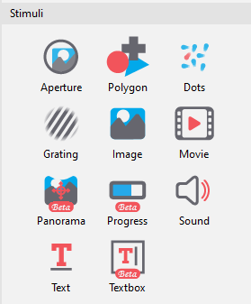
Creating and Presenting Stimuli
Types of Stimuli:
Text: Display instructions or information.
Images: Show pictures or graphics.
Sounds: Play audio files.
Videos: Present video clips.
Presentation Methods:
Sequential presentation.
Condition-based presentation.

Slide 8
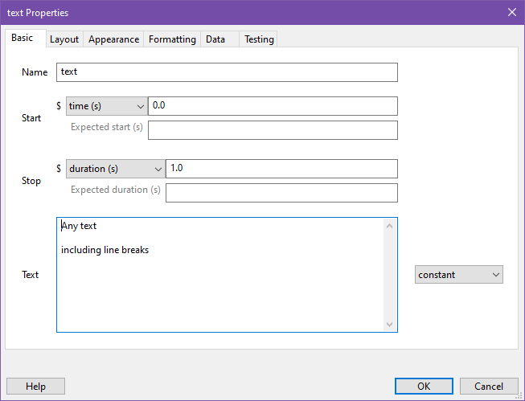
Creating Text Stimuli
Use the TextStim class.
Define parameters like text content, position, and color.
Example:
from psychopy import visual, core
win = visual.Window([800, 600])
text = visual.TextStim(win, text='Hello World', pos=(0, 0), color='white')
text.draw()
win.flip()
core.wait(2)

Slide 9
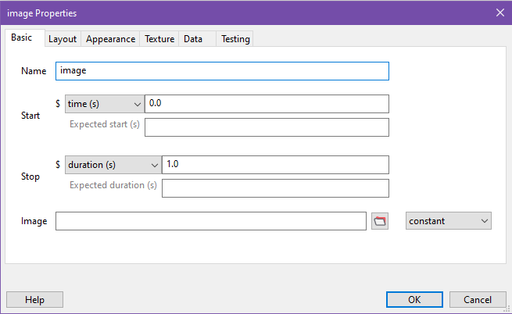
Creating Image Stimuli
Use the ImageStim class.
Define parameters like image file, position, and size.
Example:
from psychopy import visual, core
win = visual.Window([800, 600])
image = visual.ImageStim(win, image='example.jpg', pos=(0, 0), size=(1, 1))
image.draw()
win.flip()
core.wait(2)

Slide 10
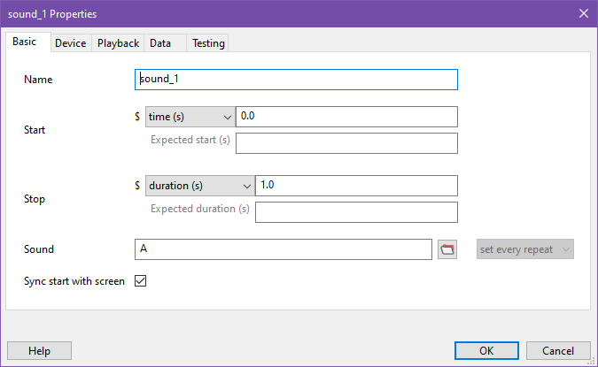
Creating Sound Stimuli
Use the Sound class.
Define parameters like sound file and volume.
Example:
from psychopy import sound, core
snd = sound.Sound('example.wav')
snd.play()
core.wait(snd.getDuration())

Slide 11
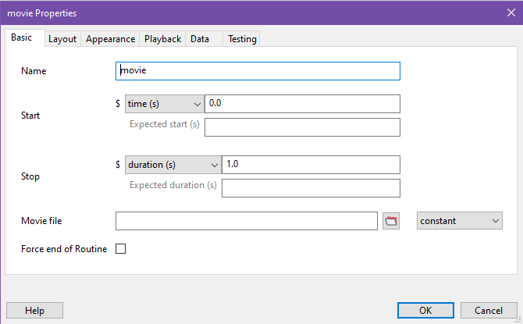
Creating Video Stimuli
Use the MovieStim3 class.
Define parameters like video file, position, and size.
Example:
from psychopy import visual, core
win = visual.Window([800, 600])
movie = visual.MovieStim3(win, 'example.mp4', pos=(0, 0), size=(1, 1))
while movie.status != visual.FINISHED:
movie.draw()
win.flip()
core.wait(2)

Slide 12
Timing Controls and Synchronization
Accurate timing is crucial for experiments.
Use core.Clock() to track time.
Synchronize stimuli presentation with experimental requirements.
Example:
from psychopy import visual, core
win = visual.Window([800, 600])
clock = core.Clock()
clock.reset()
while clock.getTime() < 2:
text = visual.TextStim(win, text=f'Time: {clock.getTime():.2f}')
text.draw()
win.flip()

Slide 13
Response Collection
Methods for collecting responses:
Keyboard responses using event.waitKeys().
Mouse responses using event.Mouse().
Other devices (e.g., response boxes).
Example for Keyboard:
from psychopy import event
keys = event.waitKeys(keyList=['space', 'escape'])
if 'space' in keys:
print('Space key pressed')
if 'escape' in keys:
core.quit()

Slide 14
Response Collection Example
Collecting mouse responses:
from psychopy import visual, event, core
win = visual.Window([800, 600])
mouse = event.Mouse(win=win)
while not mouse.getPressed()[0]:
text = visual.TextStim(win, text='Click the mouse button')
text.draw()
win.flip()
print('Mouse clicked at:', mouse.getPos())

Slide 15
Data Collection

Slide 16
Logging Data
Effective Data Logging:
Importance of organized and comprehensive data logging.
File Formats:
CSV, Excel, and text files.
Data Structure:
Structuring data for easy analysis.

Slide 17
Logging in CSV format
Use the data.ExperimentHandler class.
Define columns for your data.
Example:
from psychopy import data, core
exp = data.ExperimentHandler(dataFileName='experiment_data')
exp.addData('participant', '001')
exp.addData('trial', 1)
exp.addData('response', 'yes')
exp.nextEntry()
exp.saveAsWideText('experiment_data.csv')
core.quit()
Tip!
Change the exp.saveAsWideText('experiment_data.csv')
Line with exp.saveAsExcel(‘experiment_data.xlsx’)
And save the log file as an Excel file!

Slide 18
Synchronization with External Devices
Integrating External Hardware:
EEG, eye trackers, and other devices.
Why Synchronize:
Ensure accurate timing and data alignment.
Methods:
Use libraries and APIs for device communication.

Slide 19
Builder example
Move on to the following link to the walkthrough:
https://github.com/caggursoy/PsychoPy-Intro-Course/tree/main/scripting/stroop/builder_exp

Slide 20
Scripting example
Move on to the following link to the walkthrough:
https://github.com/caggursoy/PsychoPy-Intro-Course/tree/main/scripting/stroop/scripting

