Slide 1
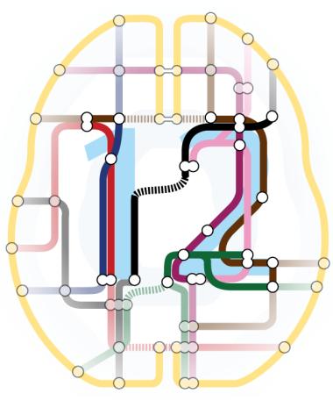
SPM in a nutshell
All the relevant information about SPM
in less than 15 slides

Slide 2
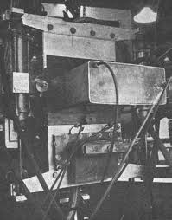
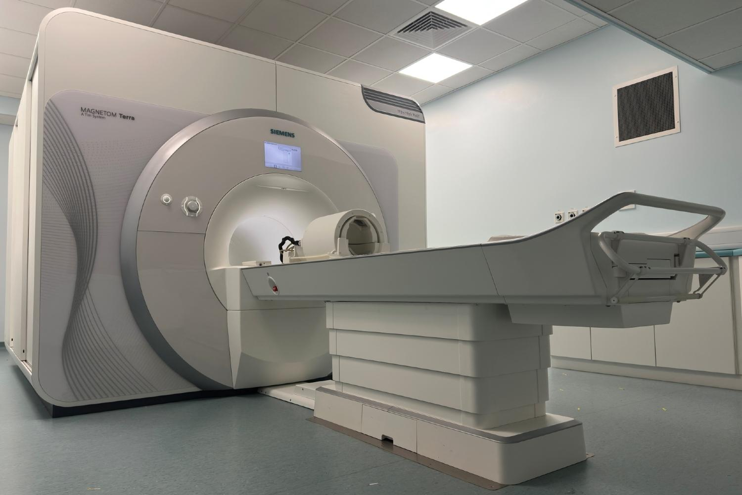
The Birth of SPM (1991)
Historical Context
Developed by Karl Friston at MRC Cyclotron Unit, London
Originally for PET; Addressed ROI limitations
First whole-brain statistical analysis
Revolutionary Concepts
Statistical parametric mapping
Voxel-wise testing
Subtraction images & t-maps
"Glass brains"
Foundation for modern analysis.

Slide 3


SPM Evolution Timeline
Open source software
Developed on GitHub
https://github.com/spm
Past
SPM91 (SPMclassic): Original PET analysis, 33,500 lines of MATLAB code
SPM94: Complete rewrite, 5,700 lines, unified GLM framework, GUI interface
SPM95/96: fMRI support, motion correction, improved registration
SPM99: Enhanced statistical inference, Random Field Theory integration
SPM2 (2003): Improved normalization, VBM introduction
SPM5 (2005): Unified segmentation, improved preprocessing
SPM8 (2009): DARTEL registration, enhanced statistical methods
SPM12 (2014): Modern interface, improved algorithms, 10-year stability
SPM25 (2025): GitHub development, Python support, new toolboxes

Slide 4
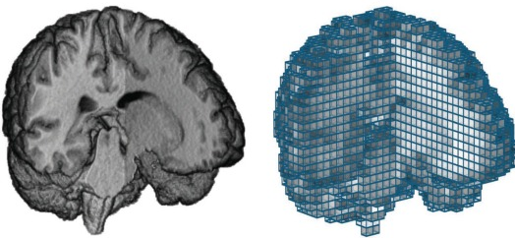
Core SPM Principles & Theory
Statistical Framework:
General Linear Model (GLM) at each voxel
Parametric statistical testing
Multiple comparisons correction
Spatial Processing
Image registration and normalization
Spatial smoothing for signal enhancement
Template-based standardization
Motion correction and artifact removal
Generative Modeling
Model-based statistical inference
Haemodynamic response function modeling
Convolution with experimental design
Bayesian statistical approaches

Slide 5
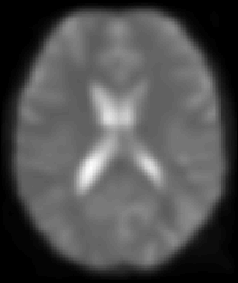
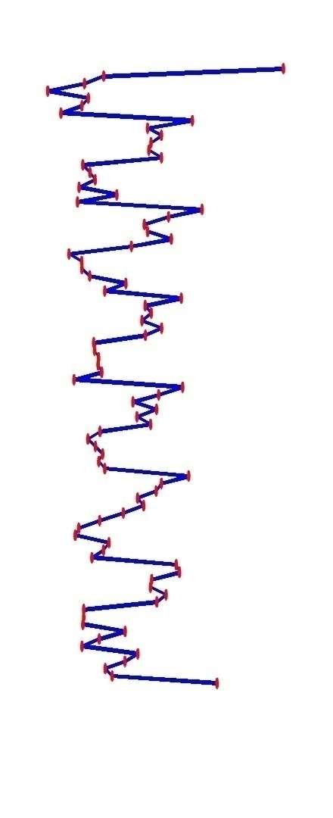
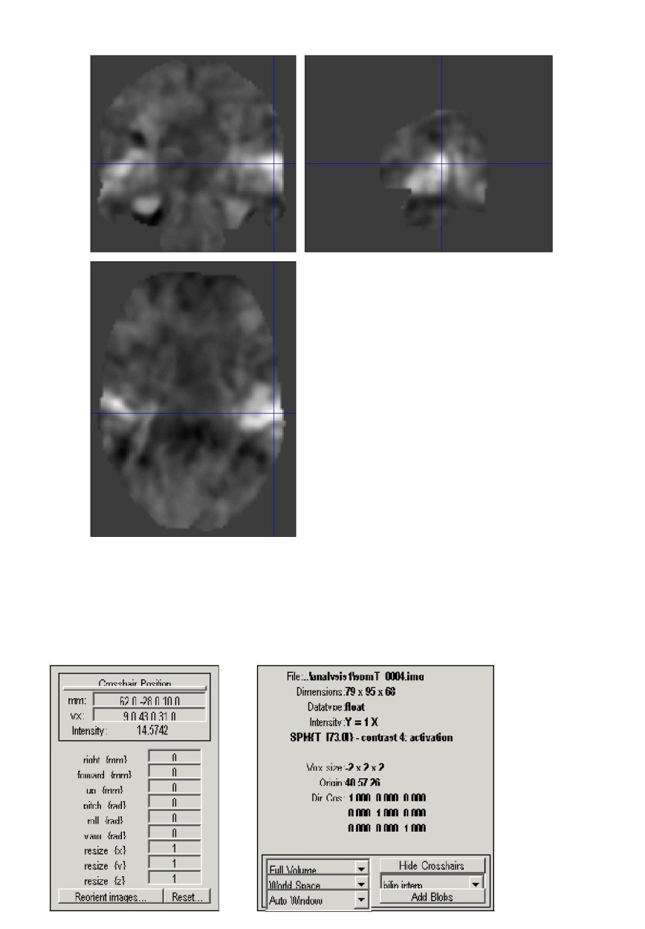
Source: SPM official course material
Voxel-wise time series analysis
Model
specification
Parameter
estimation
Time
Hypothesis
Statistic
Time
BOLD signal
single voxel
time series
SPM

Slide 6

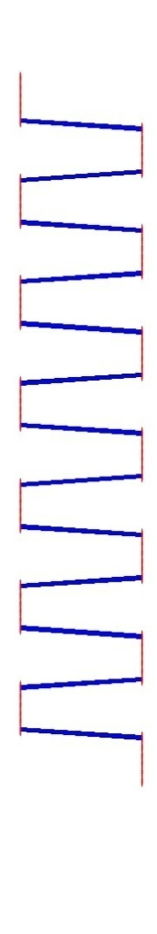

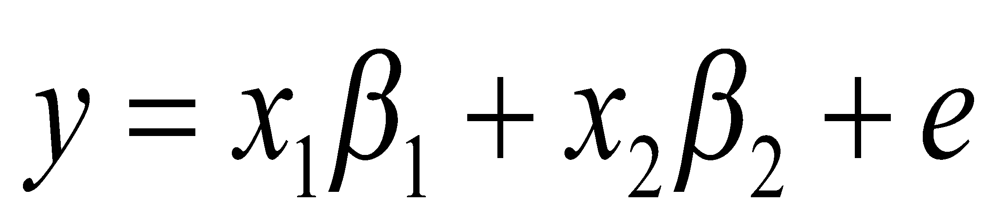
Source: SPM official course material
Single voxel regression model
Time
=
+
error
β₁
β₂
+
x₁
x₂
e
BOLD signal
Regressors
(or predictors)

Slide 7
What Makes SPM Unique?
SPM Philosophy
Mass-univariate approach (test at every voxel)
Parametric statistical methods
Model-based inference
Topological inference using Random Field Theory
Open science and collaborative development
Key Advantages
Comprehensive statistical framework
Rigorous multiple comparisons correction
Flexible experimental design support
Extensive validation and theoretical foundation
Large user community and extensive documentation

Slide 8
SPM Software Architecture
Core Components
Spatial Processing: Realignment, normalization, smoothing
Statistical Modeling: GLM specification and estimation
Results & Inference: Statistical maps and visualization
Specialized Toolboxes: VBM, DCM, connectivity analysis
User Interface
Graphical User Interface (GUI) for interactive analysis
Batch processing for automated workflows
Command-line scripting for advanced users
Integration with MATLAB ecosystem

Slide 9
The Preprocessing Pipeline
Data Import & Quality Check - DICOM conversion, visual inspection
Realignment - Motion correction using rigid-body registration
Slice Timing Correction - Account for acquisition timing differences
Coregistration - Align functional and structural images
Segmentation - Tissue classification (GM, WM, CSF)
Normalization - Transform to standard MNI space
Smoothing - Spatial filtering (typically 6-8mm FWHM)

Slide 10
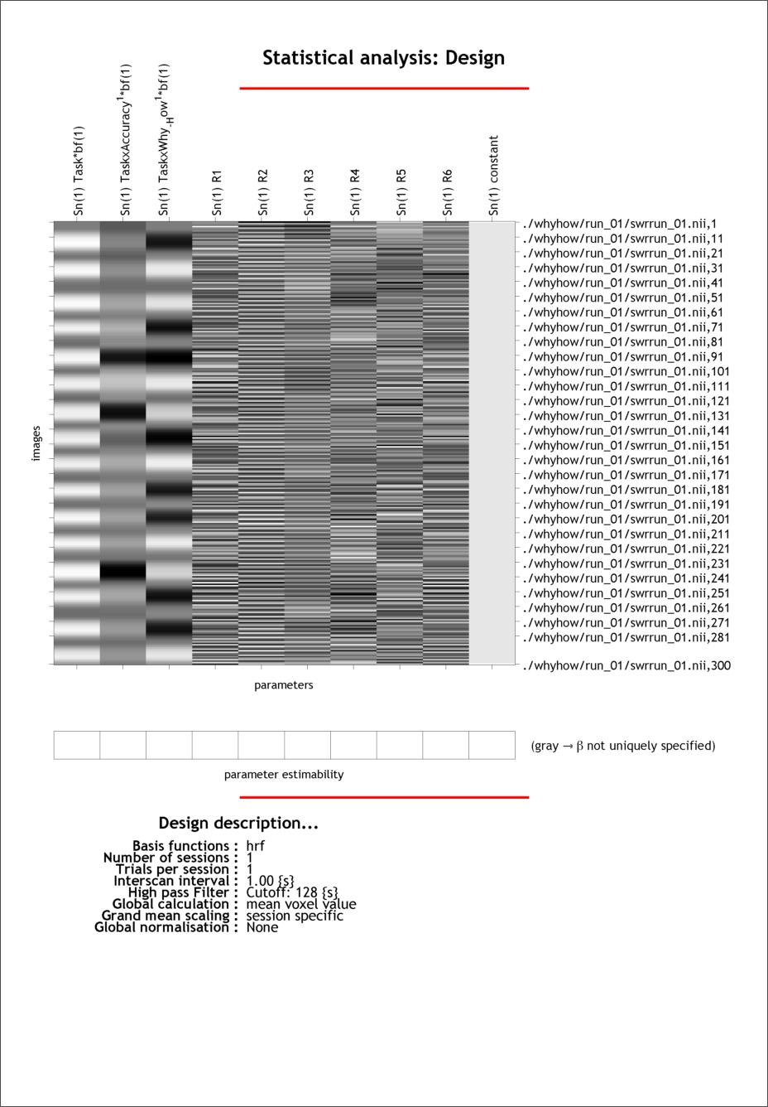
First-Level Analysis (Subject Level Analysis)
Design Matrix Specification
Experimental conditions and timing
Haemodynamic response function convolution
Motion parameters as nuisance regressors
Temporal derivatives and basis functions
Model Estimation
GLM parameter estimation at each voxel
Maximum likelihood or ReML estimation
Temporal autocorrelation modeling
Residual analysis for model validation
Statistical Inference
Contrast specification for hypothesis testing
T-statistics and F-statistics computation
Parameter estimate maps (beta images)
Statistical parametric maps
(SPM{T}, SPM{F})

Slide 11
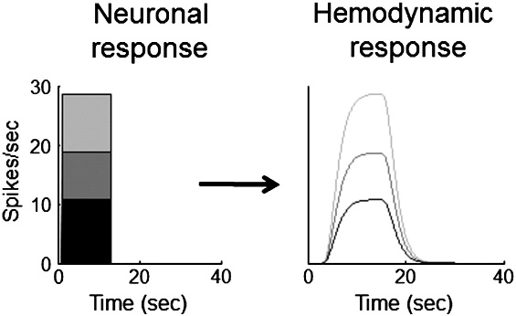
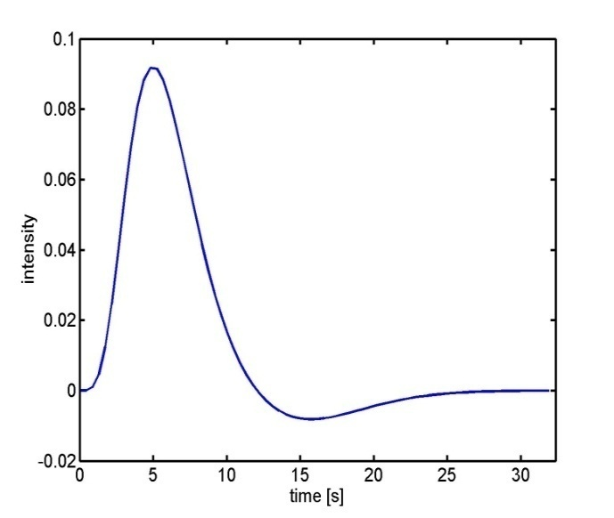
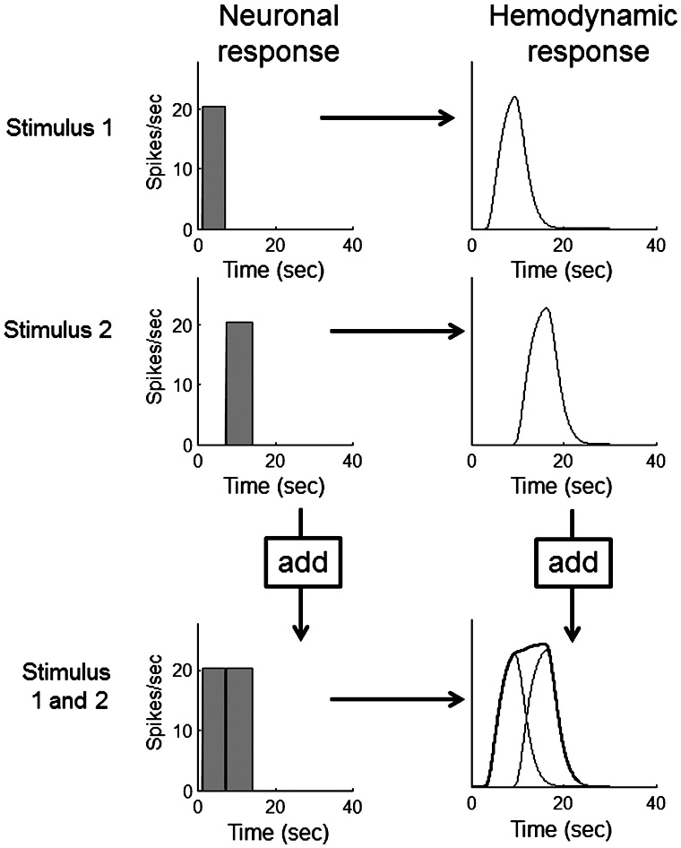

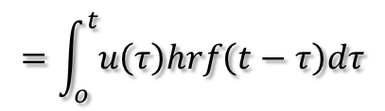
Source: SPM official course material
Problem 1: BOLD response
Hemodynamic response function (HRF):
Scaling
Shift invariance
Linear time-invariant (LTI) system:
u(t)
hrf(t)
x(t)
Convolution operator:
Additivity
Boynton et al, NeuroImage, 2012.

Slide 12
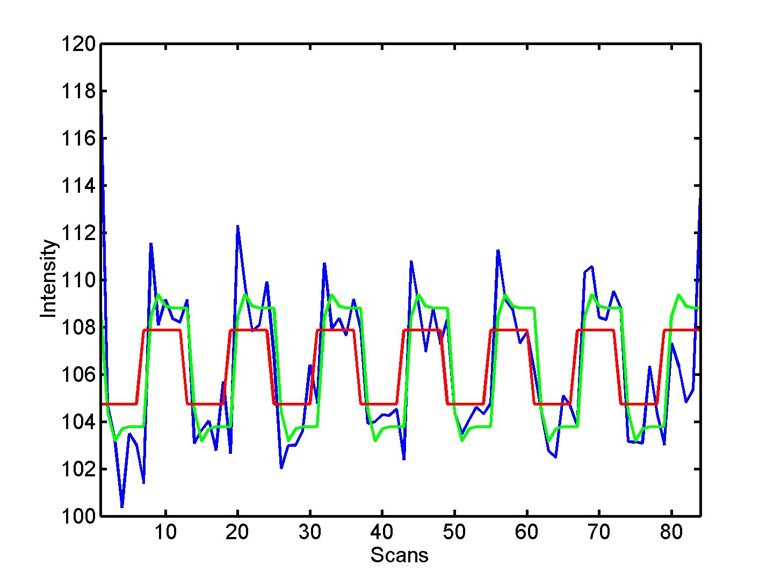
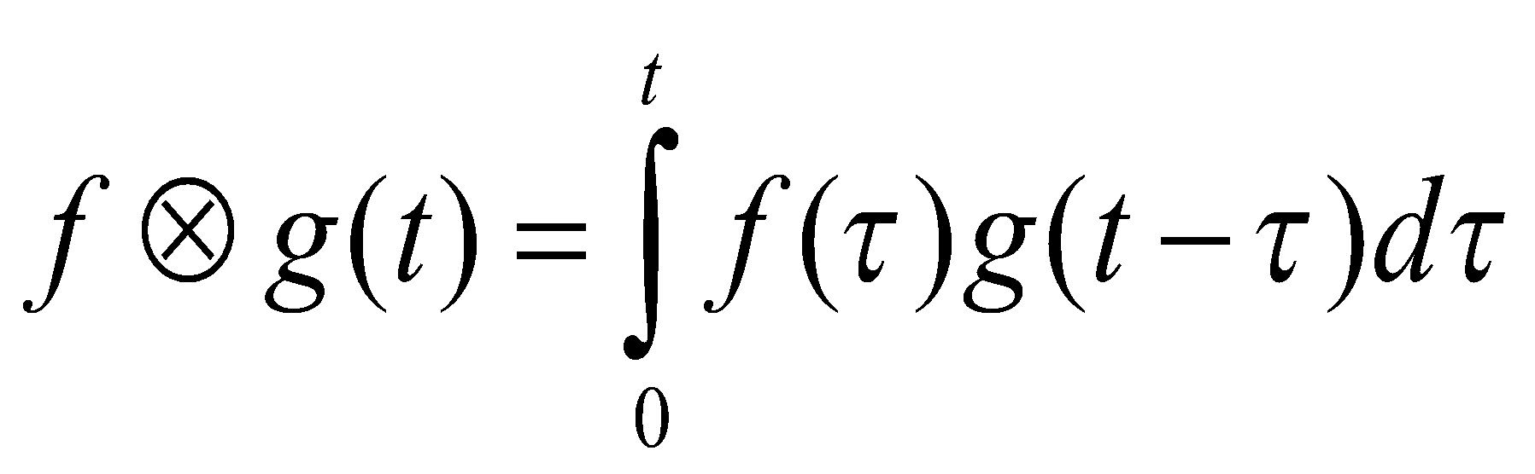


Source: SPM official course material
Convolution model of the BOLD response
Convolve stimulus function with a canonical hemodynamic response function (HRF):
⊗
HRF

Slide 13
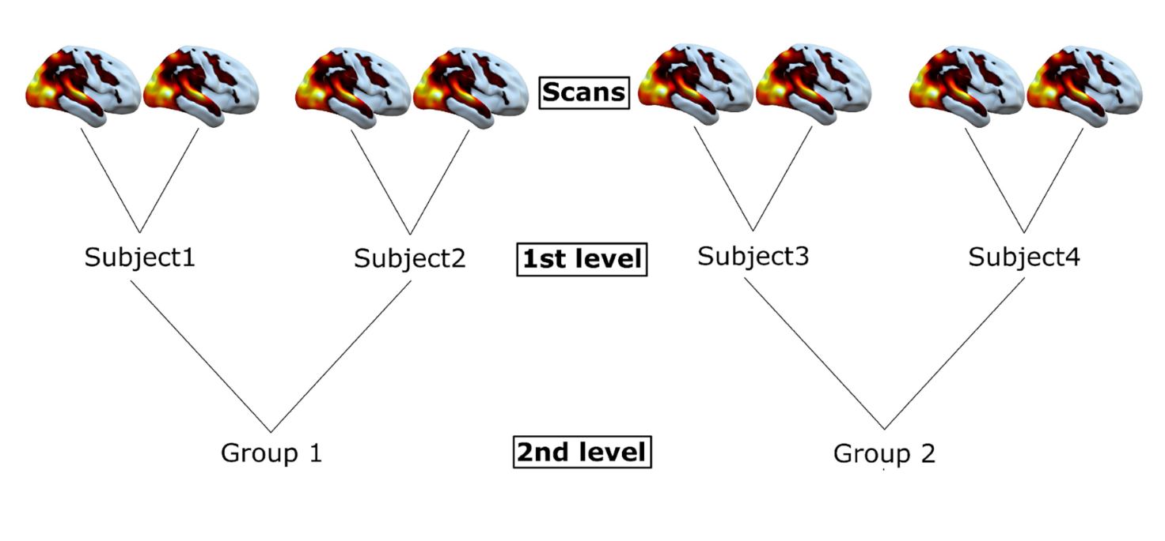
Second-Level Analysis (Group Level Analysis)
Fixed vs. Random Effects:
Fixed Effects: Within-subject consistency
Random Effects: Population-level inference
Mixed Effects: Hierarchical modeling
Analysis Types:
One-sample t-tests: Activation vs. baseline
Two-sample t-tests: Between-group comparisons
Paired t-tests: Within-subject contrasts
ANOVA: Multiple factors and interactions
Regression: Continuous covariates and correlations
Image source:
https://emotion.utu.fi/wp-content/uploads/2023/09/TUE_6_SS_2ND.pdf

Slide 14
Best Practices & Common Pitfalls
Best Practices:
Always inspect data quality before preprocessing
Use appropriate smoothing kernels for your data
Validate coregistration and normalization accuracy
Check design matrix for proper specification
Apply appropriate multiple comparisons correction
Document analysis parameters for reproducibility
Common Pitfalls to Avoid:
Ignoring motion artifacts in data
Over-smoothing high-resolution data
Inappropriate statistical thresholds
Circular analysis (double-dipping)
Inadequate sample sizes for group studies
Misinterpreting correlation vs. causation

Slide 15
Useful Links
Official SPM courses
SPM team is regularly offering on-site and online courses
Also releasing the documents almost always!
Link: https://www.fil.ion.ucl.ac.uk/spm/course/
Andrew Jahn - Andy’s Brain Book
Andy has been constructing neuroimaging tutorials; in SPM, FSL, well you name it!
Webpage: https://andysbrainbook.readthedocs.io/en/latest/SPM/SPM_Overview.html
Youtube: https://www.youtube.com/channel/UCh9KmApDY_z_Zom3x9xrEQw

