Slide 1
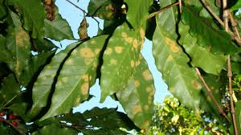
ROYA IN COFFEE PLANTS, A PARASITE TO BE ELIMINATED WITH DECISION TREES
Daniel Alejandro Cifuentes Londoño
Cristian Alexis Giraldo Agudelo
Medellín, October 29

Slide 2
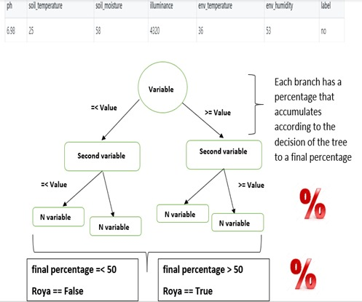
Data Structures Designed
Graph 1: This operation determines the value of the first variable. Depending on the value, it stores a percentage in an external variable.

Slide 3
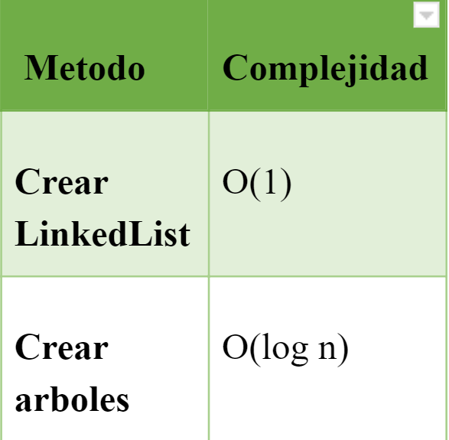
Data Structure Operations
Table 1: Complexity of the operations performed by the data structure

Slide 4
Design Criteria of the Data Structure
The structure of trees, are effective to sort and search data with less complexity of Big-O.
The structure created adapts to possible modifications by other engineers
Memory consumption is particularly low, so its transitivity and data management is highly competent

Slide 5
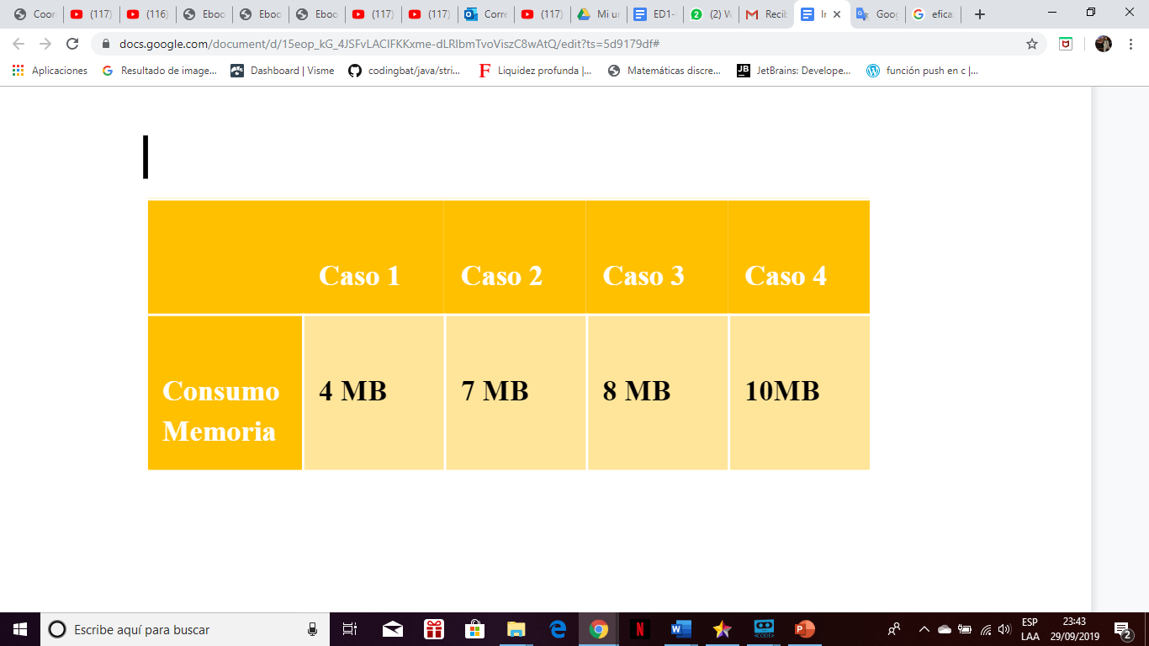
Memory Consumption

Slide 6
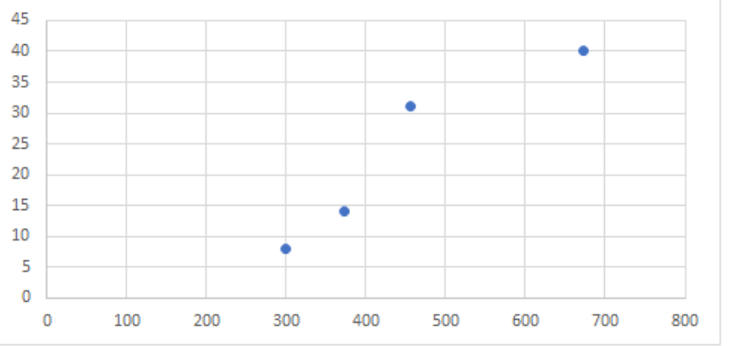
Time Consumption

