Slide 1
IOWA LIQUOR MARKET
Jim Beam Sales
Territory Analysis
Iowa Liquor Sales Database Analysis
Data Analyst – Jim Beam Brands Engagement
Presented by Cagla Celik
Notes:
SPEAKER NOTES – SLIDE 1: Title "Good [morning/afternoon], my name is [Name], and today I'll be walking you through a sales territory analysis for Jim Beam products using the Iowa Liquor Sales database." Pause. Make eye contact. Smile. You have 5 minutes — own this room.

Slide 2
Why We're Here
$31.5M
$13.68
1,302
Avg Bottle Price
Active Stores
Total Revenue

Slide 3
SUMMARY STATS | Database Snapshot
Jim Beam by the Numbers
$31.5M
$13.68
1,302
#2
Total Revenue
Iowa Market
Avg Bottle
Price
Active Store
Partners
Category
Vendor Rank
Source: Iowa Liquor Sales Database

Slide 4
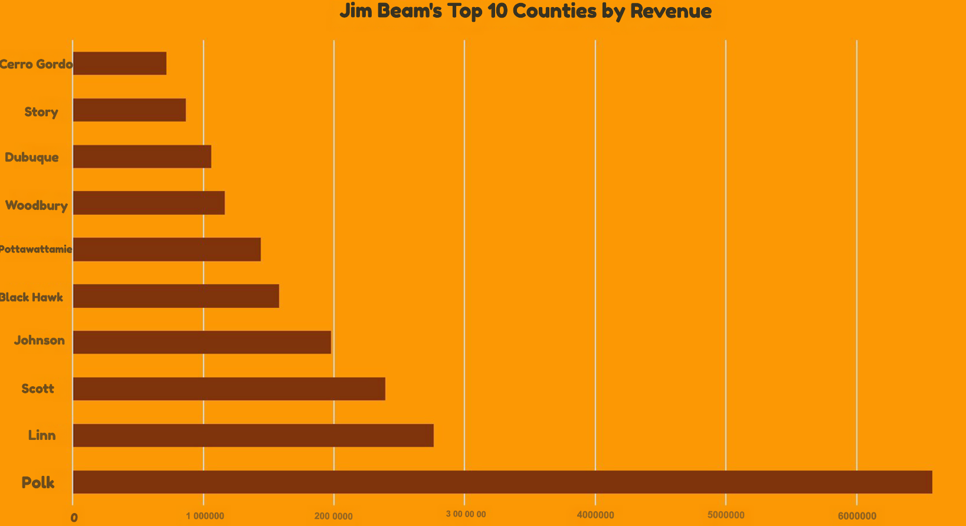
STRENGTH 1 | Geographic Dominance
Jim Beam's Top 10 Counties by Revenue

Slide 5
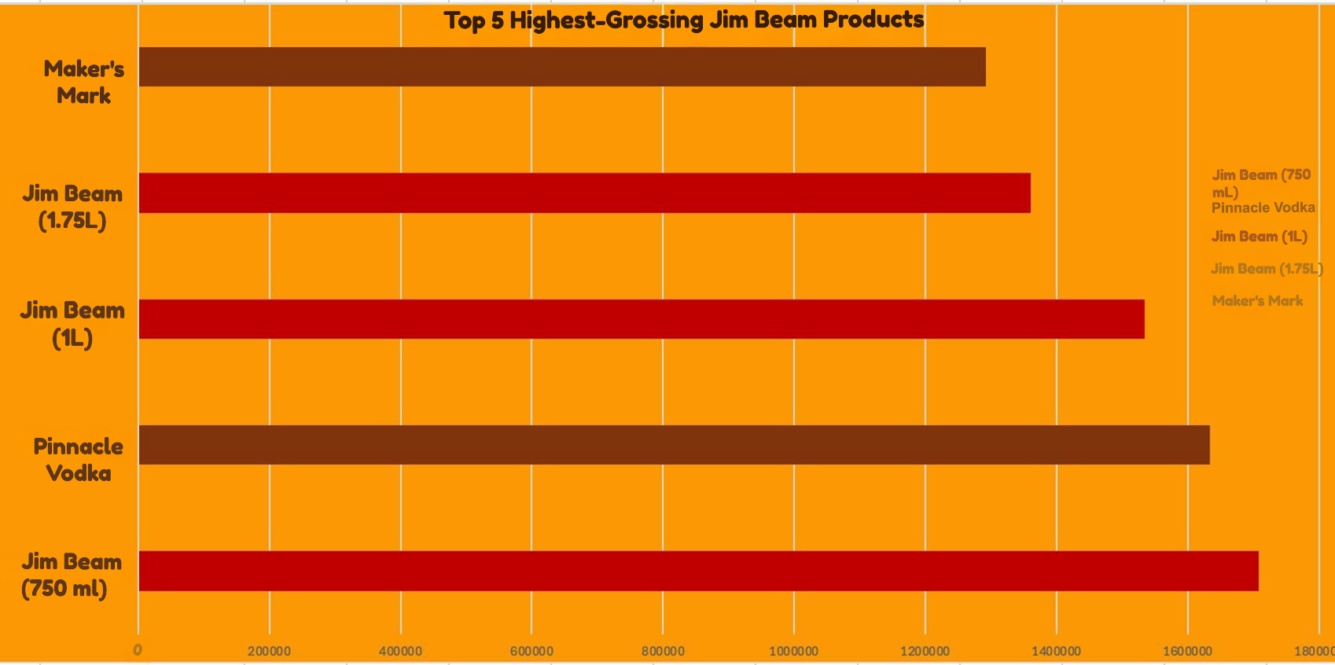
STRENGTH 2 | Hero Products Drive Revenue
Top 5 Highest-Grossing Jim Beam Products

Slide 6
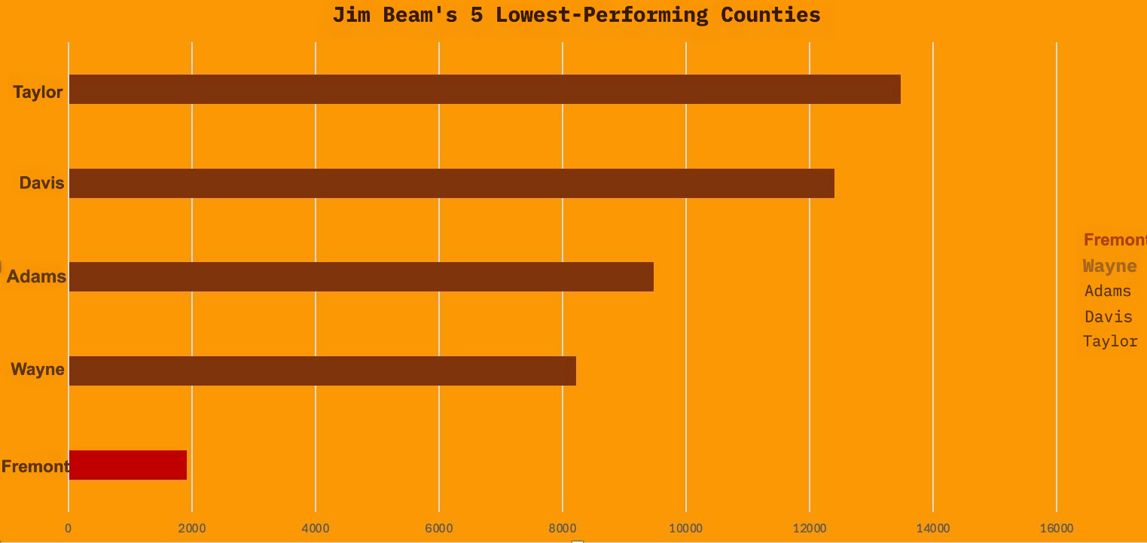
WEAKNESS 1 | Geographic Dead Zones
Jim Beam's 5 Lowest-Performing Counties

Slide 7
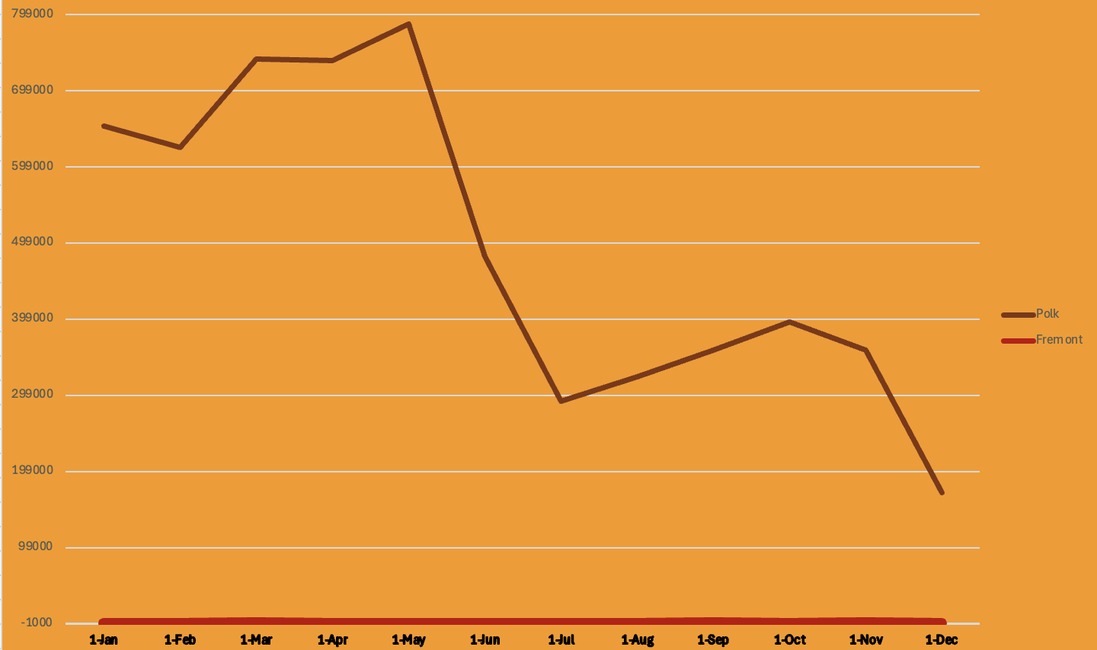
WEAKNESS 2 | Weak & Inconsistent County Performance
Monthly Revenue Trend: Fremont vs. Polk (2014)

Slide 8
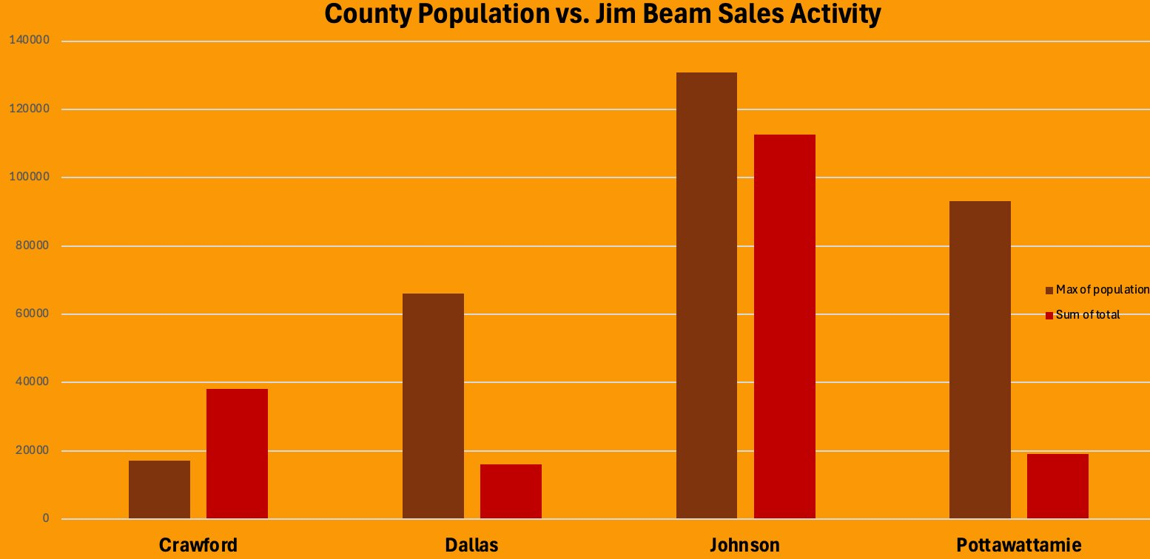
OPPORTUNITY 1 | Underserved High-Population Counties
County Population vs. Jim Beam Sales Activity

Slide 9
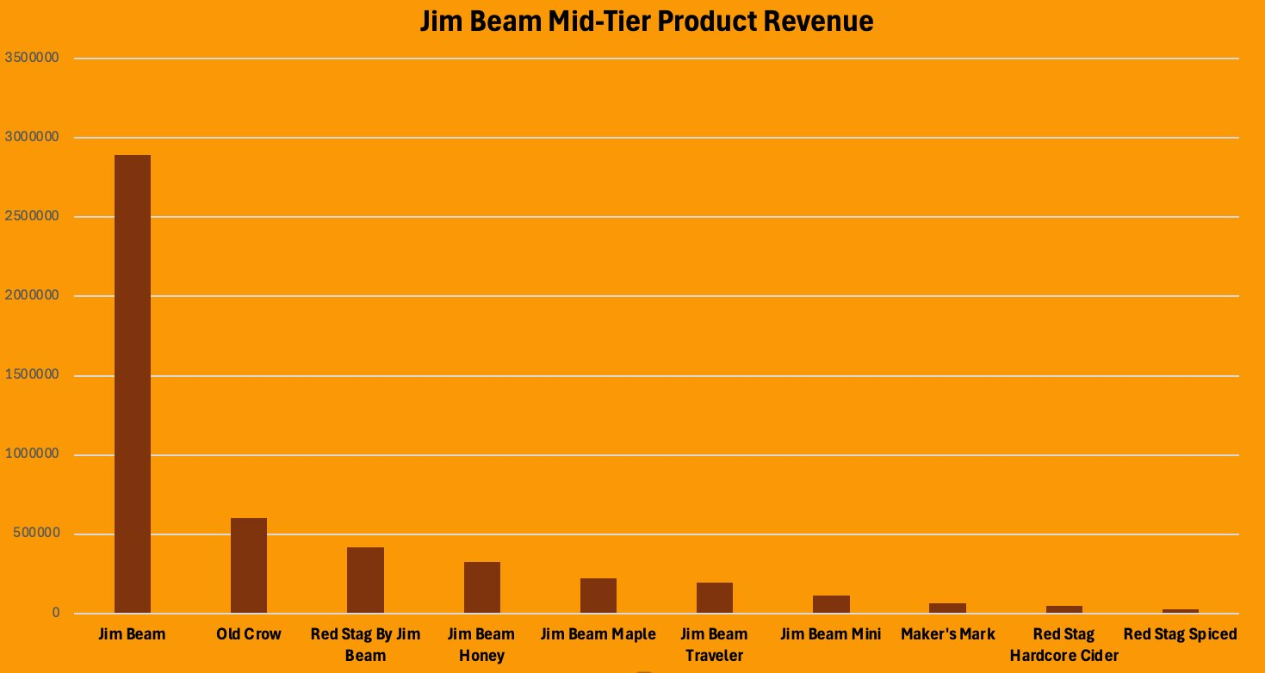
OPPORTUNITY 2 | Mid-Tier Price
Jim Beam Mid-Tier Product Revenue ($10–$20)

Slide 10
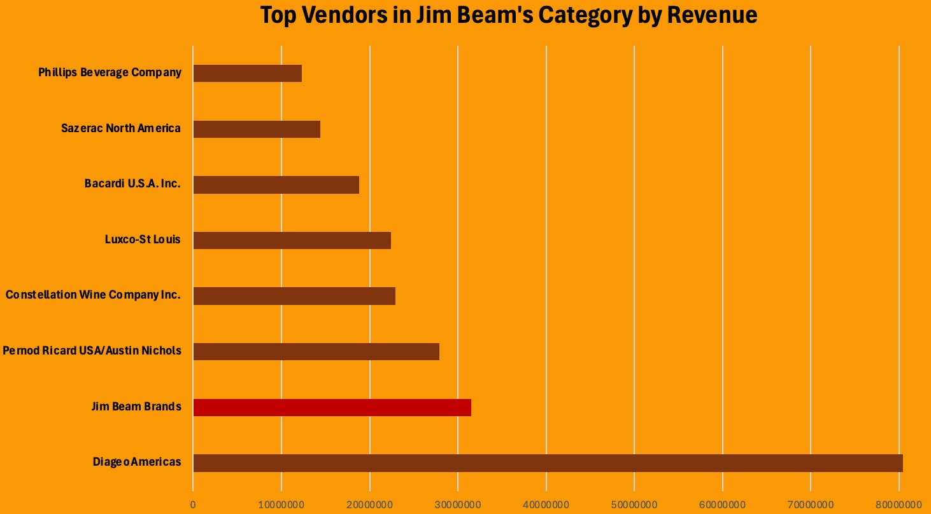
THREAT 1 | Competitor Landscape
Top Vendors in Jim Beam's Category by Revenue

Slide 11
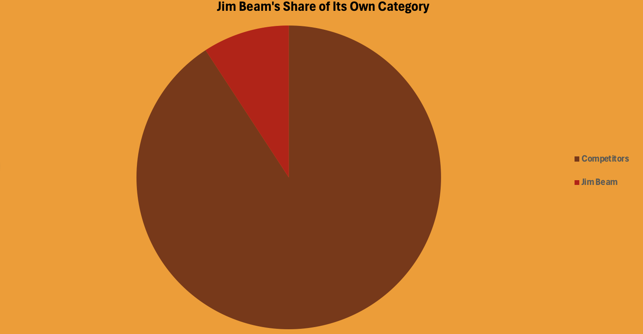
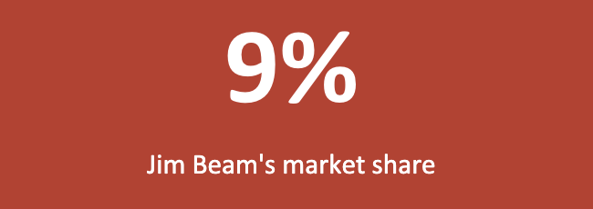
THREAT 2 | Market Share Reality
Jim Beam's Share of Its Own Category
Jim Beam Competitors

Slide 12
Summary & Recommendation
💪 STRENGTH
Polk County dominance + hero SKUs (Jim Beam 750mL) anchor $31.5M in revenue. Portfolio spans multiple tiers.
⚠️ WEAKNESS
Fremont County: $1,917. Store 4994: $17. Revenue concentrated in few locations. Fragile if partners change.
🌱 OPPORTUNITY
Dallas & Pottawattamie counties are underserved vs. population. Flavored SKUs (Honey, Maple) primed for promotion.
🔴 THREAT
Diageo generates $80M in Jim Beam's own category. Jim Beam holds just 9% market share.
3 Strategic Moves: ① Activate underserved counties · ② Promote flavored SKUs in mid-tier bracket · ③ Track Diageo's expansion closely

