Slide 1
IOWA LIQUOR MARKET
Jim Beam Sales
Territory Analysis
Iowa Liquor Sales Database Analysis
Data Analyst – Jim Beam Brands Engagement
Presented by Cagla Celik
Notes:
SPEAKER NOTES – SLIDE 1: Title "Good [morning/afternoon], my name is [Name], and today I'll be walking you through a sales territory analysis for Jim Beam products using the Iowa Liquor Sales database." Pause. Make eye contact. Smile. You have 5 minutes — own this room.

Slide 2
Why We're Here
$31.5M
$13.68
1,302
Avg Bottle Price
Active Stores
Total Revenue
To understand where Jim Beam is performing well, where revenue is weak, which markets may have growth potential, and what competitive risks exist.

Slide 3
SUMMARY STATS | Database Snapshot
Jim Beam by the Numbers
$31.5M
$13.68
1,302
#2
Total Revenue
Iowa Market
Avg
Bottle Price
Active
Store Partners
Vendor Rank
In Category
Source: Iowa Liquor Sales Database

Slide 4
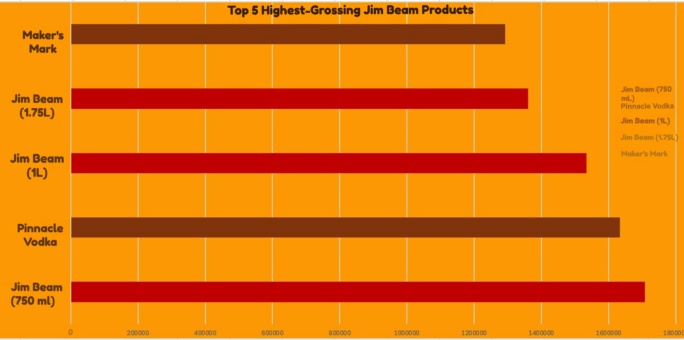
STRENGTH | Hero Products Drive Revenue
Top 5 Highest Grossing Jim Beam Products

Slide 5
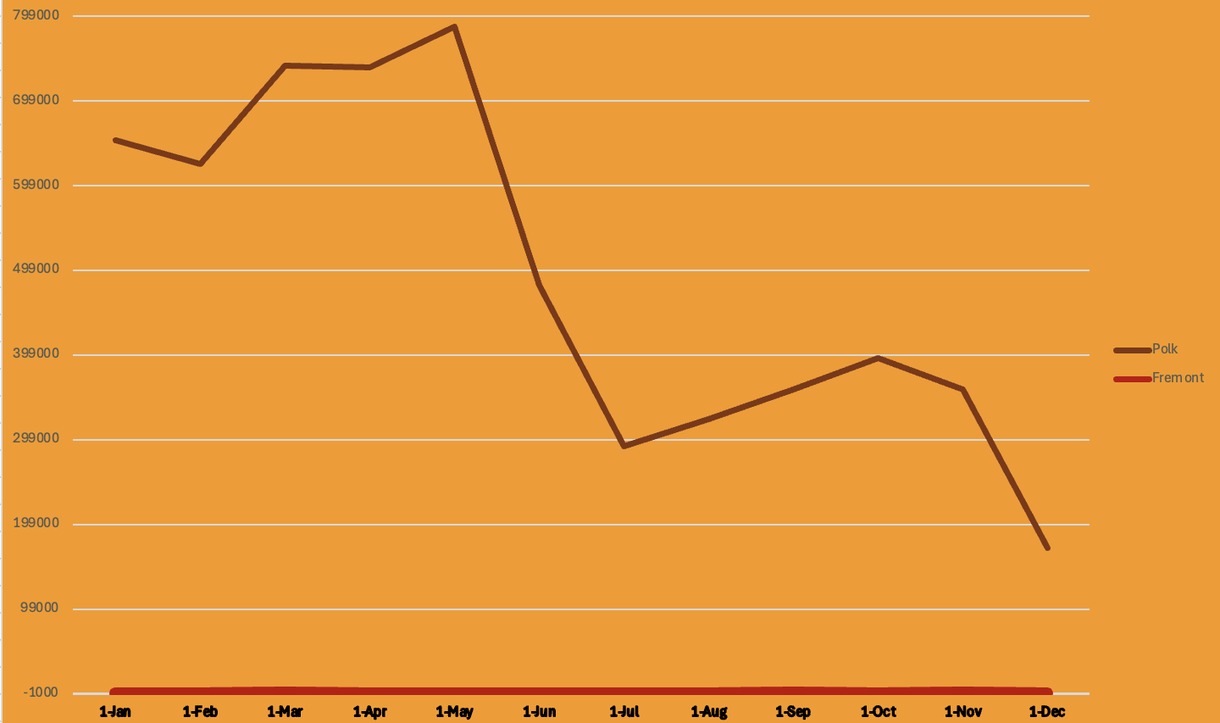
WEAKNESS | Weak & Inconsistent County Performance
Monthly Revenue Trend: Fremont vs. Polk (2014)

Slide 6
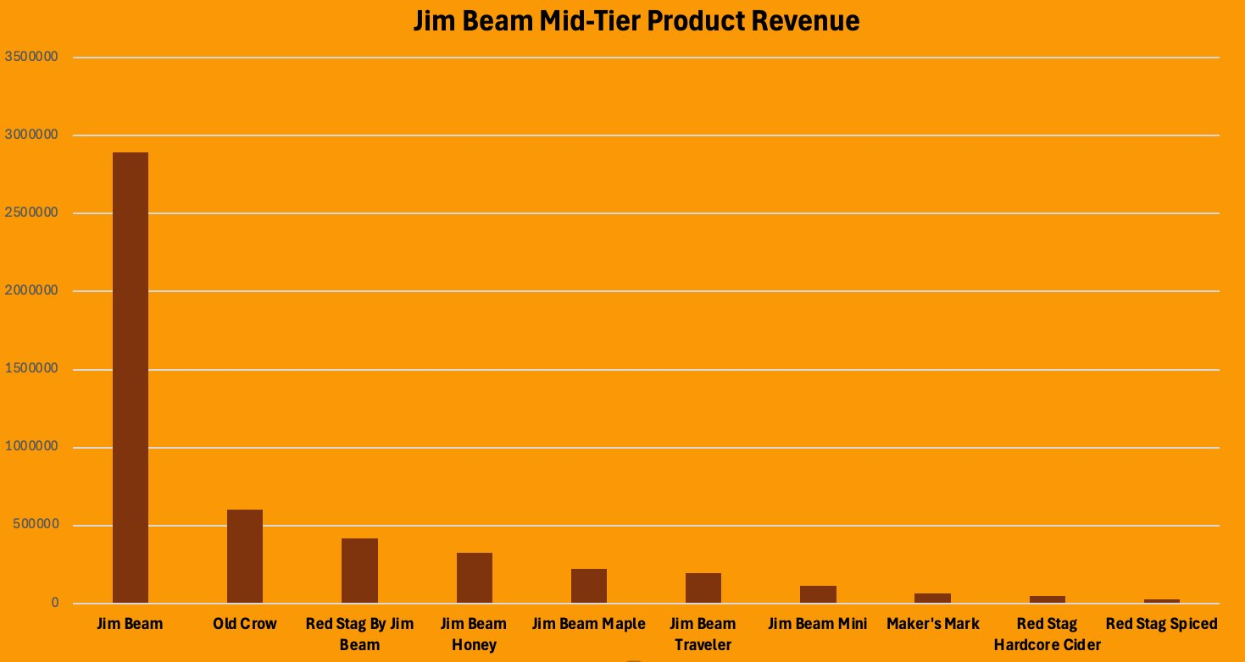
OPPORTUNITY | Mid-Tier Price
Jim Beam Mid-Tier Product Revenue ($10–$20)

Slide 7
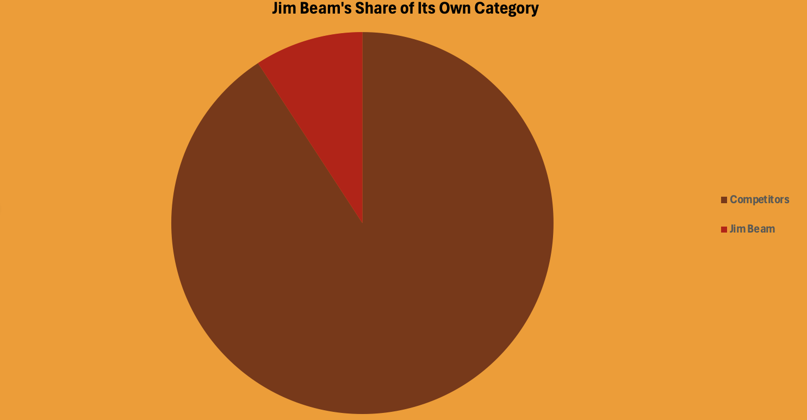

THREAT | Market Share Reality
Jim Beam's Share of Its Own Category
Jim Beam Competitors

Slide 8
Summary & Recommendation
💪 STRENGTH
Hero SKUs (Jim Beam 750mL) anchor revenue. Portfolio has multi-tier appeal.
⚠️ WEAKNESS
Dead zones in Fremont, Wayne, Adams. Minimal presence in rural counties.
🌱 OPPORTUNITY
Mid-tier flavored variants are priced right but undermarketed. Room to grow 2-3×.
🔴 THREAT
Jim Beam holds only 9% of its own category. Diageo leads at $80M.
Recommendation: Activate rural counties · Promote flavored SKUs · Monitor Diageo's growth trajectory

