Slide 1
Bogazici University Master of Science in Software Engineering
SWE573 Software Development Practice
Requirements Elicitation
Çağla Şanlibayrak
2013719117

Slide 2
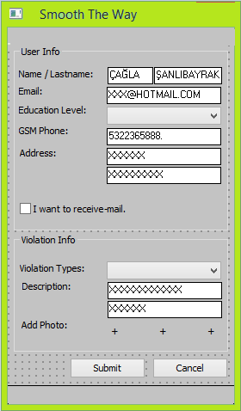
Requirements Elicitation - 1
Requirement 1. The user shall enter his/her registration information.
Last name*
Name*
Email*
Password*
Education Level
GSM Phone
Address Line 1
Address Line 1
Address City
I want to receive e-mails with the results of questionnaires I participate (Y/N)
Buttons: SUBMIT and CANCEL
Reasonable lengths for all data fields are to be assumed. All data fields are free format. Whatever user is typing is to be accepted.

Slide 3
Requirements Elicitation - 2
Requirement 2. A citizen shall send any kind of violation against the handicapped people via taking picture his/her own mobile phone and transmitting it to the central station with this mobile application.
Requirement 2.1. The citizen shall choose the violation type from the dropdown box.
Architectural obstacles
Parking areas
Stations
City Furniture
Accessing to the buildings
Elements of buildings
Lightening
Colors
Communication tools
Outlets and switches
Fire safety
Signs
Requirement 2.2. In the application, there shall be description text areas. In these text areas, the user shall do followings;
Describe the the violation and the problem specifically.
Enter the address of the violation.

Slide 4
Requirements Elicitation – 3
Requirement 2.3. The citizen shall upload 3 photos of the violation.
Requirement 2.4. The citizen shall transfer the violation by submitting to the center.
Requirement 3. The user shall update his/her registration information.
The user shall fill out a form containing the following information.
Email*
Password*

Slide 5

Thank
You!

