Slide 1
Precise Measurement of π⁺/π⁻ Ratios in Semi-inclusive DIS Part I: Charge Symmetry Violating Quark Distributions (PR12-09-002) Part II: Unraveling the Flavor Dependence of the EMC Effect (PR12-09-004) Spokespersons: D. Dutta, K. Hafidi, and D. Gaskell
Hall C Users Meeting
January 30, 2009

Slide 2
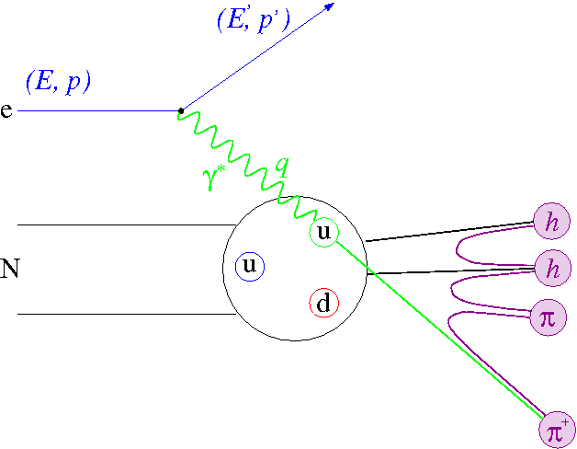
2 Experiments – 1 Technique
Semi-inclusive DIS can be used as a “flavor tag” to explore
→ Unpolarized PDFs
→ Polarized PDFs
→ Sea flavor asymmetry
2 new experiments measuring π⁺/π⁻ ratios with high precision to measure
→ Charge symmetry violating quark distributions
→ Flavor dependence of the EMC effect
quark
distribution
fragmentation
function
Inclusive
cross section
Needed precision requires high luminosity, good (charge-independent) understanding of acceptance → ideal for Hall C with HMS-SHMS

Slide 3
Charge Symmetry: Low energy nuclear physics vs. QCD
Charge symmetry (CS) is a particular form of isospin symmetry (IS) that involves a rotation of
180° about the “2” axis in isospin space
Low energy
QCD
For nuclei:
CS operator interchanges neutrons and protons
CS appears to be more respected than IS:
pp and nn scattering lengths are almost equal
m_{p} = m_{n} (to 1%)
Binding energies of ³H and ³He are equal to 1%
Energy levels in mirror nuclei are equal to 1 %
After corrections for electromagnetic interactions
u^{p}(x,Q²) = d^{n}(x,Q²) and d^{p}(x,Q2) = u^{n}(x,Q²)
Origin:
Electromagnetic interactions
δm = m_{d} – m_{u}
Naively, one would expect that CSV would be
of the order of (m_{d} – m_{u})/<M>
Where <M> = 0.5 – 1 GeV
➔ CSV effect of 1%
CS has been universally assumed in parton distribution functions !

Slide 4
Motivations
CSV measurements are important on their own as a further step in studying the inner structure of the nucleon
The validity of charge symmetry is a necessary condition for many relations between structure functions
Flavor symmetry violation extraction relies on the implicit assumption of charge symmetry (sea quarks)
Charge symmetry violation could be a viable explanation for the anomalous value of the Weinberg angle extracted by NuTeV experiment

Slide 5
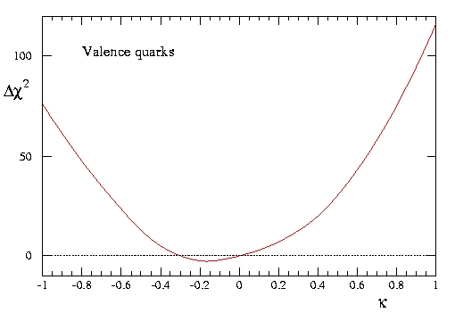
Theory, phenomenology and experimental upper limit !
Based on the same twist-2 PDF from Adelaide group
Model by Sather (PLB274(1992)433):
δd ~ 2-3% and δu ~ 1%
Model by Rodionov, Thomas and Londergan (Mod. PLA9(1994)1799):
δd could reach up to 10% at high x
MRST group studied uncertainties in PDFs (Eur. Phys. J.35(2004)325)
CSV parameterization δu_{v} = -δd_{v} = κ(1-x)⁴x^{-0.5}(x-0.0909)
The form has to satisfy the normalization condition
κ was varied in the global fit: 90% CL obtained for (-0.65 < κ < 0.8)
Upper limit obtained by comparing: F₂^{ν} and F₂^{γ} on isoscalar targets
F₂^{ν} by CCFR collaboration at FNAL (iron data)
F₂^{γ} by NMC collaboration using muons (deuterium target)
0.1 ≤ x ≤ 0.4 ➔ 9% upper limit for CSV effect!

Slide 6
Theory, phenomenology and experimental upper limit !
MRST group studied uncertainties in PDFs (Eur. Phys. J.35(2004)325)
CSV parameterization δu_{v} = -δd_{v} = κ(1-x)⁴x^{-0.5}(x-0.0909)
The form has to satisfy the normalization condition
κ was varied in the global fit: 90% CL obtained for (-0.65 < κ < 0.8)
Upper limit obtained by comparing: F₂^{ν} and F₂^{γ} on isoscalar targets
F₂^{ν} by CCFR collaboration at FNAL (iron data)
F₂^{γ} by NMC collaboration using muons (deuterium target)
0.1 ≤ x ≤ 0.4 ➔ 9% upper limit for CSV effect!

Slide 7
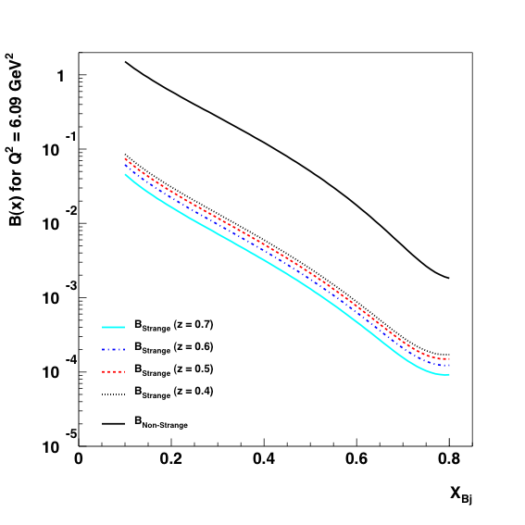
Formalism (Londergan, Pang and Thomas PRD54(1996)3154)
Assuming factorization
Impulse Approximation
D(z) R(x,z) + A(x) C(x) = B(x,z)
Extract simultaneously D(z) and C(x) in each Q² bin!
7

Slide 8
Measurements: D(e,e’π⁺) and D(e,e’π⁻) in Hall C
11 GeV electron beam
10 cm LD₂ target
HMS and SHMS spectrometers
A sister proposal to PR-09-004
SHMS
4.5 ≤ p ≤ 6.8 GeV/c
To each x setting corresponds 4 z measurements (z = 0.4, 0.5, 0.6, 0.7)
Q² = 3.5 GeV² ➔ x = 0.3, 0.35, 0.4, 0.45
Q² = 5.1 GeV² ➔ x = 0.45, 0.5, 0.55, 0.6
Q² = 6.2 GeV² ➔ x = 0.5, 0.55, 0.6, 0.65
3 Q² measurements: for each Q² we have 16 equations and 8 unknowns: D(z_{i}) and C(x_{i})
HMS
1.7 ≤ p ≤ 4.6 GeV/c
D(z) R(x,z) + A(x) C(x) = B(x,z)
8

Slide 9
Precision Measurement of Charged Pion Ratios
Acceptance for pion is independent of their charge
For each setting keep the total rates the same for π⁺ and π⁻
Reduces rate dependent systematics (tracking efficiency…)
50 μA (25 μA) beam current for negative (positive) polarity π
HMS (pions) 1.9 - 4.6 GeV
Gas Č @ 0.96 atm
p^{th}(π) = 2.65 GeV and
p^{th}(K)= 9.4 GeV
Aerogel (n = 1.015)
p^{th}(π) = 0.8 GeV and
p^{th}(K)= 2.85 GeV
Max e- rate = 90 kHz
HMS Caloe- rejection
100:1 @ 1 GeV
1000:1 @ 2 GeV
Pion detection eff> 99.5%
Aided by Č for p< 2.6 GeV
hadron
arm
Particle IDentification
electron arm
SHMS (electrons) 4.5-6.5 GeV
π⁻ rate ≈ 10s kHz
π⁻ /e in the worst case ~ 1/5
Lead glass Calo: 99% e⁻ det. eff
200:1 π rejection
Heavy gas Č @ 1 atm
to further reduce π background

Slide 10
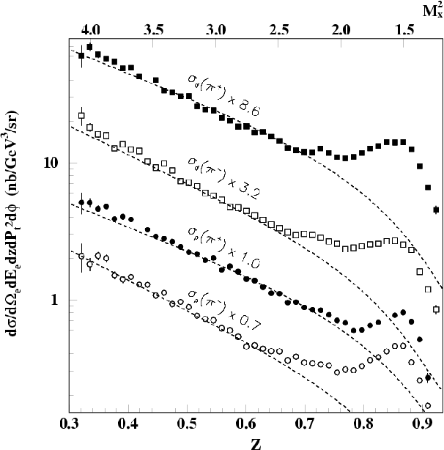
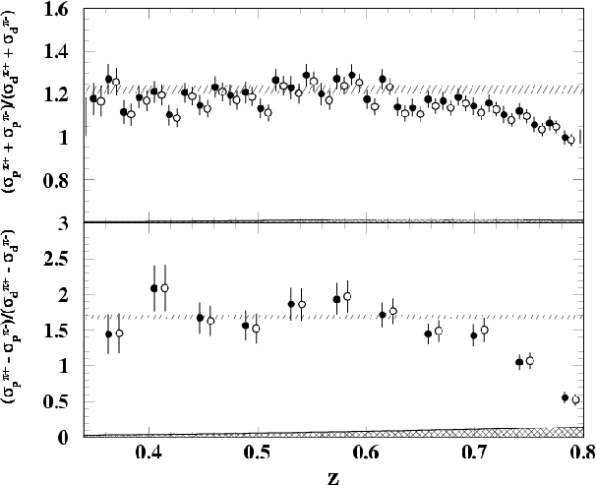
SIDIS Issues
Factorization
SIDIS = (γ∗ q) (q hadronization)
Results from E00-108 in Hall-C
T. Navasardyan et al., PRL 98, 022001 (2007)
Cross sections and ratios of π⁺ & π⁻ production from ¹H and ²H
suggest that factorization may hold even at 6 GeV for z< 0.7
We will perform similar tests with ¹H and ²H @ 12 GeV

Slide 11
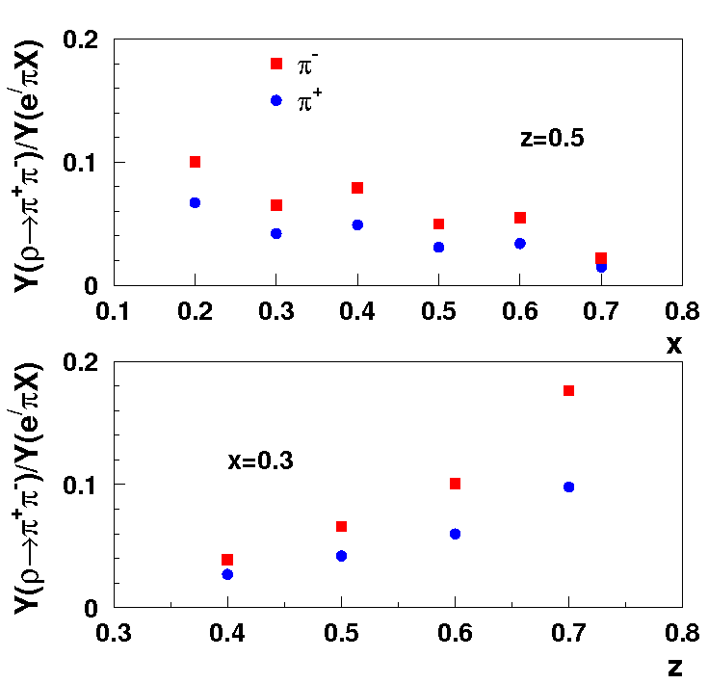
Backgrounds
Diffractive ρ⁰ production
Simulated using SIMC: cross-section from PYTHIA modified to agree
with HERMES and CLAS results.
<10% of SIDIS in the x-scan @ z=0.5
Used to estimate the uncertainty
to the super-ratio and difference
ratio.
CSV:0.2%-1.2%
(EMC: super-ratio: ~ 0.6% -0.8%)
State-of-the-art parameterizations will be used
to correct the experimental yields

Slide 12
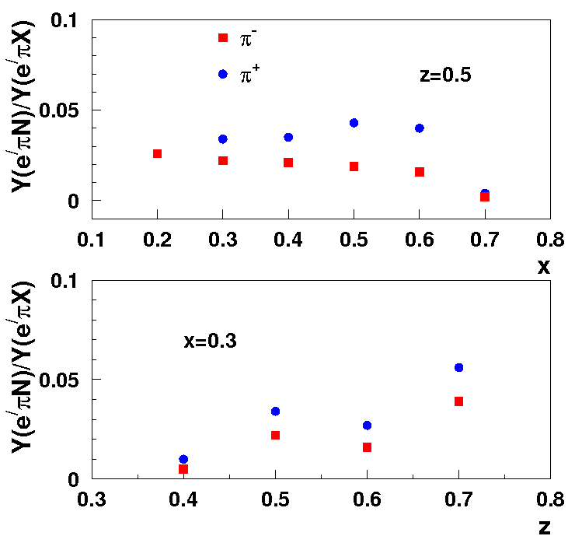
Backgrounds
Radiative background
from exclusives
Simulated using SIMC
Implementation of radiative
effects in the energy peaking
approximation combined with an
exclusive pion electroproduction
model for the resonance region.
Contributions are small (<6%)
Estimated uncertainty due to radiative background CSV: (EMC: 0.1%-1.3%~0.8%)

Slide 13
CSV Error budget
Source | Pion Yield (%) | Δ(R_{Y})/R_{Y} (%) per z bin | Δ(R_{meas})/R_{meas}) (%) Per z bin
Statistics | 0.7 | 1 | 2.6
Luminosity | 0.3 | 0.3 | 0.8
Tracking efficiency | 0.1 - 1 | 0.2 | 0.5
Dead time | < 0.1 | < 0.1 | < 0.3
Acceptance | 1 – 2 | 0.1 | 0.3
PID efficiency | < 0.5 | 0.2 | 0.5
ρ background | 0.5 – 3 | 0.2 – 0.7 (1.2) | 0.5 – 1.8 (3)
Exclusive Rad. tail | 0.2 – 1.3 | 0.1 – 0.6 (1.3) | 0.3 – 1.5 (3)
Total systematics |  | 0.49 – 1.02 (1.8) | 1.1 0.6 – 2.4 (4)
Total uncertainty |  |  | 1.1 2.6 – 3.5(4.7)

Slide 14
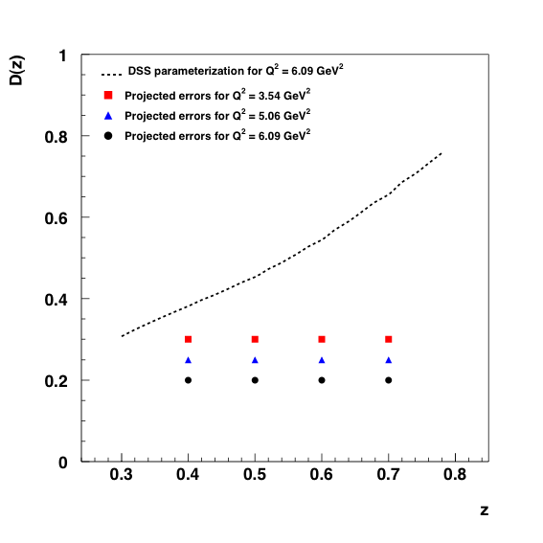
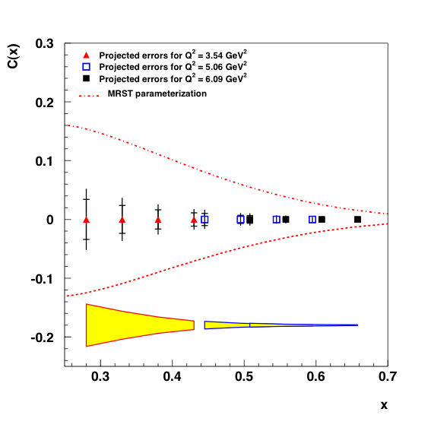
CSV Projections

Slide 15
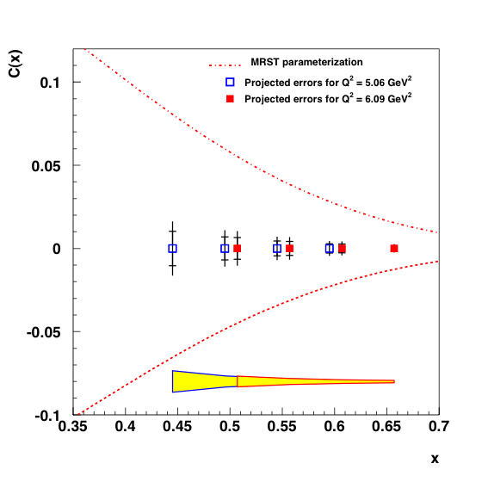
CSV Projections

Slide 16
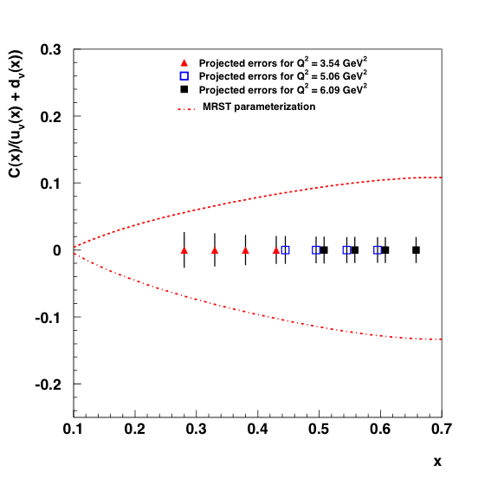
CSV Projections

Slide 17
CSV Beam time needed !
Activity | Time (Hours)
LD₂ data | 264.9
Al Dummy data | 26.5
LH₂ data | 72.1
Polarity and kinematics change | 44
Total | 407.5 (17 days)
Time common with PR-09-004 | 132 (5.5 days)

Slide 18
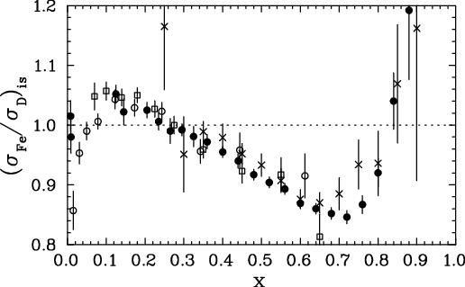
The EMC Effect
Significant nuclear dependence of the structure functions,( F₂^{A}/F₂^{D} )
discovered over 25 years ago
Indicates that quark distributions are modified inside nuclei
EMC
BCDMS
SLAC
Anti-Shadowing
Fermi smearing
Shadowing
EMC effect

Slide 19
The EMC Effect (Precision Measurements)
A and x dependence were precisely mapped at SLAC (for A > 4)
JLab E03-103 and HERMES
have made precision measurements for few-body nuclei.
EMC
BCDMS
SLAC
Size of EMC effect
varies with A
Shape of EMC effect
independent of A
Independent of Q²
Anti-Shadowing
Fermi smearing
Shadowing
EMC effect
All these measurements are inclusive measurements

Slide 20
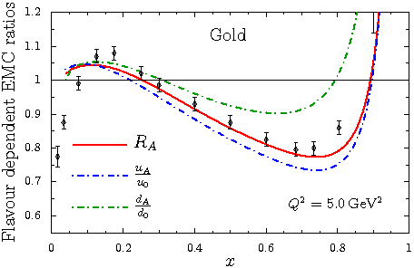
Why Another Measurement?
New handle
Some models predict a significant flavor dependence for asymmetric nuclei such as gold.
medium modified
quark distributions
Clöet, Bentz & Thomas (nuc-th/0901.3559)
nucleon quark
distributions
Experimentally, the flavor dependence of the EMC effect is as yet
completely unexplored.
It could also help explain the anomalous sin²θ_{W} measured by the
NuTeV experiment.

Slide 21
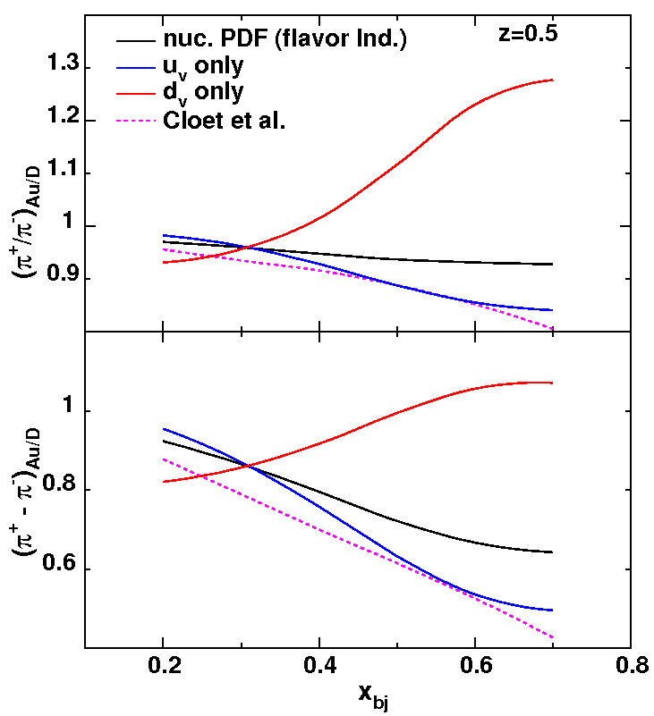
Why Another Measurement?
New Observables
EMC effect
from d-quarks
Super
ratio
EMC effect
from u-quarks
&
Nuclear PDFs of Hirai, Kumano & Nagai
Difference
ratio
Clöet et al.
Test sensitivity to flavor dependence
of the EMC effect with toy model
u_{v} only: EMC effect due to modification of u_{A} only
F₂^{A} remains
unchanged
d_{v} only: EMC effect due to modification of d_{A} only

Slide 22
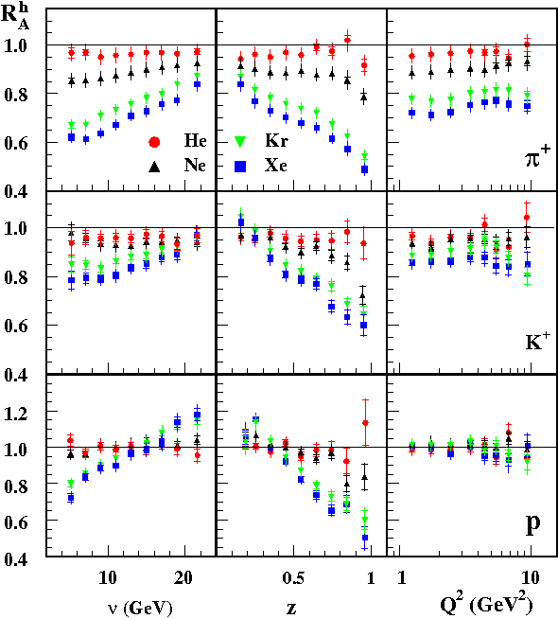
(More) SIDIS Issues
Hadron attenuation
HERMES results
Inclusive cross section are explicitly
removed, avoiding effects of differences
in u_{A},d_{A}
Nuclear environment has significant
effect on hadron formation
HERMES results indicate that
hadron attenuation for π⁺ & π⁻
are the same at the few % level
A. Airapetian et al., NPB 780, 1 (2007)

Slide 23
The New Proposal (part II)
Measure A(e,e’ π±)X on ²H (10 cm, 1.5% r.l.) and ¹⁹⁷Au (6% r.l.)
targets, with E_{e} = 11 GeV, & beam current of 15-50 μA.
Use DIS kinematics
Q² > 1.0 GeV², W² > 4.0 GeV² and W^{’2} > 2.5 GeV² , P_{T} ~ 0 (parallel kinematics)
Detect the electron in the SHMS and the hadron in the HMS,
Cover the EMC region, x = 0.2 to 0.6 in steps of 0.1,
at a fixed z = 0.5
2. Cover z=0.4 to 0.6 in steps of 0.1 and
ν =4.0 to 6.5 GeV in steps of 0.5 GeV at a fixed x =0.3
3. Cover z=0.4 to 0.6 in steps of 0.1 at a fixed x = 0.5
(study flavor dependence)
(study hadronization)
(study sensitivity to models of fragmentation functions)
Collect H(e,e’π±)X data to be used with the ²H data to verify factorization at 12 GeV

Slide 24
Total Uncertainties
The real/random ratio
is taken into account
Source | Uncertainty (%) | Uncertainty R_{Au/D} (π⁺/π⁻)
Statistics | 0.7 | 1.5
Beam current Target boiling (²H) Tracking eff. Dead time Acceptance PID eff. ρ backgrounds Excl. rad. tail | 0.4-0.8 < 1 0.1-1 <0.1 1-2 <0.5 0.5-1.3 0.4-0.7 | 0.1 0.5 0.2 <0.1 0.1 0.2 0.6-0.8 1.0
Total systematics |  | 1.3 - 1.4
Total Uncertainty |  | 2.0 – 2.1
target thickness, rescattering, and absorption cancel
in the double ratio.
The beam current is
adjusted to keep the
spectrometer rates in the
hadron arm similar for
both charge states.
Experience in Hall-C suggests that absolute yields on heavy targets can be stable to ~ 1% over the course of months. Ratios should do better.

Slide 25
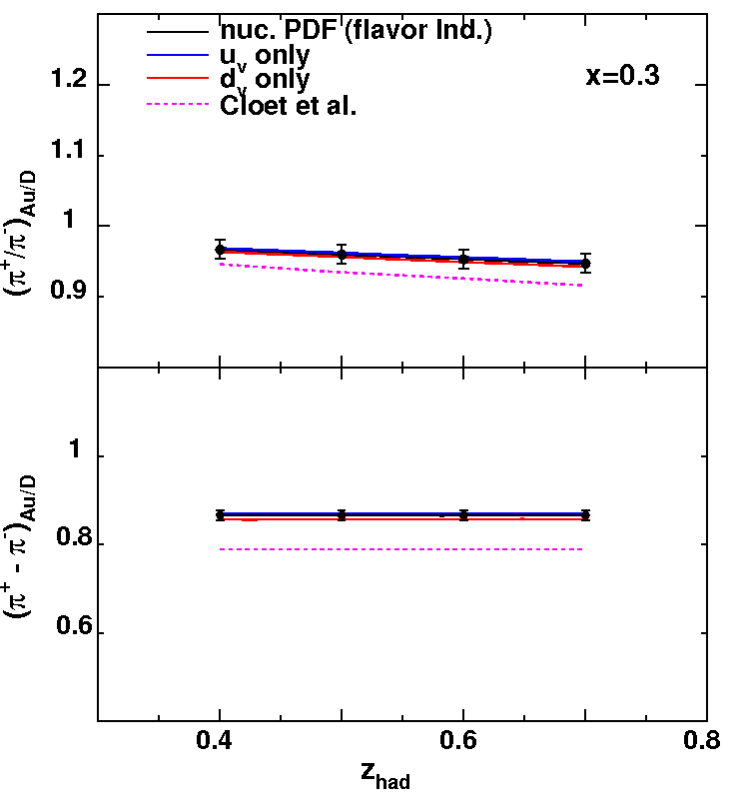
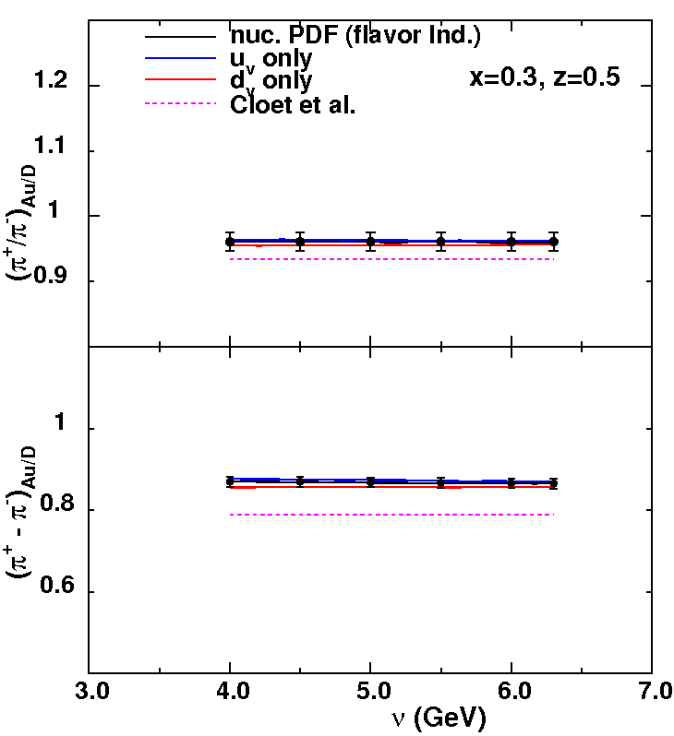
Projected Results
Hadron attenuation study
At x=0.3 there is no EMC effect and hence no flavor dependence.
z and ν scans at x=0.3 will be provide high precision measurement of
hadron attenuation of pions.

Slide 26
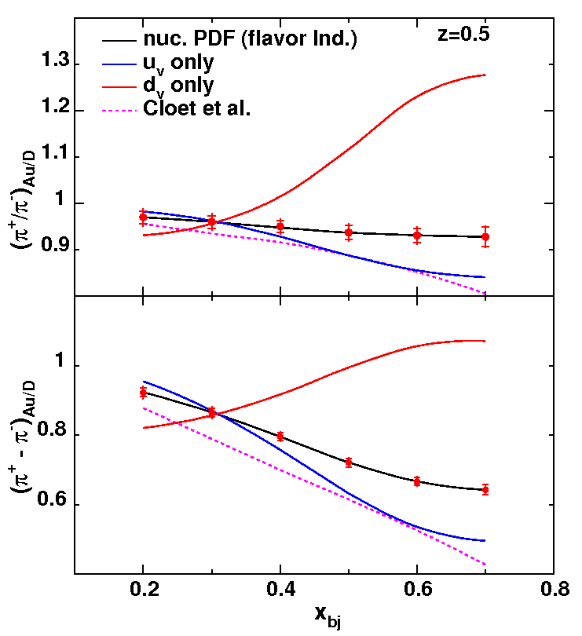
Projected Results
Flavor dependence
of the EMC effect
Both observables can be measured with sufficient precision to verify and/or set stringent limits on the flavor dependence of EMC effect

Slide 27
Beam Time Request
72 hrs of LH₂ time and
37 hrs of LD₂ time is common
between part I and part II
(PR12-09-002 and PR12-09-004)
If the EMC and CSV experiments run
together the total running time
would be reduced by 5.5 days
total run time for both = 35.5 days
Bulk of the time 418/480 hrs is
spent on the Gold target. Higher
currents would reduce this time but would need the large exit pipe on the scattering chamber.
Activity | Time (hr)
LD2 and Au data Al. dummy data LH2 data Polarity and angle change | 480.2 7 72.1 18
Total | 577.3 (24 days)

