Slide 1
Measurement of CP Observables in B⁻→D⁰K⁻ Decays at CDF
Karen Gibson
University of Pittsburgh
ICHEP 2008
08/01/08

Slide 2
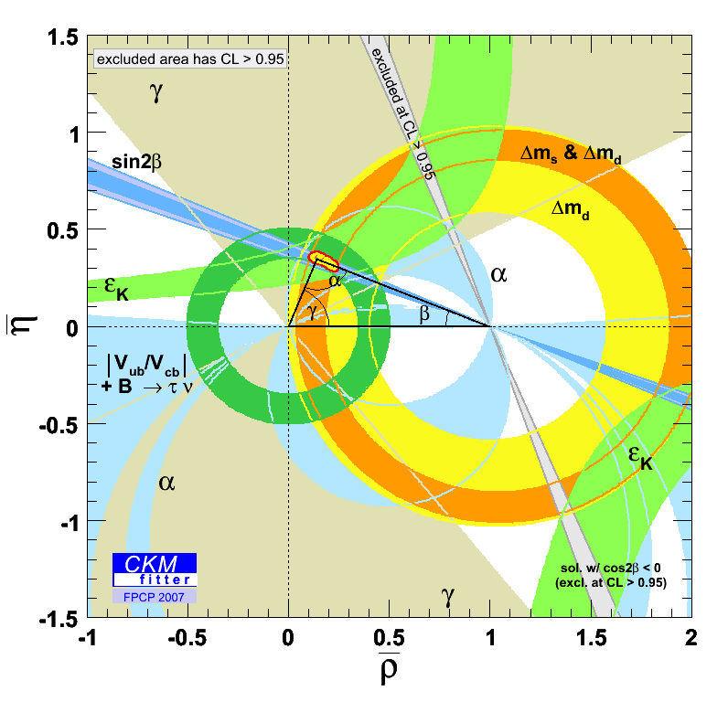
CP Asymmetries in B⁻→D⁰K⁻ Decays
CP asymmetries in B⁻→D⁰K⁻ decays can be used to gain information about CKM angle γ
Use method devised by Gronau-London-Wyler (GLW) to construct CP asymmetries based on decay rates
Note: Charge conjugates of B⁻ and D⁰ decays are implied unless both are specifically discussed!
γ= arg((−V_{ud}V*_{ub})/(V_{cd}V*_{cb}))

Slide 3
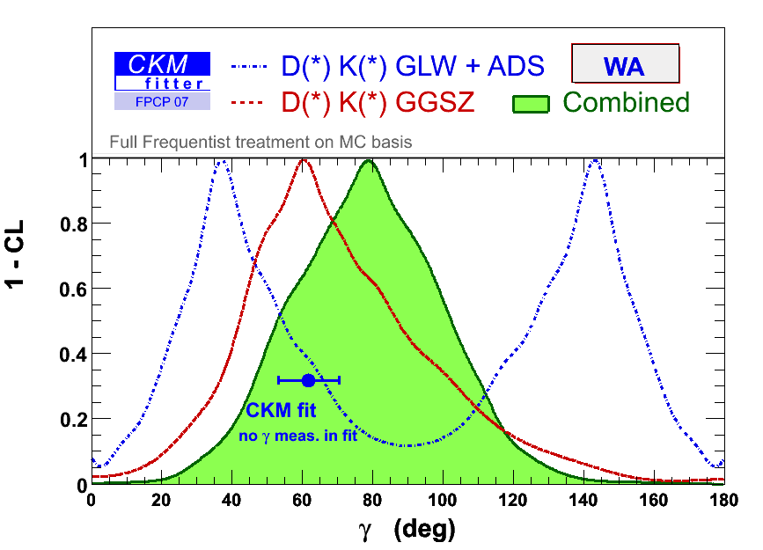
Current status of γ
As of FPCP 2007, B⁻→D⁰K⁻ asymmetries have been measured by Belle and BaBaR
Measurement is still quite statistically limited
All additional measurements help significantly
CDF’s large sample of B⁻ decays gives opportunity to contribute significantly!

Slide 4
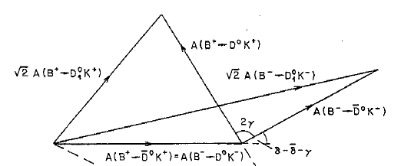
GLW Method
Measure CP asymmetry between B⁺→ D_{CP}⁰K⁺ and B⁻→ D_{CP}⁰K⁻
Ambiguities in γ remain
Measure sin γ ⇒ two possible solutions
Relative phase between f.s. final states

Slide 5
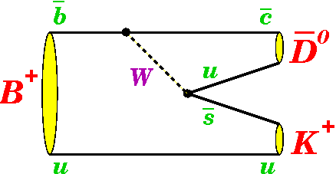
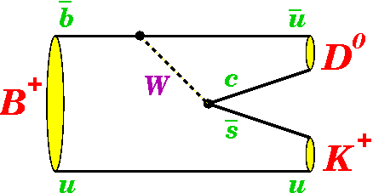
B⁻→D⁰K⁻ Decays
Consider flavor-specific and CP-even D⁰ decays
CP-even: D⁰→K⁺K⁻, D⁰ →π⁺π⁻
Flavor-specific: D⁰→K⁻π⁺
Don’t consider CP-odd decays
D⁰→K_{s}⁰π⁰, D⁰→K_{s}⁰ρ⁰, D⁰→K_{s}⁰ω, D⁰→K_{s}⁰ϕ
Can’t easily reconstruct π⁰, ρ⁰, ω & statistics too low in K_{s}⁰ϕ

Slide 6
CP Observables in GLW Method
Start with experimentally accessible observables:
Construct CP observables:

Slide 7
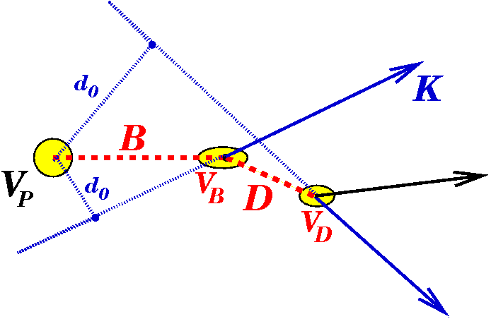
Measurement of B⁻→D⁰K⁻ at CDF
Use data collected with with CDF’s displaced track trigger detector between February 2002 and February 2006
Measure relative BR using kinematic information and particle-flavor identification in simultaneous maximum likelihood fit
Invariant mass, particle momenta, dE/dx
First measurement at a hadron collider!

Slide 8
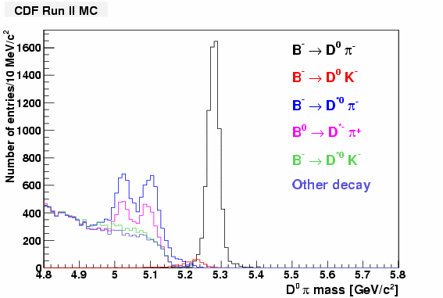
Selection to Reduce Backgrounds
Optimize sensitivity to A_{CP+}
Fit in mass window m(D⁰π) ∈ [5.17, 5.60] GeV/c²
Reduce backgrounds from decays other than B⁻→D⁰⁽*⁾π⁻
Veto event in ±2σ around B⁻→J/ψK⁻ to eliminate contamination in B⁻→D⁰[→ π⁺π⁻]K⁻ sample
Must include background events from B⁻→ K⁻ K⁺ K⁻ in likelihood fit

Slide 9
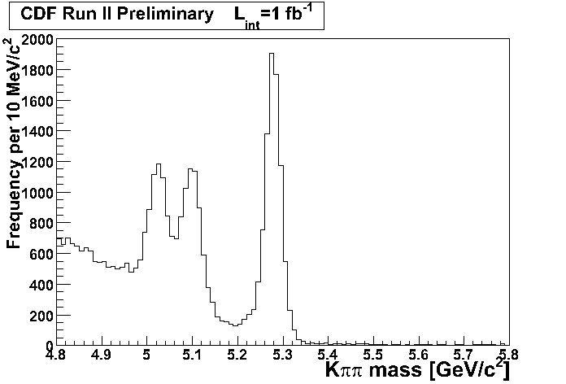
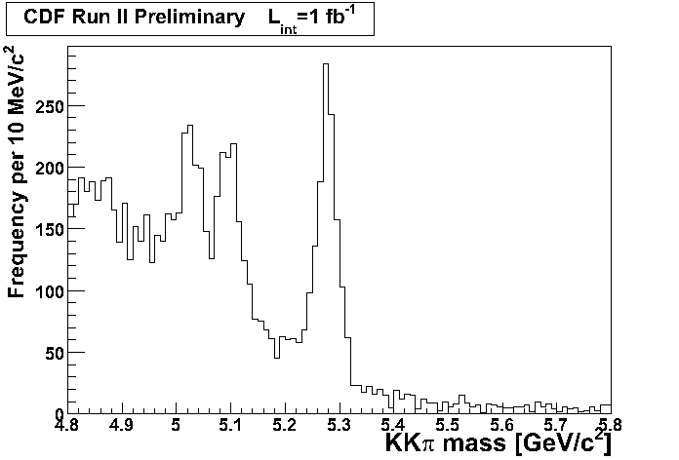
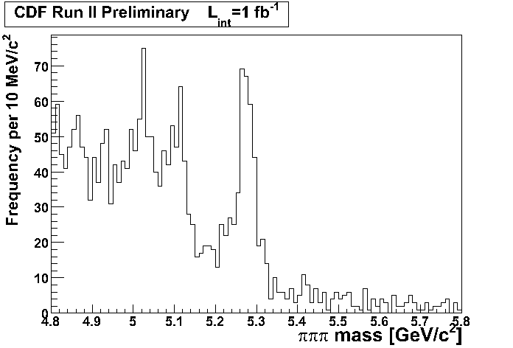
Reconstructed B⁻ after Selection
D⁰→ K⁻π⁺
N(B⁻→D⁰[→ K⁻π⁺]π⁻) ~ 7,500
N(B⁻→D⁰[→ K⁺Κ⁻]π⁻) ~ 1,000
N(B⁻→D⁰[→ π⁺π⁻]π⁻) ~ 250
D⁰→ K⁺K⁻
D⁰→ π⁺π⁻

Slide 10
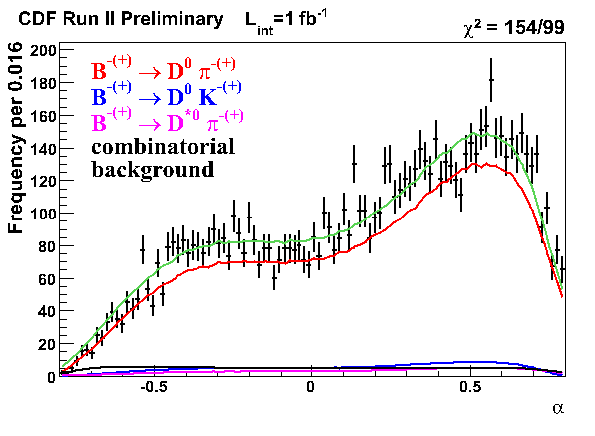
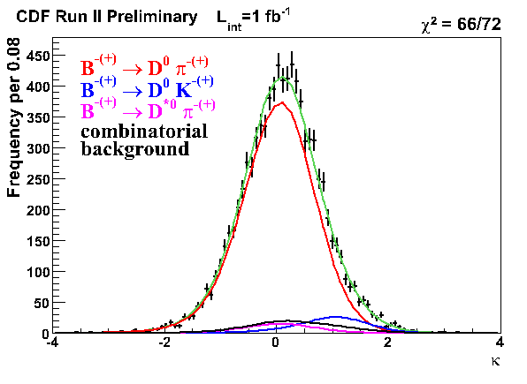
Inputs to Likelihood Fit
Variables input to fit
m(D⁰π)
p_{tot} = p_{π/K} + p_{D0}
α = 1 − p_{π/K}/p_{D0}, p_{π/K} < p_{D0}
−(1 − p_{D0}/p_{π/K}), p_{π/K} ≥ p_{D0}
κ = (dE/dx_{meas} – dE/dx_{exp}(π))/ (dE/dx_{exp}(K) – dE/dx_{exp}(π))

Slide 11
Maximum Likelihood Fit
Total likelihood written for each channel and charge
Simultaneously minimize all six likelihoods
Use MC to model correlations between α and p_{tot} in F_{DK}, F_{Dπ}, and F_{D*π} PDFs
Use mass sidebands for background F_{bg} PDF

Slide 12
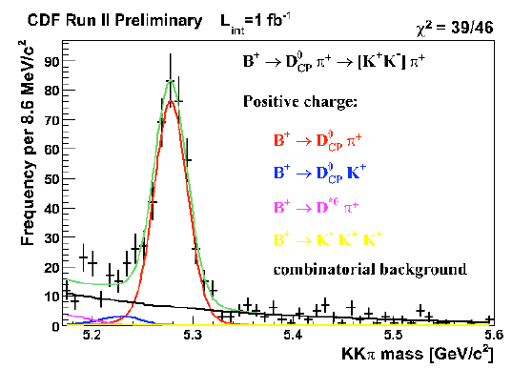
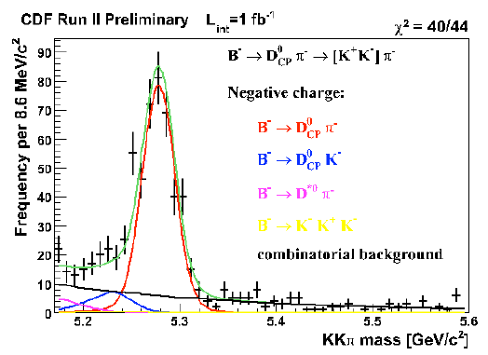
Raw Asymmetries
Correct raw numbers
Use Monte Carlo to correct for relative efficiencies between decay modes
Also correct for small biases observed in pseudo-experiments

Slide 13
Systematic Uncertainties
Source | R | R_{CP+} | A_{CP+}
dE/dx | 0.0028 | 0.056 | 0.030
Input B⁻ mass | 0.0002 | 0.004 | 0.002
D⁰*π⁻ mass model | 0.0028 | 0.025 | 0.006
Combinatoric mass model | 0.0002 | 0.020 | 0.001
(α, p_{tot}) model of combinatoric bg. | 0.0002 | 0.100 | 0.020
(α, p_{tot}) model of D⁰π⁻ | 0.0001 | 0.002 | 0.001
(α, p_{tot}) model of D⁰*π⁻ | 0.0007 | 0.004 | 0.002
(α, p_{tot}) model of D⁰K⁻ | 0.0006 | 0.002 | 0.004
Bias error | 0.0001 | 0.005 | 0.003
MC statistics | 0.002 | − | −
Total | 0.0045 | 0.12 | 0.04

Slide 14
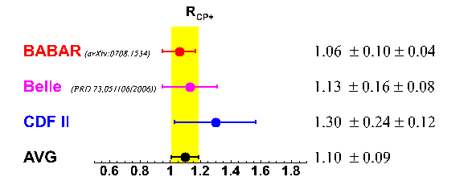
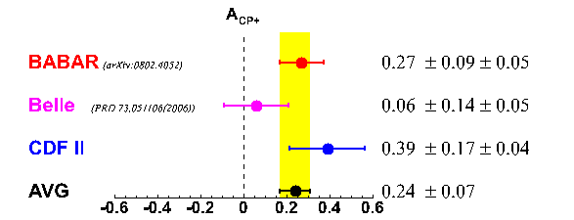
Results
R = 0.0745 ± 0.0043 (stat) ± 0.0045 (syst)
R_{CP+} = 1.30 ± 0.24 (stat) ± 0.12 (syst)
A_{CP+} = 0.39 ± 0.17 (stat) ± 0.04 (syst)
First measurement of CP observables at a
hadron collider → will soon be submitted to PRD!

Slide 15
Back-up

Slide 16
Data Selection
Optimize selection for sensitivity to A_{CP+}
Use pseudo-experiments to choose value of cuts based on smallest expected error on A_{CP+}
Parameter | Value
χ_{3D}² | 13
p_{T}(B)/(p_{T}(B)+Σ_{ΔR=1.0}p_{T}(trk)) | > 0.65
L_{xy}(B)/σ_{Lxy}(B) | > 12
Lxy(D) | > 0.04 cm
Lxy(B→D) | > 0.01 cm
|d₀(B)| | < 0.007 cm
p_{T}(π/K ) | > 2 GeV/c
ΔR(π,D⁰) | < 2
Table of selection requirements

Slide 17
Signal PDFs
Signal probabilities F_{DK} and F_{Dπ} include correlations between α and p_{tot}
Shapes of m(α, p_{tot}) and P(α, p_{tot}) are determined from CDF Monte Carlo that includes realistic detector simulation
where
for α > 0
for α ≤ 0

Slide 18
Background PDFs
Background probabilities F_{D*π} and F_{bg} also include correlations between α and p_{tot}
P_{D*π} (α, p_{tot}) determined from CDF Monte Carlo that includes realistic detector simulation
P_{bg} (α, p_{tot}) determined from mass sidebands

Slide 19
Raw Yields from Fit
Decay | Raw Fraction | Raw Yield
B⁺ →‾D⁰π⁺ | 0.902 ± 0.006 | 3769 ± 68
B⁻ → D⁰π⁻ | 0.902 ± 0.006 | 3763 ± 68
B⁺ →‾D⁰K⁺ | 0.060 ± 0.005 | 250 ± 26
B⁻ → D⁰K⁻ | 0.064 ± 0.005 | 266 ± 27
B⁺ → D_{CP}⁰π⁺ → [K⁺K⁻]π⁺ | 0.902 ± 0.017 | 498 ± 29
B⁻ → D_{CP}⁰π⁻ → [K⁺K⁻]π⁺ | 0.849 ± 0.017 | 509 ± 29
B⁺ → D_{CP}⁰K⁺→ [K⁺K⁻]K⁺ | 0.060 ± 0.017 | 33 ± 11
B⁻ → D_{CP}⁰K⁻→ [K⁺K⁻]K⁺ | 0.116 ± 0.017 | 70 ± 13
B⁺ → D_{CP}⁰π⁺ → [π⁺π⁻]π⁺ | 0.902 ± 0.017 | 109 ± 14
B⁻ → D_{CP}⁰π⁻ → [π⁺π⁻]π⁺ | 0.849 ± 0.017 | 139 ± 15
B⁺ → D_{CP}⁰K⁺→ [π⁺π⁻]K⁺ | 0.060 ± 0.017 | 7 ± 3
B⁻ → D_{CP}⁰K⁻→ [π⁺π⁻]K⁺ | 0.116 ± 0.017 | 19 ± 5

Slide 20
Extracting Asymmetry Rates
Use fractions measured in fit times total number of B ⁻ events measured in each sample to determine number of events in individual components
e.g. N(B⁻ →D⁰ K⁻ →[K+K⁻]K⁻) = N_{KKK}(1-f_{bg})(1-f_{Dπ}-f_{D*π})
Correct for relative efficiencies between decay modes using realistic MC

Slide 21
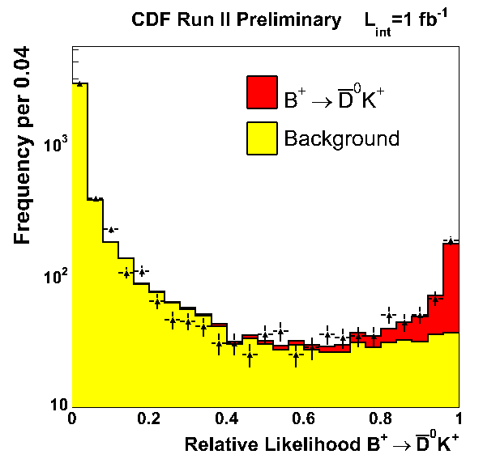
Checks of Fit
Check goodness of fit with relative likelihood

