Slide 1
NCRFC VERIFICATION
Mike DeWeese
Salt Lake City Verification Workshop
August 14-16, 2007

Slide 2
Current Activities
Approximately 380 forecast points
7 day 6 hourly RVF forecasts
9 QPF ensemble members also verified
IVP batch pairing monthly
80 hours to generate
Run weekly?
IVP batch used to generate stats txt files
IVP graphics not operationally viable due to run times
Graphics generated in Excel through pivot tables with user selectable options

Slide 3
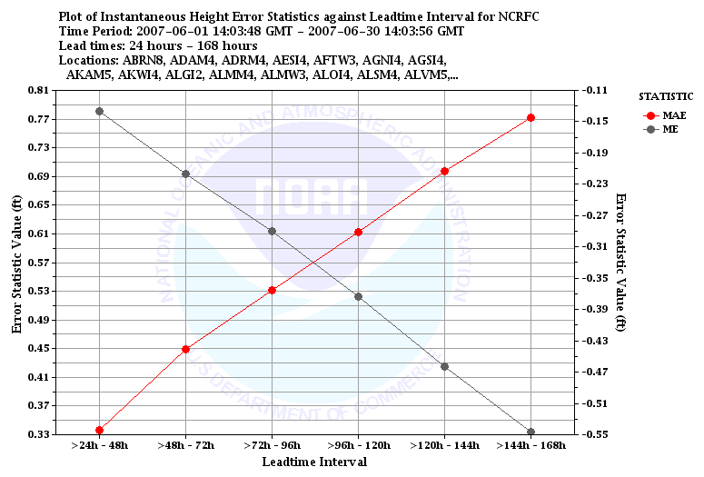
24 HR MIN QPF ERROR

Slide 4
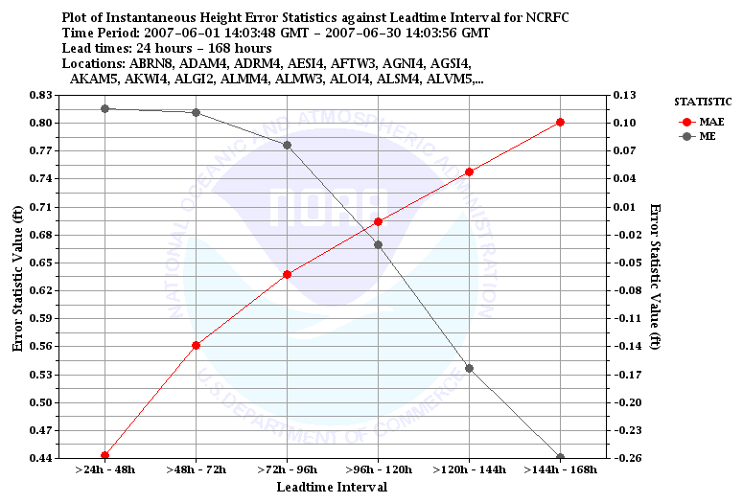
24 HR MAX QPF ERROR

Slide 5
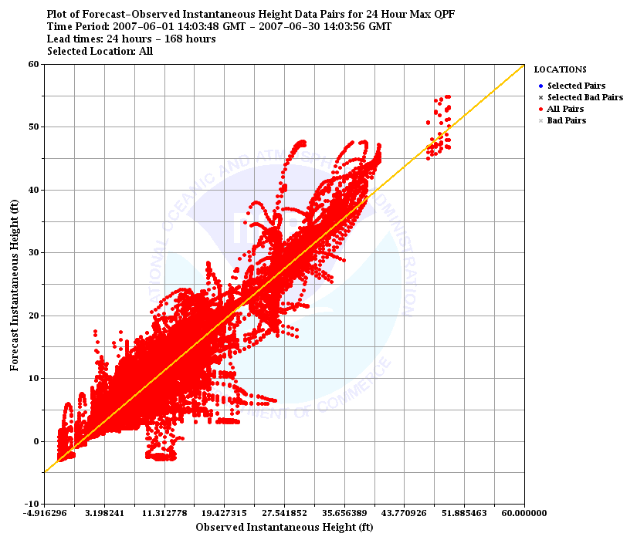
24 HR MAX QPF ERROR (3 Hour Generation)

Slide 6
QPF Ensemble Error June1-July 31, 2007

Slide 7
RVF ERROR BY FORECAST GROUP JUNE 1-30, 2007

Slide 8
RVR SEASONAL ERROR BY FORECAST GROUP

Slide 9
RESOURCE ISSUES

Slide 10
Hardware Comparison Tests
SAD is original WES machine, less memory but faster CPU
RAX upgraded to approximately 3-4 Gb memory

