Slide 1

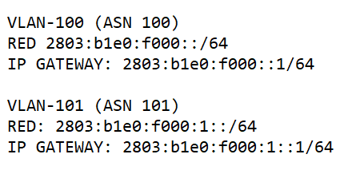
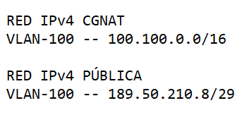

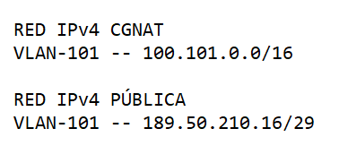

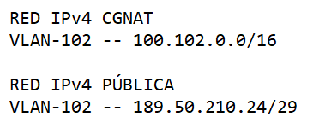
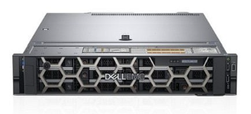
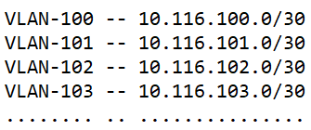
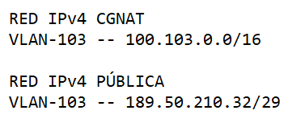
ASN 100
ASN 262191
vlan-100 .2
C&W
10.255.255.100
IPv4 189.50.210.0/24
ASN 101
IPv6 2804:b1e0::/32
eBGP
eBGP
vlan-101 .2
eBGP
.1
10.255.255.101
TRUNK
ASN 27003
eBGP
::1/64
ASN 102
eBGP
vlan-102 .2
10.255.255.102
Router Server
ASN 103
CDN
vlan-103 .2
10.255.255.103

