Slide 1
EMBER DATA: THE KEY TO GOOD RELATIONSHIPS IS COMMUNICATION
(TO YOUR REST SERVER)
Brian Gantzler brian.gantzler@cardinalhealth.com
Fuse by CardinalHealth
https://www.facebook.com/fusebycardinalhealth/

Slide 2
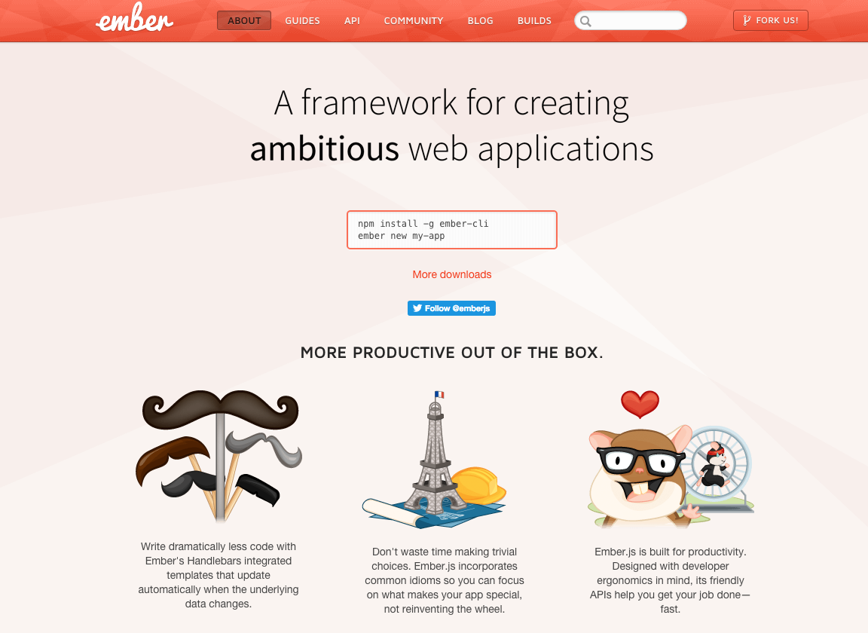

Slide 3
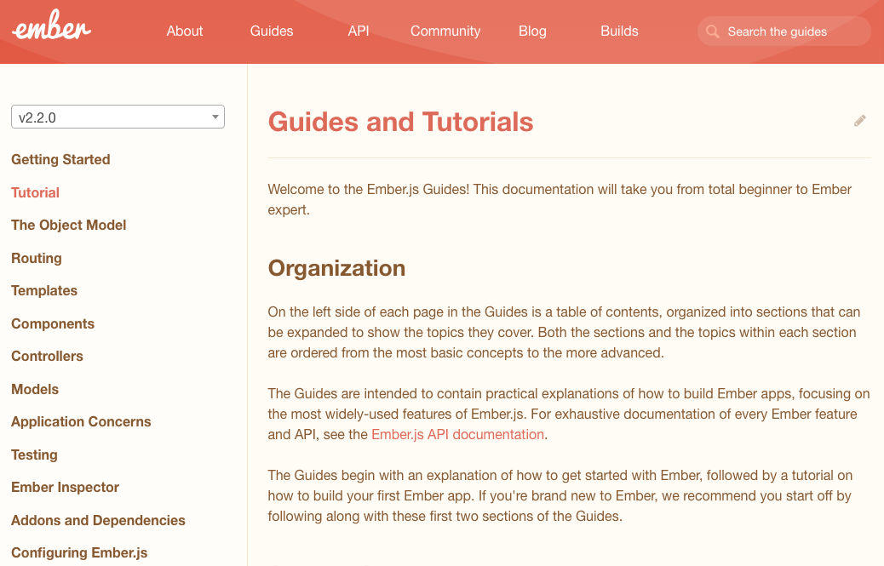

Slide 4
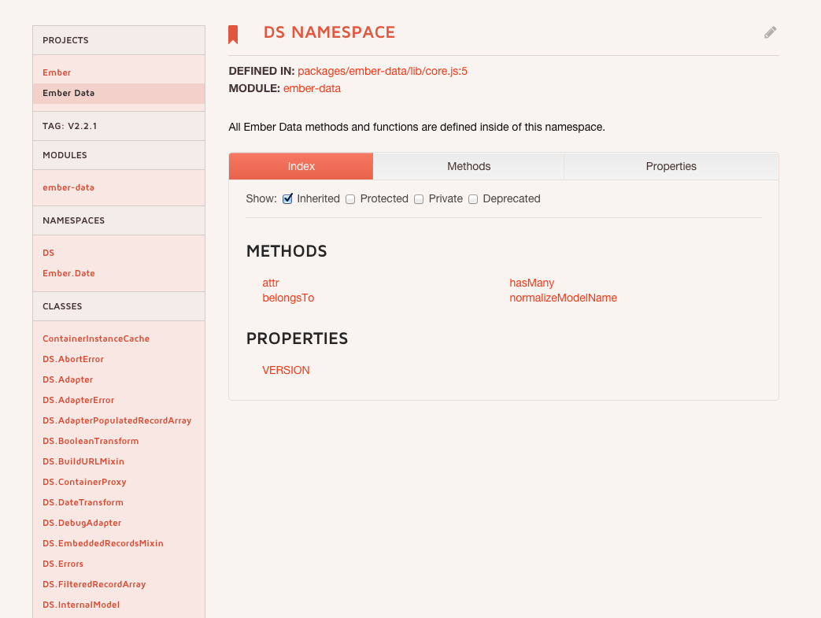

Slide 5
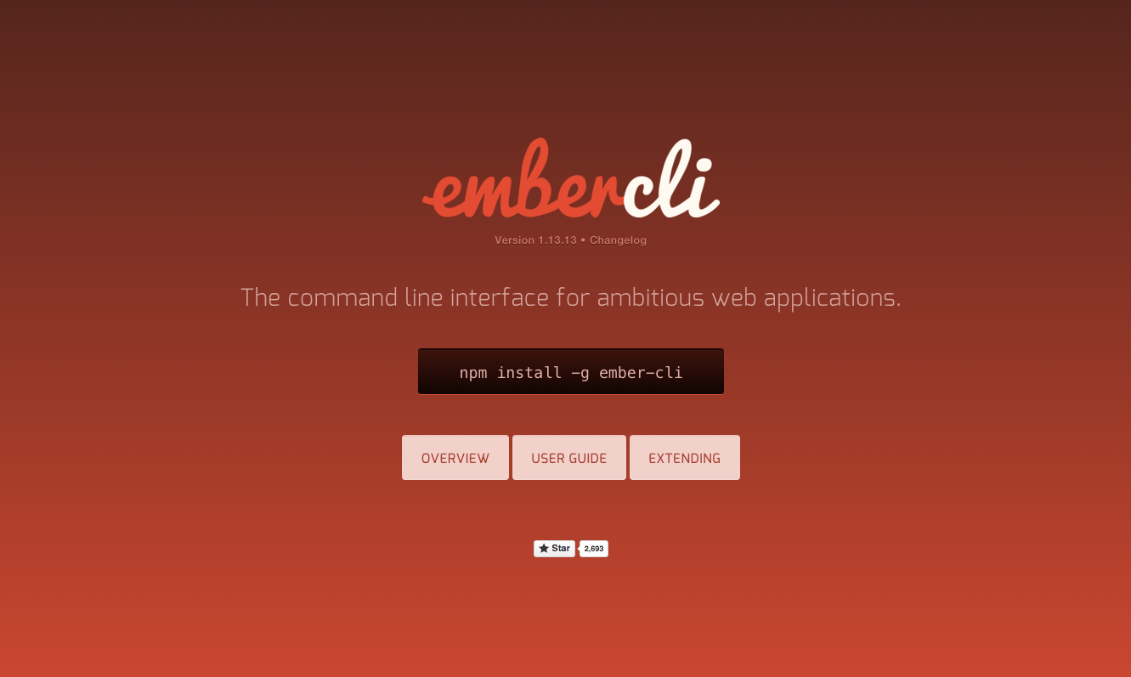

Slide 6
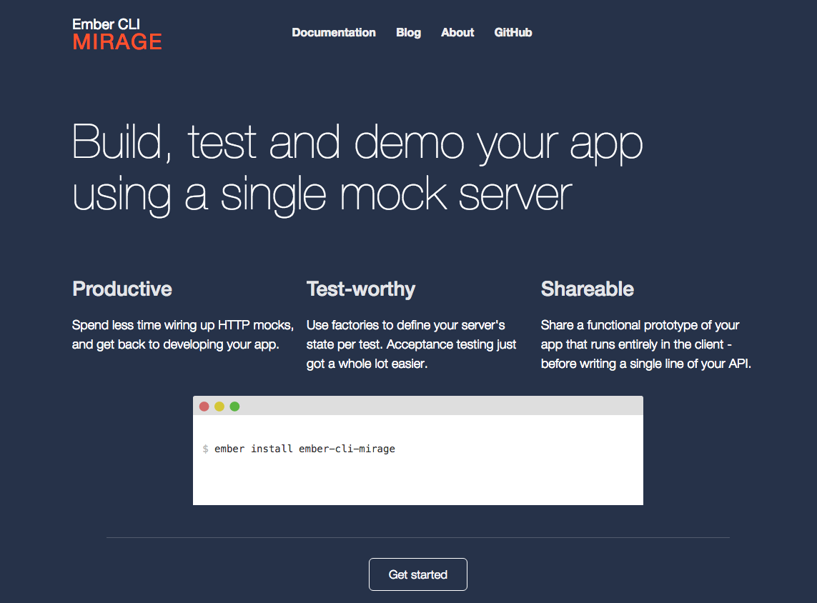

Slide 7
Adapters
Translates requests from ember to requests for the server
Allow you to completely change how your API is implemented, without impacting the application
RestAdapter vs JsonApiAdapter

Slide 8
Application Adapter
The adapter used when none is defined
export default DS.RESTAdapter.extend({ namespace: "api”,
host: “https://api.example.com”,
headers: Ember.computed(“session.authToken”, () => {
return {
“API_KEY”: this.get(“session.authToken”),
“someother_header”: “someValue”
};
});
});

Slide 9
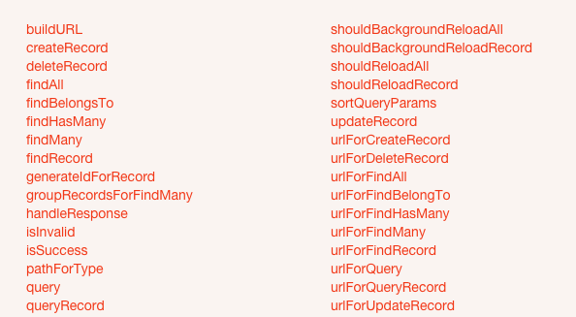
Adapter Methods

Slide 10
Serializer
Format the data sent to and received by the server

Slide 11

Jsonapi.org

Slide 12
Rest Serializer expected format
Get /api/books
{ "books": [ { "id": 1, "title": "Book title 1", "author": "a001" }, { "id": 2, "title": "Book title 2", "author": "a001" } ], "authors": [ { id: "a001", name: "Author Name 1" } } }

Slide 13
My Json
{ [ { "id": 1, "title": "Book title 1", "author": { id: "a001", name: "Author Name 1" } }, { "id": 2, "title": "Book title 2", "author": { id: "a001", name: "Author Name 1" } } ] }

Slide 14
Application Serializer
The serializer used when none is defined
import wrap from '../mixins/wrap-payload-in-root'; import unwrap from '../mixins/unwrap-payload-in-root'; export default DS.RESTSerializer.extend(wrap, unwrap, DS.EmbeddedRecordsMixin, { });

Slide 15
Models
Defines properties and behaviors
Attributes
DS.attr(“boolean”, { defaultValue: true })
Relationships
DS.belongsTo(“author”, { async: true })
DS.hasMany(“book”, {async: true})
Computed properties
Created by “ember g model book”

Slide 16
Transforms
string
number
boolean
Date
You can create your own

Slide 17
Book Model
import DS from 'ember-data'; export default DS.Model.extend({ title: DS.attr(‘string’) });
import DS from 'ember-data'; import baseModel from './base'; export default baseModel.extend({ title: DS.attr(‘string’) });

Slide 18
Model Serializer
{ "id": 1, "bookName": "Ember 101", "authorId": "a1" }, { "id": 2, "bookName": "Lord of Light", "authorId": "a2" }, { "id": 3, "bookName": "Ember Data - A Rest Guide", "authorId": "a1" }
import applicationSerializer from './application'; export default applicationSerializer.extend({ attrs: { title: { key: "bookName" } } });

Slide 19
Demo
Notes:
User branch relationships
Show files up to this point
Mirage,
Route, Template
Ember Inspector

Slide 20
Author Model
import Ember from 'ember'; import DS from 'ember-data'; import baseModel from './base'; export default baseModel.extend({ firstName: DS.attr(‘string’), lastName: DS.attr(‘string’), fullName: Ember.computed("firstName", "lastName", { get: function() { return this.get("lastName") + ", " + this.get("firstName"); } }) });

Slide 21
Author Serializer
import applicationSerializer from './application'; export default applicationSerializer.extend({ attrs: { firstName: { key: "first_name" }, lastName: { key: "last_name" } } });

Slide 22
Book Model
import DS from 'ember-data'; import baseModel from './base'; export default baseModel.extend({ title: DS.attr(‘string’), author: DS.belongsTo("author", { async: true }) });

Slide 23
Book Serializer
{ "id": 1, "bookName": "Ember 101", "authorId": "a1" }, { "id": 2, "bookName": "Lord of Light", "authorId": "a2" }, { "id": 3, "bookName": "Ember Data - A Rest Guide", "authorId": "a1" }
import applicationSerializer from './application'; export default applicationSerializer.extend({ attrs: { title: { key: "bookName" }, author: { key: "authorId", serialize: "ids", deserialize: "ids" } } });

Slide 24
RestSerializer Options
Ids – the id of the model is sent / received
records – the model is sent / received
false – the attribute is not sent / received
Notes:
RestSerializer ONLY
Go back to previous slide and give example of
Serialize: records deserialize: ids

Slide 25
DEMO
Notes:
Use crud branch
Show template
Show delay in author, Mirage requests, Ember Inspector

Slide 26
Promises - RSVP
promise.then(success, failure)
Promise.then(
function(data) {
return data;
},
function(reason) {
throw new Error(reason);
}
);
Notes:
Ember Data 1.13 doesn’t have the same defaults

Slide 27
Finding Records
// Single records var post = this.store.peekRecord('post', 1); // => no network request
var post = this.store.findRecord('post', 1); // => GET /posts/1 var post = this.store.findRecord('post', 1, { reload: true }); // Multiple records var posts = this.store.peekAll('post'); // => no network request
var posts = this.store.findAll('post'); // => GET /posts var posts = this.store.findAll('post’, { reload: true });
Notes:
Ember Data 1.13 doesn’t have the same defaults

Slide 28
Querying Records
// Querying for multiple records
// GET to /persons?filter[name]=Peter
this.store.query('person', { filter: { name: 'Peter' } }).then(
(recordArray) => { // Do something with `peters` }
); // Querying for a single record
// GET to /persons?filter[email]=tomster@example.com
this.store.queryRecord('person', { filter: { email: 'tomster@example.com' } }).then(
(record) => { // do something with `tomster` }
);
Notes:
Would not use both for the same API
RecordArray vs Record

Slide 29
Creating Records
var book = this.store.createRecord('book', { title: 'Rails is Omakase', author: this.store.peekRecord('author', 'a1') });
book.get(‘isNew’) === true;
book.get(‘dirtyType’) === ‘created’;
Records are visible in the store after create

Slide 30
NOTE: Can not set a relationship that is a promise
var book = this.store.createRecord('book', { title: 'Rails is Omakase’ // author: this.store.findRecord('author', 'a1') });
this.store.findRecord('author', 'a1').then((author) => {
book.set(‘author’, author); });

Slide 31
Updating Records
var author =
this.store.findRecord('author', 'a1').then((author) => {
author.set(‘firstName’, ‘Jason’); });
author.get(‘hasChangedAttributes’) === true;
author.get(‘dirtyType’) === ‘updated’;
changes are visible in the store

Slide 32
Deleting Records
var author =
this.store.findRecord('author', 'a1').then((author) => {
author.deleteRecord() });
author.get(‘isDeleted’) === true;
author.get(‘dirtyType’) === ‘deleted’;
records are still visible in the store
Notes:
Record is only marked as deleted, not persisted

Slide 33
Persisting Records
author.save(); // returns a promise
created records will POST /authors
updated records will PUT (Rest) PATCH (JsonApi) /authors/{id}
deleted records will DELETE /authors/{id}
-- model.destroyRecord() will delete and persist
Notes:
Record is only marked as deleted, not persisted

Slide 34
Adapter Methods
// reload (wait for promise)
shouldReloadAll: function(store, snapshotRecordArray) { return !snapshotRecordArray.length; }, shouldReloadRecord: function(store, snapshot) { return false; }, // Background (perform update)
shouldBackgroundReloadAll: function(store, snapshotRecordArray) { return true; } shouldBackgroundReloadRecord: function(store, snapshot) { return true; },
Snapshot is a copy of the record that you can inspect without side effects ( ie relationships )

Slide 35
Model Methods
rollbackAttributes – discards unsaved changes
changedAttributes – object of keys with before and after values

Slide 36
Model Computed Properties as Mixins
import Ember from 'ember'; export default Ember.Mixin.create({ fullName: Ember.computed("firstName", "lastName", { get: function() { return this.get("lastName") + ", " + this.get("firstName"); } }) });
(/mixins/model/author.js)

Slide 37
Model / Object with Mixin
import DS from 'ember-data'; import baseModel from './base'; import prop from ‘../mixins/models/author’;
export default baseModel.extend(prop, { firstName: DS.attr(), lastName: DS.attr() });
(/models/author.js)
import baseObject from './base'; import prop from ‘../mixins/models/author’;
export default baseObject.extend(prop, { firstName: null, lastName: null });
(/objects/author.js)
Notes:
Test only mixin, don’t have to interact with the store
Allows for easier creation of temp objects that the user can cancel without them being in the store

