Slide 1
EMBER DATA: THE KEY TO GOOD RELATIONSHIPS IS COMMUNICATION
(TO YOUR REST SERVER)
Brian Gantzler brian.gantzler@cardinalhealth.com
Fuse by CardinalHealth
https://www.facebook.com/fusebycardinalhealth/

Slide 2
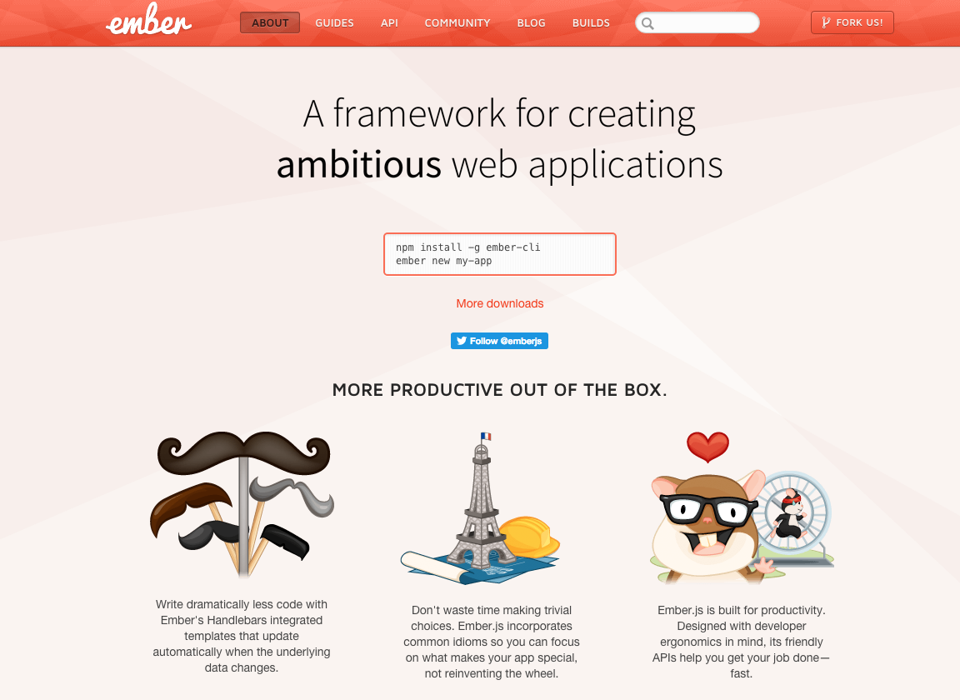

Slide 3
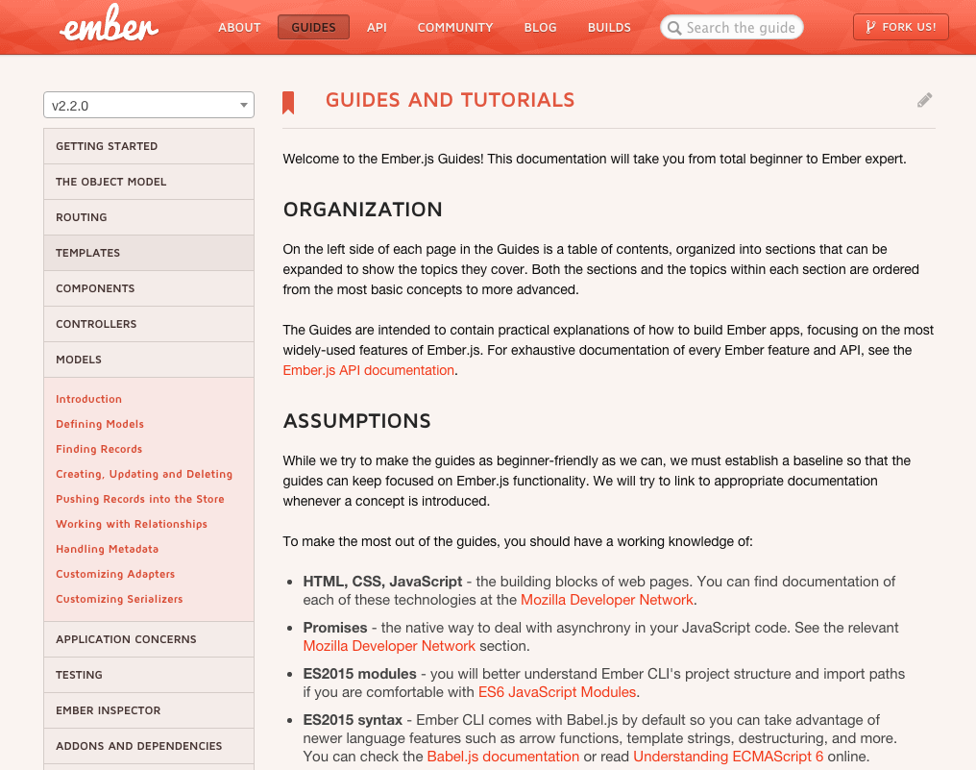

Slide 4
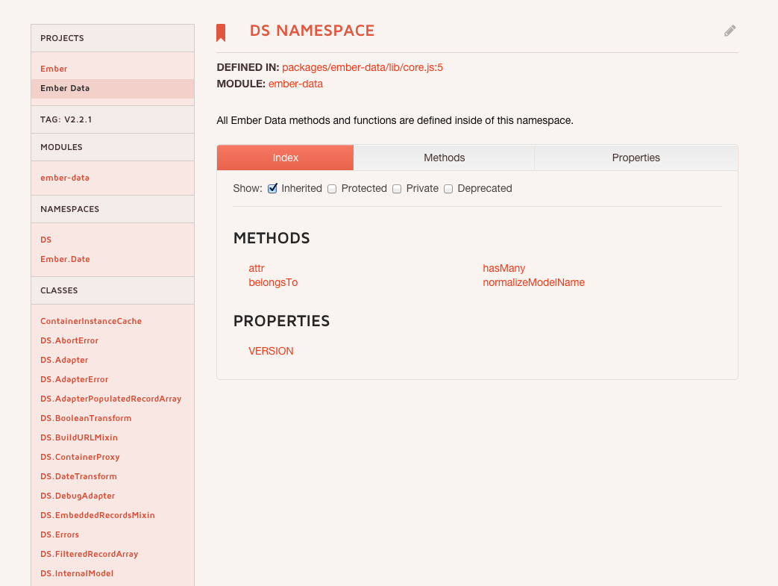

Slide 5
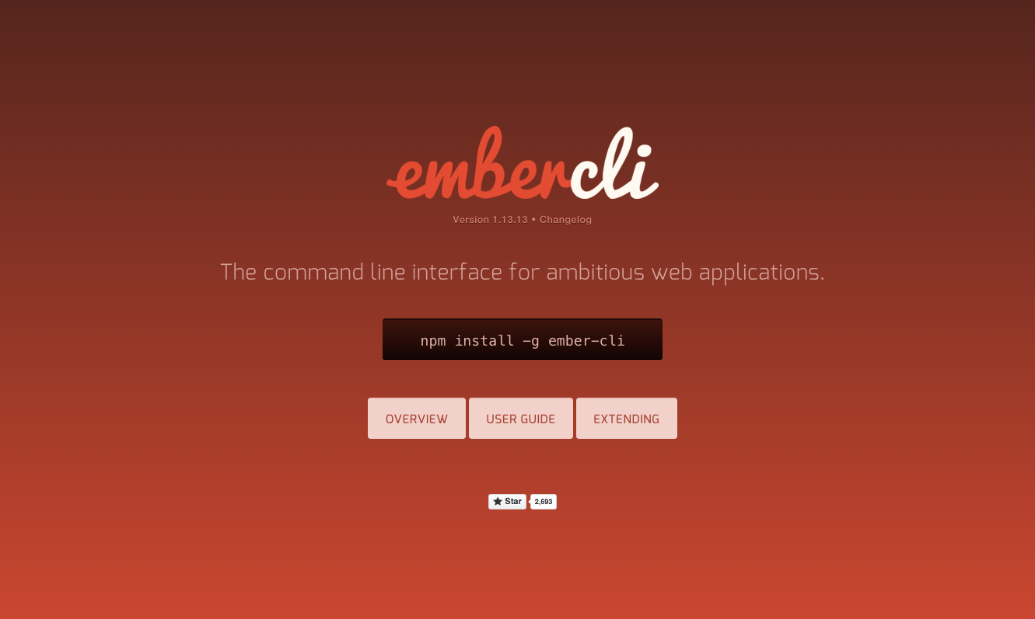

Slide 6
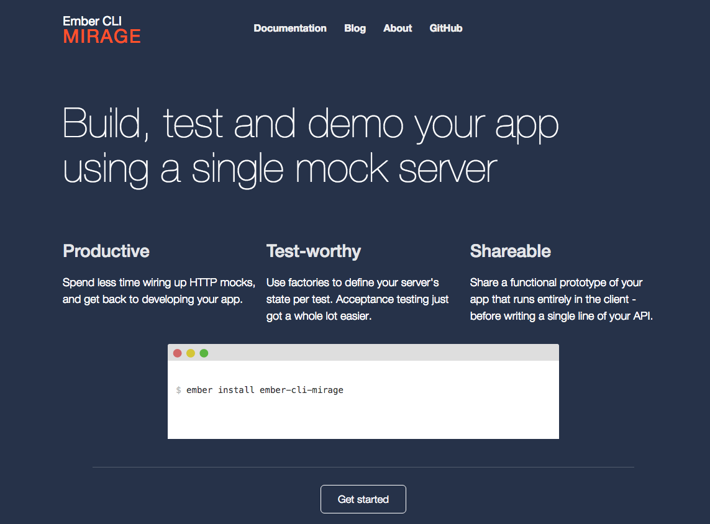

Slide 7
Finding Records
http://guides.emberjs.com/v2.2.0/models/finding-records/ /** * Single records */ var post = this.store.findRecord('post', 1); // => GET /posts/1 var post = this.store.findRecord('post', 1, { reload: true }); // => GET /posts/1 force reload var post = this.store.peekRecord('post', 1); // => no network request /** * Multiple records */ var posts = this.store.findAll('post'); // => GET /posts var posts = this.store.peekAll('post'); // => no network request /** * Querying for records */ // GET to /persons?filter[name]=Peter this.store.query('person', { filter: { name: 'Peter' } }).then(function(peters) { // Do something with `peters` }); /** * Querying for a single record */ // GET to /persons?filter[email]=tomster@example.com this.store.queryRecord('person', { filter: { email: 'tomster@example.com' } }).then(function(tomster) { // do something with `tomster` });

Slide 8
Adapter Methods
/** * reload */ shouldReloadAll: function(store, snapshotRecordArray) { return !snapshotRecordArray.length; }, shouldReloadRecord: function(store, snapshot) { return false; }, /** * Background */ shouldBackgroundReloadAll: function(store, snapshotRecordArray) { return true; } shouldBackgroundReloadRecord: function(store, snapshot) { return true; },

Slide 9
(/mixins/model/author.js)
import Ember from 'ember'; export default Ember.Mixin.create({ fullName: Ember.computed("firstName", "lastName", { get: function() { return this.get("lastName") + ", " + this.get("firstName"); } }) });

Slide 10
(/models/author.js)
import DS from 'ember-data'; import baseModel from './base'; import prop from ‘../mixins/models/author’;
export default baseModel.extend(prop, { firstName: DS.attr(), lastName: DS.attr() });
(/objects/author.js)
import baseObject from './base'; import prop from ‘../mixins/models/author’;
export default baseObject.extend(prop, { firstName: null, lastName: null });

Slide 11
MODEL PROPERTIES attributes – array of all the DS.attr() properties
dirtyType - created, updated, deleted
hasDirtyAttributes – at least one of the attributes has been changed
IsDeleted isEmpty isError isLoaded isLoading isNew isReloading IsSaving isValid
Relationships – array of all the belongsTo, hasMany properties

