Slide 1

EMBER DATA: THE KEY TO GOOD RELATIONSHIPS IS COMMUNICATION
(TO YOUR REST SERVER)
Brian Gantzler brian.gantzler@cardinalhealth.com
Fuse by CardinalHealth
https://www.facebook.com/fusebycardinalhealth/
https://github.com/cah-briangantzler/ember-data-demo1

Slide 2
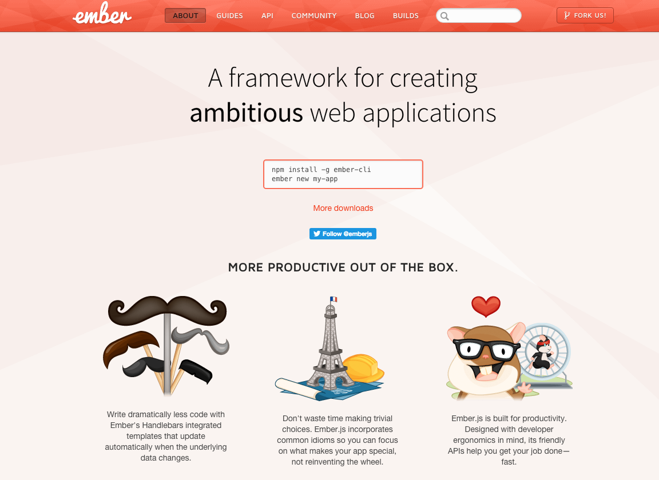

Slide 3
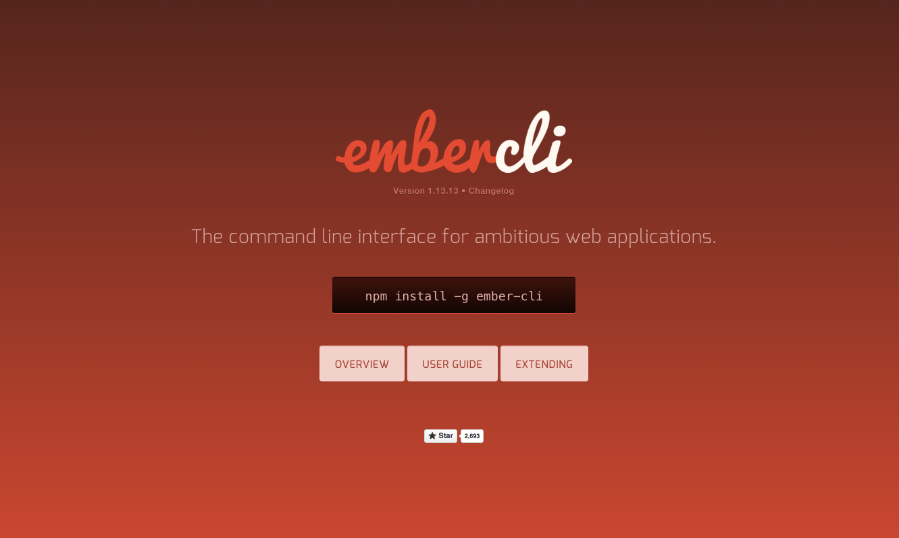
Notes:
Ember Data is an Ember Addon managed by Ember CLI
CLI does ES6 transpilation, fingerprinting, minification.
So as we go through our slides will point out the ES6 keywords

Slide 4
What is Ember Data
Single source of truth for data in your application
Provides caching
Abstract layer between application and API
Abstract layer between application and API content format

Slide 5
Ember Data Structure
Adapters – translate the API requests
Serializers – translate the API Content
Models – represent Content

Slide 6
Adapters
Translates requests from ember to requests for the server
Allow you to completely change how your API is implemented, without impacting the application
RestAdapter vs JsonApiAdapter
Notes:
We are going to be using the Rest Adapter as it probably mode closely represents your current API

Slide 7
Application Adapter
The adapter used when none is defined
import DS from 'ember-data'; export default DS.RESTAdapter.extend({ namespace: 'api', host: 'https://api.example.com', headers: Ember.computed('session.authToken', function () { return { 'API_KEY’:this.get('session.authToken'), 'someother_header': 'someValue' }; } ) });
app/adapters/application.js
Notes:
Describe Import, export
We have chose to extend from RESTAdapter

Slide 8
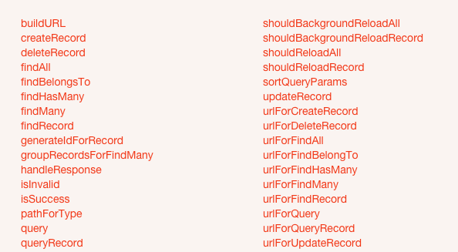
Adapter Methods
Notes:
Ember Data will attempt to create the correct URL for you, but if your API has differences, there is a method you can override to adjust that

Slide 9
Serializer
Translates the API content

Slide 10

Jsonapi.org
Notes:
Ember Data has adopted the Json API format as its internal representation. The serializer must translate the external json to this format

Slide 11
Rest Serializer expected format
{ "books": [ { "id": 1, "title": "Book title 1", "author": "a001" }, { "id": 2, "title": "Book title 2", "author": "a001" } ], "authors": [ { id: "a001", name: "Author Name 1" } ] }
Notes:
Rest serializer has an expected format. This will then be translated into Json API format
Primary entity in object or array
Secondary entities in array

Slide 12
My API json content
{ [ { "id": 1, "title": "Book title 1", "author": { id: "a001", name: "Author Name 1" } }, { "id": 2, "title": "Book title 2", "author": { id: "a001", name: "Author Name 1" } } ] }

Slide 13
Application Serializer
The serializer used when none is defined
import DS from 'ember-data';
import unwrap from '../mixins/unwrap-payload-in-root';
import wrap from '../mixins/wrap-payload-in-root';
export default DS.RESTSerializer.extend(wrap, unwrap, DS.EmbeddedRecordsMixin, {
});
app/serializers/application.js
Notes:
We have extended from RESTSerializer
Translated Both incoming and outgoing JSON
Wrap will wrap our json in the primary models type. Unwrap fixes outgoing
EmbeddedRecords extracts embedded models to secondary models

Slide 14
Models
Defines properties and behaviors
extend from DS.Model
Attributes
Relationships
Computed properties

Slide 15
Model
import DS from 'ember-data';
export default DS.Model.extend({
});
app/models/base-model.js
Notes:
Model as created by the blueprint
There is no application model, so I’m going to use base-model as mine

Slide 16
Book Model
import DS from 'ember-data';
import baseModel from './base-model';
export default baseModel.extend({
title: DS.attr('string')
});
app/models/book.js
title: DS.attr('string', { defaultValue: 'unknown' } )
string, boolean, number, date, create your own
Notes:
Since there is no application level model, I have created a base-model
Attributes support defaultValues
Javascript is typeless, If no transform specified, it carries through.
Create your own transform

Slide 17
Book Model Serializer
{ "id": 1, "bookName": "Ember 101", "authorId": "a1" }, { "id": 2, "bookName": "Lord of Light", "authorId": "a2" }, { "id": 3, "bookName": "Ember Data - A Rest Guide", "authorId": "a1" }
import applicationSerializer from './application';
export default applicationSerializer.extend({
attrs: {
title: 'bookName’
}
});
app/serializers/book.js
Notes:
Do not need to create one UNLESS you need to override
Extending from applciation serializer. Don’t have to but gives you a place to effect ALL serializers

Slide 18
What we have so far
Application Adapter
Application serializer
Book serializer
Book model
Notes:
Recap what we have
At this point we could completely use Book.

Slide 19
Relationships
DS.belongsTo
Single relationship
DS.hasMany
Multiple relationship (children)

Slide 20
Author Model
import Ember from 'ember';
import DS from 'ember-data';
import baseModel from './base-model';
export default baseModel.extend({
firstName: DS.attr('string'),
lastName: DS.attr('string'),
fullName: Ember.computed('firstName', 'lastName', {
get: function() {
return this.get('lastName') + ', ' + this.get('firstName');
}
})
});
app/models/author.js
Notes:
Extending the base
Author has two attributes
Example of a computed property (getter)

Slide 21
Author Serializer
{ "id": "a1", "first_name": "Brian", "last_name": "Gantzler" }, { "id": "a2", "first_name": "Roger", "last_name": "Zelazny" }
import applicationSerializer from './application';
export default applicationSerializer.extend({
attrs: {
firstName: 'first_name’,
lastName: 'last_name’
}
});
app/serializers/author.js
Notes:
Again our API has names that we arent really fond of and would like to change.
NOTE: If your API is consistent in its naming… remember the serializers job is to translate the request content,
You can change the application serializer to translate all underscore names to camel case as in this example
And you would NOT need to create a serializer for every model just to override he names. You could do it if you
Feel that its more explicit for the developer after you

Slide 22
Book Model with Author
import DS from 'ember-data';
import baseModel from './base-model';
export default baseModel.extend({
title: DS.attr('string'),
author: DS.belongsTo('author', { async: true } )
});
app/models/book.js
Notes:
Have added author as a single entity relationship. Books can have many authors, but for the sake of the example, ours only have one
Async true means that the data may not have been cached and a network request will be made.

Slide 23
Book Serializer
{ "id": 1, "bookName": "Ember 101", "authorId": "a1" }, { "id": 2, "bookName": "Lord of Light", "authorId": "a2" }, { "id": 3, "bookName": "Ember Data - A Rest Guide", "authorId": "a1" }
import applicationSerializer from './application';
export default applicationSerializer.extend({
attrs: {
title: 'bookName’,
author: { key: 'authorId',
serialize: 'ids', deserialize: 'ids' }
}
});
app/serializers/book.js
Notes:
Attrs can also be specfied as an object giving access to serialize and deserialize options
Renamed authorId to author because in ember data will we be given an author object, not just an id

Slide 24
Attr Options
serialize / deserialize values
Ids – the id of the model is sent / received
applies to RESTSerializer
records – the model is sent / received
applies to RESTSerializer
false – the attribute is not sent / received
Applies to RESTSerializer and JSONAPISerlializer
Notes:
Ids and records RestSerializer ONLY
False applies to both RestSerializer and JsonApiSerlializer

Slide 25
Promises - RSVP
promise.then( function(model) { return model; }, function(reason) { throw new Error(reason); } );

Slide 26
Finding Records
// Single records // no network request, returns book model
book = this.store.peekRecord('book', 1);
// GET /books/1, returns promiseObject book = this.store.findRecord('book', 1); book = this.store.findRecord('book', 1, { reload: true });
// Multiple records // no network request, returns Array
books = this.store.peekAll('book');
// GET /books, returns promiseArray
books = this.store.findAll('book'); books = this.store.findAll('book', { reload: true } );
Notes:
Peek does NO network request
Ember data implements intelligent caching
Find – explain cache, reload, background

Slide 27
Adapter Methods
// reload (do not resolve cached records) shouldReloadAll: function(store, snapshotRecordArray) { return !snapshotRecordArray.length; }, shouldReloadRecord: function(store, snapshot) { return false; }, // Background (perform network request to update records) shouldBackgroundReloadAll: function(store, snapshotRecordArray) { return true; }, shouldBackgroundReloadRecord: function(store, snapshot) { return true; },
Snapshot is a copy of the record that you can inspect without side effects
( ex. relationships )

Slide 28
Querying Records
// Querying for multiple records // GET to /persons?skill=javascript this.store.query('person', { skill: 'javascript' } ).then( function(recordArray) { // Do something } ); // Querying for a single record // GET to /states?capital=columbus this.store.queryRecord('state', { capital: 'columbus' }).then( function(record) { // do something } );
Notes:
Query always performs a network request and returns a promiseArray
QueryRecord performs a network request and returns a promiseObject

Slide 29
Creating Records
Records are visible in the store after create
var book = this.store.createRecord('book', { title: 'Rails is Omakase', author: this.store.peekRecord('author', 'a1') });
book.get('isNew') === true; book.get('dirtyType') === 'created’;
Notes: Can not currently create a record with a relationship that is a promise

Slide 30
Updating Records
All changes are visible in the store
var promise = this.store.findRecord('author', 'a1');
promise.then(function(author) { author.set('firstName', 'Jason'); });
author.get('hasChangedAttributes') === true; author.get('dirtyType') === 'updated';

Slide 31
Deleting Records
Records are still visible in the store
author.deleteRecord();
author.get('isDeleted') === true; author.get('dirtyType') === 'deleted’;
Notes:
Record is only marked as deleted, not persisted

Slide 32
Persisting Records
author.save(); // returns a promise
created records will POST /authors
updated records will PUT (Rest) PATCH (JsonApi) /authors/{id}
deleted records will DELETE /authors/{id}
-- model.destroyRecord() will delete and persist

Slide 33
BONUS
Notes:
Talk about time expired cache if have time
Demo app. Show Data Inspector

Slide 34
Time Expired Cache
import DS from 'ember-data'; export default DS.Model.extend({ lastAccessDate: DS.attr('date') });
app/models/base-model.js
export default DS.RESTSerializer.extend(…) {
attr: { lastAccessDate: { serialize: false } }, normalize: function(modelClass, resourceHash, prop) { resourceHash.lastAccessDate = new Date().getTime(); return this._super(modelClass, resourceHash, prop); } });
app/serializer/application.js

Slide 35
Time Expired Cache
shouldReloadRecord: function(store, snapshot) { var lad = snapshot.record.get('lastAccessDate'); if (lad && (new Date().getTime() - lad.getTime()) / 60000 > 20 ) { return true; } else { return false; } },
app/adapters/application.js

Slide 36
