Slide 1
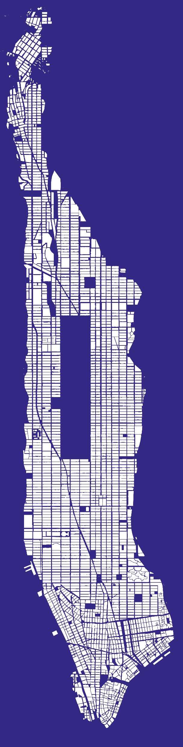
RAG Analysis of NYC Building Code Files
CS 840: Data Mining
Presented by: Cesar Herrera
Fall 2024

Slide 2
Agenda
About the Façade Inspection Safety Program (FISP and PIPs) - Application for Sales Building Summary
RAG Architecture Review (2 Experts)
Prompt Engineering / Prompt Guided Retrieval (PGR)
Next Steps

Slide 3
Motivation and Why
Motivation: Multi-Agent RAG with #langchain from AI_Marketspace
New Sales team at an Architect Firm and Problem
DoB upgraded their platform and bot blocker – failed
About base case without document

Slide 4
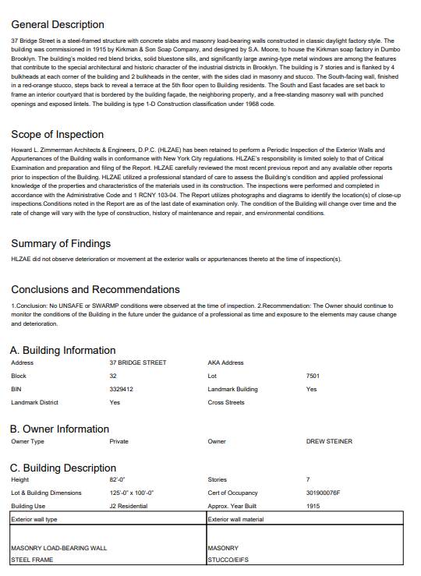
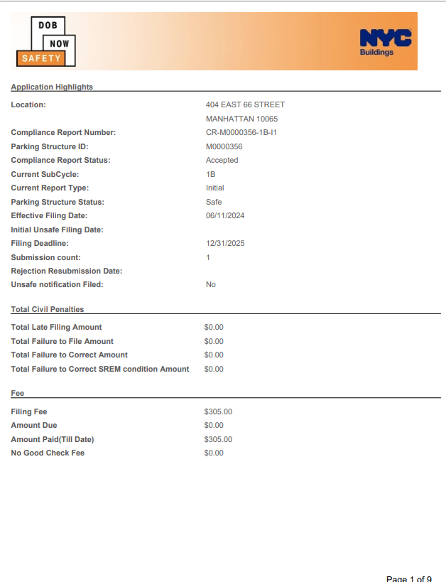
Technical Report 6 & Compliance Report documents
Document submitted per building
QEWI/QPSI Inspector Submits
Document length 10-20 pages
Building Multiclass Classification
Safe,
SWARMP/SREM
Unsafe

Slide 5
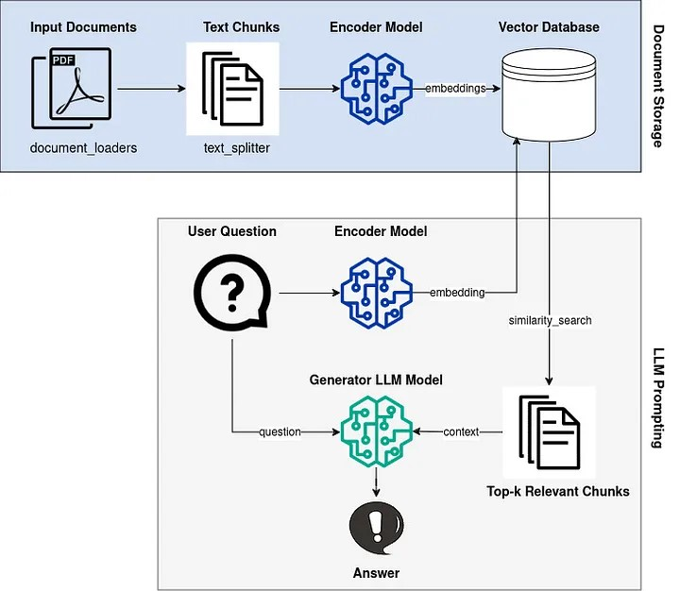
RAG architecture
Retrieval Augmented Generation
Input Documents: TR-6 and CM Docs
Encoder Model: Hugging Face
Vector Database: FAISS
LLM Model: Google Gemini (genai)

Slide 6
Prompt guided retrieval
prompt = ("""You are qualified parking structure inspector that specializes on Structural parking returns. Given the following data provide an assessment of the conditions of the building's garage""")
prompt = ("""You are a qualified wall exterior inspector that specializes on Facade inspections for NYC buildings. Given the following data provide a summary of the conditions of the building""")

Slide 7
Example of Output FISP/PIPS
The building is classified as UNSAFE per the criteria set forth in 1 RCNY 103-04. A FISP 3 Notification Form has been submitted to the Department upon discovery of the Unsafe condition and prior to the submission of this Report.
The owner has promptly taken action to protect the public and a sidewalk shed has been installed in front of the property facing East 66th Street. Construction documents for the repair of Unsafe and SWARMP conditions at the building are being prepared and will be filed with the New York City Building's Department for permits.
* Work has been performed to repair the structure, including: * Underside of rib and two-way concrete slab repairs * Concrete ramp repairs * Concrete wall repairs * Firestopping installation * Waterproofing coating application**Causes of Conditions:*** The cause of the hairline cracks is likely shrinkage.**
Conclusion:**Based on the condition assessment and physical examination, the garage is in satisfactory condition with no immediate repairs required. The observed cracks will not necessitate repairs within the next 6 years.
**Recommendations:*** Continue to monitor the conditions of the garage periodically to ensure ongoing safety.* Perform annual observation of Parking Structure components by a Qualified Professional Structural Inspector (QPSI) to address any potential changes over time.

Slide 8
Techniques to improve RAG
MultiQuery Retrieval
Contextual Compressor
LLMChainExtractor – reduces document content
Embeddings filter – similarity threshold
Ensemble Retrieval: Multiple retrievers weighted for each output
Self-Query Retriever: queries metadata tagging

Slide 9
Further Tuning
Prompt Engineering/ prompt guided retrieval
Write explicit instructions and definitions for LLM to reduce randomness
Retriever does not always extract the same entries
No random state for retriever or LLM (Sometimes gets hallucinations)
Temperature does add randomness but not consistent outputs
Tuning Retriever text_splitter chunks and overlap and number of embeddings – like homework assignment
Get bot-blocker work around to streamline

Slide 10
22:20 / 1:00:24
Multi-Agent RAG with #langchain
References
Pavlos Vougiouklis Nikos Papasarantopoulos Jeff Z. Pan Wenyu Huang, Mirella Lapata. 2023. Retrieval aug237 mented generation with rich answer encoding. An238 thology.
Yile Wang Peng Li Zhicheng Guo, Sijie Cheng and Yang Liu. 2023. Prompt-guided retrieval augmentation for non-knowledge-intensive tasks. Anthology.
AI Marketspace: Multi-Agent RAG with #langchain Youtube, 05.08.2024, youtube.com/live/ulTvNAXI_1E?si=FIKahceqSzNGfi5t

