Slide 1
Byzantine-Fault tolerant Distributed Hash Table
Charles Hartsell
Tim Krentz

Slide 2
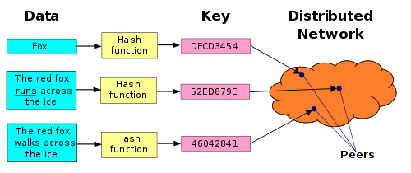
Distributed Hash Table
Image from https://commons.wikimedia.org/wiki/File:DHT_en.svg

Slide 3
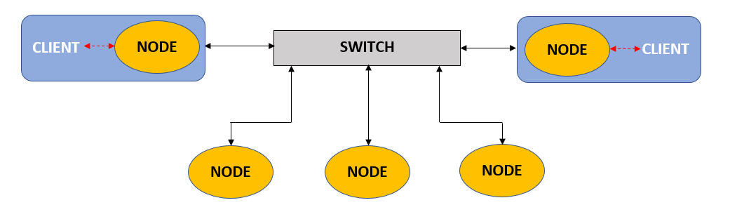
Network Topology

Slide 4
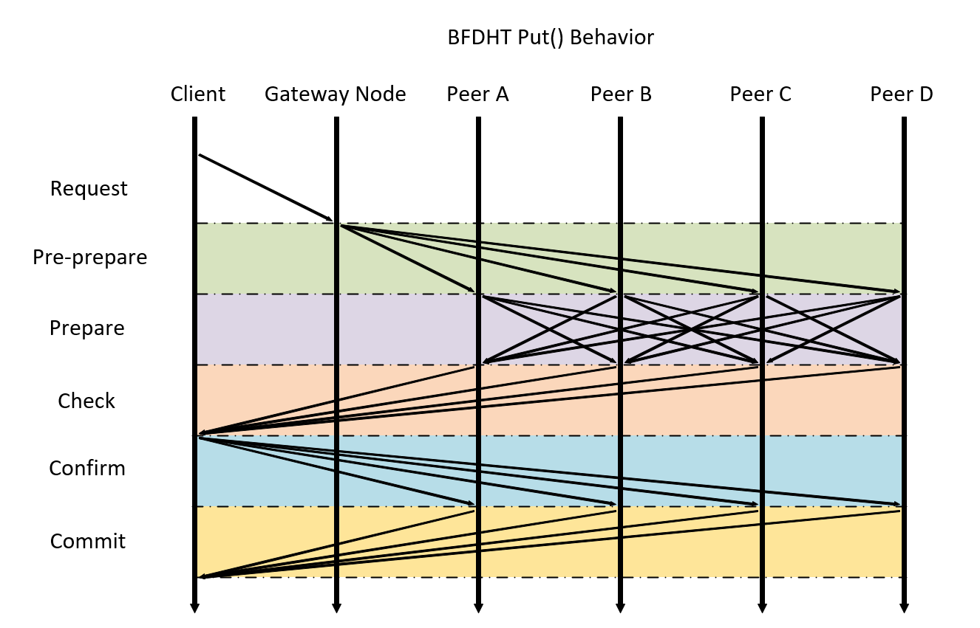
Practical Byzantine Fault Tolerance

Slide 5
