Slide 1
Modeling Environment for CFS-based Systems
Charlie Hartsell

Slide 2
Overview
Background
Project Motivation
Modeling Domain
Plugin Functionality
Examples/Demo

Slide 3
Background
Cyber Physical Systems (CPS) commonly used in safety-critical applications
System verification necessary
CPS often must perform wide range of missions
Software updates & reconfiguration on per-mission basis
Verification methods must also be reconfigurable and quick
Existing Colored Petri Net (CPN) model used for timing analysis
Models systems using the Core Flight System (CFS) framework

Slide 4
Project Motivation
CPN model allows system reconfiguration without changing model structure
Initial tokens contain information about system
Currently done by hand
Need WebGME design studio to automate reconfiguration
DSML to represent CFS systems
Plugin to generate CPN markings

Slide 5
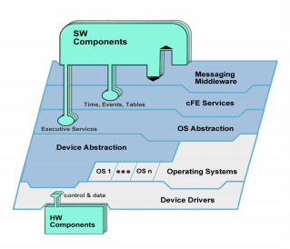
Modeling Domain
Core Flight System (CFS)
Layered, modular software framework
Common application execution model
Applications developed once
Verified independently for correctness
Integrated system must still be verified
Used for CPS
NASA Spacecraft
Unmanned Aerial Systems (UAS)
CFS Layered Architecture. Reproduced from [1]
[1] J. Wilmot, “A core flight software system,” in 2005 Third IEEE/ACM/IFIP International Conference on Hardware/Software Codesign and System Synthesis (CODES+ISSS’05), Sept 2005, pp. 13–14.

Slide 6
Plugin Functionality
Assigns unique message ID’s to all message types
Creates subscriber table in software bus node based on connected message pipes
Generates text files for:
Subscriber Table
Scheduling Table
Connected Applications
Environment
Autonomy Plans (PLEXIL)

Slide 7
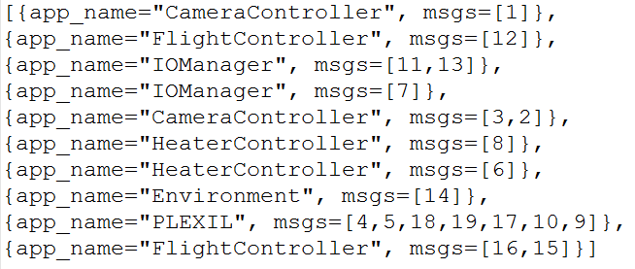
Example CPN Token
CFS provides “software bus” messaging service
Inter-application communication
Publish/Subscribe model
Need Subscription table with entries for each application

Slide 8
Demo

