Slide 1
System Verification with Colored Petri Nets
Charlie Hartsell

Slide 2
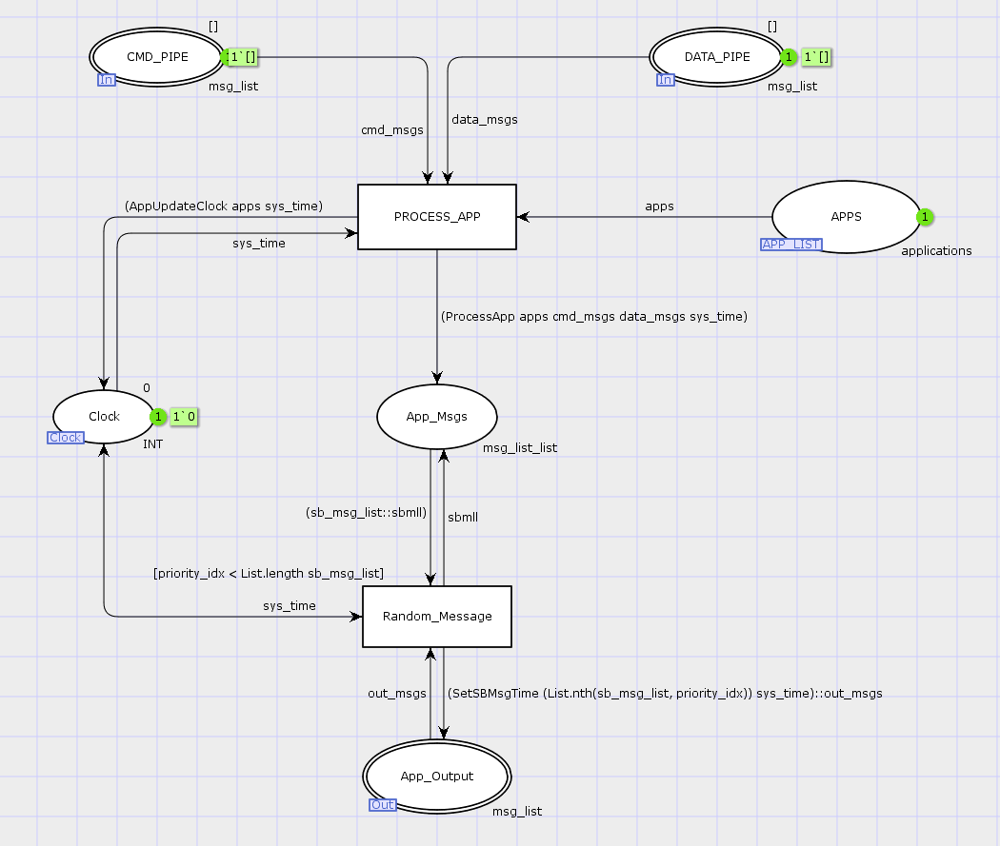
Colored Petri Net (CPN)
Problem: Cyber Physical Systems (CPS) need to perform wide range of missions
Software updates on per-mission basis
Goal: Perform rapid timing verification of new system configurations
Solution: Parameterized CPN model
New configurations loaded without model reconstruction

Slide 3
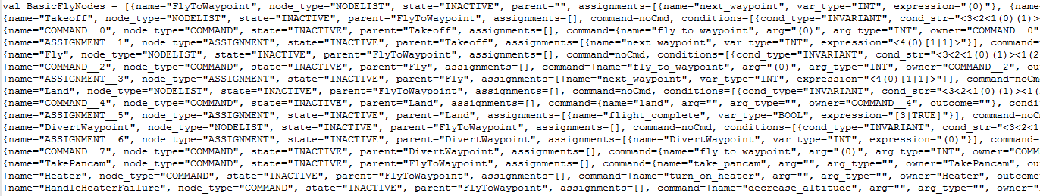
Example Parameterized Plan
Simple (<200 lines of code) autonomy plan
Approx. 10,000 characters parameterized for CPN
Need automated generation tool

Slide 4
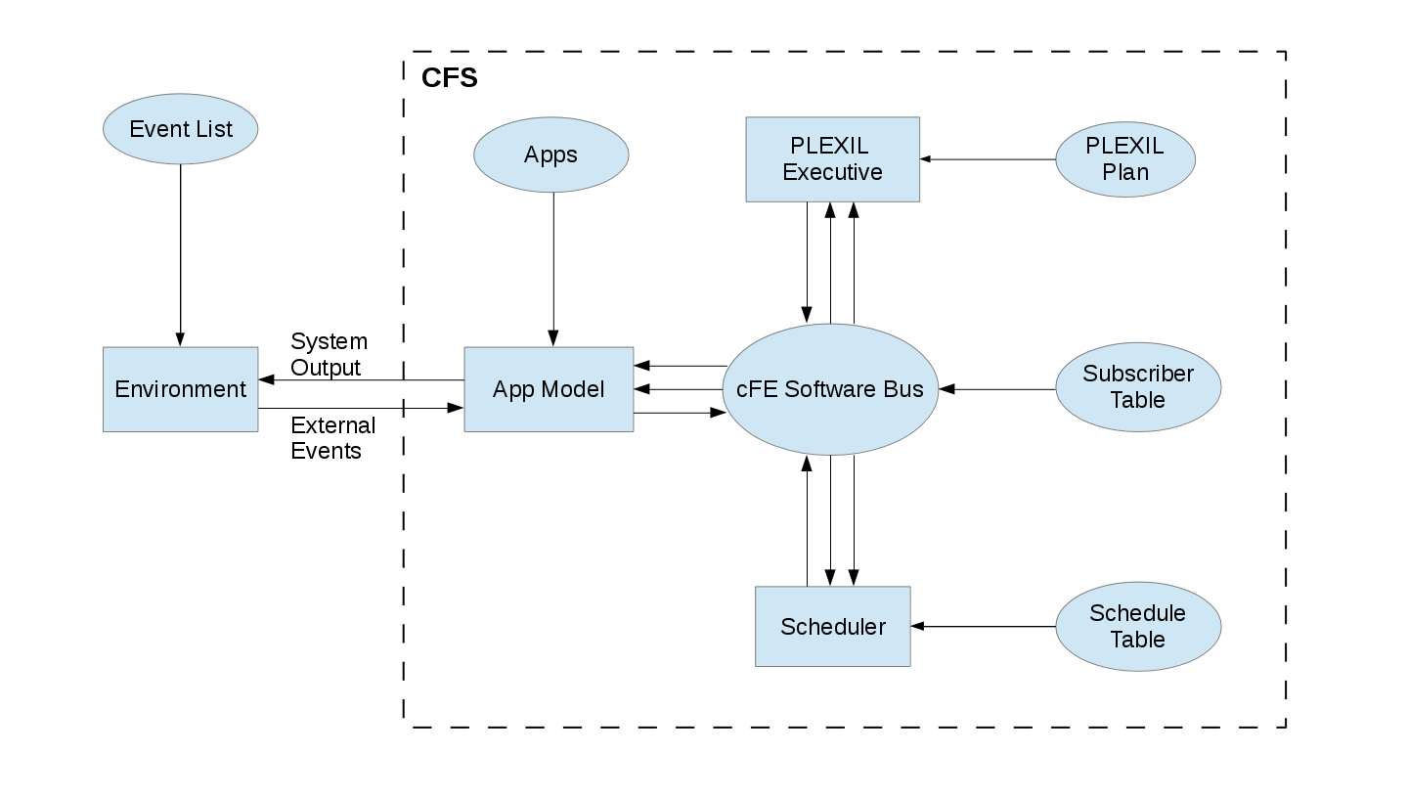
Project Goals
Create WebGME suitable meta-model and generation plugin
Application behavior
Autonomy plan
Environment model
System services (messaging, scheduling, etc.)
Plugin will generate text file with CPN compatible data structures

Slide 5
Schedule
Completed
Created meta-model (initial version)
Created example system
Some plugin functionality testing using iCore
Remaining
Finish meta-model and transition code from iCore to plugin – Nov. 17
Primary functionality of plugin completed – Nov. 24
Final Presentation – Nov. 30

