Slide 1
Introduction to Applied Predictive Modeling
© 2025 Alexandros Labrinidis, University of Pittsburgh

Slide 2
It all starts with data
Unsupervised Learning
Data (=predictor measurement)

Slide 3
It all starts with data
Unsupervised Learning
Data (=predictor measurement)
Supervised Learning
Data (=predictor measurement)
and
Labels/Values
(=response measurement)

Slide 4
Unsupervised Learning
+
Algorithms
Data
+ Parameters
= Predictor Measurements
Notes:
More on this later today

Slide 5
Unsupervised Learning
Interesting observations
Interesting patterns
+
Algorithms
Data
+ Parameters
= Predictor Measurements
Notes:
More on this later today

Slide 6
Supervised Learning
+
+
Data
Labels or Values
Algorithms
= Predictor Measurements
= Response Measurements
+ Parameters
Notes:
More on this later today

Slide 7
Supervised Learning
+
+
Data
Labels or Values
Algorithms
= Predictor Measurements
= Response Measurements
+ Parameters
model
Notes:
More on this later today

Slide 8
Supervised Learning
+
+
Data
Labels or Values
Algorithms
= Predictor Measurements
= Response Measurements
+ Parameters
+
NEW Data
model
PREDICTLabels or Values
Notes:
More on this later today

Slide 9
Examples of Unsupervised Learning Techniques
© 2025 Alexandros Labrinidis, University of Pittsburgh

Slide 10
Clustering
Clustering is the task of discovering groups and structures in the data that are in some way or another "similar", without using known structures in the data.
Members of a cluster should be more “alike” among each other, than to members of other clusters
Clustering is one type of unsupervised learning
Notes:
More on this later today

Slide 11
Clustering
Clustering is the task of discovering groups and structures in the data that are in some way or another "similar", without using known structures in the data.
Members of a cluster should be more “alike” among each other, than to members of other clusters
Clustering is one type of unsupervised learning
Notes:
More on this later today

Slide 12
Anomaly Detection
The identification of interesting data records or data errors that require further investigation.

Slide 13
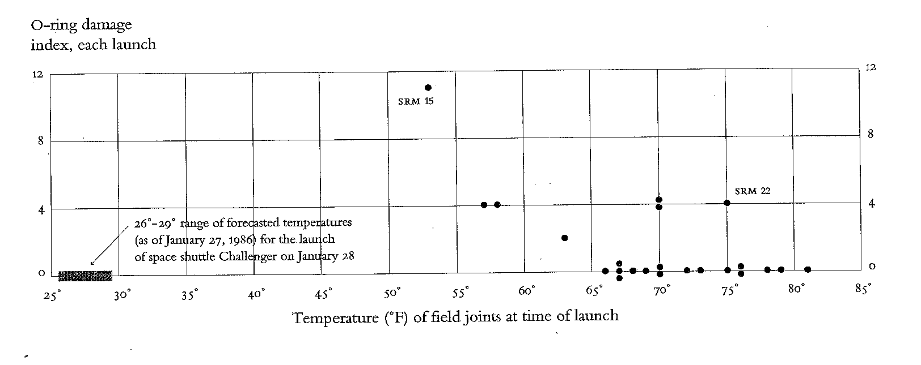
Anomaly Detection
The identification of interesting data records or data errors that require further investigation.
Source: Visual and Statistical Thinking: Displays of Evidence for Making Decisions, Edward Tufte, 1997

Slide 14
Association Rule Learning
Searches for relationships between variables.
For example, a supermarket might gather data on customer purchasing habits.
Using association rule learning, the supermarket can determine which products are frequently bought together.
For example, people buying beer often buy chips too.
Searching for novel and interesting patterns.
The supermarket can use this information for marketing purposes.
This is sometimes referred to as market basket analysis.
Notes:
More on this next week

Slide 15
Examples of Supervised Learning Techniques
© 2025 Alexandros Labrinidis, University of Pittsburgh

Slide 16
Classification vs Regression
Square Feet | Year Built | Number of Bedrooms
1500 | 1998 | 4
2100 | 2005 | 4
1650 | 1980 | 3
2500 | 2010 | 5
1850 | 1995 | 4
1400 | 1987 | 3
Initial data is referred to as “predictor measurements”
Notes:
Assume these are housing data

Slide 17
Classification vs Regression
Square Feet | Year Built | Number of Bedrooms
1500 | 1998 | 4
2100 | 2005 | 4
1650 | 1980 | 3
2500 | 2010 | 5
1850 | 1995 | 4
1400 | 1987 | 3
Has a pool?
N
Y
N
Y
N
N
+
Labels for classification tasks
“response measurements”

Slide 18
Classification vs Regression
Square Feet | Year Built | Number of Bedrooms
1500 | 1998 | 4
2100 | 2005 | 4
1650 | 1980 | 3
2500 | 2010 | 5
1850 | 1995 | 4
1400 | 1987 | 3
Has a pool?
N
Y
N
Y
N
N
+
Classification algorithm will predict the unknown label
NEW
1700 | 2000 | 3
?

Slide 19
Classification vs Regression
Square Feet | Year Built | Number of Bedrooms
1500 | 1998 | 4
2100 | 2005 | 4
1650 | 1980 | 3
2500 | 2010 | 5
1850 | 1995 | 4
1400 | 1987 | 3
Price Sold
$350K
$480K
$320K
$610K
$400K
$290K
+
Numbers for regression tasks
“response measurements”

Slide 20
Classification vs Regression
Square Feet | Year Built | Number of Bedrooms
1500 | 1998 | 4
2100 | 2005 | 4
1650 | 1980 | 3
2500 | 2010 | 5
1850 | 1995 | 4
1400 | 1987 | 3
Price Sold
$350K
$480K
$320K
$610K
$400K
$290K
+
Regression algorithm will predict the unknown value
NEW
1700 | 2000 | 3
?

Slide 21
Recommender Systems
Data are typically user ratings for items
Items can be movies/books/products
Asked to predict an item’s rating for a user
A popular algorithm is “collaborative filtering”
Notes:
More on this next week

Slide 22
Decision Trees
Can be used for classification and regression tasks
Very intuitive to implement
Example:
If the house has over 2000 square feet, then it has a pool, otherwise, it does not have a pool
Notes:
More on this next week

Slide 23
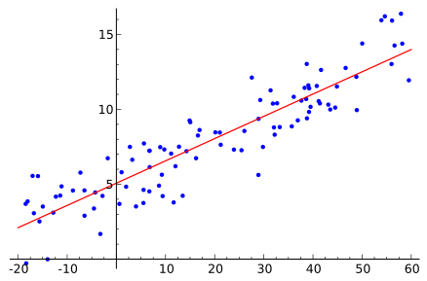
Regression
Find a function which models the data with the least error.
Source: http://en.wikipedia.org/wiki/Regression_analysis
Notes:
More on this next week

Slide 24
Naïve Bayes
Probabilistic classification algorithm
Simple, fast, and scalable
Sample applications:
Text classification (e.g., spam filtering, sentiment analysis)
Document categorization
Medical diagnosis
Notes:
More on this next week

Slide 25
Finding the right method
To find the appropriate Applied Predictive Modeling method, we must consider:
The type of problem (e.g., classification or regression task)
The type of data
The metrics of interest
What are the available APM algorithms?
What parameters should we choose for these algorithms?
Are there any optimization techniques applicable?
How to set up a full evaluation pipeline?
Notes:
More on this next week

