Slide 1
The k-NN method for classification tasks
Predicting labels with the k-Nearest Neighbors algorithm
© 2025 Alexandros Labrinidis, University of Pittsburgh
Notes:
Learning Objective
Apply the k-NN algorithm for classification tasks

Slide 2
kNN algorithm
Requirements:
Value of k
Points in n-dimensional space with coordinates and associated labels (label = class membership)
Distance function
© 2025 Alexandros Labrinidis, University of Pittsburgh

Slide 3
kNN algorithm
Requirements:
Value of k
Points in n-dimensional space with coordinates and associated labels (label = class membership)
Distance function
Algorithm:
For every new point, identify k closest neighbors
Decide label for new point based on majority of labels from neighbors
K must not be multiple of the number of classes
© 2025 Alexandros Labrinidis, University of Pittsburgh

Slide 4
kNN example – 0
Assume we have some initial data, which is labeled
Assume two classes: blue and green
© 2025 Alexandros Labrinidis, University of Pittsburgh
Notes:
Assume two kinds of labels, which we also refer to as classes

Slide 5
kNN example – 1
Assume we want to predict the label for an unlabeled new point (black)
Q: what label (color) should the new point get?
© 2025 Alexandros Labrinidis, University of Pittsburgh

Slide 6
kNN example – 1
Assume we want to predict the label for an unlabeled new point (black)
Q: what label (color) should the new point get?
A: blue (it is clearly in the blue “neighborhood”)
© 2025 Alexandros Labrinidis, University of Pittsburgh

Slide 7
kNN example – 2
Assume we want to predict the label for another unlabeled new point (black)
Q: what label (color) should the new point get?
© 2025 Alexandros Labrinidis, University of Pittsburgh

Slide 8
kNN example – 2
Assume we want to predict the label for another unlabeled new point (black)
Q: what label (color) should the new point get?
A: green (it is very close to the green “neighborhood”)
© 2025 Alexandros Labrinidis, University of Pittsburgh

Slide 9
kNN example – 3
Assume we want to predict the label for another unlabeled new point (black)
Q: Does this have an obvious label?
© 2025 Alexandros Labrinidis, University of Pittsburgh

Slide 10
kNN example – 3
Assume we want to predict the label for another unlabeled new point (black)
Q: Does this have an obvious label?
A: No, since it is in-between “neighborhoods”
© 2025 Alexandros Labrinidis, University of Pittsburgh

Slide 11
kNN example – 3
First, we need to find which points are the k closest neighbors to the black point
Let’s use a simple Euclidean distance metric
Let’s assume k=1, 2, …, 5 and identify up to 5 closest neighbors
© 2025 Alexandros Labrinidis, University of Pittsburgh

Slide 12
kNN example – 3
Let’s look at the labels of the closest neighbors of the black point
Closest neighbor => blue
2nd closest neighbor => green
3rd closest neighbor => green
4th closest neighbor => blue
5th closest neighbor => green
1
4
2
3
5
© 2025 Alexandros Labrinidis, University of Pittsburgh

Slide 13
kNN example – 3
To decide the label for the black point, we need to:
decide on value for k, and
use the majority rule.
1
4
2
3
5
© 2025 Alexandros Labrinidis, University of Pittsburgh

Slide 14
kNN example – 3
K | labels | decision
1 | blue | blue
2 | blue, green | TIE
3 | blue, green x2 | green
4 | blue x2, green x2 | TIE
5 | blue x2, green x3 | green
1
4
2
3
5
© 2025 Alexandros Labrinidis, University of Pittsburgh
Notes:
Next we will review how we compute distances between points

Slide 15
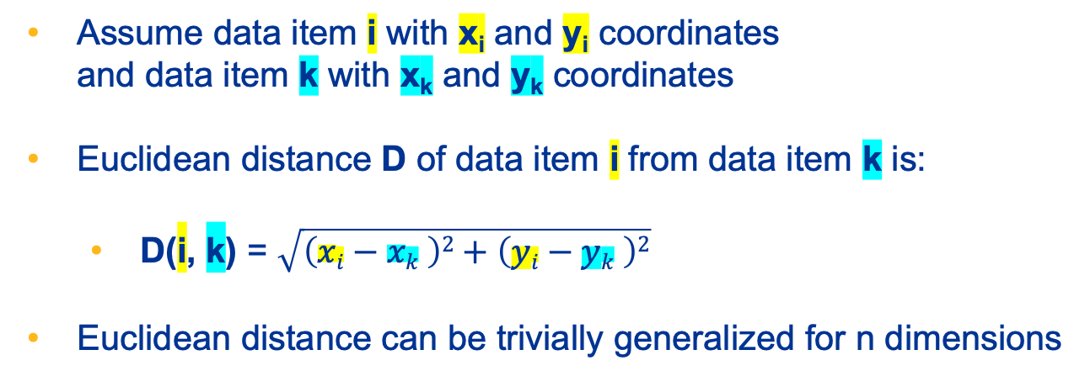
Euclidean Distances
Assume data item i with x_{i} and y_{i} coordinates and data item k with x_{k} and y_{k} coordinates
Euclidean distance D of data item i from data item k is:
D(i, k) = $\sqrt{\left(xi−xk \right)2+\left(yi−yk \right)2}$
Euclidean distance can be trivially generalized for n dimensions
© 2025 Alexandros Labrinidis, University of Pittsburgh
Notes:
Computing Euclidean distances to find the nearest neighbors is easy
Assume we have two dimensions and each data item i has an x and a y coordinate

Slide 16

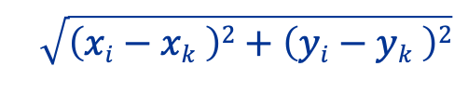





Euclidean Distance Example
Assume two data items
i and k.
Their distance D(i,k) is computed by the formula below
Y axis
i
k
y$i$
y$i−yk$
$yk$
$xi−xk$
$$\sqrt{\left(xi−xk \right)2+\left(yi−yk \right)2}$$
$$xi$$
$xk$
X axis
© 2025 Alexandros Labrinidis, University of Pittsburgh
Notes:
Computing Euclidean distances to find the nearest neighbors is easy
Assume we have two dimensions and each data item i has an x and a y coordinate

Slide 17
Strengths and Weaknesses
Strengths of kNN:
Intuitive
Simple implementation
No assumptions about data distributions
© 2025 Alexandros Labrinidis, University of Pittsburgh

Slide 18
Strengths and Weaknesses
Strengths of kNN:
Intuitive
Simple implementation
No assumptions about data distributions
Weaknesses of kNN:
Computationally expensive for large datasets
Sensitivity to irrelevant features and noisy data
Curse of dimensionality
© 2025 Alexandros Labrinidis, University of Pittsburgh

