Slide 1
The k-NN method for regression tasks
Predicting numerical values with the k-Nearest Neighbors algorithm
© 2025 Alexandros Labrinidis, University of Pittsburgh
Notes:
Learning Objective
Apply the k-NN algorithm for classification tasks

Slide 2
kNN algorithm
Requirements:
Value of k
Points in n-dimensional space with coordinates and associated values
Distance function
© 2025 Alexandros Labrinidis, University of Pittsburgh

Slide 3
kNN algorithm
Requirements:
Value of k
Points in n-dimensional space with coordinates and associated values
Distance function
Algorithm:
For every new point, identify k closest neighbors
Predict the value for the new point using the average of the values of the closest neighbors
© 2025 Alexandros Labrinidis, University of Pittsburgh

Slide 4
Example using housing data
Square Feet | Year Built | Price $ (Thousands)
1500 | 1998 | 350
2100 | 2005 | 480
1650 | 1980 | 320
2500 | 2010 | 610
1850 | 1995 | 400
1400 | 1987 | 290
2200 | 2015 | 650
1700 | 2000 | 370
1950 | 1992 | 410
2300 | 2008 | 590

Slide 5
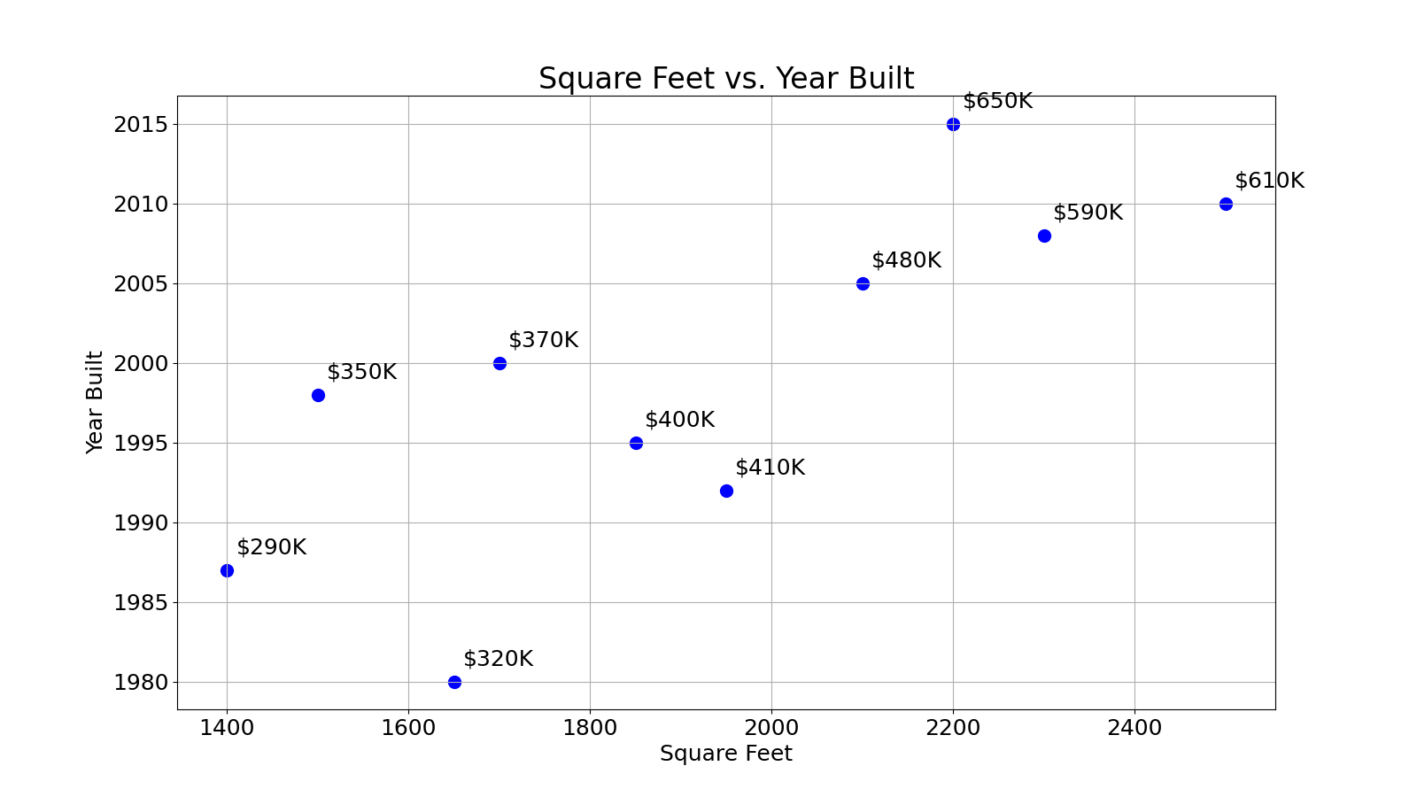
Example using housing data
Square Feet | Year Built | Price $ (Thousands)
1500 | 1998 | 350
2100 | 2005 | 480
1650 | 1980 | 320
2500 | 2010 | 610
1850 | 1995 | 400
1400 | 1987 | 290
2200 | 2015 | 650
1700 | 2000 | 370
1950 | 1992 | 410
2300 | 2008 | 590

Slide 6
Example using housing data
Square Feet | Year Built | Price $ (Thousands)
1500 | 1998 | 350
2100 | 2005 | 480
1650 | 1980 | 320
2500 | 2010 | 610
1850 | 1995 | 400
1400 | 1987 | 290
2200 | 2015 | 650
1700 | 2000 | 370
1950 | 1992 | 410
2300 | 2008 | 590
Year built = 1999 Square ft = 2000 Price = ???

Slide 7
Example using housing data
Assume k=4, find 4 nearest neighbors
Square Feet | Year Built | Price $ (Thousands)
1500 | 1998 | 350
2100 | 2005 | 480
1650 | 1980 | 320
2500 | 2010 | 610
1850 | 1995 | 400
1400 | 1987 | 290
2200 | 2015 | 650
1700 | 2000 | 370
1950 | 1992 | 410
2300 | 2008 | 590
Year built = 1999 Square ft = 2000 Price = ???

Slide 8
Example using housing data
Assume k=4, find 4 nearest neighbors
Square Feet | Year Built | Price $ (Thousands)
1500 | 1998 | 350
2100 | 2005 | 480
1650 | 1980 | 320
2500 | 2010 | 610
1850 | 1995 | 400
1400 | 1987 | 290
2200 | 2015 | 650
1700 | 2000 | 370
1950 | 1992 | 410
2300 | 2008 | 590
Year built = 1999 Square ft = 2000 Price = ???

Slide 9
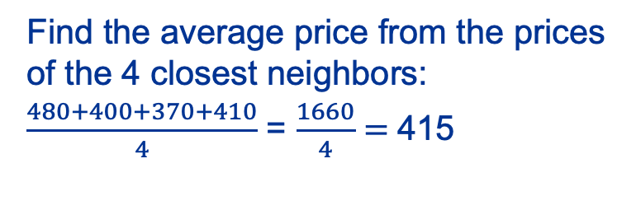
Example using housing data
Square Feet | Year Built | Price $ (Thousands)
1500 | 1998 | 350
2100 | 2005 | 480
1650 | 1980 | 320
2500 | 2010 | 610
1850 | 1995 | 400
1400 | 1987 | 290
2200 | 2015 | 650
1700 | 2000 | 370
1950 | 1992 | 410
2300 | 2008 | 590
Square Feet | Year Built | Price $ (Thousands)
2000 | 1999 | ???
Find the average price from the prices of the 4 closest neighbors:
$\frac{480+400+370+410}{4}$ = $\frac{1660}{4}=$415

Slide 10
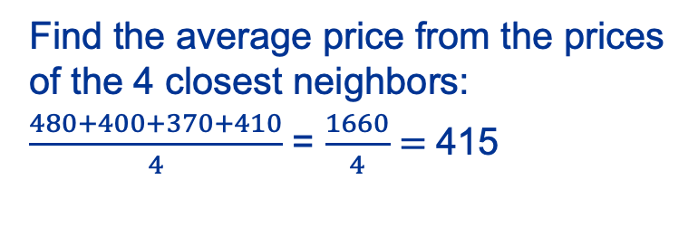
Example using housing data
Square Feet | Year Built | Price $ (Thousands)
1500 | 1998 | 350
2100 | 2005 | 480
1650 | 1980 | 320
2500 | 2010 | 610
1850 | 1995 | 400
1400 | 1987 | 290
2200 | 2015 | 650
1700 | 2000 | 370
1950 | 1992 | 410
2300 | 2008 | 590
Square Feet | Year Built | Price $ (Thousands)
2000 | 1999 | 415
Our prediction
Find the average price from the prices of the 4 closest neighbors:
$\frac{480+400+370+410}{4}$ = $\frac{1660}{4}=$415
Notes:
Next we will see how this is applied in real life

Slide 11
Real-life: train+test data split
Square Feet | Year Built | Price $ (Thousands)
1500 | 1998 | 350
2100 | 2005 | 480
1650 | 1980 | 320
2500 | 2010 | 610
1850 | 1995 | 400
1400 | 1987 | 290
2200 | 2015 | 650
1700 | 2000 | 370
1950 | 1992 | 410
2300 | 2008 | 590
We want to evaluate the quality of these algorithms
Split dataset randomly into:
Training data (80%) Use to train algorithm.
Test data (20%) 1) Pretend we don’t know the result (“mask it”). 2) Predict it using the algorithm. 3) Compare it with the known value.
Notes:
HIGHLIGHT Training Data and Test Data in next slide

Slide 12
Real-life: train+test data split
Square Feet | Year Built | Price $ (Thousands)
1500 | 1998 | 350
2100 | 2005 | 480
1650 | 1980 | 320
2500 | 2010 | 610
1850 | 1995 | 400
1400 | 1987 | 290
2200 | 2015 | 650
1700 | 2000 | 370
1950 | 1992 | 410
2300 | 2008 | 590
We want to evaluate the quality of these algorithms
Split dataset randomly into:
Training data (80%) Use to train algorithm.
Test data (20%) 1) Pretend we don’t know the result (“mask it”). 2) Predict it using the algorithm. 3) Compare it with the known value.
Notes:
This train+test technique is general and applies to both regression and classification tasks and we will see more information about it later in the course.
how well are the predictions?

Slide 13
Real-life: Evaluation Metrics
Classification Tasks:
False positives, False negatives, etc.
Precision/Recall
F1 score
Regression Tasks:
MAE: Mean Absolute Error
RMSE: Root Mean Squared Error
© 2025 Alexandros Labrinidis, University of Pittsburgh

Slide 14
Mean Absolute Error (MAE)
“Masked” result p_{i}, predicted result q_{i}
Compute the absolute error between p_{i} and q_{i}
Aggregate over all predictions
Compute the average
Notes:
\mbox{MAE} = \frac{1}{N} \times \sum_{i=1}^{N} \mid p_i \ – \ q_i \mid

Slide 15
Root Mean Squared Error (RMSE)
“Masked” result p_{i}, predicted result q_{i}
Compute the error between p_{i} and q_{i} and square it
Aggregate over all predictions and divide by N
Compute the square root
Notes:
\mbox{RMSE} = \sqrt{ \frac{\sum_{i=1}^{N} (p_i \ – \ q_i)^2}{N}}

