Slide 1
Introduction to Data Preprocessing
© 2025 Alexandros Labrinidis, University of Pittsburgh

Slide 2
A Real-Life Data Example
© 2025 Alexandros Labrinidis, University of Pittsburgh

Slide 3

The Pitt Smart Living Project
Tag line: Building a Smart City Economy and Information Ecosystem to Motivate Pro-Social Transportation Behavior
Funded by:
National Science Foundation ($1.4M) and
University of Pittsburgh (seed funding)
September 2017 – August 2022

Slide 4
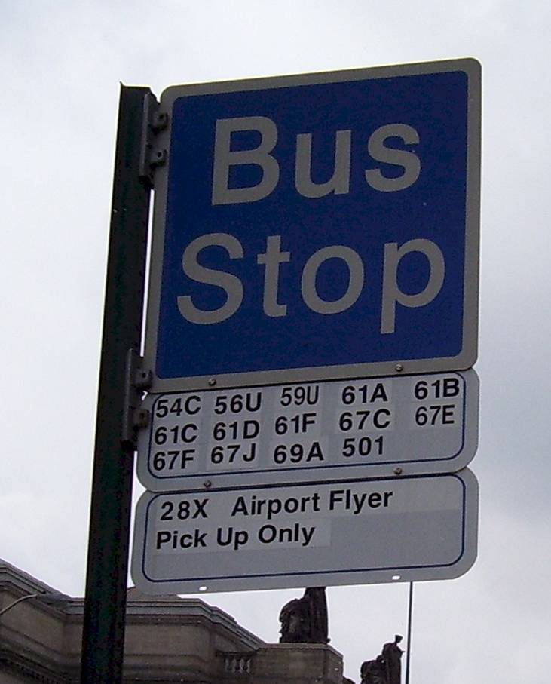


Motivating Application
People waiting at the bus stop

Slide 5
Motivating Application
Next bus arriving in 2 min!

Slide 6

Motivating Application
Bus has arrived. Bus is full!

Slide 7

Motivating Application
Bus has arrived. Bus is full!

Slide 8
Our original proposal
Mobile app notifies commuters their bus will be full
Need high-quality, real-time information
What to do next?
Provide incentives to take a later bus
E.g., discount for coffee, discount for bus ticket, discount for Uber/Lyft ride
Provide other multimodal routing options
E.g., use a shared bike to go to another bus stop and take a different bus route (must make sure bikes are available!)

Slide 9
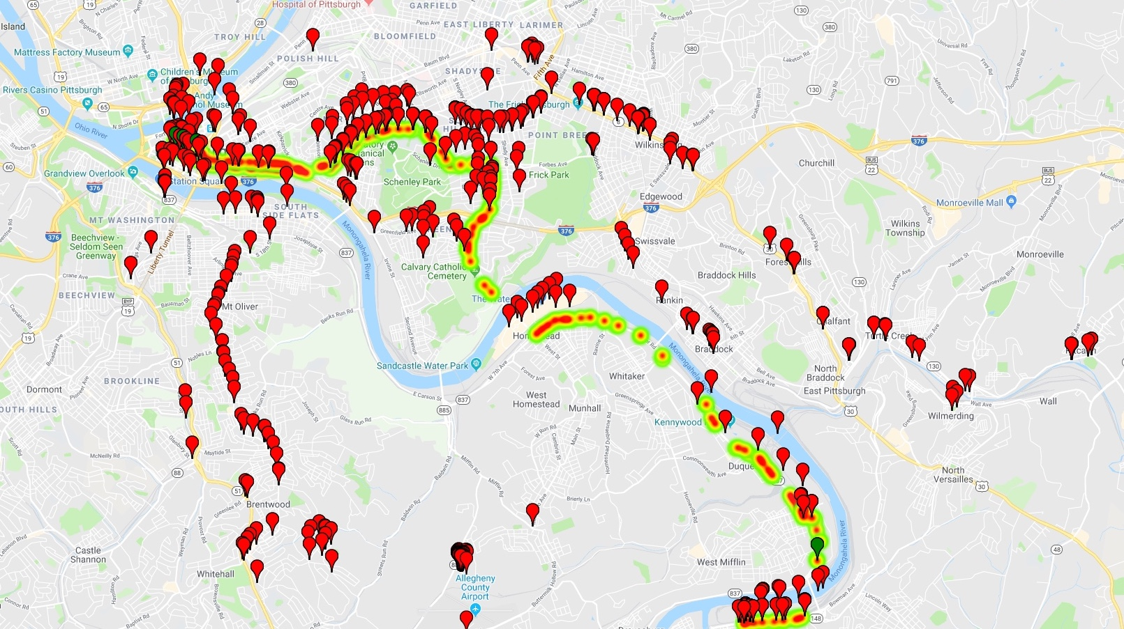
Dirty Data Example (61C)

Slide 10
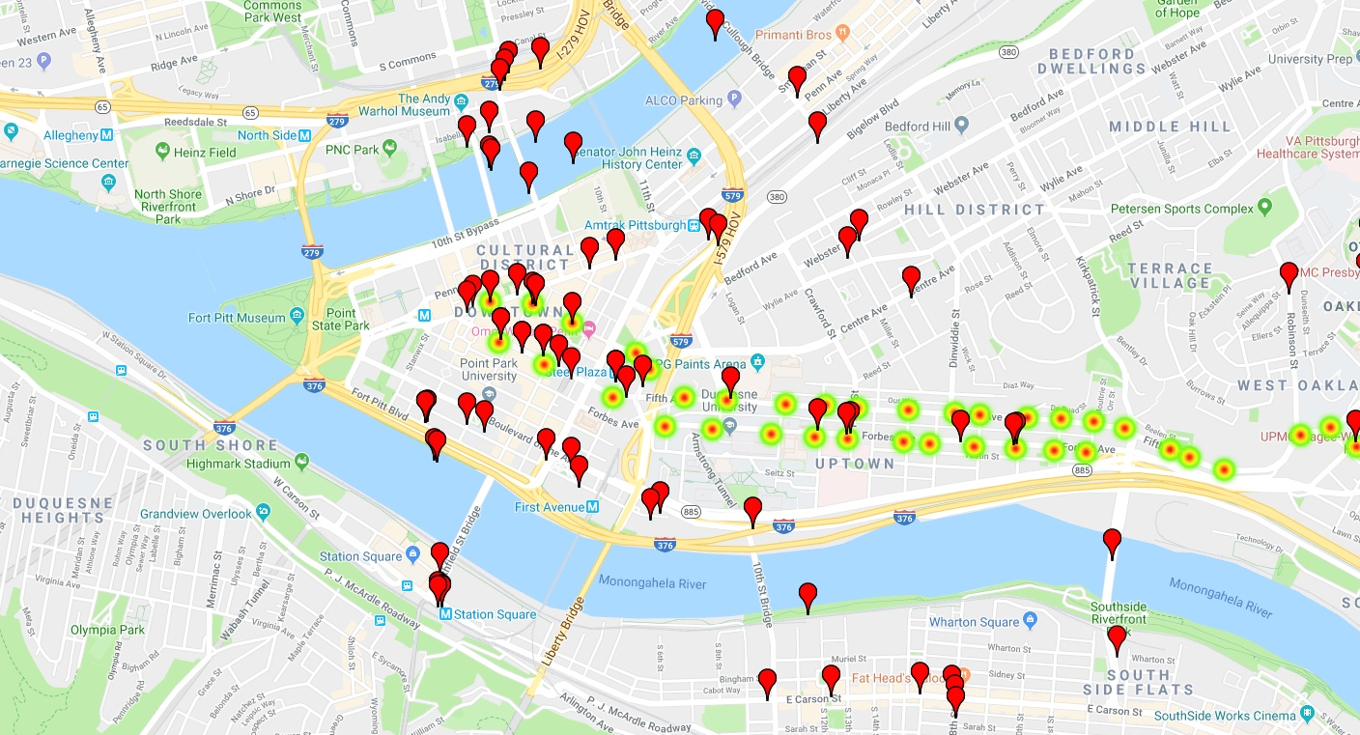
Dirty Data Example (zoom-in)

Slide 11
How do we know data is dirty?
Possible reasons:
Human errors
GPS errors
Urban Canyon Effect
We know there were no buses in the river!
How? No news stories about “buses in the river” in Pittsburgh

Slide 12

How do we know data is dirty?
There was a bus in a sinkhole in Pittsburgh in October 2019, which made national news!
News story:
Pittsburgh Tribune-Review, Monday, Oct. 28, 2019 https://triblive.com/local/bus-falls-into-downtown-sinkhole-traffic-being-rerouted-around-scene/
Image Credit: https://www.flickr.com/photos/daveynin/

Slide 13
Types of Data
© 2025 Alexandros Labrinidis, University of Pittsburgh

Slide 14
Types of attributes
Strings
Nominal (e.g., hair color)
Binary (e.g., male/female)
Ordinal (e.g., small, medium, large, x-large)
Numeric
Discrete (e.g., 5, 12, 42)
Continuous (e.g., 12.0593481423)

Slide 15
Discrete/Continuous Attributes
Discrete Attribute
Has only a finite or countably infinite set of values
Examples: zip codes, counts, set of words in a collection of documents
Often represented as integer variables.
Note: binary attributes are a special case of discrete attributes
Continuous Attribute
Has real numbers as attribute values
Examples: temperature, height, or weight.
Practically, real values can only be measured and represented using a finite number of digits.
Continuous attributes are typically represented as floating-point variables.

Slide 16
Types of data sets
Record
Data Matrix
Document Data
Transaction Data
Graph
World Wide Web
Molecular Structures
Ordered
Spatial Data
Temporal Data
Sequential Data
Genetic Sequence Data

Slide 17
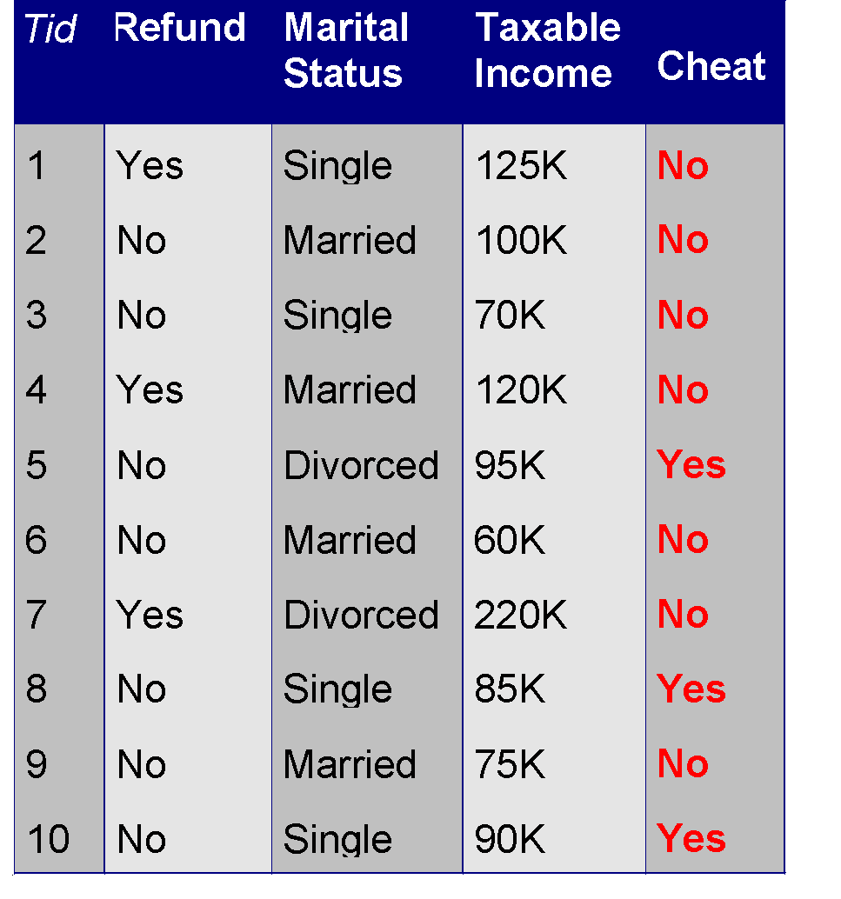
Record Data
Data that consists of a collection of records, each of which consists of a fixed set of attributes

Slide 18
Data Matrix
If data objects have the same fixed set of numeric attributes, then the data objects can be thought of as points in a multi-dimensional space, where each dimension represents a distinct attribute
Such a data set can be represented by an m by n matrix, where there are m rows, one for each object, and n columns, one for each attribute
Projection of x Load | Projection of y load | Distance | Load | Thickness
10.23 | 5.27 | 15.22 | 2.7 | 1.2
12.65 | 6.25 | 16.22 | 2.2 | 1.1

Slide 19
Document Data – 1
Initial collection of six “documents”:
Document #1: The University of Pittsburgh is located in Pittsburgh.
Document #2: Carnegie Mellon University is located in Pittsburgh.
Document #3 Pittsburgh was voted most livable city. Steelers. Steelers!
Document #4: The Steelers won over the Cleveland Browns.
Document #5: The Pittsburgh Steelers have won 6 Super Bowls.
Document #6: Cleveland is located in Ohio.

Slide 20
Document Data – 2
Documents after stop-word removal, stemming, lower-casing:
Document #1: university pittsburgh locat pittsburgh.
Document #2: carnegie mellon university locat pittsburgh.
Document #3 pittsburgh vot livable city steeler steeler!
Document #4: steeler won cleveland brown.
Document #5: pittsburgh steeler won 6 super bowl.
Document #6: cleveland locat ohio.

Slide 21
Document Data – 3
Document Number
#1 | #2 | #3 | #4 | #5 | #6
 |  |  |  | 1
 |  |  |  | 1
 |  |  | 1
 | 1
 |  | 1
 |  |  | 1 |  | 1
 |  | 1
1 | 1 |  |  |  | 1
 | 1
 |  |  |  |  | 1
2 | 1 | 1 |  | 1
 |  | 2 | 1 | 1
 |  |  |  | 1
1 | 1
 |  | 1
 |  |  | 1 | 1
Each document becomes a ‘term’ vector
Each term is a component (attribute) of the vector
The value of each component is the number of times that term occurs in the document.
6
bowl
brown
carnegie
city
cleveland
livable
locat
mellon
ohio
pittsburgh
steeler
super
university
vot
won

Slide 22
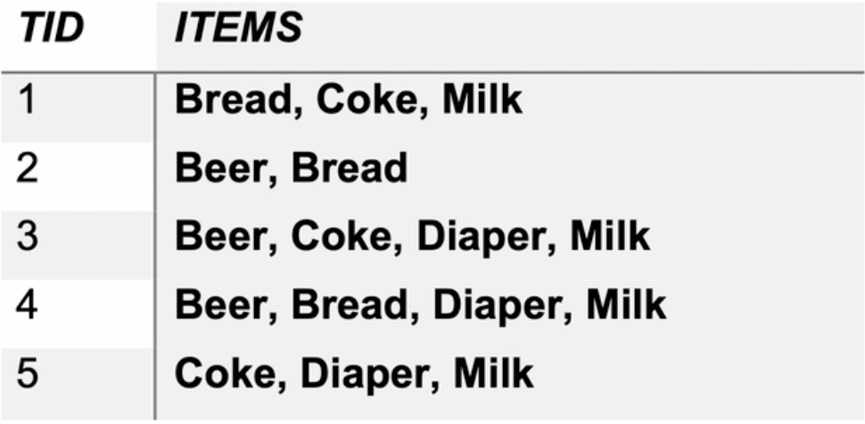
Transaction Data
A special type of data, where:
Each transaction involves a set of items.
Example: consider a grocery store. The set of products purchased by a customer during one shopping trip constitutes a transaction; the individual products purchased are the items.
Can represent transaction data as record data

Slide 23
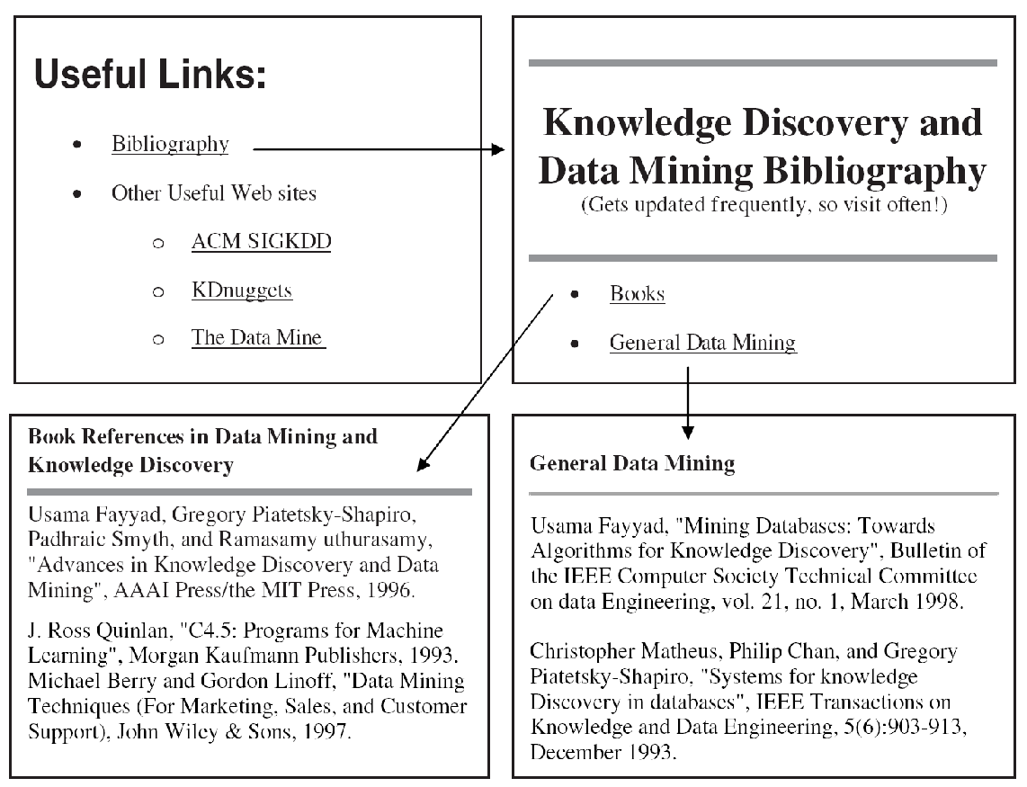
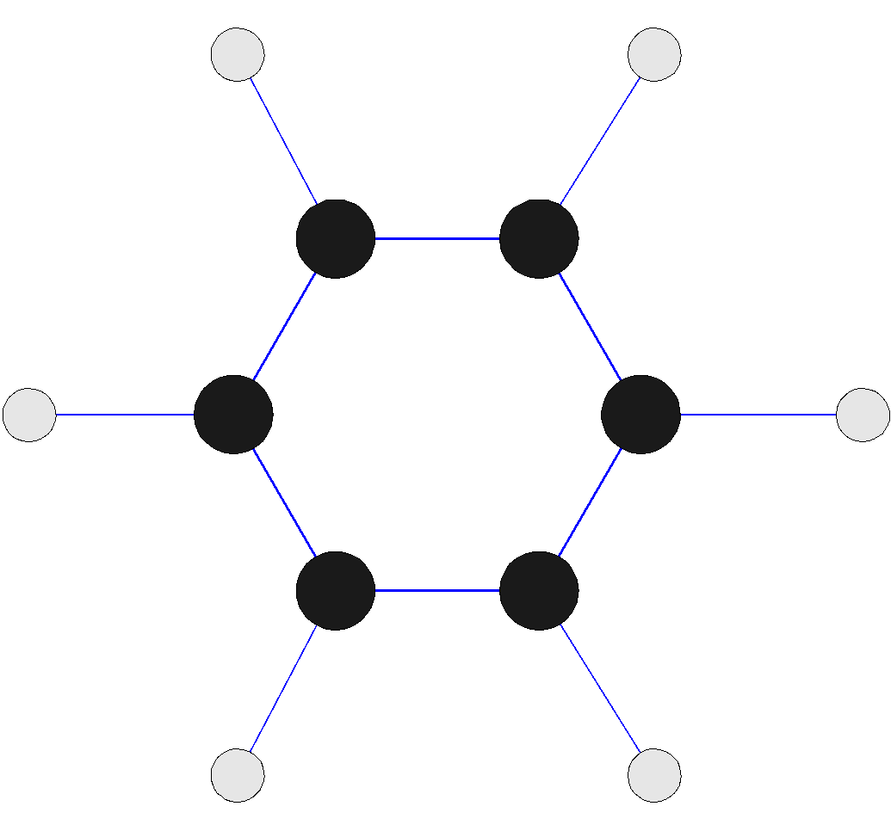
Graph Data
Examples: a costar graph, a molecule, and webpages
Tom
Hanks
Bill
Paxton
Kevin
Bacon
Gary
Sinise
Ed
Harris
Benzene Molecule: C6H6

Slide 24
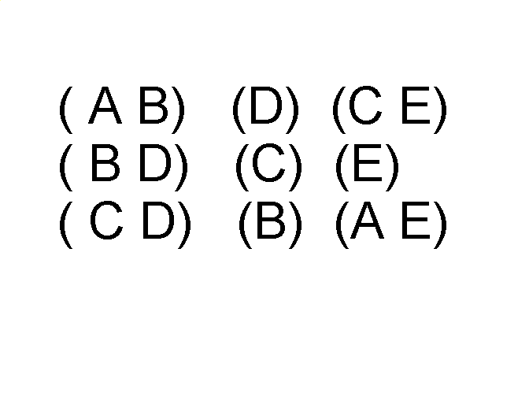
Ordered Data
Sequences of transactions
Items/Events
An element of the sequence

Slide 25
Ordered Data
Genomic sequence data
ATGCGTACGTACGATCGATCGATCGATCGATCGATCGATCGATCGATCGATCGATCGATCGATCGATCGATCGATCGATCGATCGATCGATCGATCGATCGATCGATCGATCGATCG

Slide 26
Ordered Data
Spatio-Temporal Data
Average monthly temperature of land and ocean

Slide 27
Types of Preprocessing
© 2025 Alexandros Labrinidis, University of Pittsburgh

Slide 28
Types of preprocessing
Handling missing data
Deletion or imputation (e.g., use the mean)
Dealing with outliers
Detection
Handling (e.g., removal)
Feature scaling/normalization
Feature engineering/transformation
Encoding categorical variables

