Slide 1
Data Histograms
© 2025 Alexandros Labrinidis, University of Pittsburgh

Slide 2
Measuring the Central Tendency
© 2025 Alexandros Labrinidis, University of Pittsburgh

Slide 3
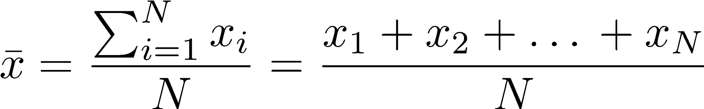
Mean (or average)
Arithmetic mean (or average) is the most common and effective measure of the “center” of a set of data
Notes:
\bar{x} = \frac{\sum_{i=1}^{N} x_i}{N} = \frac{x_1 + x_2 + … + x_N}{N}
\bar{x} = \frac{\sum_{i=1}^{N} w_i x_i}{\sum_{i=1}^{N} w_i }

Slide 4
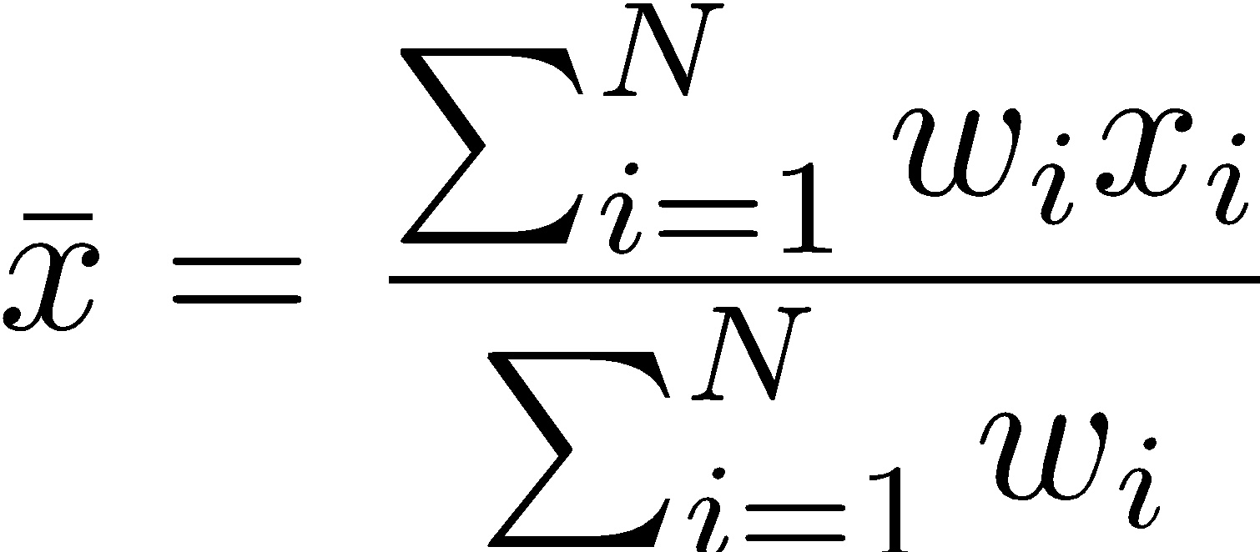
Mean (or average)
Arithmetic mean (or average) is the most common and effective measure of the “center” of a set of data
If values x_{i} are associated with weights w_{i}, we have the weighted arithmetic mean (or weighted average):
Notes:
\bar{x} = \frac{\sum_{i=1}^{N} x_i}{N} = \frac{x_1 + x_2 + … + x_N}{N}
\bar{x} = \frac{\sum_{i=1}^{N} w_i x_i}{\sum_{i=1}^{N} w_i }

Slide 5
Median
Median is the numerical value separating the higher half of a data set from the lower half.
Median can be found by arranging all the observations from lowest value to highest value and picking the middle one
E.g., the median of {3, 3, 5, 9, 11} is 5
If there is an even number of observations, then the median is usually defined to be the mean of the two middle values
E.g., the median of {3, 5, 7, 9} is (5 + 7) / 2 = 6
[ Source: http://en.wikipedia.org/wiki/Median ]

Slide 6
Mode
Mode is the value that appears most often in a set of data (i.e., has highest frequency)
It is possible for the greatest frequency to correspond to multiple items:
Unimodal (just one)
Bimodal (just two)
Trimodal (just three)
If each data appears only once, there is no mode for that data set.

Slide 7
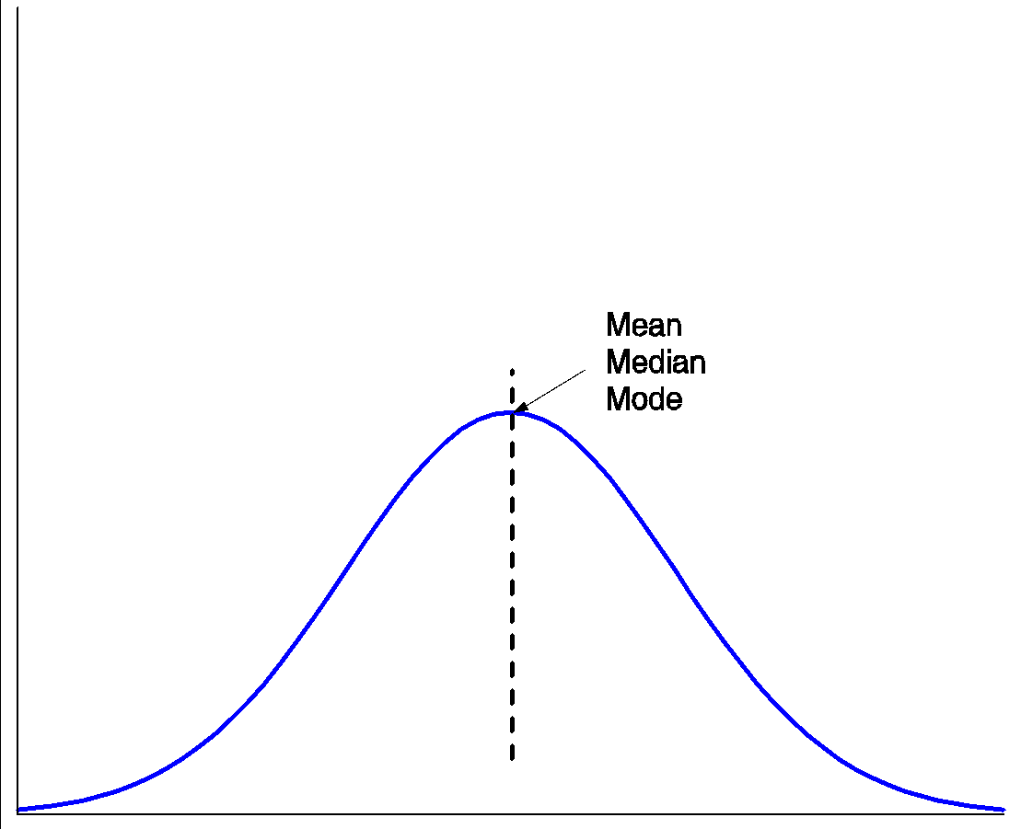
Symmetric vs Skewed Data
Symmetric Data Mean = Median = Mode
frequency
data values

Slide 8
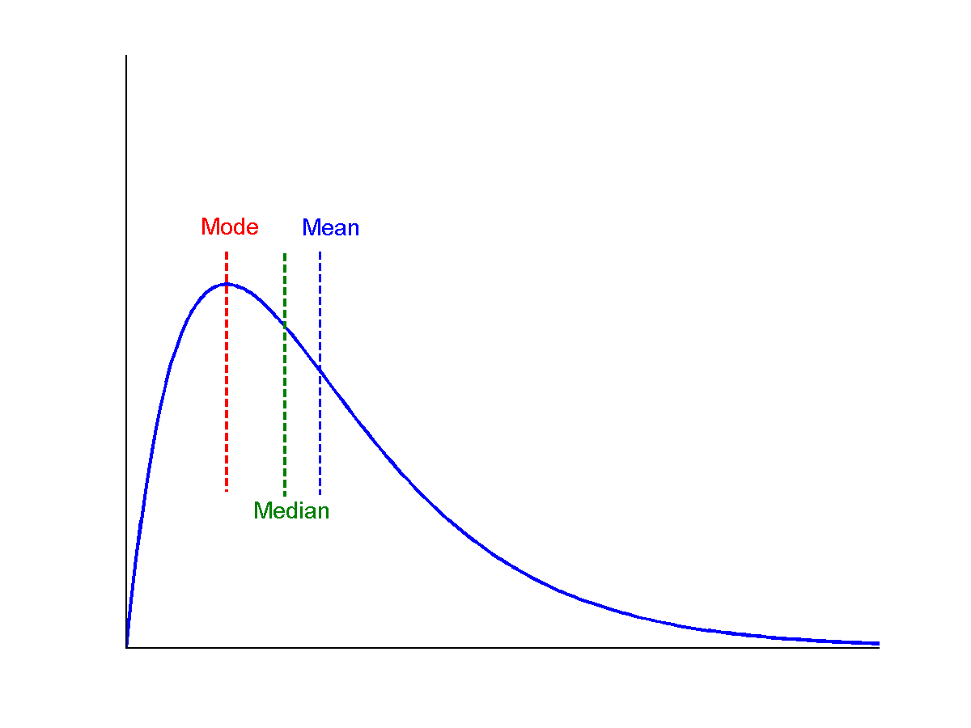
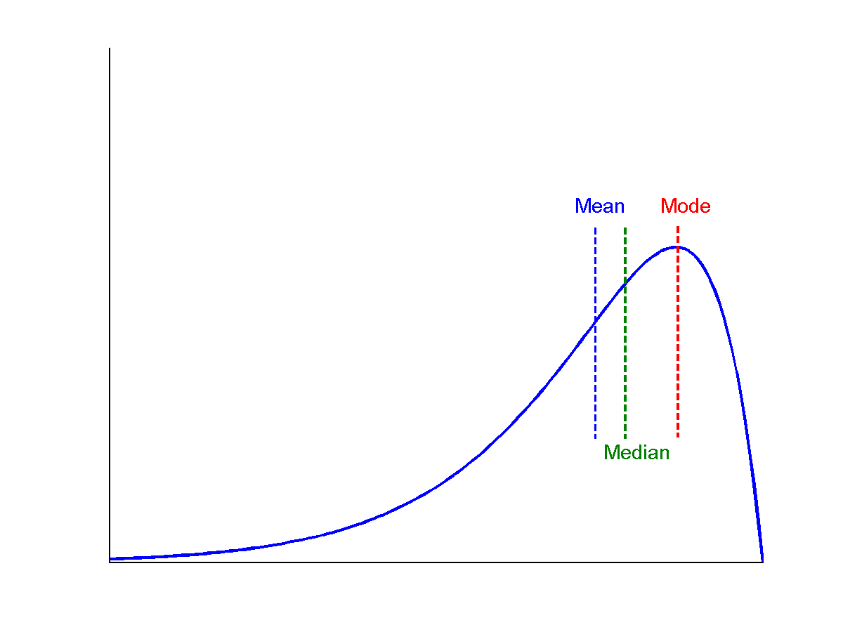
Symmetric vs Skewed Data
Symmetric Data Mean = Median = Mode
frequency
data values
Positively Skewed Data Mean > Median > Mode
Negatively Skewed Data Mean < Median < Mode

Slide 9
Measuring the Dispersion of Data
© 2025 Alexandros Labrinidis, University of Pittsburgh

Slide 10
Why the average is not enough
Dataset #1
Average = 3.0
Dataset #2
Average = 3.0
Dataset #3
Average = 3.0
1 | 2 | 3 | 4 | 5 | 1 | 2 | 3 | 4 | 5
3 | 3 | 3 | 3 | 3 | 3 | 3 | 3 | 3 | 3
1 | 5 | 1 | 5 | 1 | 5 | 1 | 5 | 1 | 5

Slide 11
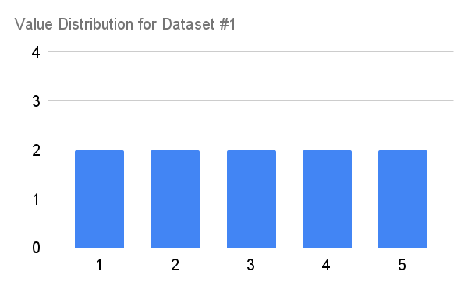
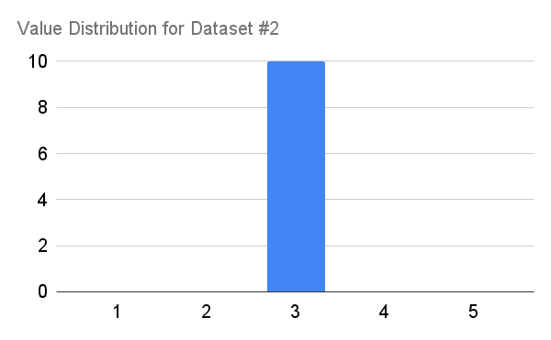
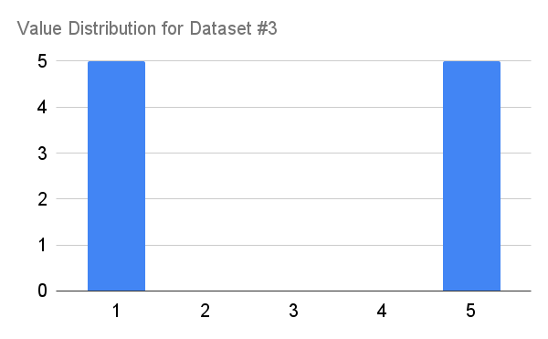
Why the average is not enough
Dataset #1
Average = 3.0
Dataset #2
Average = 3.0
Dataset #3
Average = 3.0
1 | 2 | 3 | 4 | 5 | 1 | 2 | 3 | 4 | 5
3 | 3 | 3 | 3 | 3 | 3 | 3 | 3 | 3 | 3
1 | 5 | 1 | 5 | 1 | 5 | 1 | 5 | 1 | 5

Slide 12
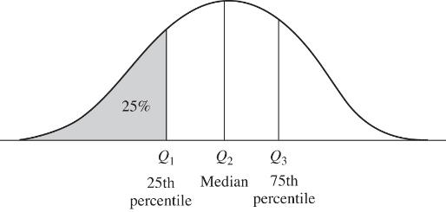
Range and Quartiles
Range is the difference between max and min values
Split distribution into equal-sized consecutive sets:
Quartiles: Split into 4 sets: Q1 – Q4
Percentiles: Split into 100 sets
Q1 = 25th percentile
Q3 = 75th percentile

Slide 13
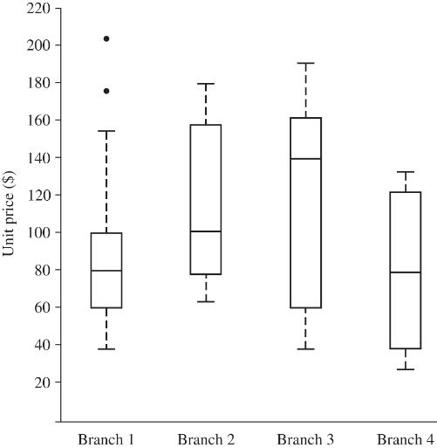
Boxplots
outliers
Max
Five-number summary of a data distribution:
Min
Q1 (=25%)
Median (=50%)
Q3 (=75%)
Max
Boxplot incorporates five-number summary
Outlier: a value higher/lower than 1.5 x IQR
Inter-quartile range (IQR) = Q3 – Q1
Q3
Median
Min
Q1

Slide 14
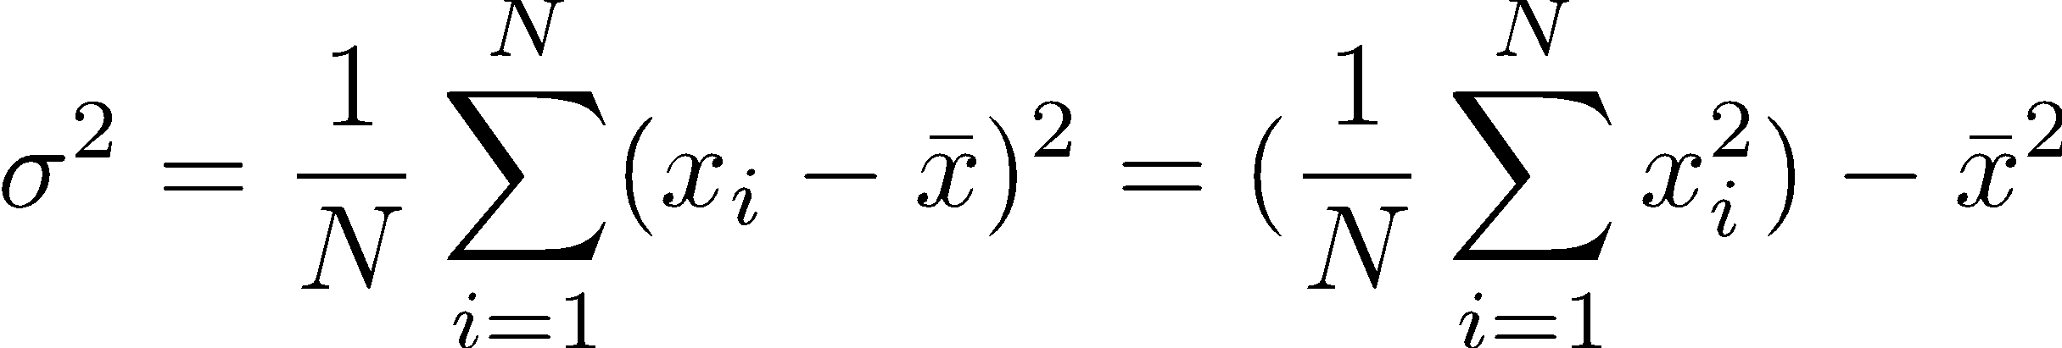
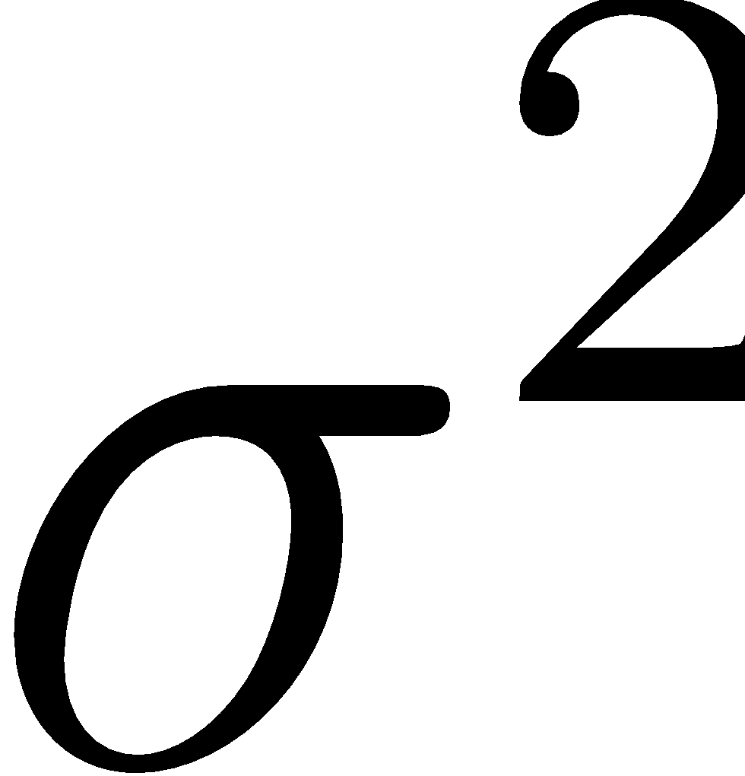
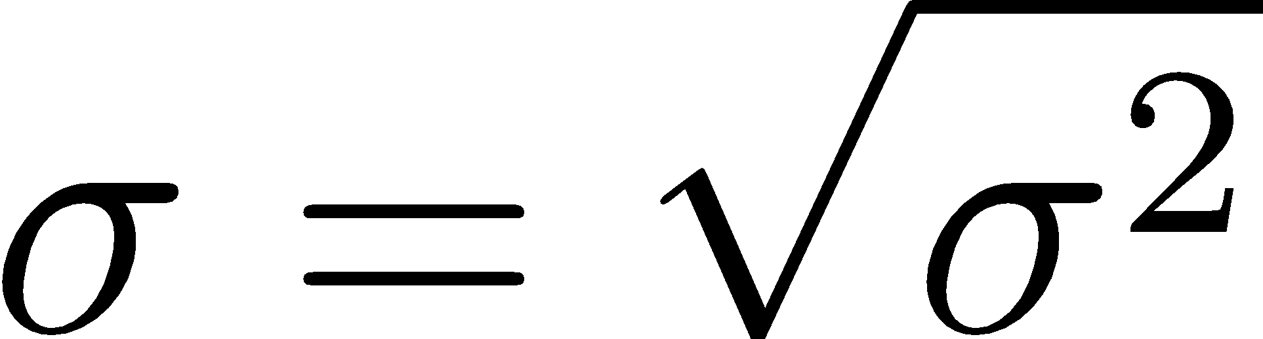
Variance / Standard Deviation
Variance and standard deviation are measures of data dispersion – they indicate how spread out a data set is
Variance:
Standard deviation:
The square root of variance
I.e.,
Notes:
\sigma^2 = \frac{1}{N} \sum_{i=1}^{N} (x_i - \bar{x})^2 = (\frac{1}{N} \sum_{i=1}^{N} x_i^2) - \bar{x}^2
\sigma^2
\sigma = \sqrt{\sigma^2}

Slide 15
Making Data Histograms
© 2025 Alexandros Labrinidis, University of Pittsburgh

Slide 16
What is a histogram
A histogram is a graphical representation of the distribution of data
estimate of the probability distribution of a continuous variable
first introduced by Karl Pearson
a representation of tabulated frequencies, shown as adjacent rectangles or squares
over discrete intervals (bins), with an area proportional to the frequency of the observations in the interval
Two main types:
Equal-width: width of each bucket range is uniform (i.e., on the X axis)
Equal-frequency (or equal-height): buckets are created so that the frequency of each bucket is about constant (i.e., on the Y axis)

Slide 17
Sample Dataset
List of prices from a store (sorted):
1, 1, 5, 5, 5, 5, 5, 8, 8, 10, 10, 10, 10,
12, 14, 14, 14, 15, 15, 15, 15, 15, 15, 18, 18, 18, 18, 18, 18, 18, 18,
20, 20, 20, 20, 20, 20, 20, 21, 21, 21, 21, 25, 25, 25, 25, 25, 28, 28,
30, 30, 30.
Tabulated prices + frequencies:
item | 1 | 5 | 8 | 10 | 12 | 14 | 15 | 18 | 20 | 21 | 25 | 28 | 30
count | 2 | 5 | 2 | 4 | 1 | 3 | 6 | 8 | 7 | 4 | 5 | 2 | 3

Slide 18
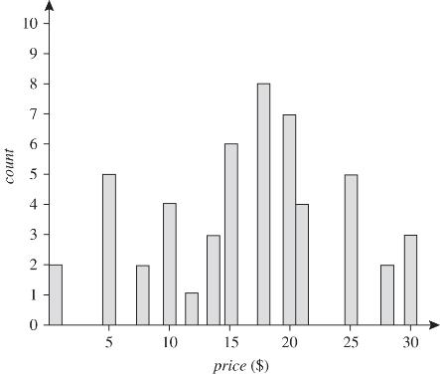
Sample Histogram (singleton buckets)
Tabulated prices + frequencies:
item | 1 | 5 | 8 | 10 | 12 | 14 | 15 | 18 | 20 | 21 | 25 | 28 | 30
count | 2 | 5 | 2 | 4 | 1 | 3 | 6 | 8 | 7 | 4 | 5 | 2 | 3

Slide 19
Equal-width Histograms – 1
Figure out the range:
(max - min) +1 = 30 – 1 +1 = 30
Divide by number of required buckets (say 3):
30 / 3 = 10
The width of each bucket should be 10
Our bucket ranges (X axis) should be:
1 – 10, 11 – 20, and 21 – 30

Slide 20
Equal-width Histograms – 2
Our bucket ranges (X axis) are:
1 – 10, 11 – 20, and 21 – 30
Bucket #1 (1 – 10) has total frequency: 2+5+2+4 = 13
Bucket #2 (11 – 20) has total frequency: 1+3+6+8+7 = 25
Bucket #3 (21 – 30) has total frequency: 4+5+2+3 = 14
 | 1 | 5 | 8 | 10 | 12 | 14 | 15 | 18 | 20 | 21 | 25 | 28 | 30
count | 2 | 5 | 2 | 4 | 1 | 3 | 6 | 8 | 7 | 4 | 5 | 2 | 3

Slide 21
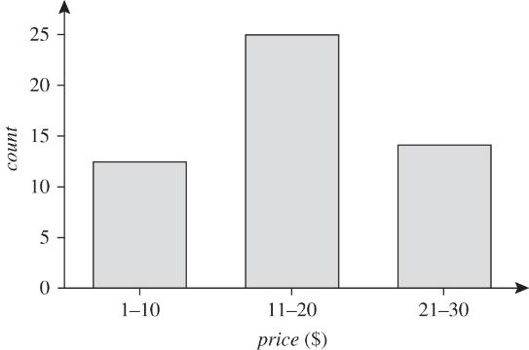
Equal-width Histograms – 3
25
14
13

Slide 22
Equal-height Histograms – 1
item | 1 | 5 | 8 | 10 | 12 | 14 | 15 | 18 | 20 | 21 | 25 | 28 | 30 | Total
count | 2 | 5 | 2 | 4 | 1 | 3 | 6 | 8 | 7 | 4 | 5 | 2 | 3 | 52
We add up the counts (frequencies): 52
Divide by the number of desired buckets
Let’s assume we want 4 buckets
52 / 4 = 13
The height of each bucket should be 13 (roughly)

Slide 23
Equal-height Histograms – 2
item | 1 | 5 | 8 | 10 | 12 | 14 | 15 | 18 | 20 | 21 | 25 | 28 | 30 | Total
count | 2 | 5 | 2 | 4 | 1 | 3 | 6 | 8 | 7 | 4 | 5 | 2 | 3 | 52
bucket
Want 4 buckets
Each bucket’s total frequency around 13
Bucket #1:
Items: 1 – 10
frequency total: 13
Bucket | Item | Item Count | Bucket Count
#1 / 4 | 1 | 2 | 2
 | 5 | 5 | 2+5=7
 | 8 | 2 | 2+5+2=9
 | 10 | 4 | 2+5+2+4=13

Slide 24
Equal-height Histograms – 3
item | 1 | 5 | 8 | 10 | 12 | 14 | 15 | 18 | 20 | 21 | 25 | 28 | 30 | Total
count | 2 | 5 | 2 | 4 | 1 | 3 | 6 | 8 | 7 | 4 | 5 | 2 | 3 | 52
bucket | #1 | #1 | #1 | #1
Each bucket’s total frequency around 13
Bucket #2:
Question: include item 18?
Bucket | Item | Item Count | Bucket Count
#2 / 4 | 12 | 1 | 1
 | 14 | 3 | 1+3=4
 | 15 | 6 | 1+3+6=10
 | 18? | 8 | 1+3+6+8=18

Slide 25
Equal-height Histograms – 4
item | 1 | 5 | 8 | 10 | 12 | 14 | 15 | 18 | 20 | 21 | 25 | 28 | 30 | Total
count | 2 | 5 | 2 | 4 | 1 | 3 | 6 | 8 | 7 | 4 | 5 | 2 | 3 | 52
bucket | #1 | #1 | #1 | #1 | #2 | #2 | #2
Each bucket’s total frequency around 13
Bucket #2:
Answer: No
Items: 12 – 15
frequency total: 10
Bucket | Item | Item Count | Bucket Count
#2 / 4 | 12 | 1 | 1
 | 14 | 3 | 1+3=4
 | 15 | 6 | 1+3+6=10
 | 18 | 8 | 1+3+6+8=18
<13
>>13
10 is closest to 13 then 18 is

Slide 26
Equal-height Histograms – 5
item | 1 | 5 | 8 | 10 | 12 | 14 | 15 | 18 | 20 | 21 | 25 | 28 | 30 | Total
count | 2 | 5 | 2 | 4 | 1 | 3 | 6 | 8 | 7 | 4 | 5 | 2 | 3 | 52
bucket | #1 | #1 | #1 | #1 | #2 | #2 | #2
Each bucket’s total frequency around 13
Bucket #3:
Items: 18 – 20
frequency total: 15
Bucket | Item | Item Count | Bucket Count
#3 / 4 | 18 | 8 | 8
 | 20 | 7 | 8+7=15
<<13
>13
15 is closest to 13 then 8 is

Slide 27
Equal-height Histograms – 6
item | 1 | 5 | 8 | 10 | 12 | 14 | 15 | 18 | 20 | 21 | 25 | 28 | 30 | Total
count | 2 | 5 | 2 | 4 | 1 | 3 | 6 | 8 | 7 | 4 | 5 | 2 | 3 | 52
bucket | #1 | #1 | #1 | #1 | #2 | #2 | #2 | #3 | #3
Each bucket’s total frequency around 13
Bucket #4:
Items: 21 – 30
frequency total: 14
Bucket | Item | Item Count | Bucket Count
#4 / 4 | 21 | 4 | 4
 | 25 | 5 | 4+5=9
 | 28 | 2 | 4+5+2=11
 | 30 | 3 | 4+5+2+3=14
<<13
>13
14 is closest to 13 then 11 is

Slide 28
Equal-height Histograms – 7
item | 1 | 5 | 8 | 10 | 12 | 14 | 15 | 18 | 20 | 21 | 25 | 28 | 30 | Total
count | 2 | 5 | 2 | 4 | 1 | 3 | 6 | 8 | 7 | 4 | 5 | 2 | 3 | 52
bucket | #1 | #1 | #1 | #1 | #2 | #2 | #2 | #3 | #3 | #4 | #4 | #4 | #4
Bucket #1:
1, 5, 8, 10 (freq=13)
Bucket #2:
12, 14, 15 (freq=10)
Bucket #3:
18, 20 (freq=15)
Bucket #4:
21, 25, 28, 30 (freq=14)
13
5
10
15
20
25
30

