Slide 1
Data Transformations for Numerical Data
Standardization and Scaling
© 2025 Alexandros Labrinidis, University of Pittsburgh

Slide 2
The need for transformations
Most predictive modeling techniques consider many features, all at once
Challenge:
Numerical features are often from different domains
For example:
Age (say 18 – 70, for working adults), and
Income (say $25,000 to $150,000, for working adults of different ages)
Challenge Accepted:
Transform numerical features to a space that allows comparisons across domains
Notes:
\bar{x} = \frac{\sum_{i=1}^{N} x_i}{N} = \frac{x_1 + x_2 + … + x_N}{N}
\bar{x} = \frac{\sum_{i=1}^{N} w_i x_i}{\sum_{i=1}^{N} w_i }

Slide 3
Data Standardization
© 2025 Alexandros Labrinidis, University of Pittsburgh

Slide 4
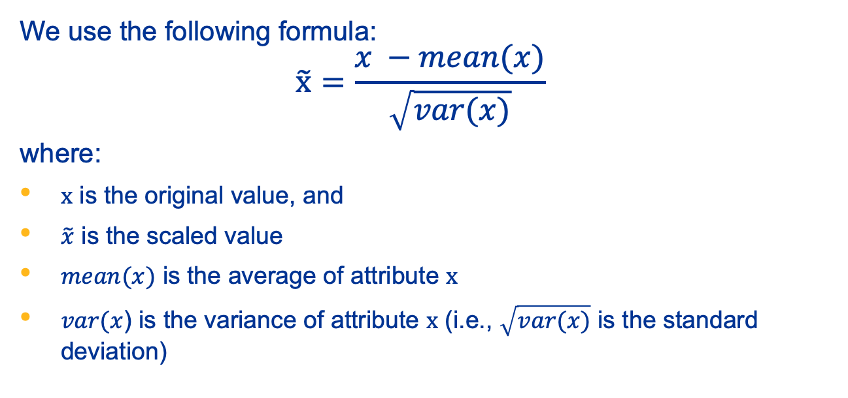
Standardization – 1

Slide 5
Standardization – 2
Standardization subtracts off the mean of the feature and divides by the standard deviation
The transformed data will have:
mean = 0
variance = 1
Also referred to as variance scaling or Z-score scaling
Ideal for algorithms that require or perform better with standardized input

Slide 6
Standardization in Python – 0
# Imports
import pandas as pd
from sklearn.preprocessing import MinMaxScaler, StandardScaler, RobustScaler
import numpy as np
# Sample dataset - 10 items
data10 = pd.DataFrame({
'age': [22, 28, 35, 40, 45, 50, 55, 60, 65, 70],
'income': [35000, 42000, 50000, 55000, 60000, 68000, 80000, 95000, 120000, 140000]
})
data=data10

Slide 7
Standardization in Python – 1
In []: data
Out[]:
 | age | income
0 | 22 | 35000
1 | 28 | 42000
2 | 35 | 50000
3 | 40 | 55000
4 | 45 | 60000
5 | 50 | 68000
6 | 55 | 80000
7 | 60 | 95000
8 | 65 | 120000
9 | 70 | 140000

Slide 8
Standardization in Python – 2
In []: data
Out[]:
In []: data.describe()
Out[]:
 | age | income
0 | 22 | 35000
1 | 28 | 42000
2 | 35 | 50000
3 | 40 | 55000
4 | 45 | 60000
5 | 50 | 68000
6 | 55 | 80000
7 | 60 | 95000
8 | 65 | 120000
9 | 70 | 140000
 | age | income
count | 10.000000 | 10.000000
mean | 47.000000 | 74500.000000
std | 15.909466 | 34416.565779
min | 22.000000 | 35000.000000
25% | 36.250000 | 51250.000000
50% | 47.500000 | 64000.000000
75% | 58.750000 | 91250.000000
max | 70.000000 | 140000.000000

Slide 9
Standardization in Python – 3
# Standardization
scaler = StandardScaler()
data_standardized = pd.DataFrame(scaler.fit_transform(data), columns=data.columns)

Slide 10
Standardization in Python – 4
In []: data_standardized
Out[]:
 | age | income
0 | -1.656392 | -1.209785
1 | -1.258858 | -0.995393
2 | -0.795068 | -0.750373
3 | -0.463790 | -0.597236
4 | -0.132511 | -0.444098
5 | 0.198767 | -0.199079
6 | 0.530045 | 0.168451
7 | 0.861324 | 0.627863
8 | 1.192602 | 1.393550
9 | 1.523881 | 2.006100

Slide 11
Standardization in Python – 5
In []: data_standardized
Out[]:
In []: data_ standardized.describe()
Out[]:
 | age | income
0 | -1.656392 | -1.209785
1 | -1.258858 | -0.995393
2 | -0.795068 | -0.750373
3 | -0.463790 | -0.597236
4 | -0.132511 | -0.444098
5 | 0.198767 | -0.199079
6 | 0.530045 | 0.168451
7 | 0.861324 | 0.627863
8 | 1.192602 | 1.393550
9 | 1.523881 | 2.006100
 | age | income
count | 1.000000e+01 | 10.000000
mean | -6.661338e-17 | 0.000000
std | 1.054093e+00 | 1.054093
min | -1.656392e+00 | -1.209785
25% | -7.122486e-01 | -0.712089
50% | 3.312784e-02 | -0.321589
75% | 7.785043e-01 | 0.513010
max | 1.523881e+00 | 2.006100

Slide 12
Data Scaling
© 2025 Alexandros Labrinidis, University of Pittsburgh

Slide 13
Min-Max Scaling – 1
Simple approach: Min-Max Scaling
Identify the original range of values [min, …, max]
Convert values to new range: [0, …, 1]
Original domain
min
max
[0-1] domain
0
1

Slide 14
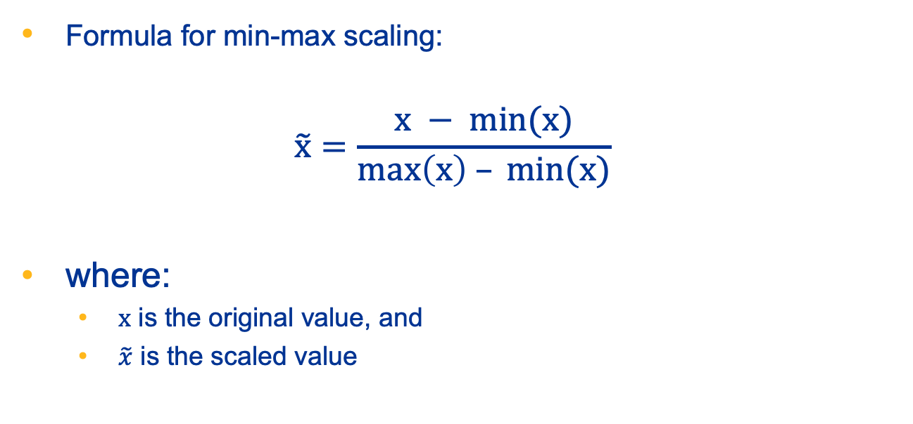
Min-Max Scaling – 2

Slide 15
Min-Max Scaling in Python – 1
In []: data
Out[]:
 | age | income
0 | 22 | 35000
1 | 28 | 42000
2 | 35 | 50000
3 | 40 | 55000
4 | 45 | 60000
5 | 50 | 68000
6 | 55 | 80000
7 | 60 | 95000
8 | 65 | 120000
9 | 70 | 140000

Slide 16
Min-Max Scaling in Python – 2
In []: data
Out[]:
In []: data.describe()
Out[]:
 | age | income
0 | 22 | 35000
1 | 28 | 42000
2 | 35 | 50000
3 | 40 | 55000
4 | 45 | 60000
5 | 50 | 68000
6 | 55 | 80000
7 | 60 | 95000
8 | 65 | 120000
9 | 70 | 140000
 | age | income
count | 10.000000 | 10.000000
mean | 47.000000 | 74500.000000
std | 15.909466 | 34416.565779
min | 22.000000 | 35000.000000
25% | 36.250000 | 51250.000000
50% | 47.500000 | 64000.000000
75% | 58.750000 | 91250.000000
max | 70.000000 | 140000.000000

Slide 17
Min-Max Scaling in Python – 3
# Min-Max Scaling
scaler = MinMaxScaler()
data_minmax = pd.DataFrame(scaler.fit_transform(data), columns=data.columns)

Slide 18
Min-Max Scaling in Python – 4
In []: data_minmax
Out[]:
 | age | income
0 | 0.000000 | 0.000000
1 | 0.125000 | 0.066667
2 | 0.270833 | 0.142857
3 | 0.375000 | 0.190476
4 | 0.479167 | 0.238095
5 | 0.583333 | 0.314286
6 | 0.687500 | 0.428571
7 | 0.791667 | 0.571429
8 | 0.895833 | 0.809524
9 | 1.000000 | 1.000000

Slide 19
Min-Max Scaling in Python – 5
In []: data_minmax
Out[]:
In []: data_minmax.describe()
Out[]:
 | age | income
0 | 0.000000 | 0.000000
1 | 0.125000 | 0.066667
2 | 0.270833 | 0.142857
3 | 0.375000 | 0.190476
4 | 0.479167 | 0.238095
5 | 0.583333 | 0.314286
6 | 0.687500 | 0.428571
7 | 0.791667 | 0.571429
8 | 0.895833 | 0.809524
9 | 1.000000 | 1.000000
 | age | income
count | 10.000000 | 10.000000
mean | 0.520833 | 0.376190
std | 0.331447 | 0.327777
min | 0.000000 | 0.000000
25% | 0.296875 | 0.154762
50% | 0.531250 | 0.276190
75% | 0.765625 | 0.535714
max | 1.000000 | 1.000000

Slide 20
Robust Scaling
© 2025 Alexandros Labrinidis, University of Pittsburgh

Slide 21
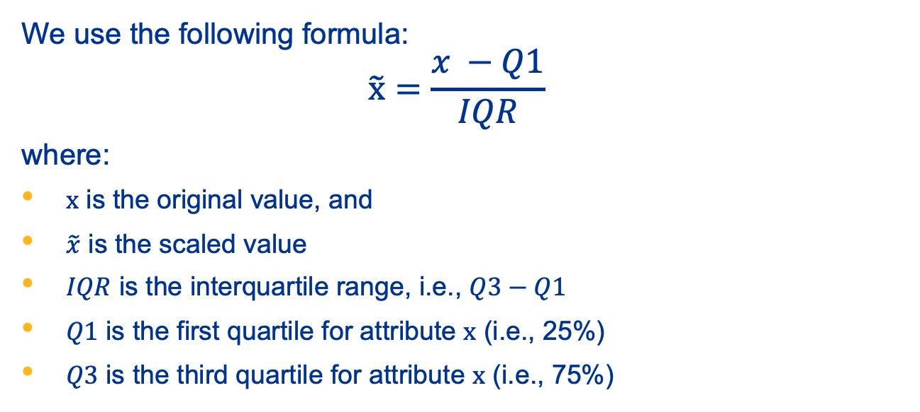
Robust Scaling – 1

Slide 22
Robust Scaling – 2
Robust Scaling subtracts off the first quartile of the feature and divides by the interquartile range
The transformed data will be:
Centered using the median (vs mean for Standardization)
Scaled based on the IQR (vs range for Min-Max Scaling)
Ideal for data that contains outliers

Slide 23
Robust Scaling in Python – 1
In []: data
Out[]:
In []: data.describe()
Out[]:
 | age | income
0 | 22 | 35000
1 | 28 | 42000
2 | 35 | 50000
3 | 40 | 55000
4 | 45 | 60000
5 | 50 | 68000
6 | 55 | 80000
7 | 60 | 95000
8 | 65 | 120000
9 | 70 | 140000
 | age | income
count | 10.000000 | 10.000000
mean | 47.000000 | 74500.000000
std | 15.909466 | 34416.565779
min | 22.000000 | 35000.000000
25% | 36.250000 | 51250.000000
50% | 47.500000 | 64000.000000
75% | 58.750000 | 91250.000000
max | 70.000000 | 140000.000000

Slide 24
Robust Scaling in Python – 2
# Robust Scaling
scaler = RobustScaler()
data_robust = pd.DataFrame(scaler.fit_transform(data), columns=data.columns)

Slide 25
Robust Scaling in Python – 3
In []: data_robust
Out[]:
 | age | income
0 | -1.133333 | -0.725
1 | -0.866667 | -0.550
2 | -0.555556 | -0.350
3 | -0.333333 | -0.225
4 | -0.111111 | -0.100
5 | 0.111111 | 0.100
6 | 0.333333 | 0.400
7 | 0.555556 | 0.775
8 | 0.777778 | 1.400
9 | 1.000000 | 1.900

Slide 26
Robust Scaling in Python – 4
In []: data_robust
Out[]:
In []: data_robust.describe()
Out[]:
 | age | income
0 | -1.133333 | -0.725
1 | -0.866667 | -0.550
2 | -0.555556 | -0.350
3 | -0.333333 | -0.225
4 | -0.111111 | -0.100
5 | 0.111111 | 0.100
6 | 0.333333 | 0.400
7 | 0.555556 | 0.775
8 | 0.777778 | 1.400
9 | 1.000000 | 1.900
 | age | income
count | 10.000000 | 10.000000
mean | -0.022222 | 0.262500
std | 0.707087 | 0.860414
min | -1.133333 | -0.725000
25% | -0.500000 | -0.318750
50% | 0.000000 | 0.000000
75% | 0.500000 | 0.681250
max | 1.000000 | 1.900000

