Slide 1
Bayes Classifier
Big Data
986636 - Carlos HERNANDEZ 986775 - SEBASTIAN VALENCIA
PROF. DR. Premchand Nair
H

Slide 2

What did we learn
Naive Bayes algorithm: Behind scenes how it works
Load data
Summarize
Make single/massive predictions
Evaluate accuracy
How to implement Bayes from scratch in Python
Starting with the sample
How to use it to train and make predictions in own dataset
Train
Predict
Our accuracy compared to other ML algorithms
H

Slide 3
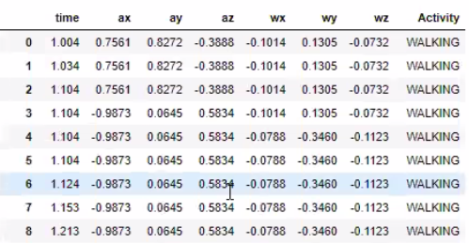







Use in own dataset
Use of Naive Bayes algorithm in Human Activity Recognition from smartphones data:
Classify
V

Slide 4

Best accuracy
Random Forrest performed better:
Bayes accuracy:
H

Slide 5
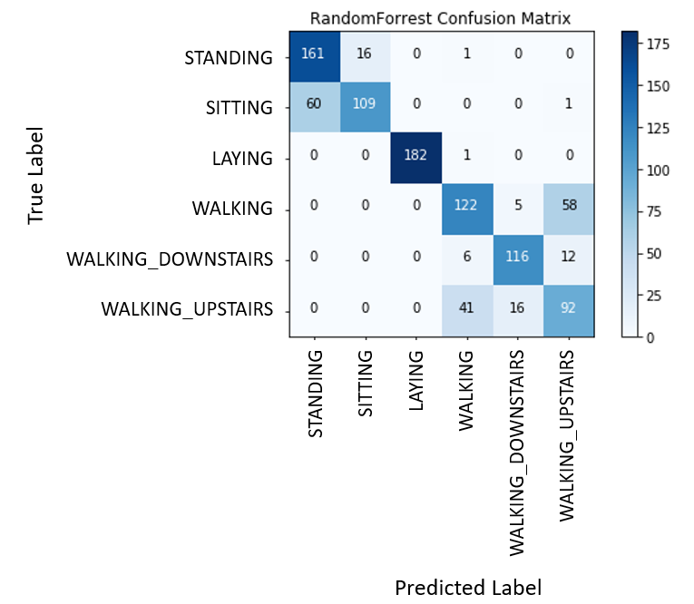
Confusion Matrix – Random Forest
Some issues between:
Sitting x Standing
Walking x Walking_Upstairs
V

Slide 6


