Slide 1

Human resources slide 1
BIG-DATA
FINAL PROJECT
Group 1: Sebastian Valencia ID: 986775
Carlos Hernandez ID: 986636
Prof.: Prem Nair, PhD
Jan -2019
h

Slide 2
Human resources slide 2
OUTLINE
1. Java code InMapperWordCount
2-3. Java code Average
4-5. Java code InMapperAverage
6-8. Pseudo code for PAIR approach
9-11. Pseudo code for STRIPE approach
12-14. Pseudo code for HYBRID approach
15. Time and resource comparision
16. Spark Problem statement
17-18. Scala code
19. MR Team Challenge
h

Slide 3
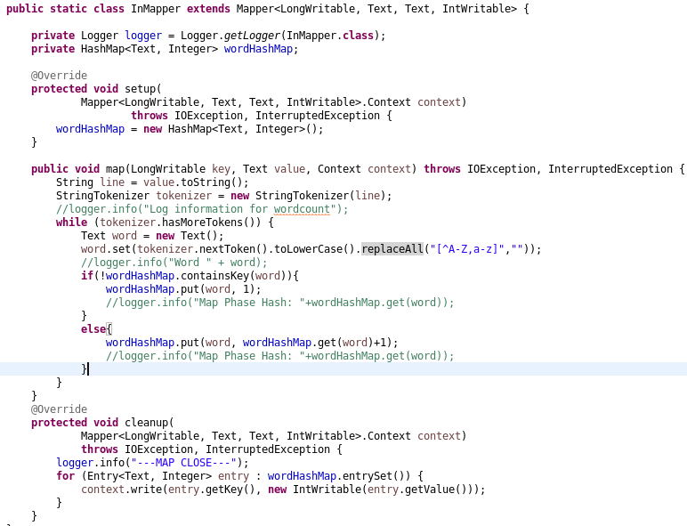
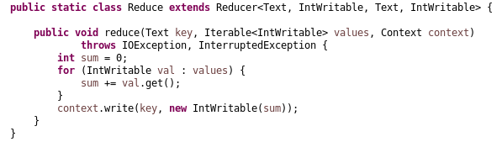
Human resources slide 9
1. InMapperWordCount - Java code
h

Slide 4
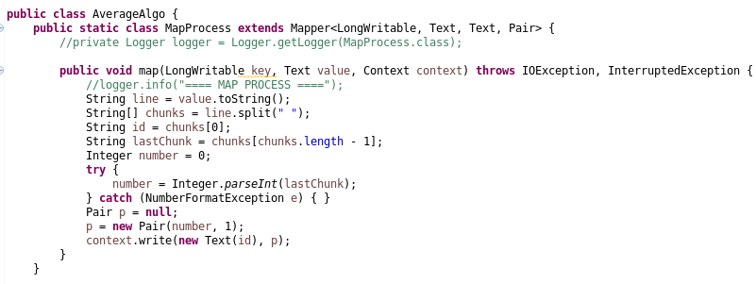
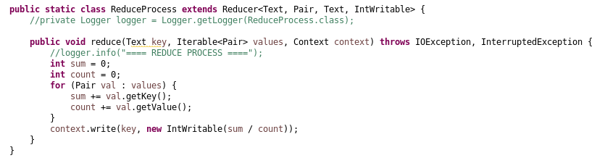
Human resources slide 9
2. Average - Java code
,
Additional Class
Pair
h

Slide 5
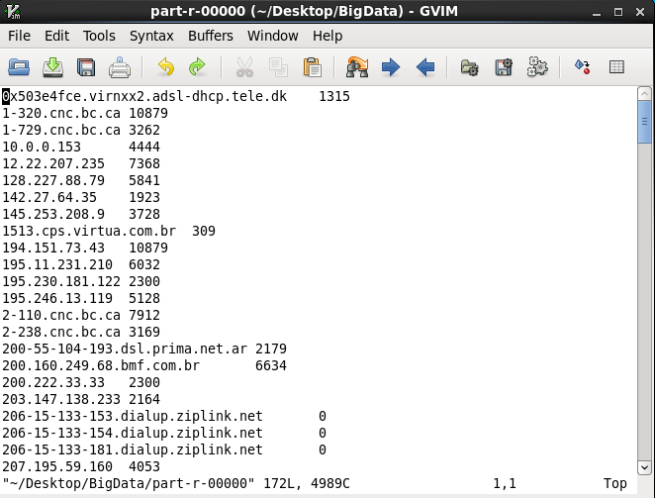
Human resources slide 9
3. Average - output
h

Slide 6
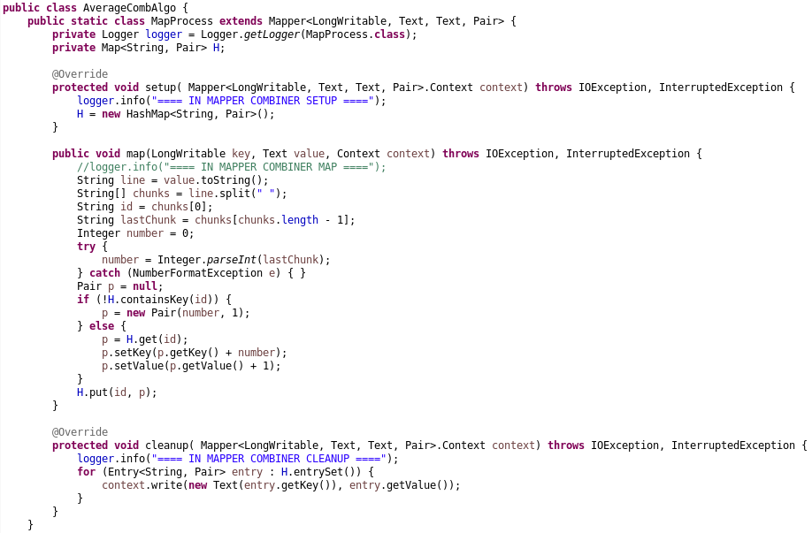
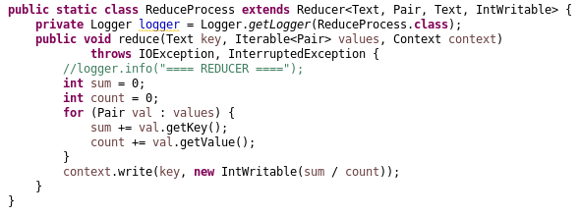
Human resources slide 9
4. InMapperAverage - Java code
h

Slide 7
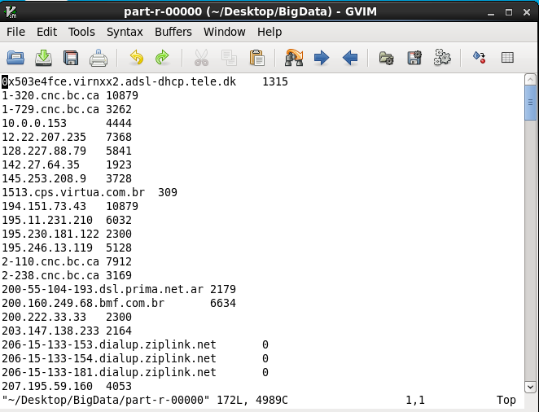
Human resources slide 9
5. InMapperAverage - output
h

Slide 8
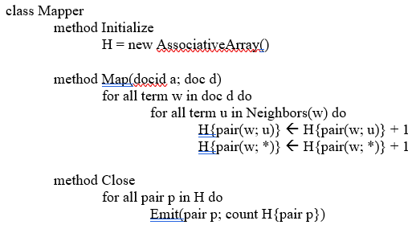
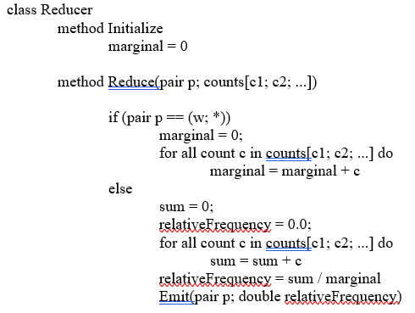
Human resources slide 9
6. PAIR approach - Pseudo code
s

Slide 9
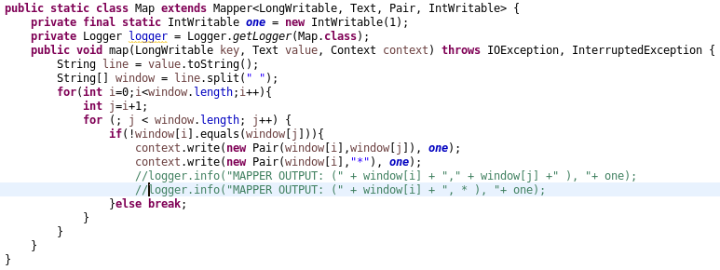
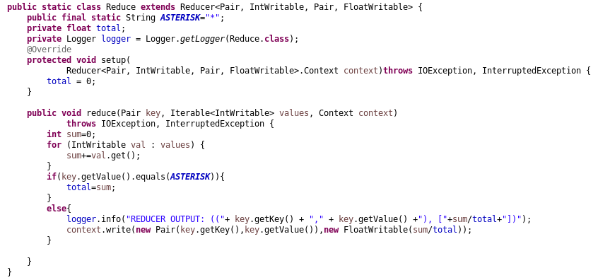
Human resources slide 9
7. PAIR approach - Java code
s

Slide 10
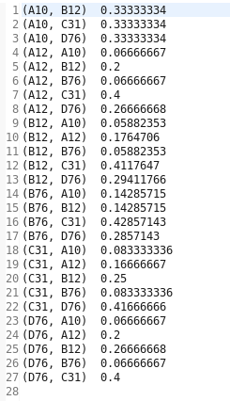
Human resources slide 9
8. PAIR approach - output
s

Slide 11
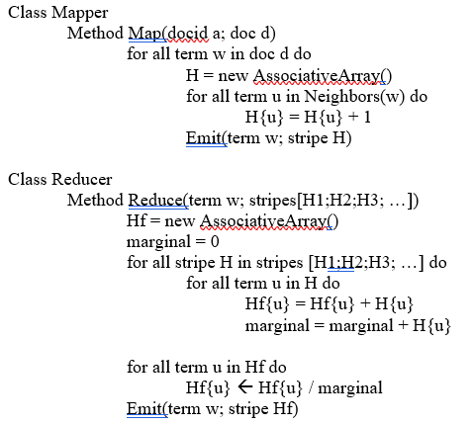
Human resources slide 9
9. STRIPE approach- Pseudo code
s

Slide 12
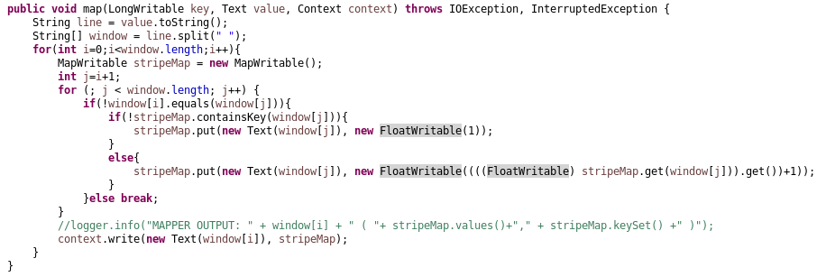
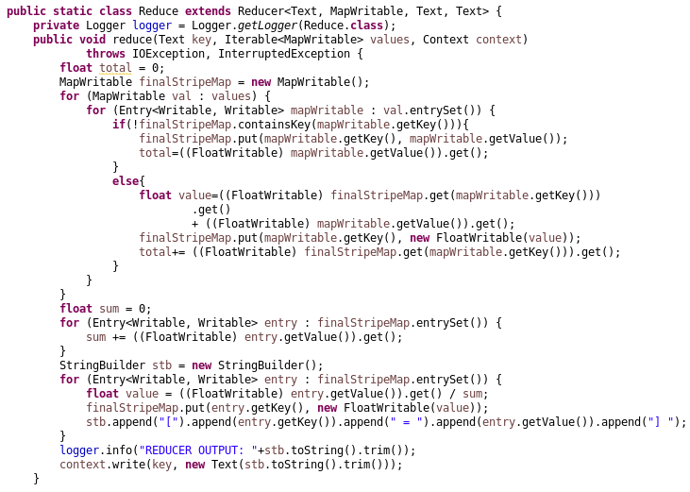
Human resources slide 9
10. STRIPE approach-Java code
s

Slide 13
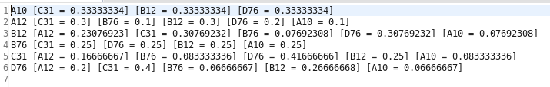
Human resources slide 9
11. STRIPE approach - output
s

Slide 14
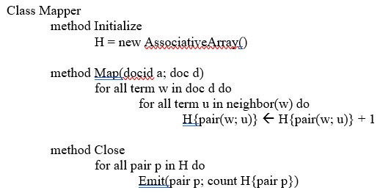
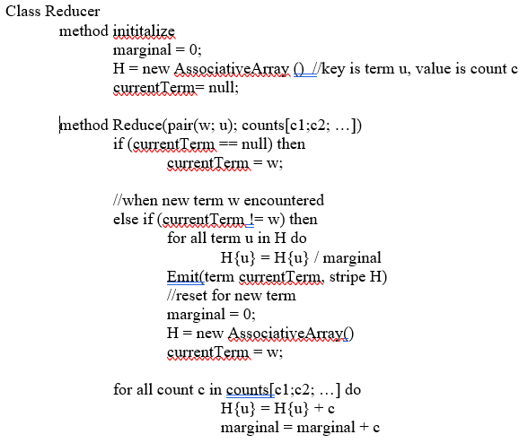
Human resources slide 9
12. HYBRID approach-Pseudo code
s

Slide 15
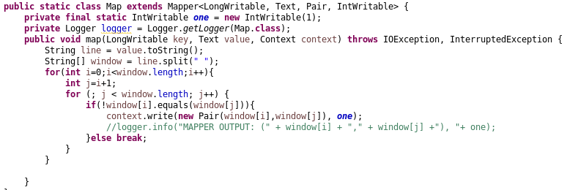
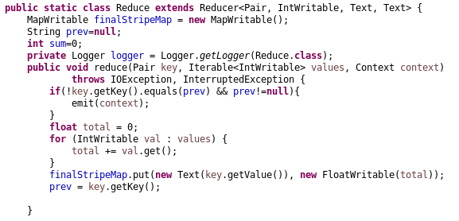
Human resources slide 9
13. HYBRID approach- Java code
s

Slide 16
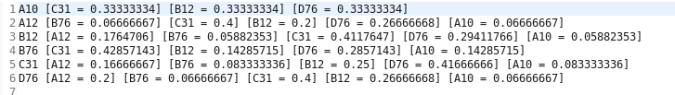
Human resources slide 9
14. HYBRID approach-output
s

Slide 17
Human resources slide 9
15. Time n resource comparison : Pair-Stripe-Hybrid
h

Slide 18

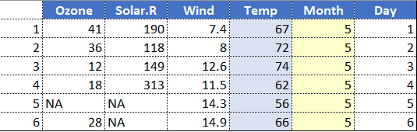
Human resources slide 7
16. Spark-Problem statement
Dataset
Categorical Variable
Numeric Variable
New York Air Quality Measurements
https://vincentarelbundock.github.io/Rdatasets/datasets.html
Month (May to Sep)
Temp (temperature in F.)
h

Slide 19
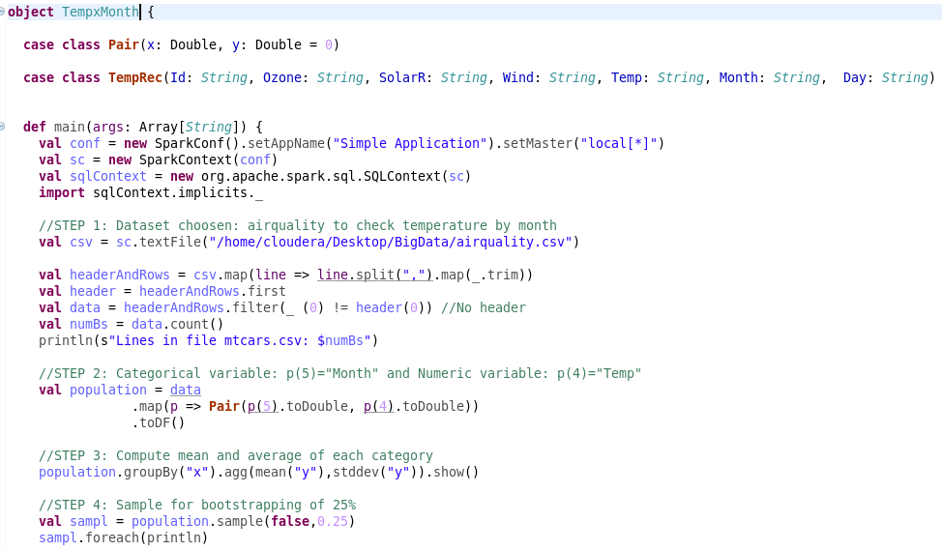
Human resources slide 9
17. Spark– Scala code…
s

Slide 20
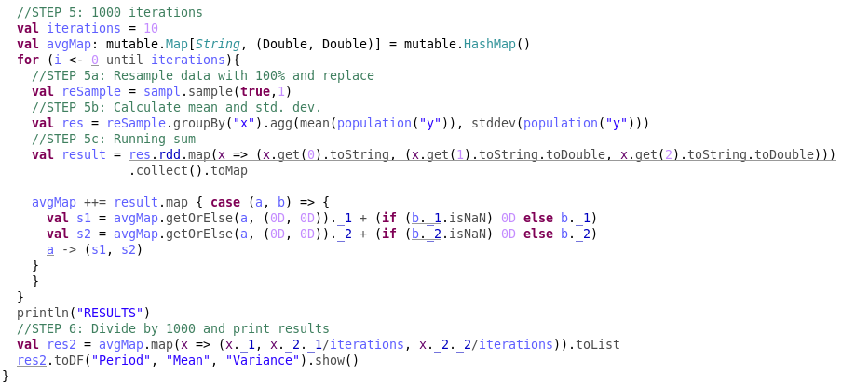
Human resources slide 9
17. Spark– Scala code
s

Slide 21
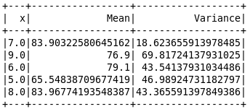
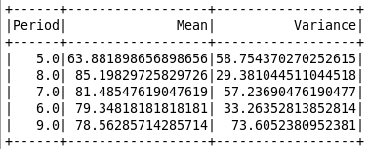
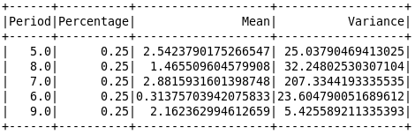
Human resources slide 9
18. Spark – output
Actual
Estimates
Error
s

Slide 22
Human resources slide 9
19. Spark – extra point
s

Slide 23
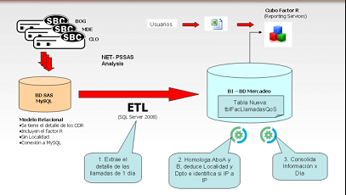
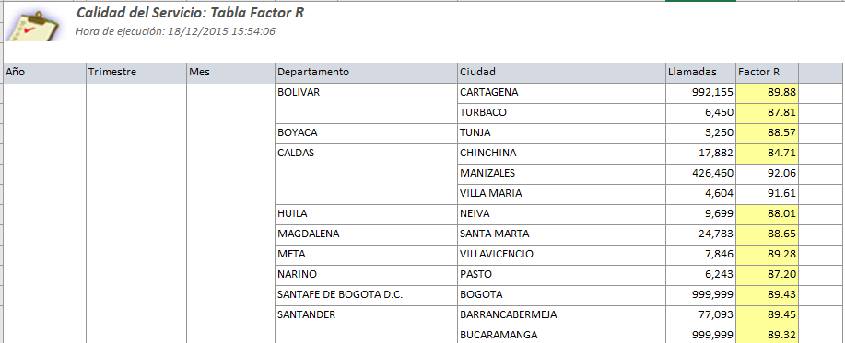
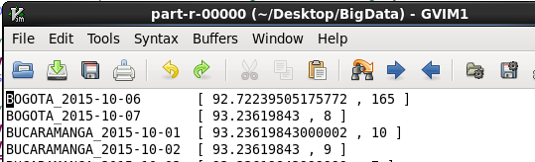


Human resources slide 9
20. MR Team Challenge
Data thrice, 3 developer, 3 months
Data only once (savings in disk), 1.5 hours of 1 developer
h

Slide 24
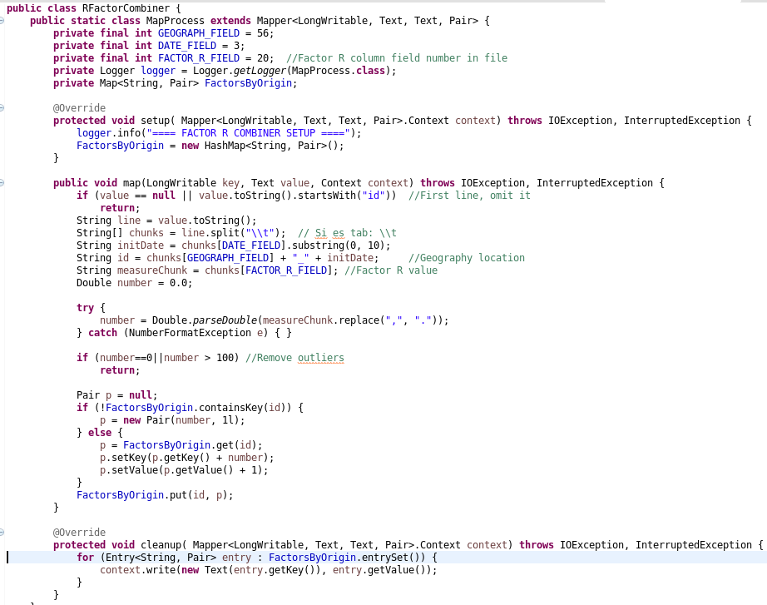
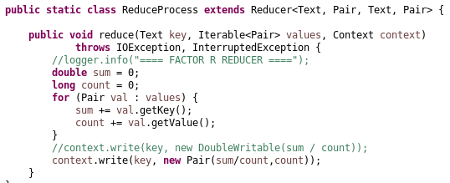
Human resources slide 9
21. MR Team Challenge - Code
s

Slide 25
Human resources slide 10
Thank You

