Slide 1
Human Activity Recognition Using Smartphones
Machine learning | GROUP 4
986636 - Carlos HERNANDEZ 986585 - Daniel Guimaraes 986775 - SEBASTIAN VALENCIA
PROF. DR. EMDAD KHAN

Slide 2
Outline
What we did
Motivation
The goal
The physics behind
Dataset
What problems we solve
Implemented Algorithms
What challenges we had
Grid Search
Author Issues
Our Own Experiment
Next Steps

Slide 3
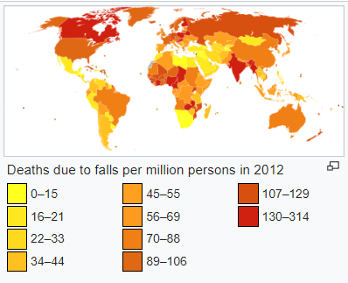
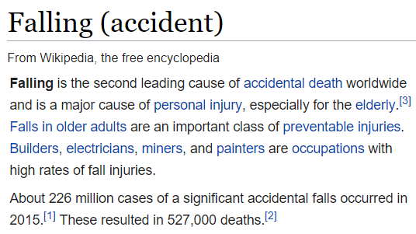
Motivation – Why?
Machine Learning: How machines can help humans?
In case of an accident?
We have a real example of this here

Slide 4
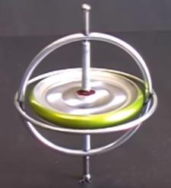







Goal
Build a ML model to process the data generated by common smartphones (based on gyroscope and accelerometer data), to recognize the type of activity being performed:
Walking
Downstairs, Upstairs
Sitting
Standing
Laying
Falling down

Slide 5
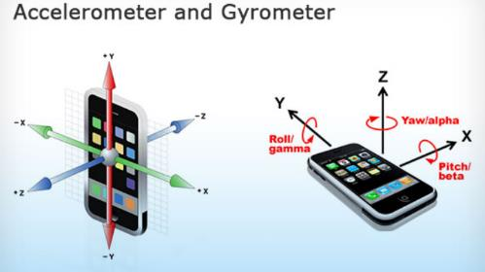
Physics Behind
From 2015 wearable devices start to populate the market (IoT)
These device produces high valuable information but needs to be processed for diversity of applications.
Smartphones today are very common and has incorporated devices like gyroscope and accelerometer, and goes everywhere user goes.
Those devices are limited in processing and power
Using ML models to classify the information is compute intensive and has accuracy problems
In this project we will explore several ML algoritms to check best accuracy

Slide 6
Project Steps
Step 1
Data Quality
Step 2
Try != algorithms
Step 3
Experiment
Conclude best model
Choose model
Feature Selection
Train
Test
Check accuracy
Conclusions

Slide 7
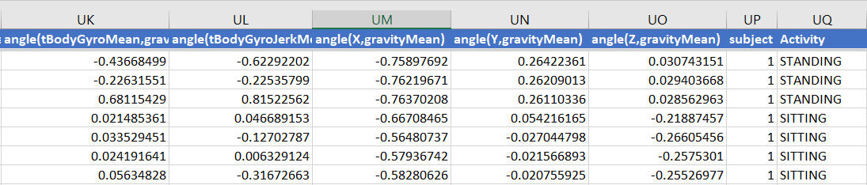
Dataset
Depends on mobile type and model data from those devices stored (around 70MB)
Data has many measures (563 columns)
1000 records for training, 1000 for testing
The challenge: too many columns, too much information to be processed with some high computational algorithms in real time in small devices.

Slide 8
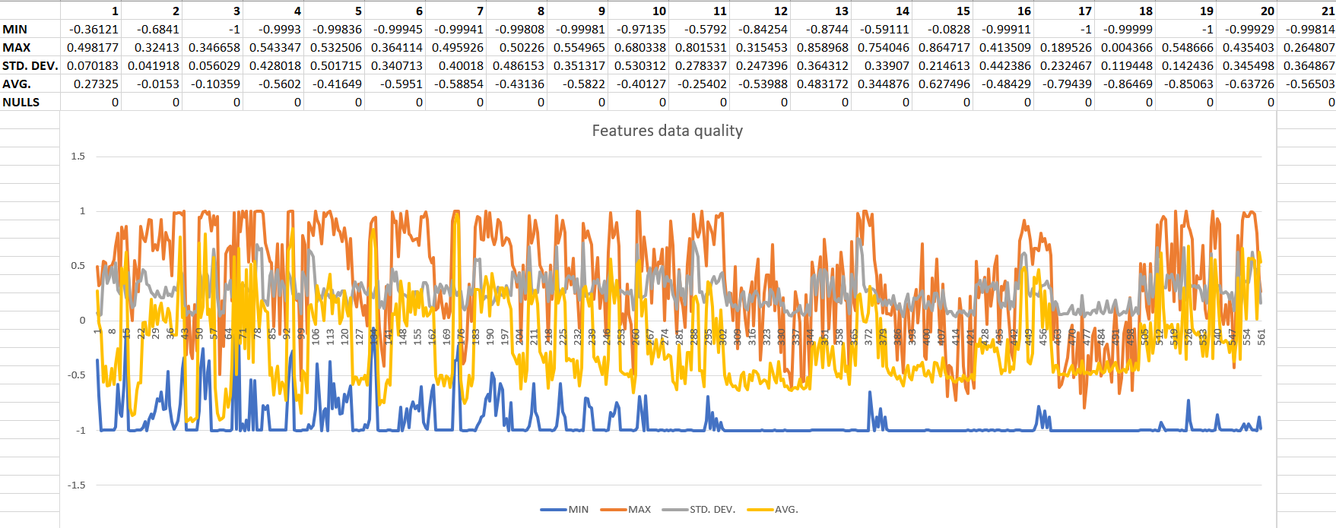
Data Quality
Data Ok. Features scaled to be between -1 and 1

Slide 9
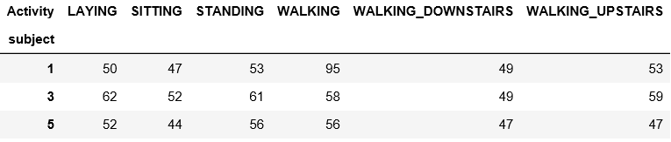
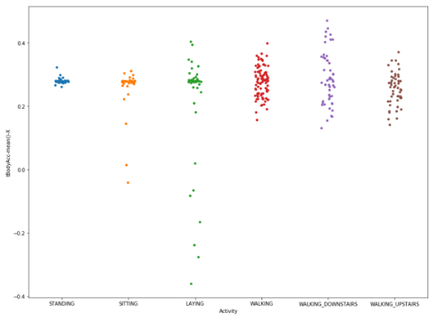
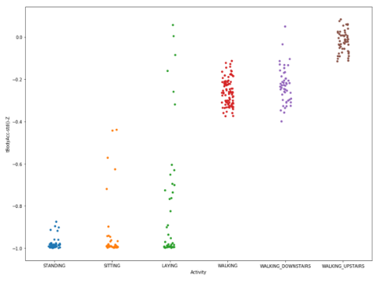
Data Distribution
Using Python we checked for data distribution, one column at a time. Some of them more relevant to differentiate the activity

Slide 10

Implemented Algorithms
Logistic Regression
Keras Neural Network
Random Forest
SGD
SVM
K Nearest Neighbors

Slide 11
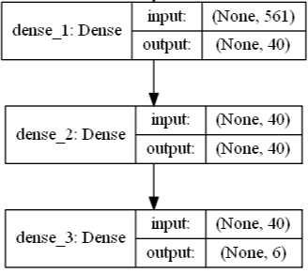
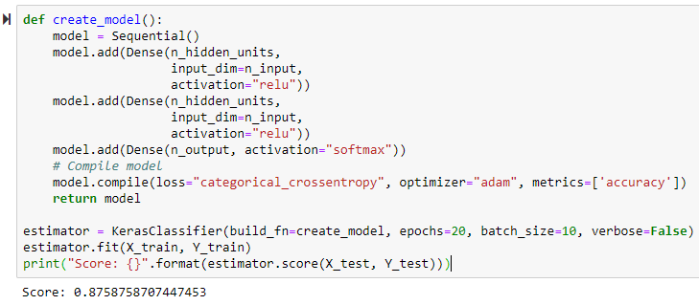
Keras Neural Network

Slide 12
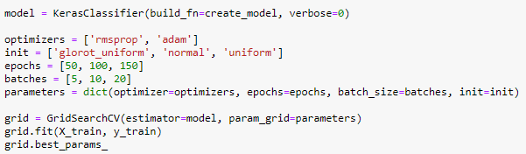
Grid Search
Results

Slide 13
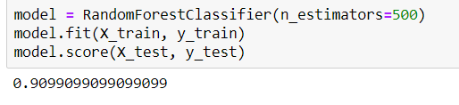
Best accuracy
Random Forrest performed better:
Random Forest Advantages:
One of the most accurate learning algorithms available
Can handle thousands of input variables without variable deletion.
It offers an experimental method for detecting variable interactions.
Random Forest Disadvantages:
Overfitting can easily occur
Need to choose the number of trees

Slide 14
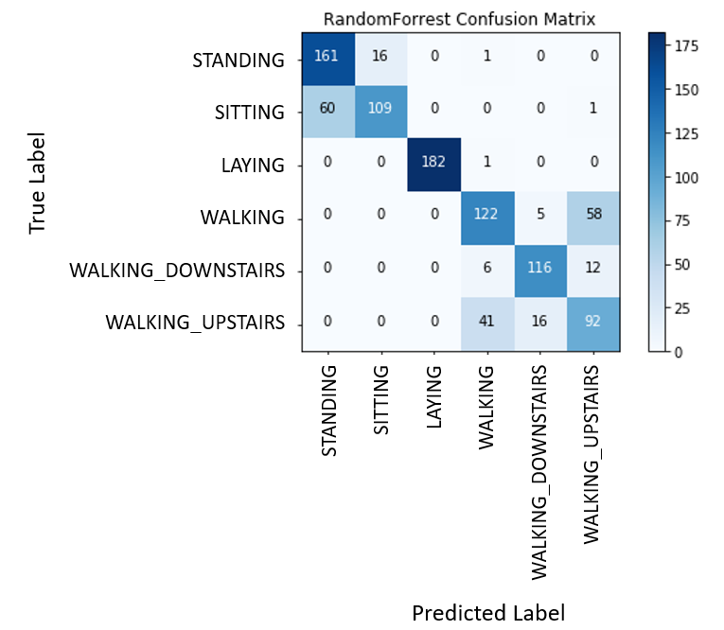
Confusion Matrix – Random Forest
Some issues between:
Sitting x Standing
Walking x Walking_Upstairs

Slide 15
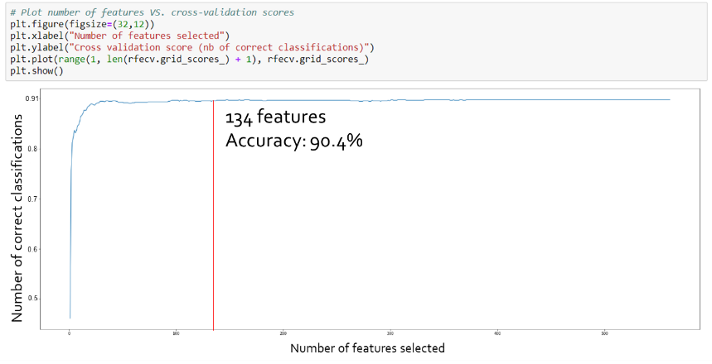
Author Issues
The author pointed out on the paper the need to deal with the processing in small computation capabilities devices when classifying Human Activity in real time.
To address this problem, we applied Feature Selection resulting in less memory and processor usage, with a good accuracy.

Slide 16
Conclusion
Key procedures for application of machine learning algorithms:
Data Balance
Data Quality
Grid Search
Feature Selection
The Random Forest model was the most efficient machine learning algorithm
We could prove that it is possible to use a simple mobile device (e.g. Sony XA 1) to read key features for Human Activity Recognition
Next steps: develop a mobile app to read and classify human activities. Possible applications:
Fall alert - Fast rescue
Measure the benefits of TM - Cross TM practice frequency with other inputs (such as heart rate, blood pressure, etc.) and then create structured reports

Slide 17


