Slide 1
DATABUSTERS
Team 16: Andrea Tan, Koh Cai Ling, Trinity Teo, Wu Yilin
Github: [https://github.com/Atzy837/Databusters.git]

Slide 2
TABLE OF CONTENTS
01
02
03
04
05
DESCRIPTIVE STATISTICS
MODELLING METHODS
KEY FINDINGS
ECONOMIC ANALYSIS
CONCLUSION

Slide 3
DESCRIPTIVE STATISTICS
01

Slide 4
DESCRIPTIVE STATISTICS
Data type: Quarterly
Time range: 2006 - 2024
Number of predictors: 246

Slide 5
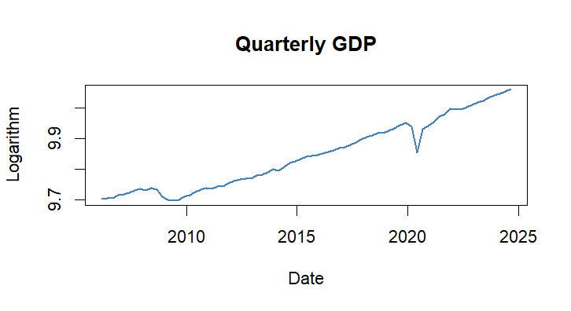
DESCRIPTIVE STATISTICS

Slide 6
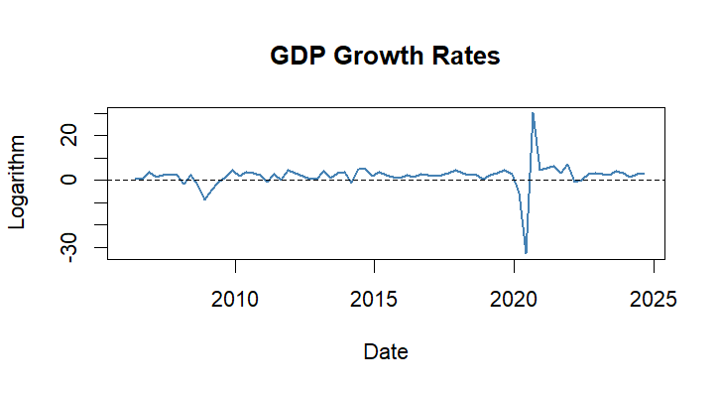
DESCRIPTIVE STATISTICS

Slide 7
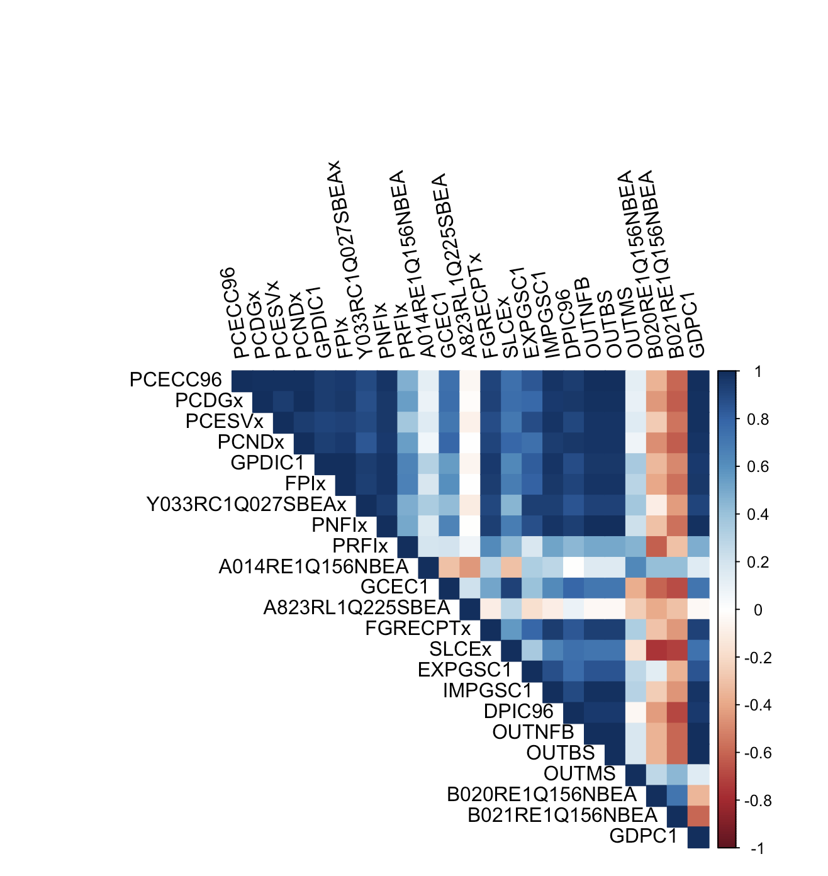
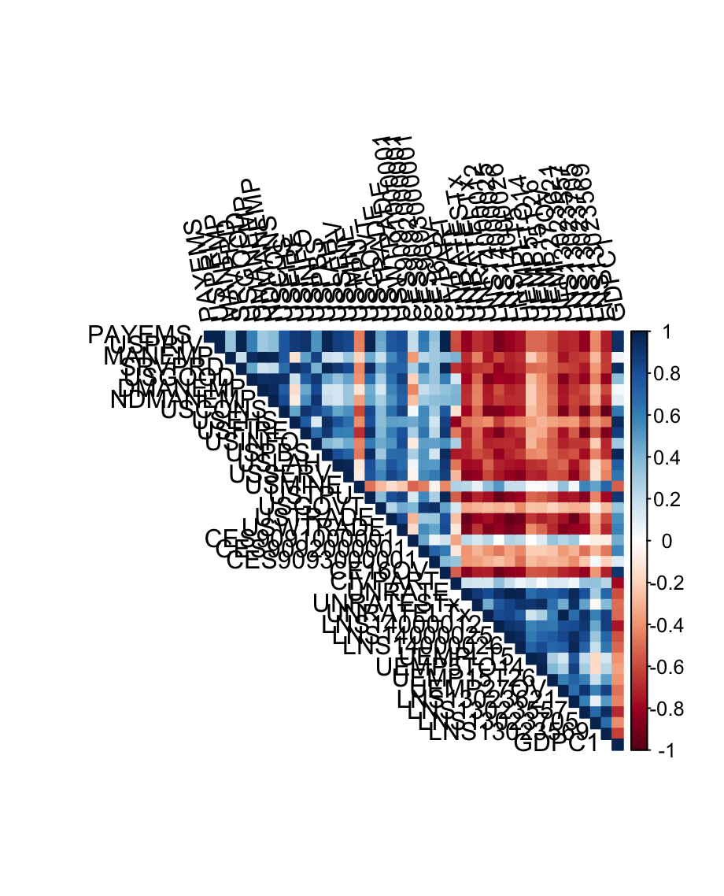
Correlation Plot for Group 1 and 3

Slide 8
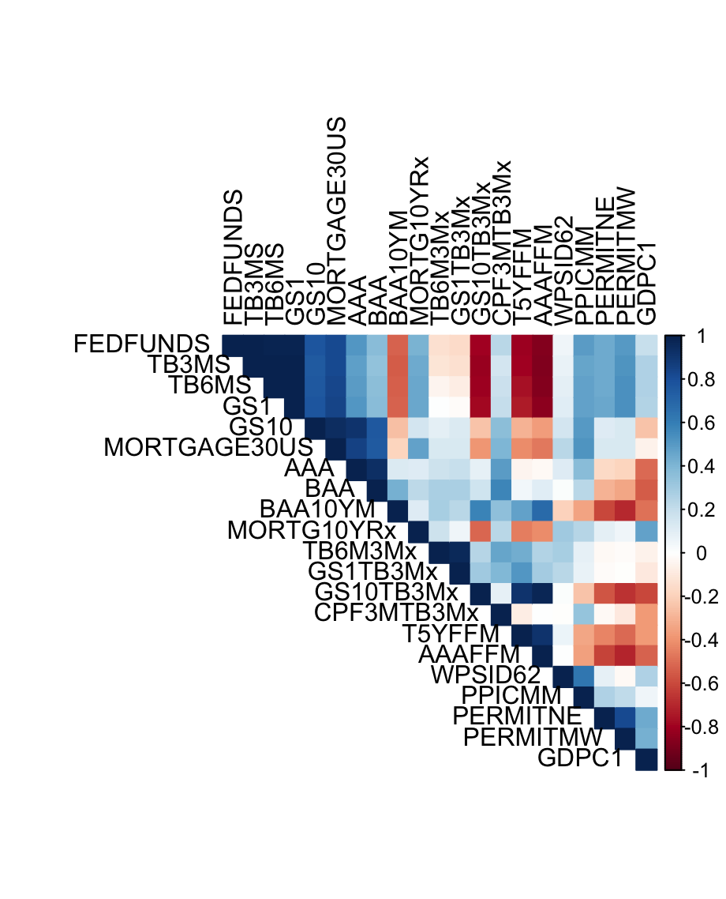
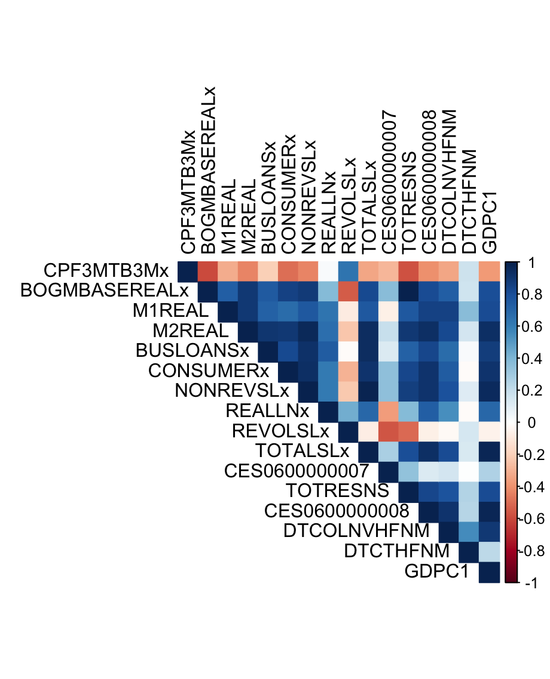
Correlation Plot for Group 8 and 9

Slide 9
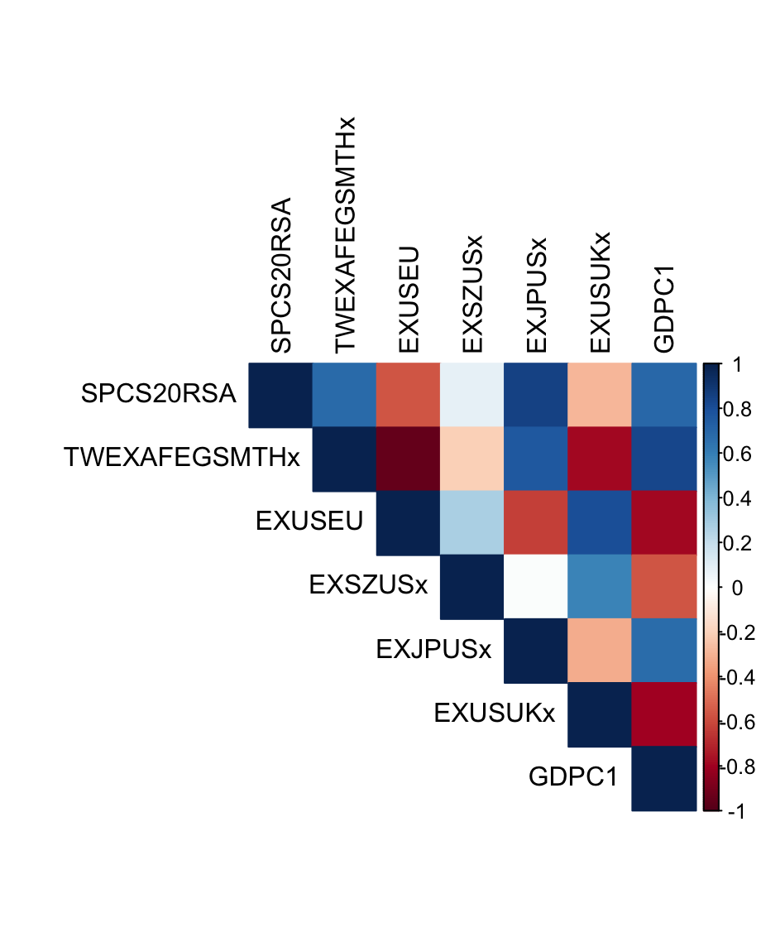
Correlation Plot for Group 3 and 11

Slide 10
MODELLING METHODS
02

Slide 11
MODELLING METHODS
Principal Component Analysis (PCA)
Purpose:
Dimension reduction
Data scaling
Process:
Firstly, group-wise (except Group 12)
Next, across all PCs chosen from all groups

Slide 12
MODELLING METHODS
2. Autoregressive Distributed Lag (ADL) model
Purpose:
Past values of Y_{t} will affect Y_{t+h}
Process:
7 PCs chosen by PCA
AIC to determine optimal lag length

Slide 13
MODELLING METHODS
2. Autoregressive Distributed Lag (ADL) model
Compare AR(1) and AR(2)
Lag order of GDP = 2
Fan Chart of AR(2) plotted
Repeat for all PCs
ADL model with p lags of GDP and ql lags of PCs where l = 1 … k.
ADL(2, (2, 1, 1, 1, 2, 1, 3))

Slide 14
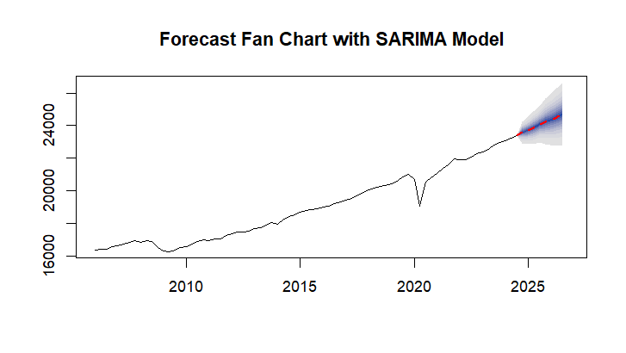
MODELLING METHODS

Slide 15
KEY FINDINGS
03

Slide 16
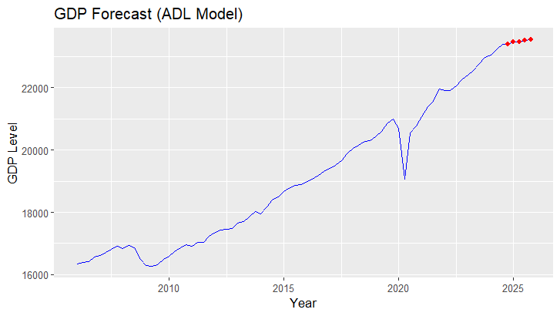
KEY FINDINGS

Slide 17
KEY FINDINGS
Year & Quarter | GDP forecast
2024 Q4 | 23400.29
2025 Q1 | 23453.77
2025 Q2 | 23470.59
2025 Q3 | 23504.38
2025 Q4 | 23548.41

Slide 18
ECONOMIC ANALYSIS
04

Slide 19
ECONOMIC ANALYSIS
Based on GDP forecasts, GDP growth rates are positive
Economic contraction in the U.S. is unlikely

Slide 20
CONCLUSION
05

Slide 21
IN CONCLUSION
PCA: 7 PCs
ADL model
Our forecast: economic contraction is unlikely in 2025
Uncertainty in the global economy

Slide 22
THANKS!

