Slide 1
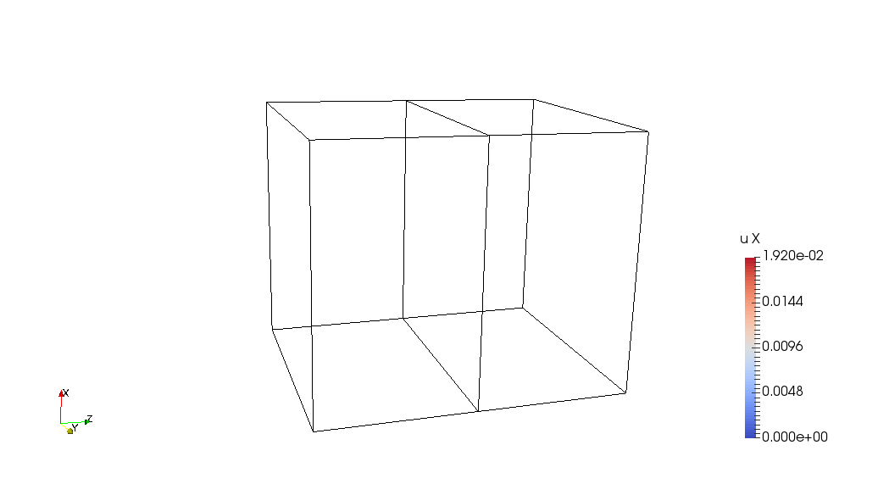
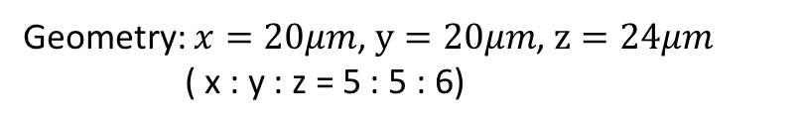
Bicrystal Model
Rotate along X axis for 30 degrees
X
X
Z
Y
Z
Y
Geometry: $x=20μm$, $y=20μm$, $z=24μm$
( x : y : z = 5 : 5 : 6)

Slide 2
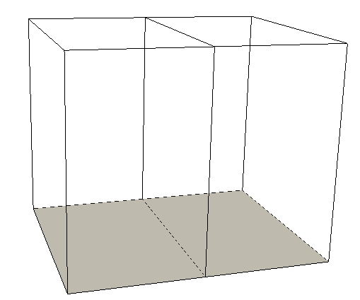
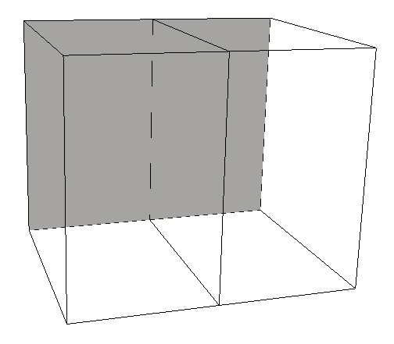
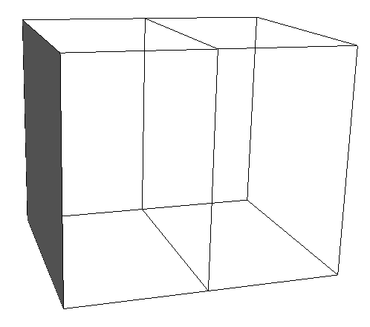
Boundary conditions:
Bottom: Ux = 0
Back: Uy = 0
Left: Uz = 0

Slide 3
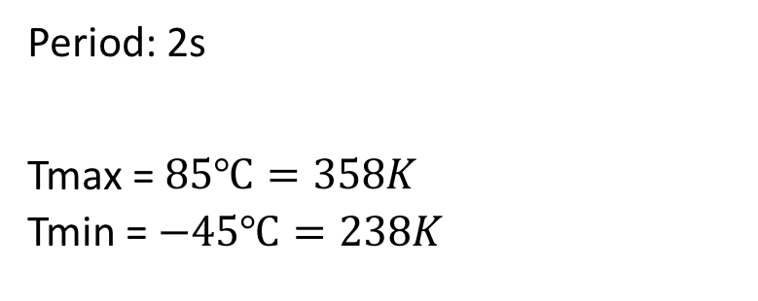
Loading: thermal cycling
Period: 2s
Tmax = $85℃=358K$
Tmin = $−45℃=238K$

Slide 4
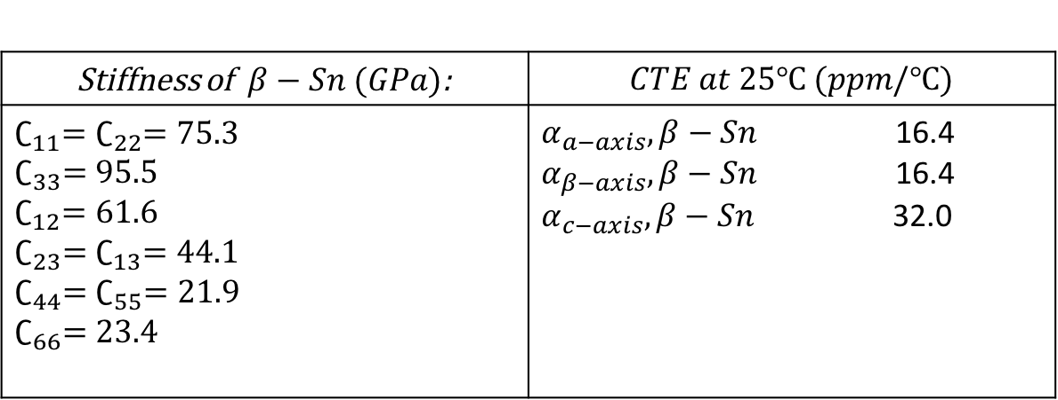
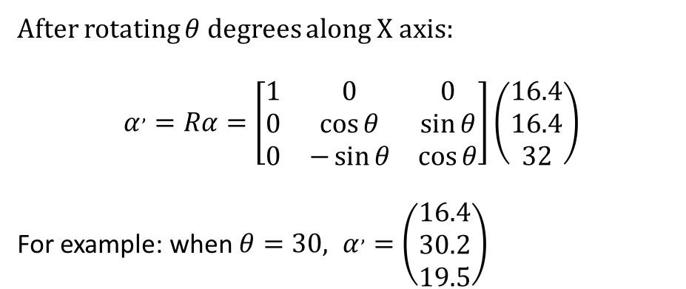

Material: $β−Sn$ (body-centered tetragonal)
Stiffness of$β−Sn (GPa)$: | $$CTE at 25℃ (ppm/℃)$$
$∁_{11}=∁_{22}=75.3$ $∁_{33}=95.5$ $∁_{12}=61.6$ $∁_{23}=∁_{13}=44.1$ $∁_{44}=∁_{55}=21.9$ $∁_{66}=23.4$ | $α_{a−axis},β−Sn$ 16.4 $α_{β−axis},β−Sn$ 16.4 $α_{c−axis},β−Sn$ 32.0
After rotating $θ$ degrees along X axis:
$$α^{,}=Rα=\left[\begin{matrix}1 & 0 & 0 \\ 0 & \cos{θ} & \sin{θ} \\ 0 & −\sin{θ} & \cos{θ}\end{matrix}\right]\left(\begin{matrix}16.4 \\ 16.4 \\ 32\end{matrix}\right)$$
For example: when $θ=30, α^{,}=\left(\begin{matrix}16.4 \\ 30.2 \\ 19.5\end{matrix}\right)$

Slide 5
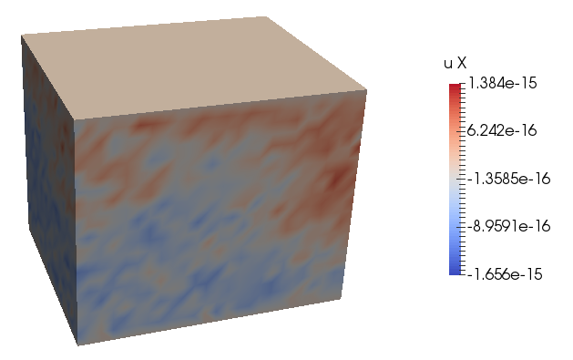
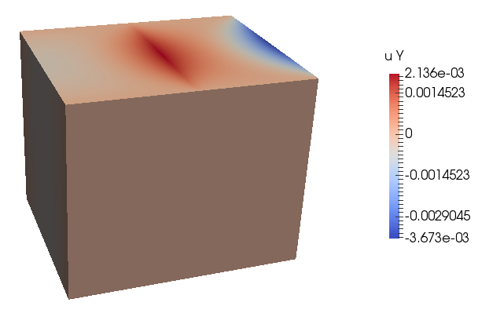
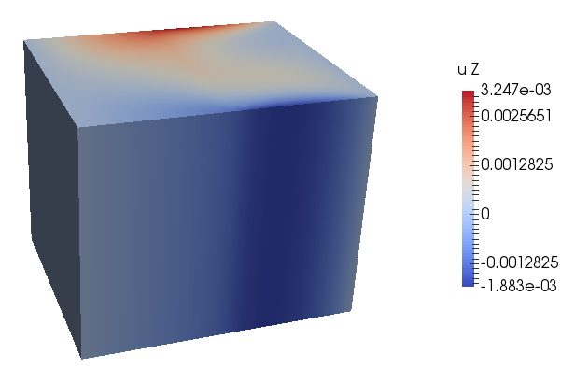
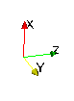

Displacement $(μm)$
Number of time step for one cycle: 200
Number of time step to reach max temperature: 50
Here are the displacements at time step 50

Slide 6
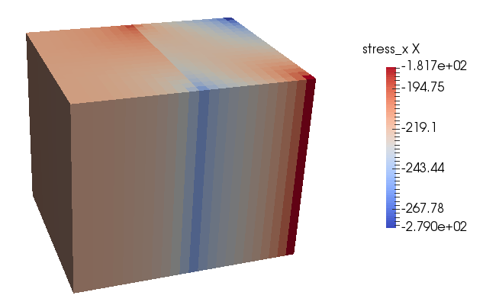
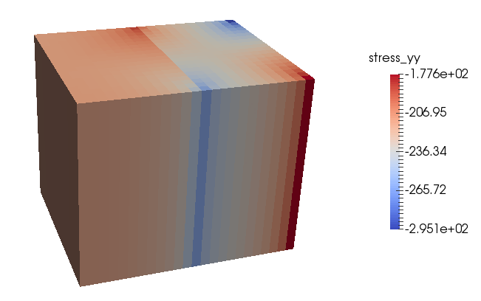
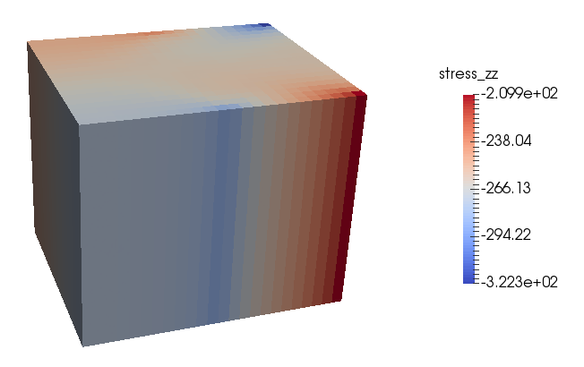
Stress
At time step 50:

