Slide 1
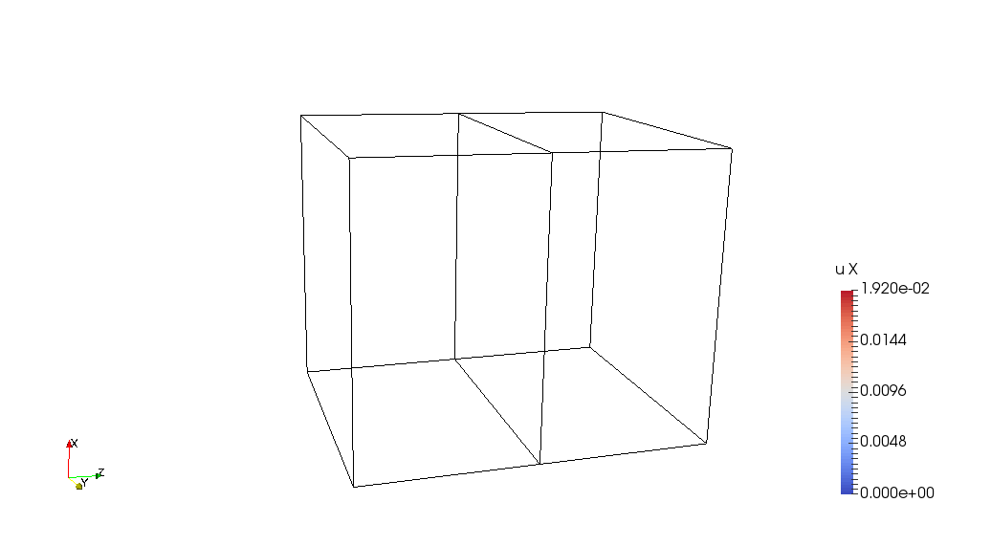
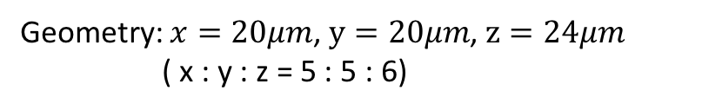
Bicrystal Model
Case 1: Rotate along X axis for 30 degrees;
Case 2: Rotate along X axis for 45 degrees
X
X
Z
Y
Z
Y
Geometry: $x=20μm$, $y=20μm$, $z=24μm$
( x : y : z = 5 : 5 : 6)

Slide 2
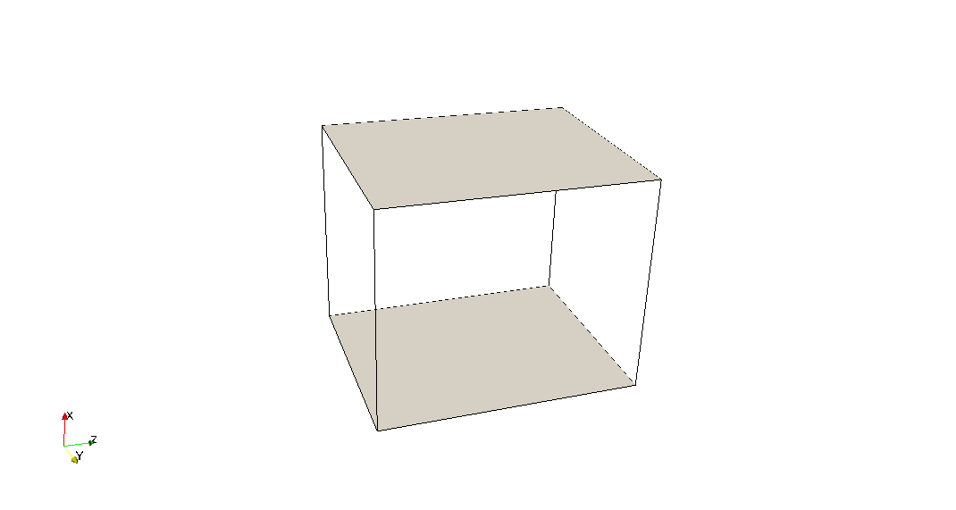
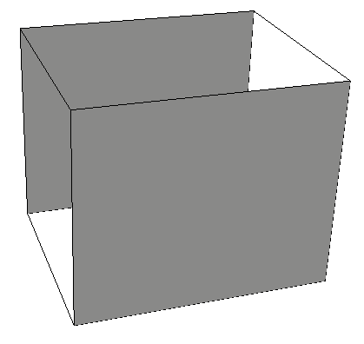
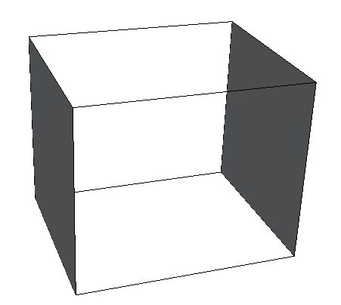
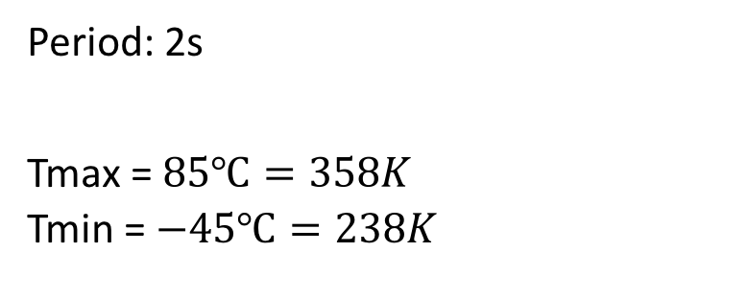
Boundary conditions:
Loading: thermal cycling
Constrain all the boundaries, no displacements
Period: 2s
Tmax = $85℃=358K$
Tmin = $−45℃=238K$
Ux=0
Uy=0
Uz=0

Slide 3
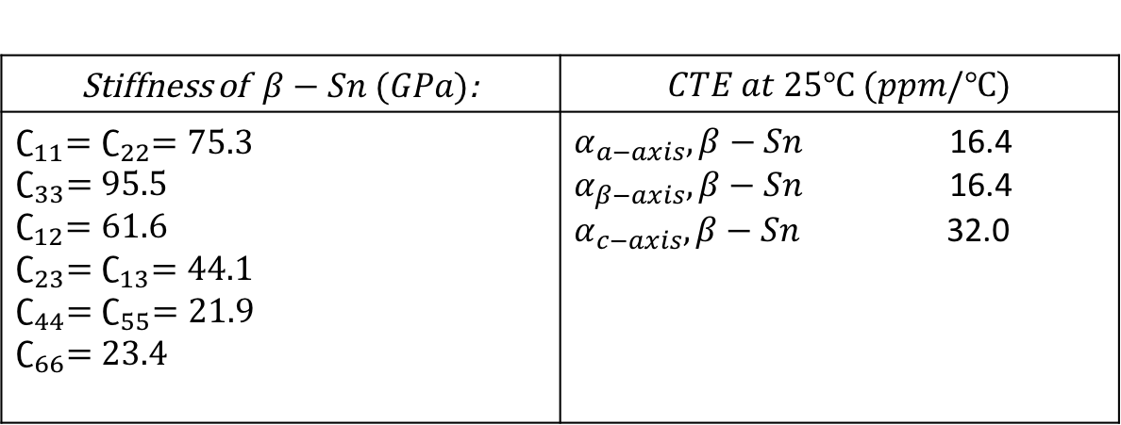
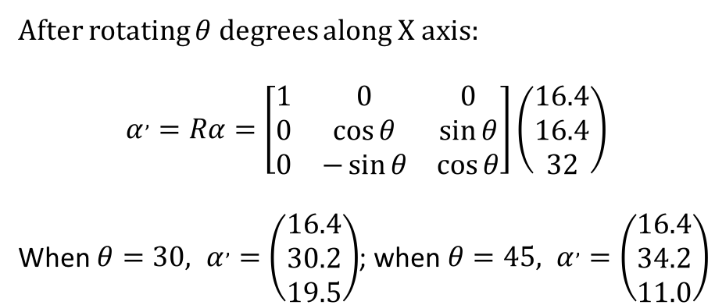

Material: $β−Sn$ (body-centered tetragonal)
Stiffness of$β−Sn (GPa)$: | $$CTE at 25℃ (ppm/℃)$$
$∁_{11}=∁_{22}=75.3$ $∁_{33}=95.5$ $∁_{12}=61.6$ $∁_{23}=∁_{13}=44.1$ $∁_{44}=∁_{55}=21.9$ $∁_{66}=23.4$ | $α_{a−axis},β−Sn$ 16.4 $α_{β−axis},β−Sn$ 16.4 $α_{c−axis},β−Sn$ 32.0
After rotating $θ$ degrees along X axis:
$$α^{,}=Rα=\left[\begin{matrix}1 & 0 & 0 \\ 0 & \cos{θ} & \sin{θ} \\ 0 & −\sin{θ} & \cos{θ}\end{matrix}\right]\left(\begin{matrix}16.4 \\ 16.4 \\ 32\end{matrix}\right)$$
When $θ=30, α^{,}=\left(\begin{matrix}16.4 \\ 30.2 \\ 19.5\end{matrix}\right)$; when $θ=45, α^{,}=\left(\begin{matrix}16.4 \\ 34.2 \\ 11.0\end{matrix}\right)$

Slide 4
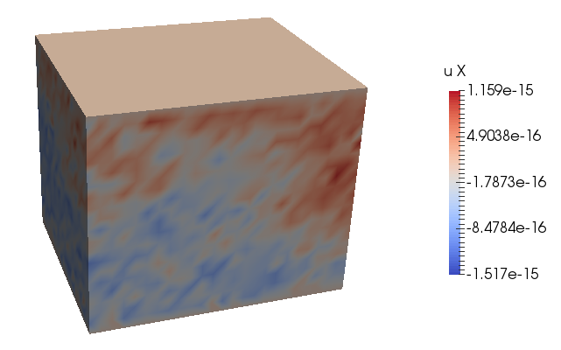
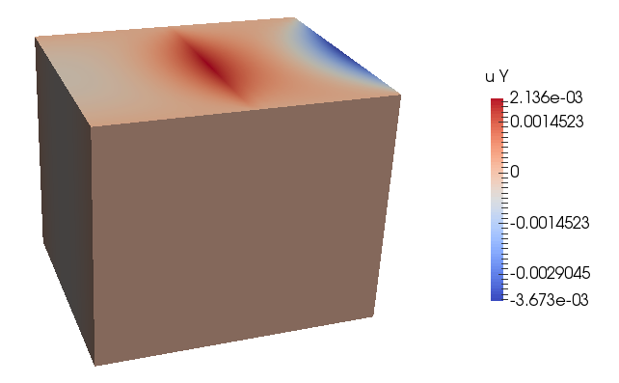
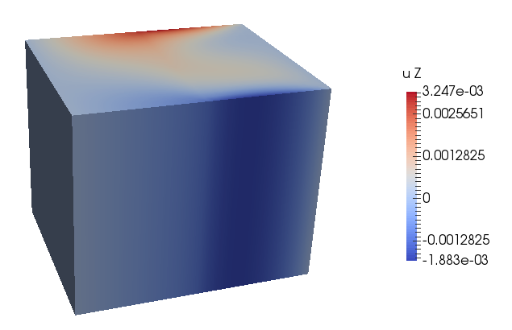
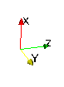
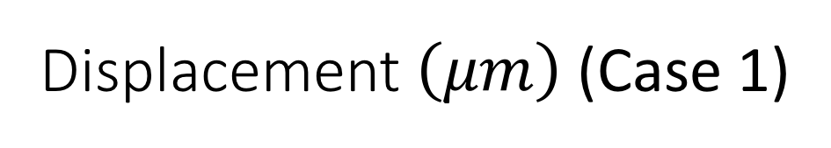
Displacement $\left(μm\right)$ (Case 1)
Number of time step for one cycle: 200
Number of time step to reach max temperature: 50
Here are the displacements at max temperature

Slide 5
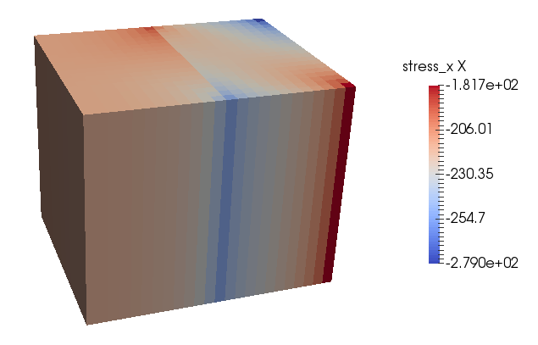
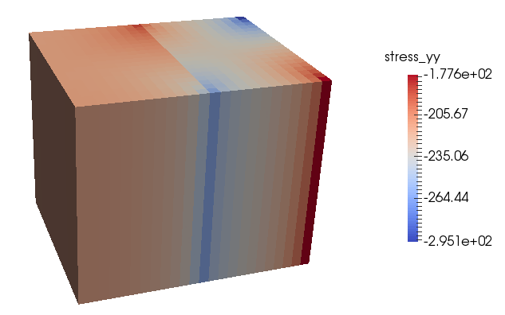
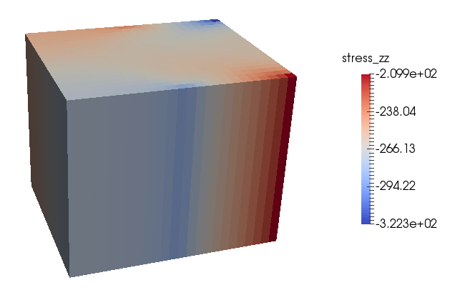
Stress (MPa)
At max temperature

Slide 6
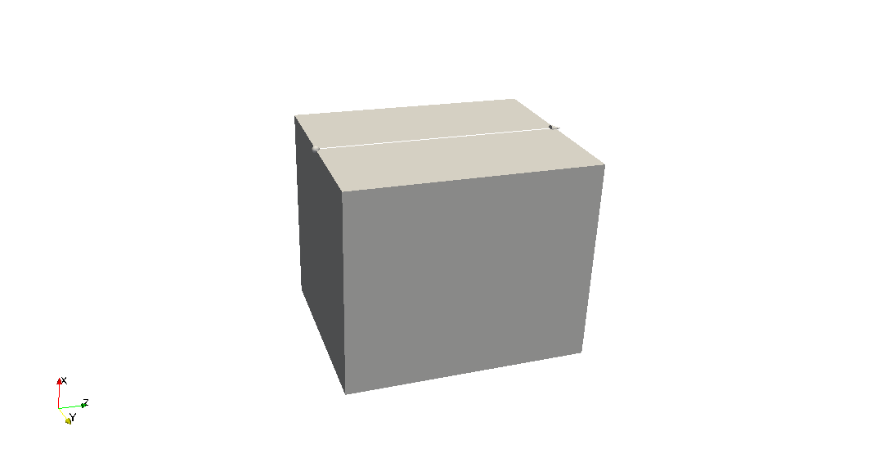

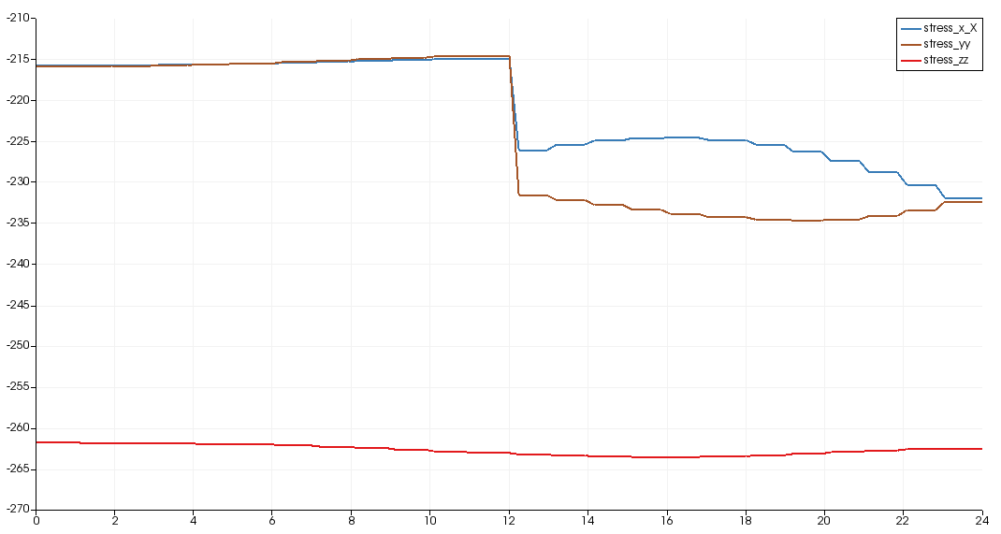
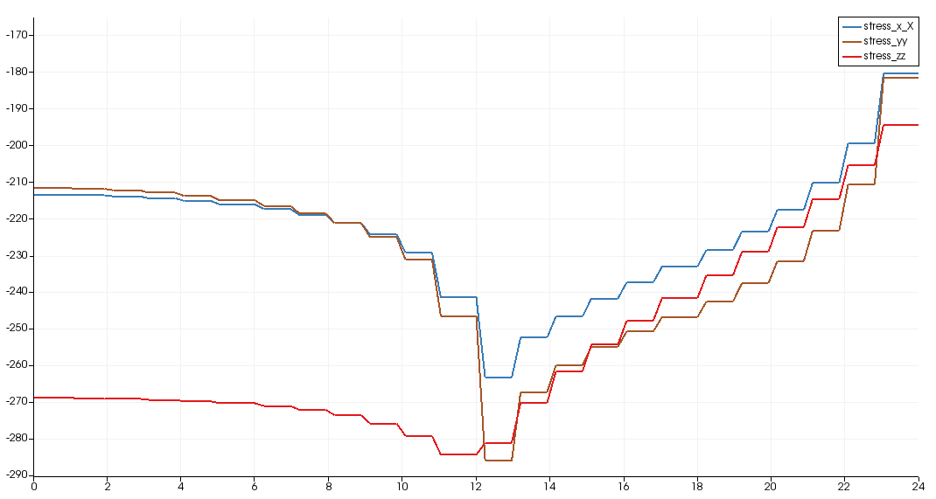
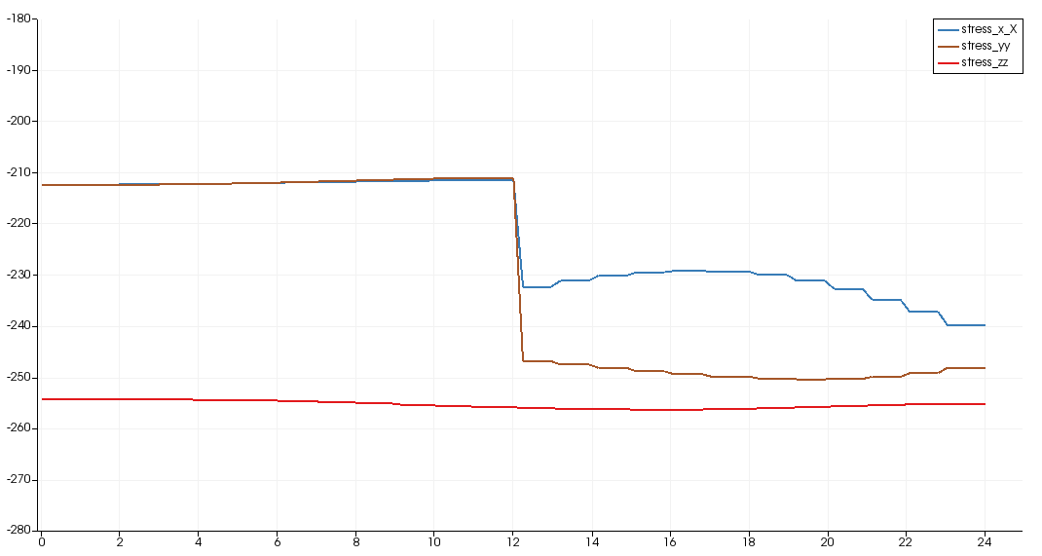
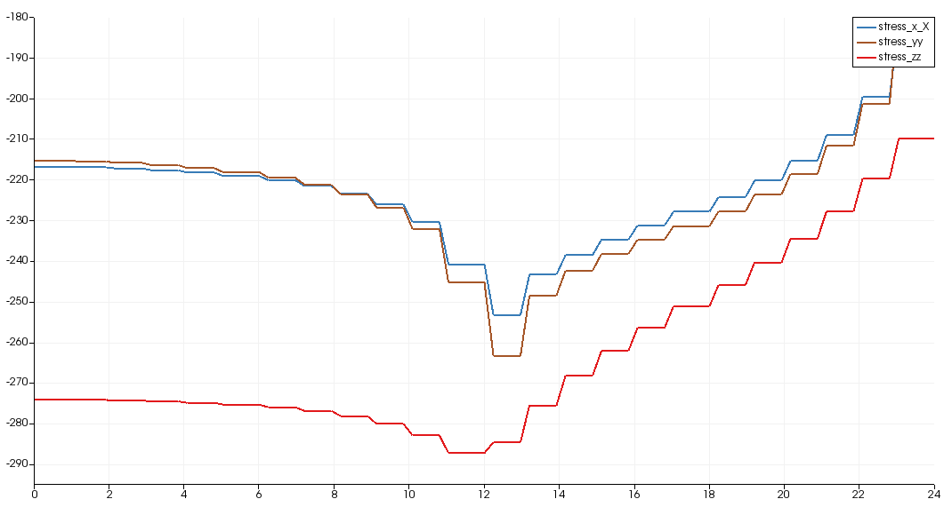
Normal to grain boundary
Case 1:
rotate 30 degrees
Case 2:
rotate 45 degrees

Slide 7
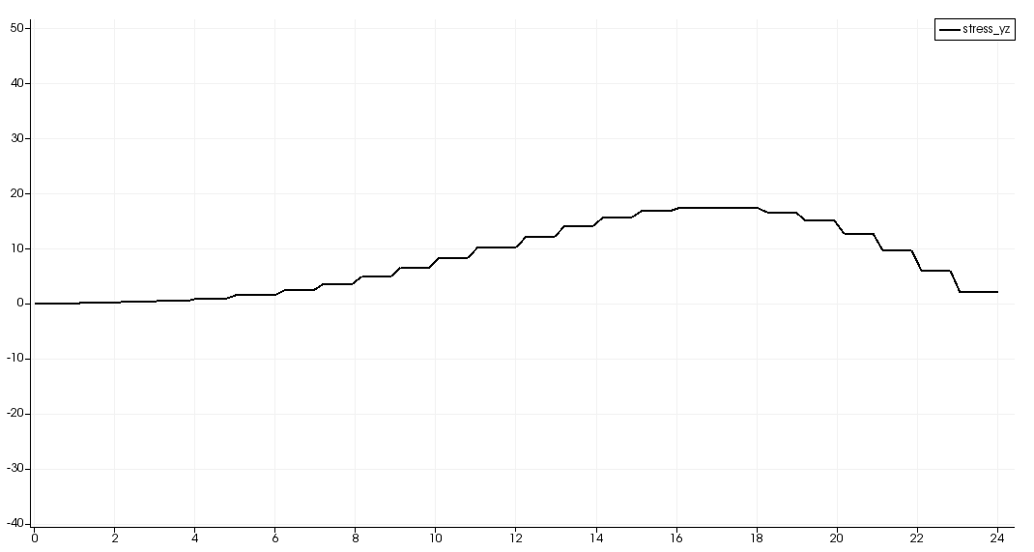
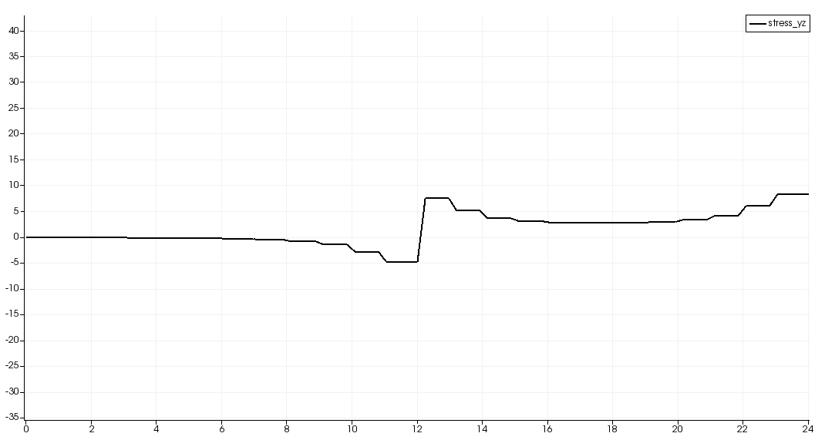
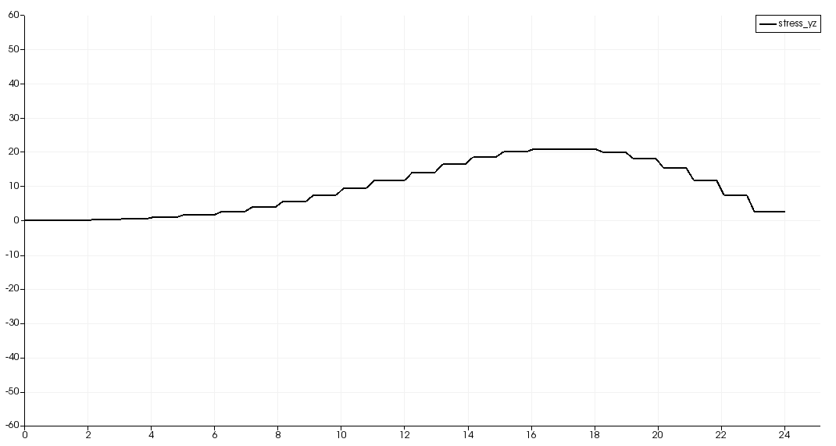
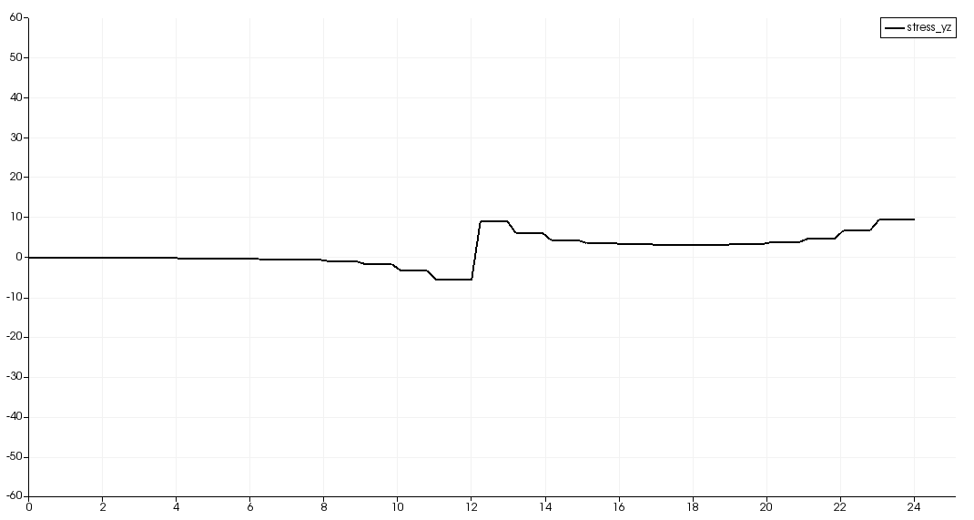
Normal to grain boundary
Stress_ xy = 0, Stress_xz = 0
Case 1:
rotate 30 degrees
Case 2:
rotate 45 degrees

Slide 8
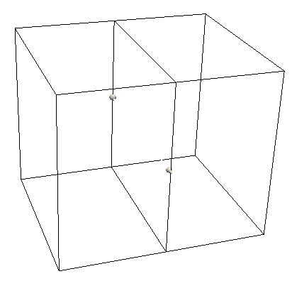
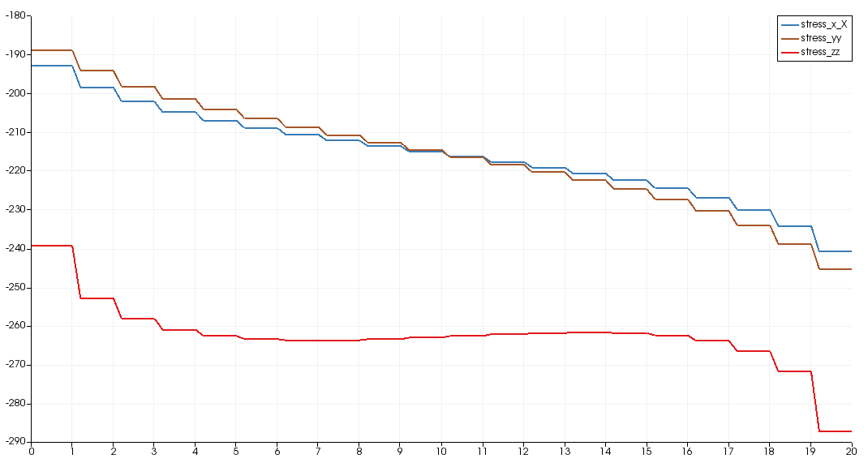
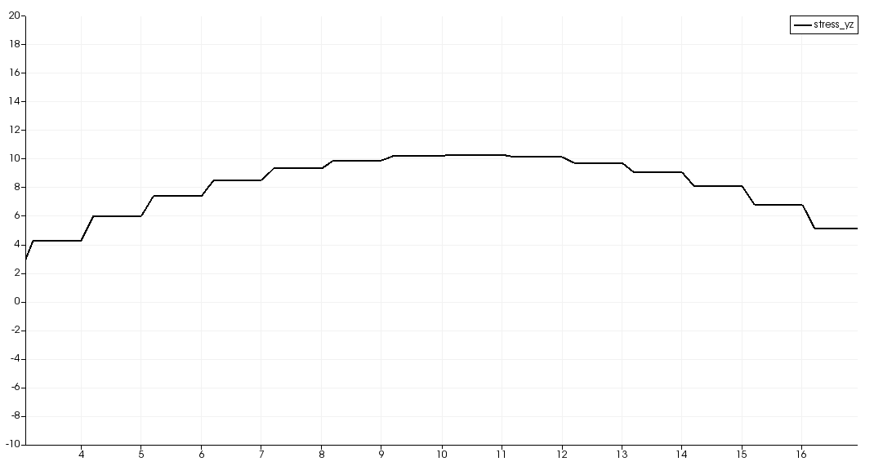
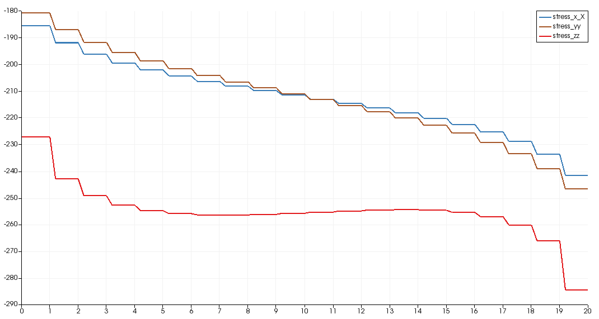
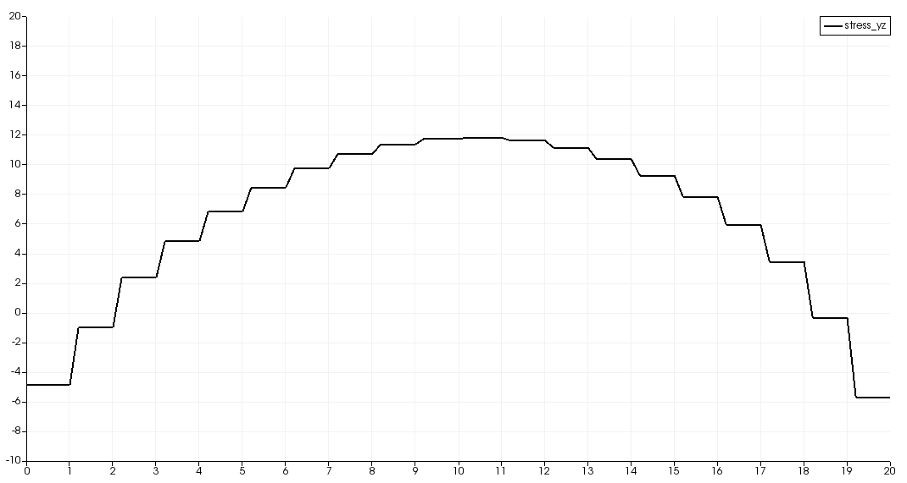
Parallel to grain boundary
Stress_ xy = 0, Stress_xz = 0
Case 1:
rotate 30 degrees
Case 2:
rotate 45 degrees

Slide 9
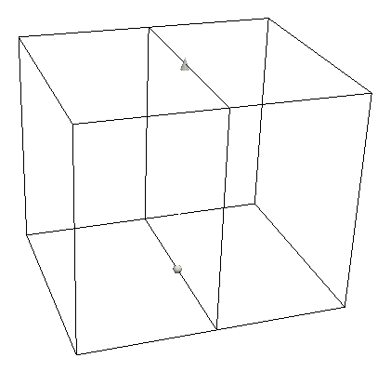
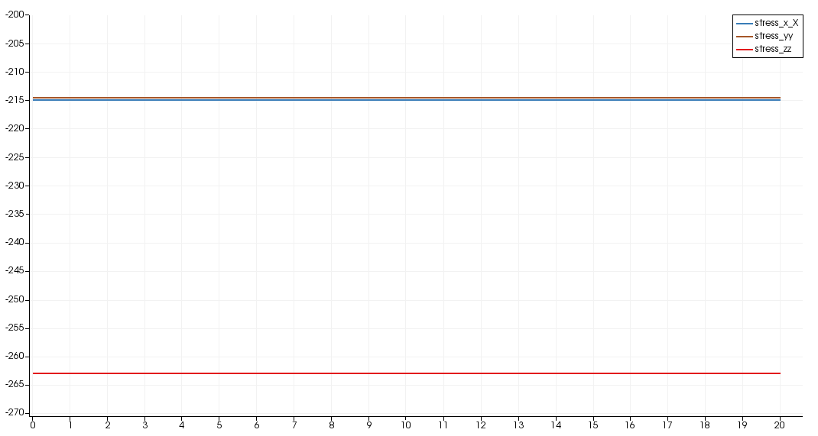
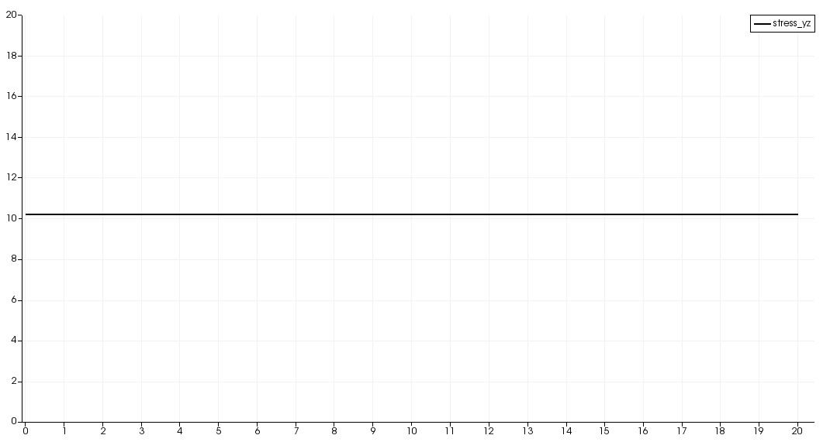
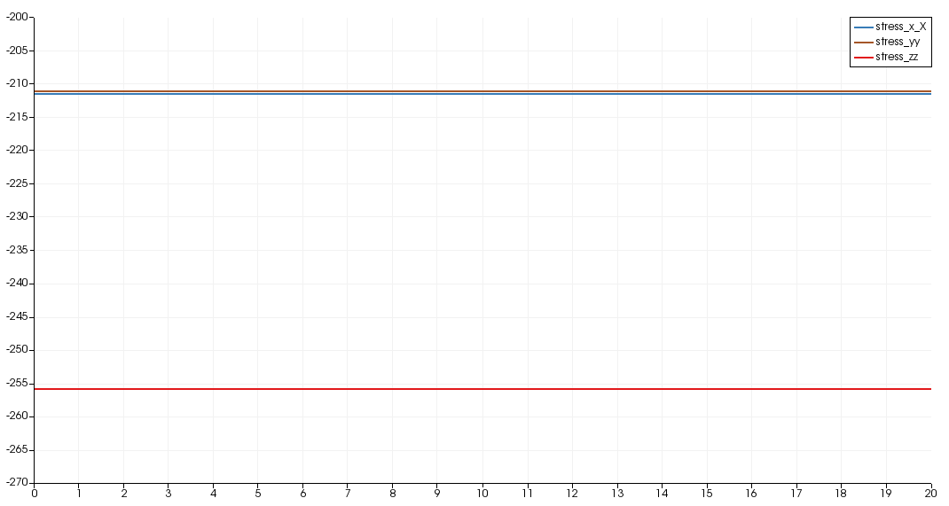
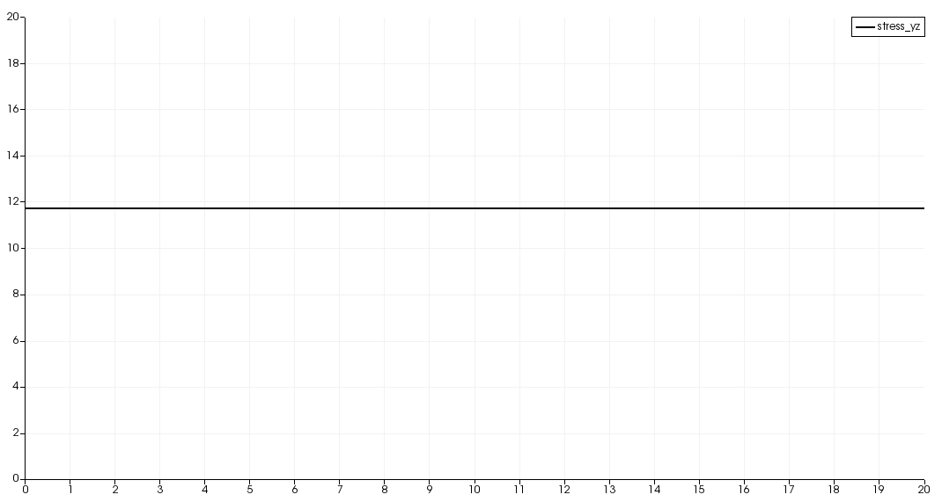
Out of plane
Stress_ xy = 0, Stress_xz = 0
Case 1:
rotate 30 degrees
Case 2:
rotate 45 degrees

